Slide 1
Apprenticeship Induction - Note to ACL and WBL Coach:
These Template Induction Slides are updated and held in the Apprenticeships Teaching and Essentials Assessment Web pages. Please make sure you check for updates.
Notes on slide selection, adaptation and co-delivery
ACLs are responsible for organising induction
All the material in these slides should be covered during induction and regularly referred to thereafter.
ACLs and WBL Coaches may have preferred versions, or alternative formatting they may wish to use, but should not remove any of the content or messages.
Additional material may be added.
The method of delivery may vary depending on attendance and timing of the overall induction and initial teaching delivery (in liaison with employers as appropriate)
The timing and duration of each section of slides is optional.
Both ACL and WBLC should emphasise areas that cover Apprenticeship Essentials (OTJT, KSBs, E-portfolios, English and Maths Development, Support, IT Literacy, Staying Safe on-Line, Attendance, British Values, Prevent, Equality Diversity and Inclusion, Career Development).
Please emphasise the opportunities for development of Apprenticeship Essentials through curriculum, linked to APRs and the Apprenticeship Impact and Information Resource (AIIR).
Please use induction as an opportunity for the ACL and WBL to be joined up in messages about the integrated nature of an Apprenticeship, which depends on engagement across the curriculum, APRs, work based projects, employer integrated Training Plans and how the ACL and WBL Coach will work together to support the apprentice's success at EPA.
The delegation of slides is not a delegation of accountability, to support the Apprenticeship journey. There is an indicative table to help split the slides and emphasis between ACL / WBLC / Other. Nb. Coaches will have their own template slides as indicated throughout
Please send any feedback on the slides to s.moorwood@shu.ac.uk
Note - red font indicates an action to prepare slide and insert content.
Slides with banners across are highlighted as being optional in the approach and level of focus.
You can review delivery of some of this at the Welcome Event on this video Good luck out there!
Notes:
This slide is hidden. It is provided for information and guidance on:
Designing induction
Identifying respective roles in delivering the induction
Providing links to further resources

Slide 2
Table:
Induction Essentials and Guidance on Roles
Click on table to enlarge.
Nb. Coach will have own template as indicated throughout this deck
ACCESS – NEW Link KSB Assess
Slide 3 numbers
Nb. Hyperlinks will be updated24/25 to new Sharepoint location
– watch this space
Notes:
This slide is hidden. It is provided for information and guidance on:
Designing induction
Identifying respective roles in delivering the induction
Providing links to further resources

Slide 3
Brief Indicative Outline of Slide delivery (for guidance)
Slides | Topic | ACL | WBLC | Notes
4-5-6-7 | General welcome /intro material | Y |  | ACL can decide how much detail to reveal and any break ice breaker
8 | SSOs to deliver |  |  | ACL to request Apprenticeship friendly version
9-10-11 | Apprentice Support (AIIR) | Y |  | Key messages on roles from ACL
12 | Discussion why Apprenticeship... | Y | Y | Joint? ACL needs to drive messaging
13 | The Standard | Y |  | Key Leadership messages from ACL
14-15 | Contact info check | Y | Y | This bit designed to capture/correct apprentice and mentor details
16-17-18-19 | The KSBs | Y | Y | Put in PPD module ideally to conclude the Starting Point Exercise
20-21-22-23 | The Course, WBL, confidentiality | Y |  | ACL to cover Course structure, ethos. Insert slides as needed
24-25-26 | Projects (WBL theme continued) | Y |  | Decide how much you want to cover in here or refer to module?
27-28-29 | Training plan (+OTJT) | Y | Y | ACL to lead on Commitment. WBLC may come in for detail on OTJT
30-43 | Apprenticeship Journey | Y | Y | ACL / Coach to reduce slides to and use at discretion.
44-47 | Roles: WBLC, SHU AA, Mentor |  | Y | Ensure roles are clear (ACL to cover their own role in this)
48 | Apprenticeship Progress Reviews |  | Y | Select and use slides at discretion
49 | E-portfolio intro. |  | Y | Determine what demo approach required - should be in MAYTAS
50-54 | Focus: E-portfolio, Evidence, EPA |  | Y | Introduce STARE + link to AIIR - facilitate discussion - slides optional
55 | Attendance and Engagement | Y |  | ACL ROLE - INTRODUCE JISC (bring earlier in agenda if required)
56 - 62 | Apprenticeship Essentials | Y | Y | Mandatory to cover: Split between ACL and WBLC at discretion
63 | British Values EXTRAs | tbc | tbc | Hidden slide with guidance & resource on embedding British Values
64-69 | Get involved – Impact + Celebrate + Course Rep | Y | Y | Highlight potential to enter awards at SHU and externally ACL must identify at least one course rep for the cohort
70 | Starting Point Exercise | Y | Y | Ensure this is lined up for first teaching day(s) ideally PPD module. Coach to take forward in APR1
Notes:
This slide is hidden. It is provided for information and guidance on:
Designing induction
Identifying respective roles in delivering the induction
Providing links to further resources

Slide 4
Welcome
INSERT Apprenticeship Standard
INSERT Course Name
INSERT NAME
Apprenticeship Course Leader
INSERT CONTACT DETAILS
INSERT NAME
Work Based Learning Coach
INSERT CONTACT DETAILS

Slide 5
Induction agenda
INSERT Apprenticeship Standard
INSERT Course Name
Picture
Section 1 Student Support Induction
Discussion / Icebreaker
Section 2 The Apprenticeship Standard & Course Overview
Section 3 Key Roles and Functions - more detail
Section 4 Apprenticeship Essentials:
Close

Slide 6
Induction agenda - more detail
Section 3 Key Roles and Functions - more detail
The SHU Work Based Learning Coach
Your Academic Adviser
Your Employer and your Mentor
Apprenticeship Progress Reviews
Discussion: What is good Evidence?
E-Portfolios
End Point Assessment Methods
Section 4 Apprenticeship Essentials:
English and Maths
Attendance, Well-being & Safeguarding,
British Values, Prevent Duty,
Equality, Diversity, Inclusion
Career Development
Getting Involved
Impact and Celebration
Section 1 Student Support Induction
Discussion / Icebreaker
Section 2 The Apprenticeship Standard & Course Overview
Training Plan
Off The Job Training
Apprenticeship Journey & Gateway to EPA
Work Based Learning

Slide 7
Ice Breaker
INSERT Apprenticeship Standard
INSERT Course Name
This section at ACL discretion:
Ice-Breaker ideas here:
Hallam Welcome Blog
Picture

Slide 8
Student Support Services
Course Leader to Agree input and content from Student Support Officer
Contact Sarah Smart for update on Apprenticeship Friendly slides/ video content (if available)
Ensure wellbeing and staying safe on line covered + "report & support"
Ensure emphasis on Disability Support included
(note - Apprentices have same entitlement for disability support, but different funding. ACL and WBL Coach need to be aware and monitor progress of all learners, observing, checking and responding to the impact of any learning contracts)
Notes:
Be aware when bringing Student Services Staff in to deliver the standard induction, they need to be briefed on any differences for your Apprenticeship Delivery.
Be joined up - Check student support standard slides in advance and advise on any changes, or slides to be removed and why.
For example:
Apprentices have enhanced library/resource access, as if they are distance-learners
Does the standard model for Academic Advising apply or an apprenticeship approach using PPD modules?
The Student Support Triangle for a mainstream student does not include reference to the WBL Coach or the Work place mentor at the employer

Slide 9
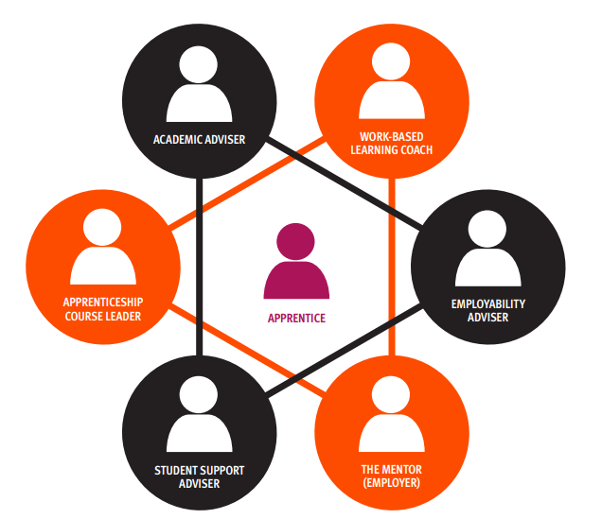
Apprenticeship Support Triangles
Coach should have a slide in their induction material
– be clear who is covering this

Slide 10
Getting the right support as an Apprentice
Coach should have a slide in their induction material – be clear who is covering this
All Apprentices benefit from Library Access for Distance Learners Register and find out more
Additional Learning Needs - Contact our disability support team to arrange an assessment, or find out what help and resources are available. [ Let them know you are an apprentice ]
Register for Linked-in-Learning
Apprenticeship Impact and Information Resource (AIIR): https://blog.shu.ac.uk/apprenticeship-essentials/wellbeing-and-support/

Slide 11

AIIR covers 6 Essential themes for apprentices including...
Coach should have a slide in their induction material – be clear who is covering this

Slide 12
Discussion
Why do Degree Apprenticeships exist?
Advantages?
Disadvantages?
What do you want to get from the programme?
What does your employer want to get from you being on the programme?
Notes:
Potentially collect thoughts on post it notes.
If running virtual induction use White board / other device.
See Guidance here:
INSERT

Slide 13
The Apprenticeship Standard
ISSERT LINK to page at IFATE e.g.: https://www.instituteforapprenticeships.org/apprenticeship-standards/academic-professional
Training Plan Statement including your employer
Knowledge Skills & Behaviours (your Starting Point Exercise!)
Requirements to pass through Gateway:
English & Maths GCSE Certificates, or Level 2 Functional Skills completion
Full record of OTJT
Evidence of engagement with British Values and Prevent Duty
Evidence of engagement with Equality, Diversity, Inclusion
E-portfolio showing evidence of competency for all KSBs
Other [ as per the Assessment Plan, e.g. case studies / major project / etc.]
End Point Assessment Timing and Methods [ more info to follow ]
Notes:
ACL to provide overview of the Apprenticeship, placing the KSBs and EPA front and centre

Slide 14
contact details...
We need to make sure we have correct up-to-date contact details for you and also your mentor in the workplace so we can support you in Apprenticeship Progress Reviews and get the right information to you at the right time.
We want to help you get started with the targets and actions in the workplace that will support your development of knowledge, skills and behaviours.
We have some instructions, so you can provide us with the updated information where you have that....

Slide 15
Hidden Slide...!
INSTRUCTIONS FOR WBL Coach / ACL
For on campus induction a relatively straight forward approach can be used by circulating a printed copy of this template
For virtual induction you can create a duplicate of this google form and save it in your own google drive. Put this in the chat during the sessions and each Apprentice can access and populate. Only you can see and download the full data in Google forms
TO BE CONFIRMED
(Access the survey form, click the three dots top right and make a copy in your own folder. You can then share the link for your own version with the Apprentices, e.g. in the chat.

Slide 16
Knowledge, Skills and Behaviours (KSBs)
The underlying framework that defines your programme... and are the foundations of the End Point Assessment.
Aligned to academic syllabus
Aligned to role
(Employer Training Plan and Stretch targets)
Ref: On-boarding Suitability Process
Need to be EVIDENCED
Supported by OTJ Training hours
Review your skills scan in PPD modules
Starting Point Exercise
Tangible, Testimony, STAREvaluation

Slide 17
Core Knowledge
1. A range of teaching, assessment and feedback methods used in higher education to support learning and achievement
2. How students learn and how research is conducted, within their own and related disciplines and in inter-disciplinary or transdisciplinary contexts.
3. The regulatory, administrative, financial and planning procedures, risk management, quality assurance and enhancement, and technological processes associated with effectiveness in their role in higher education.
4. Methods for evaluating the effectiveness of academic activities, such as teaching or the quality and impact of research.
5. How to engage with relevant professional bodies and other external organisations to support their work.
6. Innovative approaches to undertaking their work to create interest, understanding and enthusiasm among their students, funders or stakeholders
7. The application of technological processes associated with effectiveness in their role within the HE sector.
8. How to adapt delivery methods to support a range of needs.
9. The principles of reflective practice and the methods for applying reflective practice to their own professional development.
INSERT CORRECT KSBs IF REQUIRED FOR REFERENCE
PPD Module Leader to deliver the Starting Point Exercise
using the Academic Resource here

Slide 18
Core Skills
1. Deliver higher education teaching of high quality through lectures, tutorials, practicals or seminars.
2. Use varying teaching styles depending on the learning environment and students’ needs.
3. Developing research questions and hypotheses prior to undertaking research.
4. Analysing, synthesising and using critical thinking in the conduct of research.
5. Supervision and mentoring of students and peers to develop knowledge in their subject discipline.
6. Manage their own continuing professional development (CPD) in subject disciplines and pedagogy, incorporating research, scholarship and professional practices.
7. Self-management through preparation and prioritisation, time management, responsiveness to change, and achieving a work-life balance.
8. Communicate orally and in writing and collaborate effectively, to manage people, processes or teams.
9. Use digital technologies effectively to develop and disseminate knowledge and understanding of subject disciplines.
10. Share ideas and evidence with students, peers, policy makers, private and public organisations, as well as collecting evidence of the impact of their work.
11. Implementing approaches to academic practice informed by equality and diversity.
INSERT CORRECT KSBs IF REQUIRED FOR REFERENCE
PPD Module Leader to deliver the Starting Point Exercise
using the Academic Resource here

Slide 19
Core Values & Behaviours
1. Consider ethical, sustainable and inclusive practices and equality of opportunity to a professional standard.
2. Be mindful of one’s CPD in relation to career management, responsiveness to opportunities, networking, reputation and esteem.
3. Commit to CPD in relation to relevant contemporary issues such as: student employability and graduate employment destinations; ethics and sustainability, academic integrity, legal compliance and intellectual property, respect and confidentiality, and health and safety.
4. Consider evidence- informed approaches and the outcomes from research, scholarship and CPD to inform their own professional practice.
5. Be mindful of the wider context (policy, economic, societal, technological, legal, cultural and environmental) in which higher education operates, recognising the implications for professional practice.
6. Seek opportunities to network, to practise public engagement and to communicate effectively.
7. Be enthusiastic, self- confident, and self-reflective.
8. Persevere, have integrity, be prepared to take responsibility, to lead, mentor and supervise.
INSERT CORRECT KSBs IF REQUIRED FOR REFERENCE
PPD Module Leader to deliver the Starting Point Exercise
using the Academic Resource here

Slide 20
Apprenticeship: STANDARD
SHU Qualification: BSc/BA/BEng
Course Ethos
Professional Body and Career Options [ INSERT ]
Starting Point Exercise for Individualised journey
Delivery Model and Structure - see slide to follow
End Point Assessment - more detail to follow
The modules [ May need additional slide / handout ]
Your “Training Plan” – showing employer-led activities for all modules Apprentice and Employer Guide to Training plans
You will not receive your award certificate, nor attend graduation until you have taken your End Point Assessment
Notes:
Apprenticeship Course Leader (ACL) to insert slides as necessary.
Explain how the Course has been designed to meet the needs of the Apprenticeship Standard.
Emphasise the potential impact fo the apprentice in their job role and importance of the employer's role to develop the Training plan for work-place experiences and formal training opportunities to compliment the course and drive KSB development.

Slide 21
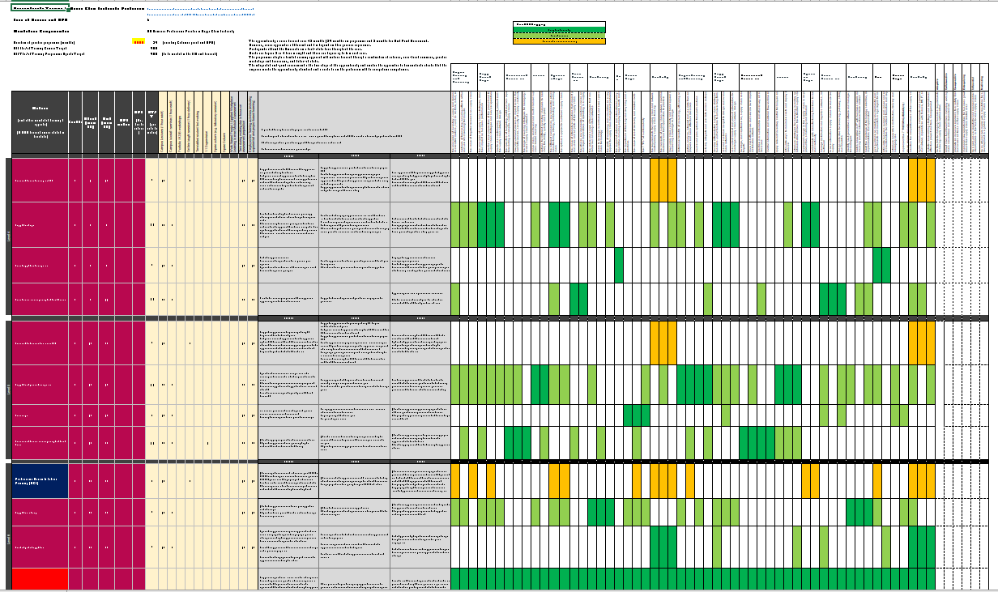
Training Plans
Delivery Grid – main tab
INSERT APPRENTICESHIP SPECIFIC SCHEME
MAKE REFERENCE TO THE ROLE OF APRENTICESHP PROGRESS REVIEWS (APRs)
Coaches can supply diagramtic of journey to EPA
Standard, Assessment Plan, Course Overview
OTJT Target
Module Sequence
Gateway and EPA Modules
(Any RPL)
OTJT Breakdown
Includes taught, blended,
directed time on campus,
employer-based, etc.
Apprenticeship Essentials (badges)
Employer activity
Before During and After Modules
KSBs

Slide 22
Integration of Work-Based Learning into the Curriculum
Training Plan (Employer actions - Before, During, After – each module)
Lectures (Theoretical and Practical Frameworks for WBL)
Seminars (Activities for KSB development)
Collaborative (Peer to Peer Discussions)
Portfolio Workshops (Reflective evidence review - STARE)
Assessment (Reflective Review, Planning and Impact Analysis)
Project modules (Critical development opportunities)
Apprenticeship Progress Reviews (SMART action plans)
End Point Assessment Workshops (Your roadmap to Gateway!)
Q. What is a reflective practitioner?
https://blog.shu.ac.uk/apprenticeship-essentials/onboarding/transitioning-to-higher-education/
Notes:
Lectures typically provide theory, rules and principles to set the context in which to embed knowledge through application and provide a framework to develop skills and behaviours through practical exercises and the experience gained in your job role.
Seminars are often more interactive allowing small group work and focussed on your own development against specific themes from the module, making clear links to the relevant KSBs
Collaborative opportunities are provided to compare your experience and engage in active reflection about your development and future opportunities to plan for. See the ground-rules in AIIR
Portfolio Workshops in reflective practice modules and also with your WBL Coach will support you to identify tangible evidence and conduct evaluation of work place impact (See STARE later), comparing your journey with other apprentices.
Assessment methods will vary, but be aware of those requirements to draw on your reflective analysis, and explore your job role. For example you could be required to submit an account and evaluation of your impact in your organisation and how that relates to your sector.
Project modules are key to setting up the right enquiries and impactful work focus that will drive learning through practice and support your readiness for the End Point Assessment.
Apprenticeship Progress Reviews will use previous curriculum activities to help set targets for your development and keep an eye on what is coming up, particularly to negotiate the right projects and experience in your Employer training plan.

Slide 23
WBL Conversations
Principles of Confidentiality
Students (Apprentices) and staff will engage in peer to peer learning in good faith.
Students (Apprentices) will take all due care not to share sensitive, or confidential information without first concealing the identity of all relevant parties. This includes informal discourse and submissions for assessment.
Where necessary, the submission of work will indicate which parts of the submission are to be treated as sensitive.
All participants will treat any discussions, submissions of work, sharing of case studies, or expression of opinion (etc.) with respect.
Any matters that are highlighted, or could be considered as confidential and/or include commercially sensitive information about an individual, a participant, stakeholder or an organisation will not be shared beyond their immediate purpose in the educational setting.
Set out in AIIR here: Evidence of Your Development

Slide 24
Purpose of the projects
To facilitate the connections between:
The programme and the job role
the organisation and the individual
The knowledge, skills and behaviours
Intention, implementation and impact
Your development and the EPA requirements

Slide 25
Discussion
What makes a good project?
Can you think of examples?
What were the objectives?
What else was learned?

Slide 26
A good project...
should
should not
stretch the Apprentice in their role
be of interest to the Apprentice
develop Knowledge, Skills & Behaviours (KSBs) (respond to gap analysis)
have both definition and structure
be feasible (e.g. resources)
be manageable (scope + timescale)
be useful to the employer- think impact
be beyond their capability or expertise
be disconnected from the job-role
require support or resources beyond their/your control
be too ambitious/ complicated
be a pet project /naval gazing
be amorphous

Slide 27

Apprenticeship Training Plan
This is a three way agreement confirming that you are committed to learn, develop and pursue success at the End Point Assessment
We - SHU will provide the programme which underpins your development. The Training Plan includes a grid to show how the modules support development of KSBs and how Off The Job Training Targets will be agreed and monitored
Your employer has committed to providing you with support and in particular a mentor to attend all your Apprenticeship Progress Reviews
  The Training Plan grid provides initial baseline requirements for employers to provide support with direct reference to the modules.
  Your employer will develop your work-place Training Plan to optimise your job role, e.g. identify relevant placements / projects / experience. Your employer should check your Skills Scan and also use the KSB grid to align training opportunities to KSBs progressively throughout the Apprenticeship.
Notes:
It is strongly recommended that the Apprenticeship Course Leader takes ownership of the messages and intention of this slide
WBL Coaches can follow up with the detail

Slide 28
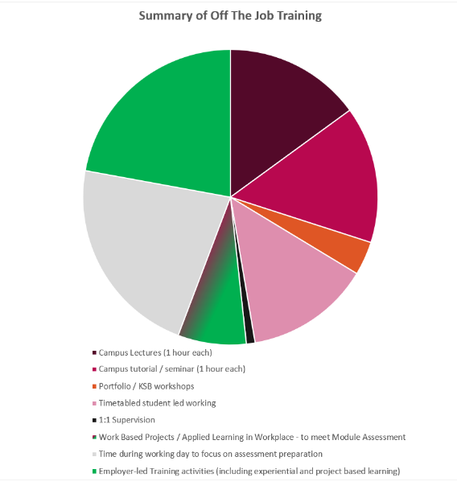
REVIEW YOUR TRAINING PLAN- Off the Job Learning Breakdown & examples – these must be planned in with your employer/mentor throughout your programme
Off The Job Training (OTJT)
EXAMPLE ONLY
Note to ACL: Your OTJT Pie Chart is available on the Training Plan supplied to each Apprentice.
For help contact: apprenticships@shu.ac.uk
Nb.Your Coach should mhave a slide in their pack

Slide 29

Off The Job Training (OTJT)
Coach should have a slide in their induction material – be clear who is covering this
Targets for Off The Job Training are set out in your Training Plan and the “Delivery Grid”. They are there to ensure a proper, well balanced Apprenticeship experience and protect wellbeing
Your target is detailed in your training plan for you to log hours in MAYTAS Hub and monitor progress with your Apprenticeship Coach and workplace mentor every month
Off-the-job-Myths-Facts-130919.pdf )

Slide 30

What is an Apprentice?
Who will you become?
How will get there?
KEEP / DELETE SLIDES FROM THIS WALK THROUGH.
Nb. Please see VIDEO Available in AIIR for demonstration:
https://blog.shu.ac.uk/apprenticeship-essentials/supporting-your-apprenticeship-journey/
Coaches Likely to have Standard specific version
?
e
Training Plan
Notes:
This next batch of slides is helpful to explain the overall approach to Apprenticeship delivery and slides can be selected / deleted to suit the course.
The slides help to emphasise:
The Role of EPA and Gateway; The importance of the Commitment Statement; The role of the E-portfolio, the tripartite arrangements for Progress Reviews etc.

Slide 31




Coach should have a slide in their induction material – be clear who is covering this
On the job training
and experience
e
Training Plan

Slide 32
Coach should have a slide in their induction material – be clear who is covering this
EPA
All Apprentices must pass an End Point Assessment to complete their Apprenticeship
e
Training Plan

Slide 33
Coach should have a slide in their induction material – be clear who is covering this
EPA
An Apprenticeship is a job with training.
Experience through work is key to developing knowledge, skills and behaviours
120
e
120
The credit bearing award from SHU is a framework to support your development and contribute towards the development of knowledge, skills and behaviours
20+ 20 + 20 + 20 + 20 +20 = 120

Slide 34
Coach should have a slide in their induction material – be clear who is covering this
e
Attendance:
Day release:
Surveying
Engineering

Slide 35
Coach should have a slide in their induction material – be clear who is covering this
e
Attendance:
Block release:
Management

Slide 36
Coach should have a slide in their induction material – be clear who is covering this
EPA
6 month
Gateway
120 credits
Level 6
18 months
EPA
120 credits
Level 5
18 months
e
6 months Gateway
120 credits
Level 4
18 months
Attendance:
Blocks of learning
Construction

Slide 37
Coach should have a slide in their induction material – be clear who is covering this
e
Attendance:
Accelerator then
Block release:
Digital

Slide 38
Coach should have a slide in their induction material – be clear who is covering this
e
Attendance:
Block release
+
Placement
Occupational Therapy
Physiotherapy

Slide 39
Coach should have a slide in their induction material – be clear who is covering this
Your Apprenticeship Progress Reviews are every 12 weeks
e
They support progress and involve action planning.
They help to link your job role to the programme requirements
Training Plan

Slide 40

Coach should have a slide in their induction material – be clear who is covering this
Work-place Mentor
(Possibly your line manager)
e
Training Plan
Work-Based-Learning Coach
(SHU)

Slide 41
Coach should have a slide in their induction material – be clear who is covering this
Work place Mentor
e
Work-Based-Learning Coach
(SHU)
A three-way discussion to check the evidence in your E-portfolio and agree SMART action plans

Slide 42

Coach should have a slide in their induction material – be clear who is covering this
e
Assessment is both theoretically rigorous
and integrated with your Work-Based Learning to support reflective practice

Slide 43
Coach should have a slide in their induction material – be clear who is covering this
EPA
Work-place
Mentor
Training Plan
Work-Based-Learning Coach
(SHU)

Slide 44

Coach should have a slide in their induction material – be clear who is covering this
Work Based Learning Coaches

Slide 45
Work Based Learning Coaches (SHU)
Coach should have a slide in their induction material – be clear who is covering this
Pre-join suitability interview Career discussion Is this the right programme and is the job role suitable? The Skills Scan informs the starting position - Feeds PPD module + Review 1
During the Apprenticeship Programme Progress Reviews: 3-way discussions to support SMART planning. Focus on KSBs and personal development, e.g. literacy, numeracy, BV & EDI E-Portfolios: Focus on evidence of impact, targets for EPA & development. Negotiate, plan and monitor Off-The-Job Training including Projects Help employers meet obligations and actions set out in an evolving Training Plan
Moving forward Agree readiness for EPA Gateway with your employer (...what next for you?) Feedback into academic practise to support work place impact

Slide 46
Your Academic Adviser
All students at SHU are allocated an Academic Adviser to support your academic progression, personal and professional development.
Your AA can help you:
Understand the requirements of university study,
Identify patterns in your feedback
Get additional support if required (eg: Student Support Adviser, Skills Centre or Disabled Student Support)
AAs will be available as part of the personal and professional development modules as well as individual meetings where needed
Your AA can also team up with your Work Based Learning Coach to advance your personal development, including the behaviours set out in the apprenticeship standard and enhance your professional development generally.
ACL to check 4th bullet point and tidy up this slide
(this is not an optional slide, but can be adapted)
Notes:
ACL to check the 4th bullet point is the appropriate model for the Apprenticeship.
If you are running a standard or different AA model then you should delete, or replace the 4th bullet point with your appropriate advice.

Slide 47
Your Employer Mentor https://blog.shu.ac.uk/apprenticeship-essentials/onboarding/employer-commitment/
Coach should have a slide in their induction material – be clear who is covering this
At the Start
Review your Skills Scan and agree a Training Plan with you in your job role
Agree, monitor and support the targets for Off the Job Training
Attend Welcome Event and review the Information Advice and Guidance
During the Apprenticeship
Attend Apprenticeship Progress Reviews you and the SHU WBL Coach
Provide feedback and SMART planning to implement your Training Plan
Facilitate projects and new opportunities to meet the Apprenticeship KSBs
Moving forward
Agree when you are ready for EPA
Support you to the next step in your career

Slide 48
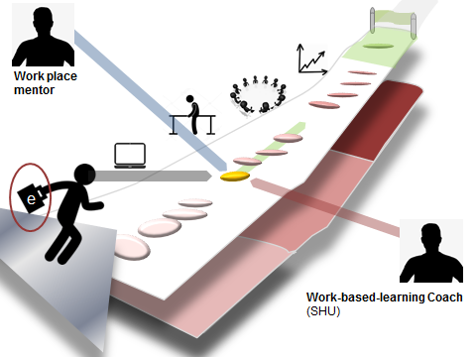
Apprentice Progress Reviews
WBL Coach to decide with ACL, how much information to cover on APRs during induction. APR Slides are optional for induction
NEW APR form due for release in MAYTAS for September 2021
Guidance on MAYTAS Hub for Apprentices and for mentors is here: AIIR Homepage

Slide 49

E-portfolio
WBL Coach to insert E-portfolio slides
Guidance on MAYTAS Hub for Apprentices and for mentors is here: AIIR Homepage

Slide 50
The Journey to
End Point Assessment
Monitor progress from your Training Plan as shown in your Skill Scan
Starting Point Exercise: individualise your journey with achievement targets
Review progress of KSBs and actions at 3-way Progress Review
Support from SHU WBL Coach and work place mentor
Review at the Gateway period
Submit E-Portfolio (and other requirements) for End Point Assessment
Typically used in a "Professional Discussion"
Complete Major project / case studies (specific differences in each sector)
After taking your EPA you can receive you certificate and attend graduation!
Discussion: What does good evidence look like?

Slide 51
What does good evidence look like?
Addressing each competency (KSB) in the standard:
Artefact 1
Thing 2
Stuff 3
Critical Reflection
+
+
+
WBL Coach to decide with ACL, how much information on evaluating Evidence to cover during induction.
Evidence Slides are optional for induction.
WBL Coach can take their own approach to this discussion, but must use the STARE approach
E- Portfolio
End Point Assessment

Slide 52
What does good evidence look like?
Addressing each competency (KSB) in the standard:
Artefact 1
Thing 2
Stuff 3
Critical Reflection
+
+
+
WBL Coach to decide how with ACL much information on evaluating Evidence to cover during induction.
Evidence Slides are optional for induction.
WBLCoach can take their own approach to this discussion, but should use the STARE approach
Annotated photo of H&S on site
SHU Assignment e.g. H&S law & practice
Apprentice Designed Training Programme
Discussion of learning and future action
Possibly errors were made!?
E.g. 65% mark for 20 credits at Level 5.
Evidence of further development and application in work ; showing leadership.
Reflective evaluation of own competence and sector issues; using material from WBL;
uploaded to E-Portfolio

Slide 53
S.T.A.R.E.
Situation - sets the context within which you performed a job or faced a challenge
Task - describes your responsibility in the situation. What was required? What was the aim?
Actions - what did YOU do? Describe how you completed the task or endeavoured to meet the challenge
Results - what was the impact/outcome as a result of YOUR actions?
Evaluation - how does this meet the criteria for the learning outcomes
STARE approach and examples

Slide 54
End Point Assessment
ACL needs to prepare a bespoke slide or two addressing these questions...
Ensure emphasis and clarity regarding Graduation
(FINAL BULLET POINT
What are the methods of Assessment?
When will you practice techniques for EPA?
Which modules will support the gateway requirements?
How will readiness for EPA be decided with your employer?
How will you be supported by SHU during the Gateway period?
Who will do the EPA?
You will not receive your award certificate, nor attend graduation until you have taken your End Point Assessment

Slide 55

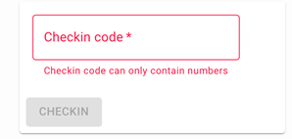
Apprenticeship Essentials
✓ Attendance Recording through Study Goal
How to record your attendance using Study Goal
Access the following website: studygoal.jisc.ac.uk
Choose Sheffield Hallam University from the drop-down list and click ‘Login’
Enter your regular SHU username and password
Your lecturer will provide a 4 digit PIN code at the start of your lecture or seminar
Enter this code into the box and click ‘Checkin’
Your attendance has now been recorded

Slide 56
Apprenticeship Essentials
Coach should have a slide in their induction material – be clear who is covering this
Safeguarding obligations
An employer is legally responsible for Health and Safety at work.
In some instances ("vulnerable adults") (or for any other reason) SHU will exercise a duty of care and is required to ensure the employer has the appropriate measures in place, offering the apprentice the opportunity to raise any concerns.
https://blog.shu.ac.uk/apprenticeship-essentials/wellbeing-and-support/getting-help-and-safeguarding/
Note: Your Designated Safeguarding Officer is Sam Moorwood

Slide 57
Coach should have a slide in their induction material – be clear who is covering this
Apprenticeship Essentials
Safeguarding obligations
Safeguarding is about knowing how to keep yourself and others safe from physical, psychological, emotional and sexual harm and free from bullying and intimidation (including on-line).
You can contact: your employer safeguarding officer, your WBL Coach, an academic, your course leader or student support services... https://reportandsupport.shu.ac.uk/
On-line resources, for example, Staying Safe On-line:
https://blog.shu.ac.uk/apprenticeship-essentials/wellbeing-and-support/staying-safe-online/

Slide 58




Apprenticeship Essentials
Coach should have a slide in their induction material – be clear who is covering this
Equality Diversity & Inclusion
https://www.shu.ac.uk/about-us/equality-and-diversity
https://www.shu.ac.uk/about-us/governance-and-strategy/governance/our-student-charter
Our Equality Objectives set our vision to be recognised as a University that adds value to the futures of all our students, staff and partners by drawing on their unique and diverse talents and providing an environment that allows everyone to flourish and succeed

Slide 59
Coach should have a slide in their induction material – be clear who is covering this
Apprenticeship Essentials
Equality Diversity & Inclusion
Learning Opportunities:
Read the SHU Student Charter
Research and discuss your employer's policies
The Equality Act in your sector and impact on your role
Apprenticeship Progress Review with WBL Coach:
Behaviours in the standard...
When have you felt challenged?
WBL Module: Inquiry into Unconscious bias
Your Active Bystander Training

Slide 60

Coach should have a slide in their induction material – be clear who is covering this
Apprenticeship Essentials
Careers Information Advice & Guidance
At the start
Build on your Suitability Interview (Skills Scan and career aspirations...)
During the Apprenticeship
Development of KSBs & PPD modules
Sector leading careers guidance:
Bespoke Apprenticeship resource:
The Future
WBL Project: Organisational context & aspirations
Adviser workshop (1:1 bookings)
Alumni access to support for 5 years
https://blog.shu.ac.uk/apprenticeship-essentials/careers-advice-and-guidance/

Slide 61
Apprenticeship Essentials
Coach should have a slide in their induction material – be clear who is covering this
Prevent Duty
Apprenticeship funding requires all parties to work together in support of the Prevent Agenda. This is a Government initiative to address extremist behaviour and radicalisation of people to consider, encourage or commit illegal an violent acts against other people in society.
This is not limited to any single group in society, but extends to all "hate crimes".
Sheffield Hallam is a safe and tolerant community.
Report and Support (Harassment, abuse, hate crimes...)
https://reportandsupport.shu.ac.uk/

Slide 62
Coach should have a slide in their induction material – be clear who is covering this
Apprenticeship Essentials
British Values
...underpin the principles of a democratic and free society:
Recognition and respect for the democratic process
Respect for the rule of law
Individual Liberty
Respect and tolerance of others
Speak to your Course Leader about becoming a Student Rep.

Slide 63
British Values (BV) V Approach &Resources
ACL needs to plan how induction will be used to introduce BV and signal further learning, through modules and APRs
How will later modules (PPD or other) pick up on the themes? - check you are embedding the Apprenticeship Essentials including BV, Prevent and EDI
WBLC will follow up using APRs and release of sections from AIIR, but they need to integrate (introduce or follow up) with planned curriculum activities
The powerpoint file embedded below provide an approach to exploring BV in an academic, non-judgemental way. This has been road tested.
Introduce your own ideas, for example: Ask your cohort how the study of British Values relates to Free speech to engage them - Be the facilitator of an open and tolerant conversation, worthy of higher education
It is recommended that learners conduct a Matrix exercise using a table to compare the L4 modules (initially) with the 4X British Values (see slides embedded here)
See AIIR section:
https://blog.shu.ac.uk/apprenticeship-essentials/british-values-and-prevent/

Slide 64
Apprenticeship Course Representatives (ACRs)
Duties and opportunities
Meetings
Your Apprenticeship Course Leader will invite you to attend two meetings each year to feed back on your course
On-line meetings will normally be 4.30 to 5.30 to help avoid work clashes
Log this time as Off The Job Training and show development of knowledge skills and behaviours through this activity!
If you are in your final year then you will be invited to College meetings as well – maximum two each year.
At all meetings you are asked to present feedback in a non-biased and professional way
to support problem resolution and ongoing course enhancement.
Outside of Meetings:
You will get feedback from your study-piers through:
    timetabled forum during teaching hours (ask your Course Leader)
    on-line backboard forum set up by your Course Apprenticeship Course Leader
    direct by email or other forms your course community might prefer.
You will also check the minutes and actions that the Course Leader produces so your you study peers can stay involved
You should also try to encourage active and productive discussion in the course Blackboard forum.
You may be offered opportunities to represent SHU as a National Centre of Excellence for Degree Apprenticeships

Slide 65
Apprenticeship Course Representatives (ACRs)
Content of this slide to be lodged in AIIR and Apprenticeship Essentials web page
SHSU might wish to use.
ACR Duties and opportunities:
Attend two course feedback meetings each year, convened by your Apprenticeship Course Leader (ACL).
All meetings should be convened by the ACL on line to enable attendance from various courses with different attendance patterns and at the end of the working day, typically 4.30 to 5.30 to avoid work clashes and enable you to log time as Off The Job Training
Before the Meeting:
ACR to gather feedback from peers during the course. ACLs will send reminders two weeks prior to each meeting
It is recommended to arrange (with your ACL) class forums to be timetabled during Portfolio / reflective practice modules to facilitate discussion.
During the Meeting:
ACR to present feedback in a non-biased and professional way to support problem resolution and ongoing course enhancement.
Feedback should also be delivered in line with the Standard Apprenticeship Course Meeting (ACM) agenda embedded below)
Feedback should include comments on how well the course representation approach is working.
You should inform the ACL of any matters you would like to escalate to the Apprenticeship Board for the College (ABC).
After the Meeting:
ACR to review and agree the summary minutes (key points and actions) provided by the ACL, who can then post a file on Blackboard within two weeks of the meeting.
ACLs will also release periodic updates to your course using blackboard Forum and you should participate in a professional representative and collaborative way to support the sense of community on your course.
Between meetings:
Final Year Course Reps should participate in the annual Apprenticeship Board for the College (ABC) to be convened and run by the Associate Dean for Business and Enterprise representing Apprentices across your college. (Link to structure + agenda in AIIR).
There will be opportunities for ACRs to represent the University as a National Centre of Excellence for Degree Apprenticeships
Double click on Word template for Course / College Apprenticeship Rep Meetings:
Further Info on course representation: https://www.hallamstudentsunion.com/reYour presentation/academicinterests/training/#all

Slide 66
Get involved
– make an impact and celebrate! https://blog.shu.ac.uk/apprenticeship-essentials/wellbeing-and-support/your-community-and-enrichment/
Coach should have a slide in their induction material – be clear who is covering this
Course Leaders have an obligation to secure a Course Rep.
Your AIIR has more information about:
Apply to become your Course Rep
Students Union activities
Clubs and societies
Keep active on campus
Hallam Award
SHU Inspirational Student Award
Apprentice of the Year applications
SHU Apprenticeship Ambassador scheme

Slide 67
Apprenticeship Course Representatives (ACRs)
Duties and opportunities
Meetings
Your Apprenticeship Course Leader will invite you to attend two meetings each year to feed back on your course
On-line meetings will normally be 4.30 to 5.30 to help avoid work clashes
Log this time as Off The Job Training and show development of knowledge skills and behaviours through this activity!
If you are in your final year then you will be invited to College meetings as well – maximum two each year.
At all meetings you are asked to present feedback in a non-biased and professional way
to support problem resolution and ongoing course enhancement.
Outside of Meetings:
You will get feedback from your study-piers through:
    timetabled forum during teaching hours (ask your Course Leader)
    on-line backboard forum set up by your Course Apprenticeship Course Leader
    direct by email or other forms your course community might prefer.
You will also check the minutes and actions that the Course Leader produces so your you study peers can stay involved
You should also try to encourage active and productive discussion in the course Blackboard forum.
You may be offered opportunities to represent SHU as a National Centre of Excellence for Degree Apprenticeships
Course Leaders have an obligation to secure a Course Rep.

Slide 68


New Slide for Apprenticeship Course Induction:
Apprentices...
Your Student Union is there for you...
Coach should have a slide in their induction material – be clear who is covering this
Welcome 2022: All services - All the discounts (!)
Apprenticeship Monthly Newsletter
Living at home while studying: https://www.hallamstudentsunion.com/news/article/6013/living-at-home/
Support you Apprentice Rep - https://www.hallamstudentsunion.com/get_involved/societies/
Change Something: https://www.hallamstudentsunion.com/representation/
Current Campaigns: https://www.hallamstudentsunion.com/representation/campaigns/
Volunteering – Get your employer involved! https://www.hallamstudentsunion.com/get_involved/volunteering/
Sports and Social Events: https://www.hallamstudentsunion.com/whatson/
Advice and Wellbeing: https://www.hallamstudentsunion.com/advice_help/student-essentials/
While you are in the City: https://www.hallamstudentsunion.com/news/article/6013/arts-and-culture-sheffield/
Video link

Slide 69



SHU Apprenticeship
Ambassador Scheme
Coach should have a slide in their induction material – be clear who is covering this
Get
involved...
Options:
Championing your community in the Apprenticeship Newsletter
Being a Course rep for your study colleagues
Being interviewed for the local press/social media
Talking to Y13 students at a sixth form
Talking to employers at a business event
Positive press for your own organisation
Whatever works for you – this can count as off-the-job training,
enhance your profile and provide supporting evidence for a prestigious award!

Slide 70
Apprenticeship Essentials
Your Starting Point & Individual Journey
Review your Skill Scan to complete the Mandatory Onboarding activities
Identify your starting position in terms of knowledge, skills & behaviours
Review and record your strengths, challenges and uncertainty
This will help you set overall targets for achievement
Opportunity to discuss with peers in your first classes
Apprenticeship Progress Review to evolve your Training Plan
Check your assessment submission requirements.
Notes:
Use your Academic Adviser, the Skills Centre and Studiosity
Benefit from Library Access for Distance Learners
Additional Learning Needs - Contact our disability support team
Register for Linked-in-Learning – find resources to suit your needs
Ongoing: Apprenticeship Impact and Information Resource (AIIR)

Slide 71
Starting Point Exercise
Coach has template slides.
Teaching Slides and grid located here: https://blogs.shu.ac.uk/wblapprenticeships/resources-opportunities/

