Slide 1
ESFA Funding Rules Changes 22/23 – Impact on Delivery
Sam Moorwood, Head of Work Based Learning
Apprenticeship Safeguarding Officer
s.moorwood@shu.ac.uk
07787 006 340

Slide 2
ESFA Funding Rules Changes 22/23 – Impact on Delivery
A bit about SHU
Overview of Funding Rule Changes
From Commitment Statements to Training Plans
Discussion
Training Plan Delivery Grid
Final thoughts

Slide 4
Work Based Learning
Higher and Degree Apprenticeships

Slide 5
Occupancy last year
2057 Apprentices, across 33 standards in 13 Departments
554 total employers
... 41 Standards in delivery
A further 600+ applications coming in for Jan/Feb March starts

Slide 6
What's available?
Building & Surveying
Surveyor (Quantity, Building, Property)
Construction Site Supervisor / Manger
Construction QS (& Technician)
Construction Design Manager
Architect
Chartered Town Planner
Health & Social Care
Health and Social Care
Social Worker
Occupational Therapy
Physiotherapy
Healthcare Science Practitioner
Advanced Clinical Practitioner
Diagnostic Radiography
Therapeutic Radiographer
Operating Dept Practitioner
Dietetics
Leadership & Management
Operations/Departmental Manager
Chartered Manager
Senior Leader
Supply Chain Leader
Digital & Technology
Digital & Tech Solutions Professional
Software Engineer
Business Analyst
Cyber Security Analyst
Data Analyst
IT Consultant
Network Engineer
Digital & Tech Solutions Specialist
Software Engineer
Data Analyst
Academic Professional
Post Graduate Academic
Policing
Police Constable DA
Food & Drink Sectors
Food Technologist
Food Engineering
Packaging Professional
Engineering
Mechanical
Electrical
Manufacturing
Materials
Rail Engineering
Under development
Banking
Paramedic Practice
Registered Nurse
Enhanced Clinical Practitioner
Creative Digital
Creative Digital Design
Digital User Experience Professional

Slide 7
Drivers for Change 2022/23
IFATE consultation outcome for integrated EPA in Degree Apprenticeships
ESFA Funding Rule changes
SHU Future Strategy Programme
(Model D – Apprenticeship Delivery Principles
OfSTED Quality Improvement Plan

Slide 8
How does this affect us in 22/23?
ESFA Rules Training Plan Key Extracts:
P56.1 This must set out the training (including the volume of off-the-job training hours) that will be delivered in the practical period and document how all three parties (apprentice, employer and main provider) will support the achievement of the apprenticeship.
P56.3 The training plan must be agreed before any training is delivered (see paragraph P57.6.3).
P57.6.2 For standards with a mandatory qualification this must be, as a minimum, a list of the units, along with a description of any additional activities that the apprentice will undertake to develop occupational competency.
P57.6.3 Details of when content will be delivered. We accept that for longer programmes (i.e. 12 months +) these details may not yet be finalised, and the plan may initially only detail the first year; in these circumstances the training plan should be updated as the information becomes available. This equally applies where an apprentice may have optional aspects
“Have we gone overkill on this?”
“There is nothing in the Training Plan that doesn’t need to be in it and there is nothing we need that is not in it”.

Slide 9
From Commitment Statements to Training Plans
The new rules mean that we have to offer more information up front about how we will deliver “the training”
We also need to be clearer about the expectations on employers.
This helps us to be more rigorous about the correct amount we charge - the Total Negotiated Price (TNP) (allowing for any RPL and adjustment to the programme “duration”). (RPEL and RPCL)
The changes will help us to monitor and track the Off the Job Training ( 20% OTJT !!)
Nb, There are other changes impacting on On-Boarding, 12 weekly Apprenticeship Progress Reviews (APRs), etc.
Students and employer access to training plans and their content
Covering two versions of Commitment Statement / Training Plans and two versions of [ 20% ] Off the Job training in IAG has been a challenge

Slide 10
Discussion How did you bake yours...

Slide 11
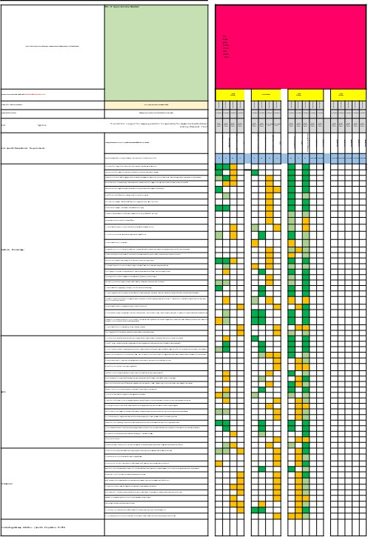
Mapping doc from validation gets appended to the “Commitment Statement”
Modules
KSBs

Slide 12
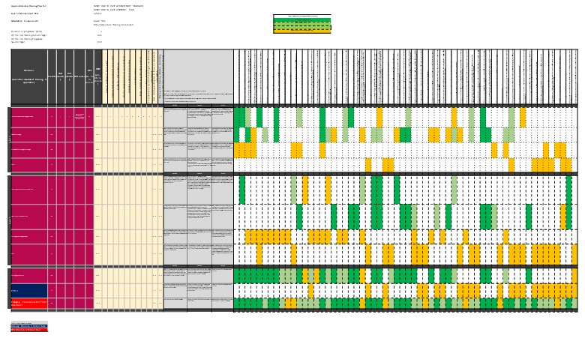
BESE will release re-worked maps into a new template for a map to be appended to the “Training Plan”
KSBs
Modules

Slide 13
Academically led changes
“Training Plan Delivery Grid”
Check key information and insert course overview
1
2
3
Start & End
Delivery breakdown
Employer-led actions
(Before, During, After)
Thinking about the KSBs

Slide 14
Devising the Employer-Led Actions for each module (example) Before During After
Offer insight into decision making process within organisation, which feature economic factors. Allow access and review of the business models used.
Provide opportunities for delivering business critical change, for example shadowing senior staff and actively supporting their work.
Help the Apprentice to use the next progress review to re-examine how they have been engaging in potential mitigation strategies to manage projected legislative/regulatory risks and opportunities to develop evidence for EPA.

Slide 15
Employer-Led Actions Before, During, After
Employer led activities designed with reference to KSB mapping for each module
Think of it as a wish list, think beyond the module end date – Exemplar provided.
Some modules will require focussed tasks, but avoid high risk specificity:
“Make sure your apprentice is engaged in a serious conflict resolution action in week 2 of the Apprenticeship”
Others may be broadly expressed allowing for diverse employers, but avoid bland:
“Offer the apprentice plenty of relevant work experience before the module”
All employers must ultimately cover all KSBs in job role! so we can influence the timing for better integration. How do we police? = Assessment + APR.
OfSTED expect us to have a KSB-centric curriculum, so how can we make use of the employer-led actions in our LTA plan for the module: Updated guidance on Assessment for KSB Development

Slide 16
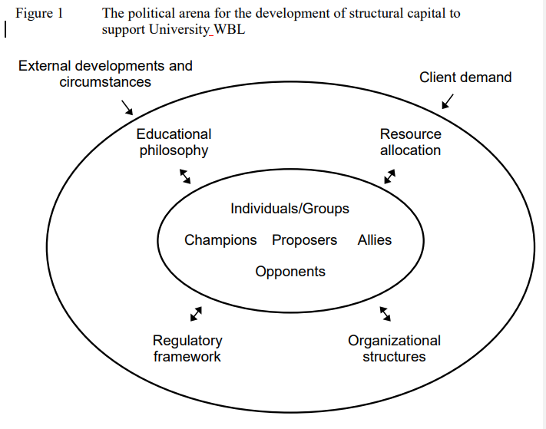
Developing the structural capital of Higher Education Institutions to support work based learning programmes
“Structural capital is concerned with the organising and structuring capability of an organisation and is expressed in formal policies, regulations, procedures, codes, functional business units, task groups, committees or less formal cultures, networks and practices which influence practices and procedures” (Stewart 1997)
“... activities include partnership working, staff development, resource allocation, curriculum design, facilitation and management of academic accreditation and administrative support systems”
Garnett, Jonathan, Workman, Barbara, Beadsmoore, Alan and Bezencenet, Stevie (2008) Developing the structural capital of higher education institutions to support work based learning. In: Work-based learning: workforce development: connections, frameworks and processes. Tallantyre, Freda, ed. Higher Education Academy, York, pp. 18-30. ISBN 9781905788774.

Slide 17
Developing the structural capital of Higher Education Institutions to support work based learning programmes
Preparing the Portfolio for Inspection Structural Capital – from 3 to 33
“It is anticipated that these issues are likely to have a ripple effect in that, once systems are designed to respond to one group of non-traditional students, principles are generated and transferable to others demonstrating that there is real potential to improve the way an institution functions and responds to the needs of a knowledge-driven economy”.
Garnett, Jonathan, Workman, Barbara, Beadsmoore, Alan and Bezencenet, Stevie (2008) Developing the structural capital of higher education institutions to support work based learning. In: Work-based learning: workforce development: connections, frameworks and processes. Tallantyre, Freda, ed. Higher Education Academy, York, pp. 18-30. ISBN 9781905788774.

Slide 18
Culture drives behaviour Shared assumptions Actions change culture
What happens as a
result of deep-dive?

