Slide 1
Preparing the Portfolio for Inspection Structural Capital – from 3 to 33
Sam Moorwood
Head of Work Based Learning
Designated Safeguarding Officer for Apprenticeships

Slide 2
Preparing the Portfolio for Inspection Structural Capital – from 3 to 33
What are the challenges in aligning the OfSTED approach and the HE agenda?
... do we have clear expectations of each other?
Some key initiatives and success factors:
Golden Thread through Governance
Management Information
Deep Dive Preparation
Embedding Personal Development
Individualising the Curriculum

Slide 3
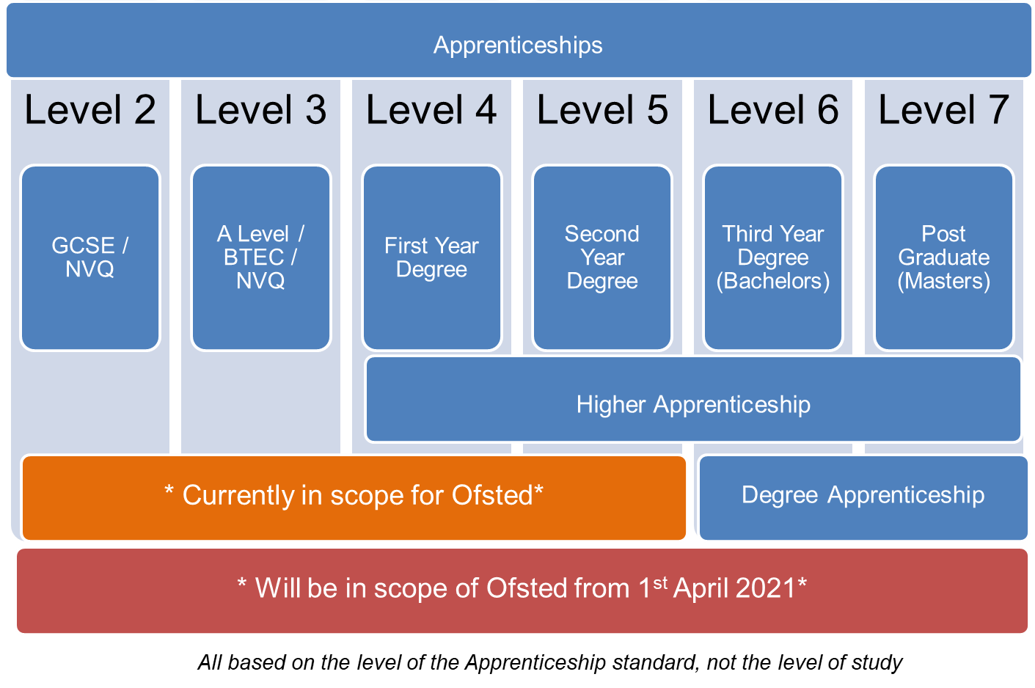
Looking back The Shifting Ofsted Landscape

Slide 4
Cultural Alignment and Expectations
Adult Learners
Andragogy, See Knowles 1983
Self-directed, autonomous and internally motivated
Learn by experience and problem-centred
Informal situations and equal status
Heutagogy:
self constructed learning in a context of social, economic and technological flux
(e.g. see Hase & Kenyon, 2000)
The OfSTED perspective?
Are you an active citizen?
Q. Who is your Safeguarding Officer?
Where is mutual respect in the curriculum?
Q. Are you mentally Healthy?
Q. Do you receive careers advice?
Q. Do you demonstrate BV in your local community
Notes:
No I am on Furlough, or alternatively, managing the logistics for PPE distribution across England - bit busy
Has he got the vaccines?
If I mute my camera can I send a work email?
How can I increase my Wifi bandwidth?
I already have a job... Can anyone help my child with GCSE maths – He hasn’t got an exam coming up so needs to prepare.

Slide 5
Reflections on the journey Value from the Interim visits during COVID-19?
Intent – Implementation – Impact
Overcoming Challenges:
Digital Delivery: Innovation -v- Inertia
Staff Priorities: Initiatives -v- Retrenchment
On-line Progress Reviews: Transparency -v- Tick-box
On-Line Safety: Contextualisation -v- Token gesture

Slide 6
Reflections on the journey Value from the Interim visits during COVID-19?
Action Research: Stepping up to on-line delivery
Key Considerations:
On-Boarding and Building Community
Maintaining Trust and Confidentiality
Balancing Flexibility with Compliance
Teaching Models for Blended Delivery of Work-Based Learning:
Experiential Workshops for KSB Evidence
Peer to Peer Story Telling
Simulation for Work-Based Learning

Slide 7
As OfSTED scope expands, how do you prepare in a large and diverse university?
Leadership & Management
Operations/Departmental Manager
Chartered Manager
Senior Leader
Supply Chain Leader
Building & Surveying
Surveyor (Quantity, Building, Commercial Property/ Valuation)
Chartered Town Planner
Construction Site Supervisor & Manager
Construction QS (& Technician)
Construction Design Manager
Architect
Town Planner
Health & Social Care
Health and Social Care
Social Worker
Occupational Therapy
Physiotherapy
Healthcare Science Practitioner
Advanced Clinical Practitioner
Diagnostic Radiography
Therapeutic Radiographer
Academic Professional
Post Graduate Academic Award
Digital & Technology
Digital & Tech Solutions Professional
Software Engineer
Business Analyst
Cyber Security Analyst
Data Analyst
IT Consultant
Network Engineer
Digital & Tech Solutions Specialist
Software Engineer
Data Analyst
Food & Drink Sectors
Food Technologist
Food Engineering
Packaging Professional
Policing
Police Constable DA
Engineering
Mechanical
Electrical
Manufacturing
Materials
Rail Engineering
Under development
(subject to approval)
Paramedic Practice
Registered Nurse
Teacher
Creative Digital (X2 Design and UX)

Slide 8
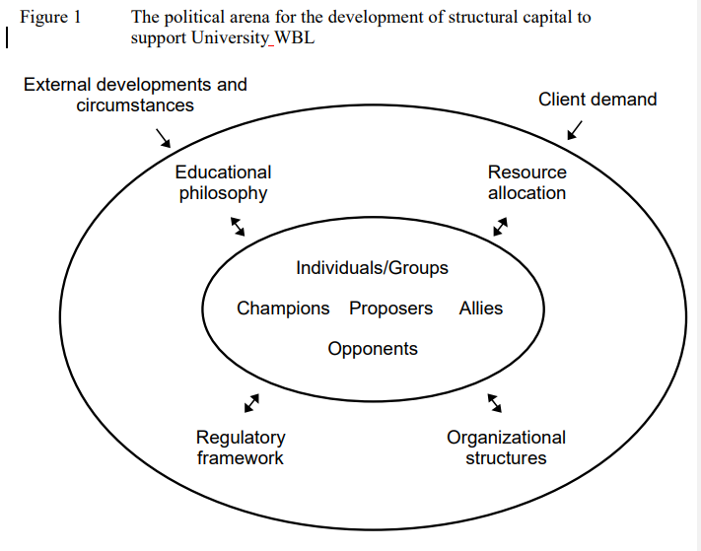
Developing the structural capital of Higher Education Institutions to support work based learning programmes
“Structural capital is concerned with the organising and structuring capability of an organisation and is expressed in formal policies, regulations, procedures, codes, functional business units, task groups, committees or less formal cultures, networks and practices which influence practices and procedures” (Stewart 1997)
“... activities include partnership working, staff development, resource allocation, curriculum design, facilitation and management of academic accreditation and administrative support systems”
Garnett, Jonathan, Workman, Barbara, Beadsmoore, Alan and Bezencenet, Stevie (2008) Developing the structural capital of higher education institutions to support work based learning. In: Work-based learning: workforce development: connections, frameworks and processes. Tallantyre, Freda, ed. Higher Education Academy, York, pp. 18-30. ISBN 9781905788774.

Slide 9
Preparing the Portfolio for Inspection Structural Capital – from 3 to 33
Some key initiatives and success factors:
Golden Thread through Governance
Management Information
Deep Dive Preparation
Embedding Personal Development
Individualising the Curriculum

Slide 10
Academic Assurance Committee (B of Governors)
Accountability in wider SHU governance
Academic Board
Governance chain for enhanced leadership and Management
University Leadership Team
(Simplified version, excludes specific communities and sub-groups, e.g. Apprenticeship Operations Group, National Centre for Excellence,
WBL Coach Team Meetings, etc.)
Apprenticeship & Work Based Learning Steering group
Apprenticeship
lines of escalation
Apprenticeship Operations Leadership Team
Apprenticeship College Operations Group (ADOG)
Monthly delivery/ operational cycle
3-way APRs
Progression Monitoring
Attendance & 20% OTJT
Monthly Delivery Team Meetings (ACL / WBLC)
Apprenticeship Departmental Operations Group (ADOG)

Slide 11
Preparing the Portfolio for Inspection Structural Capital – from 3 to 33
Some key initiatives and success factors:
Golden Thread through Governance
Management Information
Deep Dive Preparation
Embedding Personal Development
Individualising the Curriculum

Slide 12
The Monthly report – KPIs:
Institutional QAR ​
EPA Grading ​
Average Degree Classification ​
Destination​
Programme Progression - Overall ​
Programme Progression by Demographics ​
Programme Progression by Subcontractor​
Functional Skills ​
EPA Grade Forecast ​
Average Caseload for WBLC ​
Module Pass Rate​
Average Module Marks​
Out of Funding​
Review Timescale Compliance​
Attendance​
Apprentices Touch Point Survey Results ​
Employer Touch Point Survey Results​
Engagement with DSS, SSAs and EAs​
Engagement with SU offering ​
Award Entries​
Award shortlists​
Applications ​
Offers​
Accepts​
UF Accepts​
Enrolments ​

Slide 13
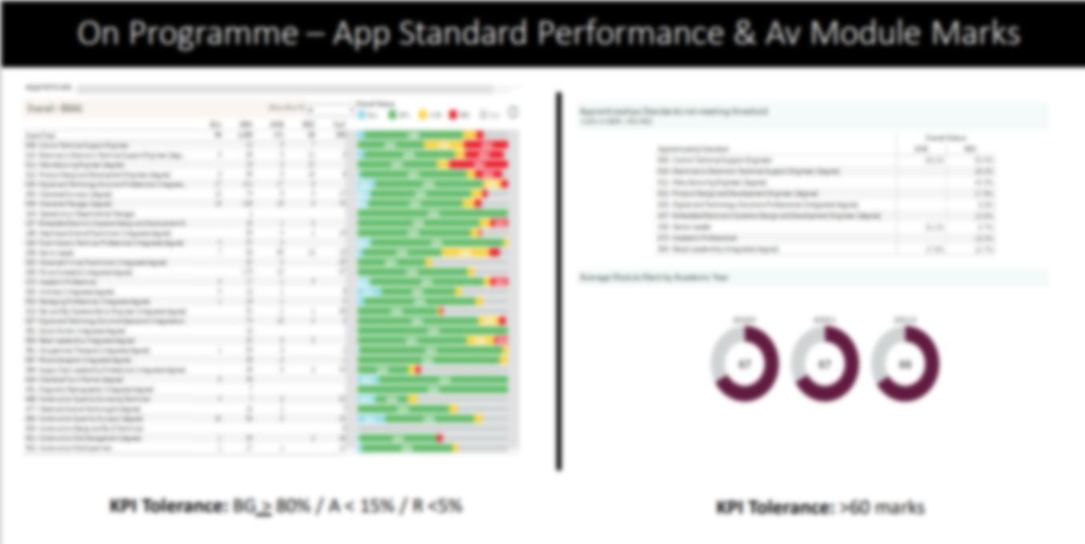
Management Information

Slide 14
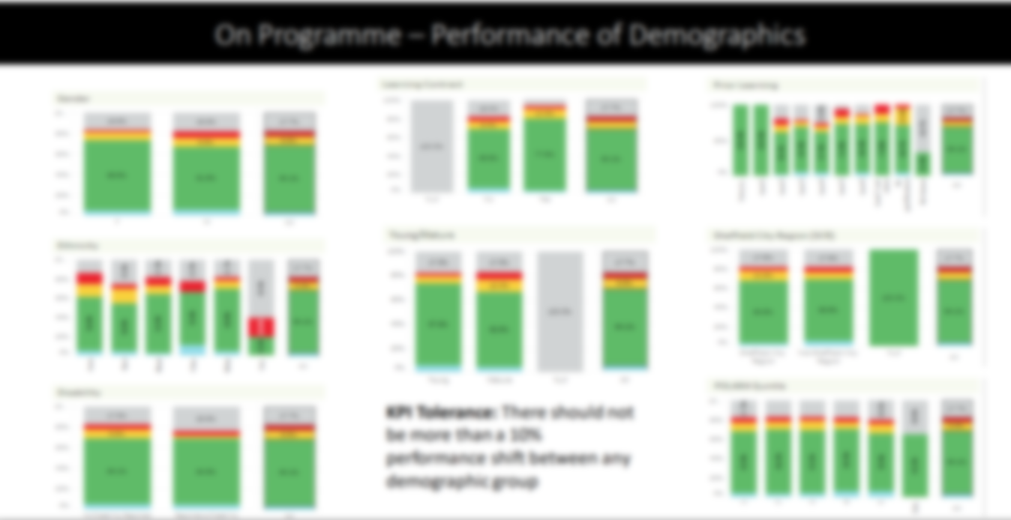
Management Information

Slide 15
Preparing the Portfolio for Inspection Structural Capital – from 3 to 33
Some key initiatives and success factors:
Golden Thread through Governance
Management Information
Deep Dive Preparation
Embedding Personal Development
Individualising the Curriculum

Slide 16
What is a deep-dive?
Not a mock Ofsted but...
Quality review based on EIF
Identify areas of strength and areas for improvement
Led by our external consultants (quality improvement partners), Mesma
Panels are 50/50 split Mesma / SHU

Slide 17
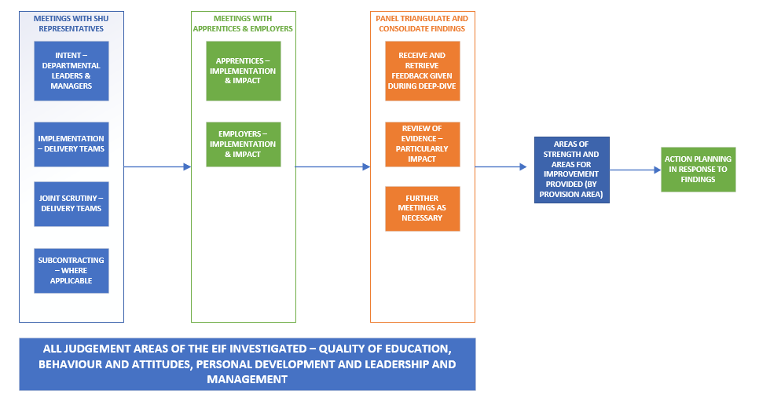
What happens during a deep-dive?

Slide 18
Culture drives behaviour Shared assumptions Actions change culture
What happens as a result of deep-dive?

Slide 19
Preparing the Portfolio for Inspection Structural Capital – from 3 to 33
Some key initiatives and success factors:
Golden Thread through Governance
Management Information
Deep Dive Preparation
Embedding Personal Development
Individualising the Curriculum

Slide 20
Embedding Personal Development Education Inspection Framework (EIF) - Extract:
The curriculum should support learners to develop their knowledge and skills beyond the purely academic, technical or vocational. This judgement evaluates the provider’s intent to provide for the personal development of learners, and the quality of the way in which it does this.
developing responsible, respectful and active citizens who are able to play their part and know how to become involved in public life
developing and deepening learners’ understanding of the fundamental British values of democracy, individual liberty, the rule of law and mutual respect and tolerance
promoting equality of opportunity so that all learners can thrive together, understanding that difference is a positive, not a negative, and that individual characteristics make people unique
promoting an inclusive environment that meets the needs of all learners, irrespective of age, disability, gender reassignment, race, religion or belief, sex or sexual orientation, relationship status or pregnancy
developing learners’ character, which we define as the set of positive personal traits, dispositions and virtues that informs their motivation and guides their conduct so that they reflect wisely, learn eagerly, behave with integrity and cooperate consistently well with others. This gives learners the qualities they need to flourish in our society
developing learners’ confidence, resilience and knowledge so that they can keep themselves mentally healthy
developing learners’ understanding of how to keep physically healthy and maintain an active lifestyle
providing an effective careers programme that offers advice, experience and contact with employers to encourage learners to aspire, make good choices and understand what they need to do in order to reach and succeed in their chosen career
supporting readiness for the next phase of education, training or employment so that learners can make the transition to the next stage successfully.
Ofsted will look for that integration by asking your Apprentices
We need to SEE this in curriculum

Slide 21
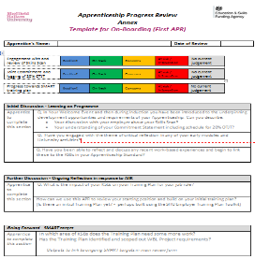
Scheme to Embed Essentials SEE: 6 themes for structure
Integrated Implementation...
3 methods:
Curriculum
Essentials contextualised by subject
On-Boarding
Wellbeing and Safeguarding
Succeeding in your OTJT
Equality Diversity and Inclusion
British Values and Prevent
Careers Guidance
AIIR (on-line resource)
Developmental tools, linked to job role
APR - Annex documents
Discussion of curriculum
Reflection on experience
KSB Action planning

Slide 22
OfSTED, 2022
Leaders and managers have developed a comprehensive framework for planning the wider curriculum for apprentices. They have developed a ‘scheme for embedding essentials’, which helps staff to plan where relevant topics such as preparing for life in modern Britain fit naturally into the curriculum.

Slide 23
Preparing the Portfolio for Inspection Structural Capital – from 3 to 33
Some key initiatives and success factors:
Golden Thread through Governance
Management Information
Deep Dive Preparation
Embedding Personal Development
Individualising the Curriculum

Slide 24
Your
Workplace
Experiences

Slide 25
Your
Workplace
Experiences
Reflective Practice
KSB Achievement

Slide 26
Individualised Apprenticeship Curriculum at SHU
Don’t we already do this?
By Design: Projects and PPD
Skill Scan and Starting Point Exercise
Autonomous learning: Critical thinking, meta learning skills for Apprentices to develop KSBs in their own individual way.
Lecturers/seminars use a variety of instructional methods
Learning styles (e.g. questionnaires)
Tools available and software supported by the SKills Centre (linked in)
Group work & peer review promote identity through reflective comparison.
Work-based learning submissions are mapped out in SEE
Employer training plan tool kit in AIIR for individual 20% OTJT
WBL Coaches support personal development and stretch targets in APRs.
Enrichment of curriculum is built in to the Scheme for Embedding

Slide 27
Individualising the Curriculum Starting Point Review Activity
Overview of steps:
Apprentice and Employer complete the Skill Scan
WBL Coach introduces the mandatory Starting Point Exercise
The Apprentice completes the preparation
ACL emphasise during induction
PPD Module tutor facilitates peer to peer curriculum session
Apprentice completes and sends the grid to WBL Coach for 1st APR
Action Plan appended to PPD assessed submission
Notes:
WBL Coach has introduced the task during On-Boarding and provided the Apprentice with a link to the preparatory activity.
Perhaps assign break out discussion groups according to the timetable you are working to.
Consider groups of 3, for example, each participant spends 3 minutes talking /asking about each question – that would require 10 minutes per question per group, and then some time for feedback / capturing community thinking on a whiteboard(?) – perhaps between each question or at the end - perhaps 1 hour overall.
Check the next slide below where you have the opportunity to discuss matters that are specific to your standard / PSRB requirements.
Complete / Set this task on day one and collect the evidence of learning so the Coach can put this in the Learning File (upload to MAYTAS at the time of the first APR – we need to evidence the first day of learning and how we individualise the curriculum in response to starting position.
For belt and braces ask them to append this task to their 1st Submission in the PPD module so we have a record of this initial learning and how we have begun to individualise the curriculum with each of them.

Slide 28
Starting Point Review Activity
Based on your Skill Scan and using the grid in “Mandatory Exercise 1”
Identify 3 areas where you are least sure of your Skills Scan judgement
Be prepared to ask and listen to what your peers think about this area of competence
Identify 3 specific areas of competence (knowledge, skill, or behaviour) where you are most advanced.
Be prepared to discuss how you could use the course to stretch yourself and generate even better evidence of your competence in this area.
Identify 3 specific areas (knowledge, skill, or behaviour) where you are least developed.
Be prepared to exchange ideas with colleagues about the support you need from your employer and the planning required to ensure you gain the experiences and projects needed to climb the milestones.
Notes:
WBL Coach has introduced the task during On-Boarding and provided the Apprentice with a link to the preparatory activity.
Perhaps assign break out discussion groups according to the timetable you are working to.
Consider groups of 3, for example, each participant spends 3 minutes talking /asking about each question – that would require 10 minutes per question per group, and then some time for feedback / capturing community thinking on a whiteboard(?) – perhaps between each question or at the end - perhaps 1 hour overall.
Check the next slide below where you have the opportunity to discuss matters that are specific to your standard / PSRB requirements.
Complete / Set this task on day one and collect the evidence of learning so the Coach can put this in the Learning File (upload to MAYTAS at the time of the first APR – we need to evidence the first day of learning and how we individualise the curriculum in response to starting position.
For belt and braces ask them to append this task to their 1st Submission in the PPD module so we have a record of this initial learning and how we have begun to individualise the curriculum with each of them.

Slide 29
Preparing the Portfolio for Inspection Structural Capital – from 3 to 33
Some key initiatives and success factors:
Golden Thread through Governance
Management Information
Deep Dive Preparation
Embedding Personal Development
Individualising the Curriculum

Slide 30
Preparing the Portfolio for Inspection Structural Capital – from 3 to 33
Some conclusions:
OfSTED are learning to adapt a child-centred compliance framework to a fluid academic community. Those academics may have less vocational knowledge than the collection of “learners in the room”.
HE adaptation is resource intensive, but it can have remarkably positive impact
(“... Hey we should do this for all 30,000 learners!”)
Investment in Structural Capital is key, needing top level buy in and actions flowing throughout.
Escalation through governance must be data driven and transparent to drive authentic intervention and support
Compliance is not a project. Focus on the positive practice.
A collaborative culture across academic, operational and coaching communities is key to realising impact.

Slide 31
Developing the structural capital of Higher Education Institutions to support work based learning programmes
Preparing the Portfolio for Inspection Structural Capital – from 3 to 33
“It is anticipated that these issues are likely to have a ripple effect in that, once systems are designed to respond to one group of non-traditional students, principles are generated and transferable to others demonstrating that there is real potential to improve the way an institution functions and responds to the needs of a knowledge-driven economy”.
Garnett, Jonathan, Workman, Barbara, Beadsmoore, Alan and Bezencenet, Stevie (2008) Developing the structural capital of higher education institutions to support work based learning. In: Work-based learning: workforce development: connections, frameworks and processes. Tallantyre, Freda, ed. Higher Education Academy, York, pp. 18-30. ISBN 9781905788774.

