Slide 1

Preparing the Portfolio for Inspection
Lessons Learned and Applied
Structural Capital – from 3 to 33
Sam Moorwood
Head of Work Based Learning
Designated Safeguarding Officer for Apprenticeships

Slide 2
Preparing the Portfolio for Inspection
Lessons Learned and Applied
Structural Capital – from 3 to 33
What are the challenges in aligning the OfSTED approach and the HE agenda? ... Is there a culture clash and do we have clear expectations of each other?
Interpretation of the Education Inspection Framework... From 3 to 33 Standards
  Management Information
  Deep Dive Preparation
  Embedding Personal Development
  Individualising the Curriculum
Work to do...

Slide 3
Cultural Alignment and Expectations
Adult Learners
Andragogy, See Knowles 1983
Self-directed, autonomous and internally motivated
Learn by experience and problem-centred
Informal situations and equal status
Heutagogy: self constructed learning in a context of social, economic and technological flux
(e.g. see Hase & Kenyon, 2000)
The OfSTED perspective?
Are you an active citizen?
Q. Who is your Safeguarding Officer?
Where is mutual respect in the curriculum?
Q. Are you mentally Healthy?
Q. Do you receive careers advice?
Notes:
No I am on Furlough, or alternatively, managing the logistics for PPE distribution across England - bit busy
Has he got the vaccines?
If I mute my camera can I send a work email?
How can I increase my Wifi bandwidth?
I already have a job... Can anyone help my child with GCSE maths – He hasn’t got an exam coming up so needs to prepare.

Slide 4
Reflections on the journey
Value from the Interim visits during COVID-19?
Intent – Implementation – Impact
Overcoming Challenges:
Digital Delivery: Innovation -v- Inertia
Staff Priorities: Initiatives -v- Retrenchment
On-line Progress Reviews: Transparency -v- Tick-box
On-Line Safety: Contextualisation -v- Token gesture

Slide 5
Reflections on the journey
Value from the Interim visits during COVID-19?
Action Research: Stepping up to on-line delivery
Key Considerations:
On-Boarding and Building Community
Maintaining Trust and Confidentiality
Balancing Flexibility with Compliance
Teaching Models for Blended Delivery of Work-Based Learning:
Experiential Workshops for KSB Evidence
Peer to Peer Story Telling
Simulation for Work-Based Learning

Slide 6
Structural Capital – from 3 to 33
Management Information
Deep Dive Preparation
Embedding Personal Development
Individualising the Curriculum

Slide 7


As OfSTED scope expands, how do you prepare in a large and diverse university?
Leadership & Management
Chartered Manager
Senior Leader
Supply Chain Leader
Building & Surveying
Quantity Surveyor
Building Surveyor
Commercial Property / Valuation Surveyor
Chartered Town Planner
Construction Site Supervisor & Manager
Construction Design Manager
Architect
Town Planner
Health & Social Care
Health and Social Care
Social Worker
Occupational Therapy
Physiotherapy
Healthcare Science Practitioner
Advanced Clinical Practitioner
Diagnostic Radiography
Academic Professional
Post Graduate Academic Award
Food & Drink Sectors
Food Technologist
Food Engineering
Packaging Professional
Digital & Technology
Digital & Tech Solutions Professional
Software Engineer
Business Analyst
Cyber Security Analyst
Data Analyst
IT Consultant
Network Engineer
Digital & Tech Solutions Specialist
Software Engineer
Data Analyst
Policing
Police Constable DA
Engineering
Mechanical
Electrical
Manufacturing
Materials
Rail Engineering
Under development (Examples)
(subject to approval)
Paramedic Practice
Registered Nurse
Teacher
Creative Digital

Slide 8
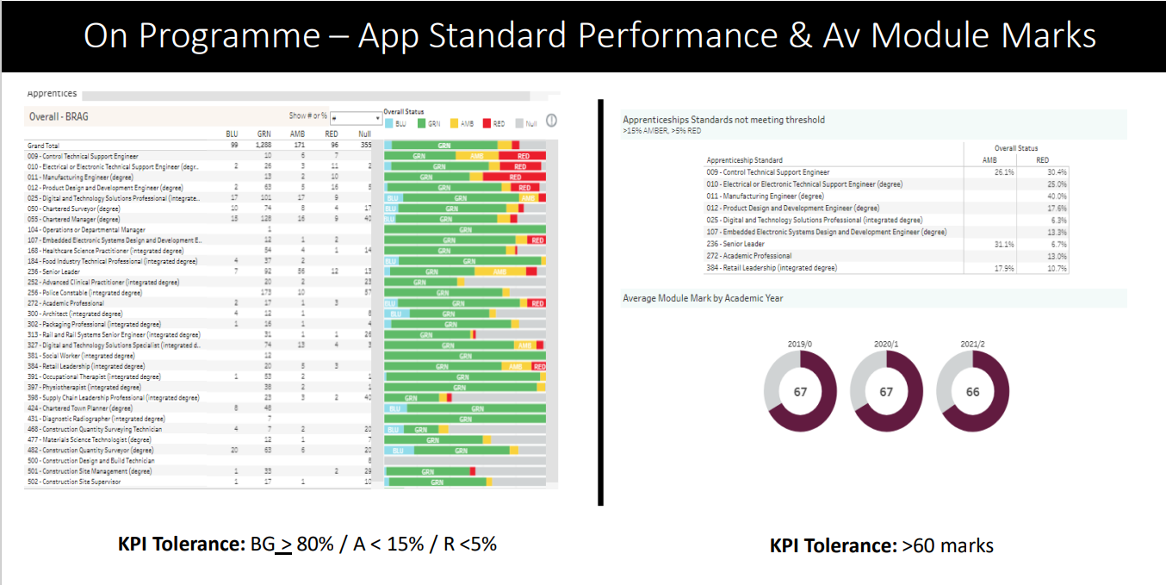
Management Information

Slide 9
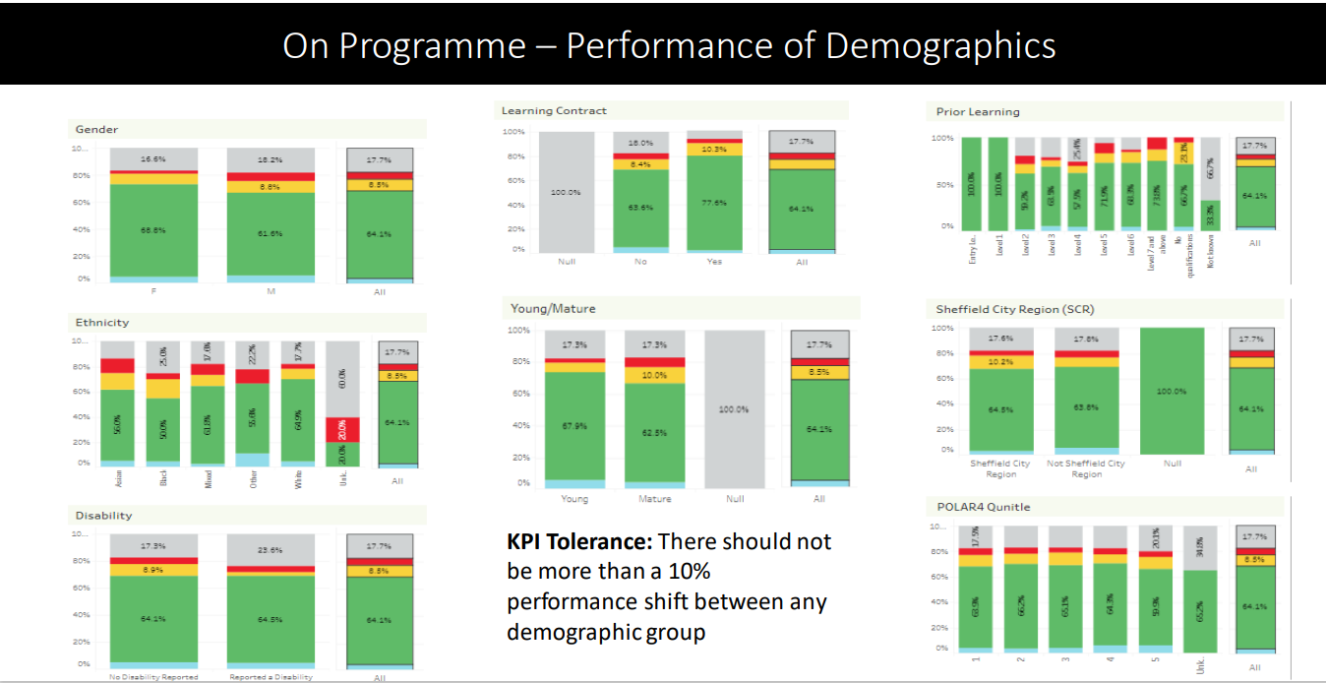
Management Information

Slide 10
Deep-dives into SHU’s Apprenticeship Provision
July 2021

Slide 11
What is a deep-dive?
Not a mock Ofsted but...
Quality review based on EIF
Identify areas of strength and areas for improvement
Led by our external consultants (quality improvement partners), Mesma
Panels are 50/50 split Mesma / SHU

Slide 12
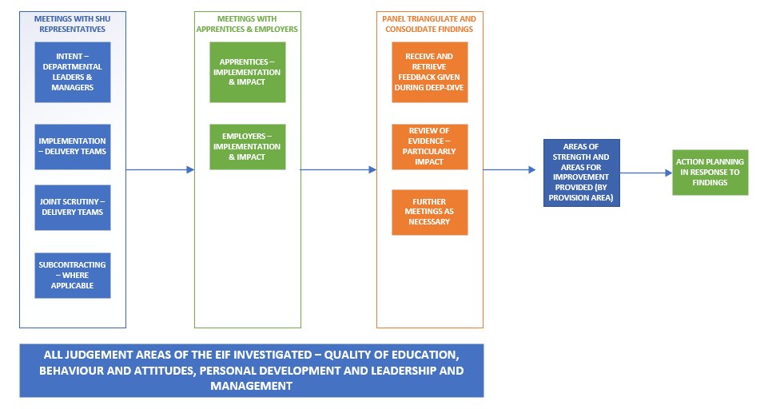
What happens during a deep-dive?

Slide 13
Top Tips
Preparation
Watch the overview videos – especially the 3rd EIF overview
Read the SAR and QIP
Review data sets and performance pack to understand KPI’s and your dept/course performance
Refresh yourself on SEE and AIIR
  Understanding starting points
  EDI, Prevent, British Values and Safeguarding
Things to cover
Talk about a single Apprenticeship – not a separated award!
Understand your strengths and key achievements – what do you want to shout about
Have specific apprentice examples – Blue and Support
Don’t take SHU BAU for granted or assume 'they know'
Consider the 'Golden Thread' - joint the dots between the sessions
Managing the discussion
Everyone to know their role and contribution/specialism - have a room leader/facilitator
Drive the conversation – not a question and response approach

Slide 14
Education Inspection Framework (EIF)
Extract:
The curriculum should support learners to develop their knowledge and skills beyond the purely academic, technical or vocational. This judgement evaluates the provider’s intent to provide for the personal development of learners, and the quality of the way in which it does this.
developing responsible, respectful and active citizens who are able to play their part and know how to become involved in public life
developing and deepening learners’ understanding of the fundamental British values of democracy, individual liberty, the rule of law and mutual respect and tolerance
promoting equality of opportunity so that all learners can thrive together, understanding that difference is a positive, not a negative, and that individual characteristics make people unique
promoting an inclusive environment that meets the needs of all learners, irrespective of age, disability, gender reassignment, race, religion or belief, sex or sexual orientation, relationship status or pregnancy
developing learners’ character, which we define as the set of positive personal traits, dispositions and virtues that informs their motivation and guides their conduct so that they reflect wisely, learn eagerly, behave with integrity and cooperate consistently well with others. This gives learners the qualities they need to flourish in our society
developing learners’ confidence, resilience and knowledge so that they can keep themselves mentally healthy
developing learners’ understanding of how to keep physically healthy and maintain an active lifestyle
providing an effective careers programme that offers advice, experience and contact with employers to encourage learners to aspire, make good choices and understand what they need to do in order to reach and succeed in their chosen career
supporting readiness for the next phase of education, training or employment so that learners can make the transition to the next stage successfully.
Ofsted will look for that integration by asking your Apprentices
We need to SEE this in curriculum

Slide 15
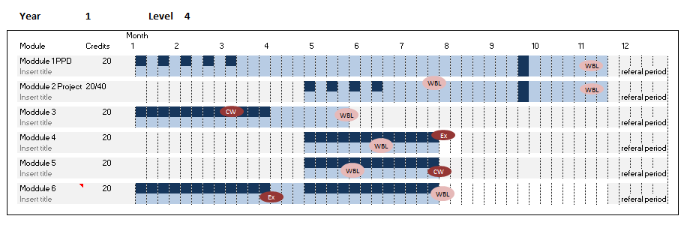

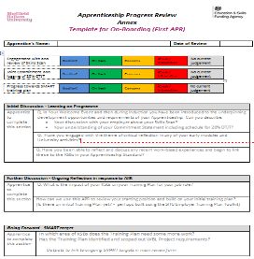
Scheme to Embed Essentials
SEE: 6 themes for structure
Integrated Implementation...
3 methods:
Curriculum
Essentials contextualised by subject
On-Boarding
Wellbeing and Safeguarding
Succeeding in your OTJT
Equality Diversity and Inclusion
British Values and Prevent
Careers Guidance
AIIR (on-line resource)
Developmental tools, linked to job role
APR - Annex documents
Discussion
Reflection
Action

Slide 16
Easy wins to build on...
Town Planner: British values including Democracy and rule of law
Engineering: professional reports to be written - targets for Literacy development.
The use of statistics in quantitative research
Mathematical angle in anatomy (Physiotherapy)
Mathematical development in finance modules
Mathematical development in statistical research support
Prevent in Police Constable!!
Safeguarding in all Healthcare
Law (British Values) crops up everywhere!
On-Line Safety in research methods
EDI in all reflective Practice modules
Values in 360 ECR reports
Career Development (advice) in Professional Development / E-portfolio sessions

Slide 17
OfSTED Feedback:
Staying Safe On-Line in Curriculum...
L4 Construction ongoing work:
Professional Practice Module
WB Project
(Safe & ethical research)

Slide 18
Apprenticeship Progress Review
WBL Coaches use one Thematic Guidance for each review to drive coaching conversations that build and strengthen the impact from curriculum
Connect to curriculum
Reflect on experience (AIIR)
E.g. Democracy
Drive KSB Development

Slide 19
OfSTED, 2022
Leaders and managers have developed a comprehensive framework for planning the wider curriculum for apprentices. They have developed a ‘scheme for embedding essentials’, which helps staff to plan where relevant topics such as preparing for life in modern Britain fit naturally into the curriculum.

Slide 20
Starting Point Review Activity
Overview of steps:
Apprentice and Employer complete the Skill Scan
WBL Coach introduces the mandatory Starting Point Exercise
The Apprentice completes the preparation
ACL emphasise during induction
PPD Module tutor facilitates peer to peer curriculum session
Apprentice completes and sends the grid to WBL Coach for 1st APR
Action Plan appended to PPD assessed submission
The link for the Apprentice to the Starting Point Activity grid
Take a look so you know what they should be thinking about.
Get them to bring this or access it for the timetabled session. BB Upload?
Notes:
WBL Coach has introduced the task during On-Boarding and provided the Apprentice with a link to the preparatory activity.
Perhaps assign break out discussion groups according to the timetable you are working to.
Consider groups of 3, for example, each participant spends 3 minutes talking /asking about each question – that would require 10 minutes per question per group, and then some time for feedback / capturing community thinking on a whiteboard(?) – perhaps between each question or at the end - perhaps 1 hour overall.
Check the next slide below where you have the opportunity to discuss matters that are specific to your standard / PSRB requirements.
Complete / Set this task on day one and collect the evidence of learning so the Coach can put this in the Learning File (upload to MAYTAS at the time of the first APR – we need to evidence the first day of learning and how we individualise the curriculum in response to starting position.
For belt and braces ask them to append this task to their 1st Submission in the PPD module so we have a record of this initial learning and how we have begun to individualise the curriculum with each of them.

Slide 21
Individualised Apprenticeship Curriculum at SHU
By Design: Projects and PPD
Skill Scan and Starting Point Exercise
Autonomous learning: Critical thinking, meta learning skills for Apprentices to develop KSBs in their own individual way.
Lecturers/seminars use a variety of instructional methods
Learning styles (e.g. questionnaires)
Tools available and software supported by the SKills Centre (linked in)
Group work & peer review promote identity through reflective comparison.
Work-based learning submissions are mapped out in SEE
Employer training plan tool kit in AIIR for individual 20% OTJT
WBL Coaches support personal development and stretch targets in APRs.
Enrichment of curriculum is built in to the Scheme for Embedding

Slide 22
Starting Point Review Activity
Based on your Skill Scan and using the grid in “Mandatory Exercise 1”
Identify 3 areas where you are least sure of your Skills Scan judgement
Be prepared to ask and listen to what your peers think about this area of competence
Identify 3 specific areas of competence (knowledge, skill, or behaviour) where you are most advanced.
Be prepared to discuss how you could use the course to stretch yourself and generate even better evidence of your competence in this area.
Identify 3 specific areas (knowledge, skill, or behaviour) where you are least developed.
Be prepared to exchange ideas with colleagues about the support you need from your employer and the planning required to ensure you gain the experiences and projects needed to climb the milestones.
Notes:
WBL Coach has introduced the task during On-Boarding and provided the Apprentice with a link to the preparatory activity.
Perhaps assign break out discussion groups according to the timetable you are working to.
Consider groups of 3, for example, each participant spends 3 minutes talking /asking about each question – that would require 10 minutes per question per group, and then some time for feedback / capturing community thinking on a whiteboard(?) – perhaps between each question or at the end - perhaps 1 hour overall.
Check the next slide below where you have the opportunity to discuss matters that are specific to your standard / PSRB requirements.
Complete / Set this task on day one and collect the evidence of learning so the Coach can put this in the Learning File (upload to MAYTAS at the time of the first APR – we need to evidence the first day of learning and how we individualise the curriculum in response to starting position.
For belt and braces ask them to append this task to their 1st Submission in the PPD module so we have a record of this initial learning and how we have begun to individualise the curriculum with each of them.

Slide 23


Your
Workplace
Experiences

Slide 24

Your
Workplace
Experiences
Reflective Practice
KSB Achievement

Slide 25
Your
Workplace
Experiences
You’re already
accumulating oranges.
Reflective Practice
KSB Achievement

Slide 26
Your
Workplace
Experiences
You’re already
accumulating oranges.
Reflective Practice
Sue & John are showing you how to work the juicer.
KSB Achievement

Slide 27
Work to do
Continue to develop and evaluate the ‘scheme for embedding essentials’ framework so that all apprentices are well prepared for life in modern Britain.
Ensure that there is clear oversight of the safeguarding training that staff complete to confirm that there is full compliance with university policies.
Consider and identify additional ways in which the expectations of workplace mentors can be successfully communicated to all employers, so that all apprentices can enjoy the same high levels of support.
Ensure that all apprentices are fully aware of the range of support services available to them

Slide 28
Preparing the Portfolio for Inspection
Lessons Learned and Applied
Some conclusions:
OfSTED are learning to adapt a child-centred compliance framework to a fluid academic community that may sometimes has less vocational knowledge than the “learners in the room”.
HE Adaptation is resource intensive, but it can have remarkably positive impact
(“... Hey we should do this for all 30,000 learners!”)
The interim visit during COVID-19, was proportionate and acted as a focus for review and evaluation. Some staff may now think they are OfSTED ready, but have yet to experience full “triangulation”.
Embedding EIF in 50 courses has meant creating a strategic approach that drives the minutiae in it’s implementation... Collaboration between academic community and WBL Coaches is key to realising impact.

