Slide 1
Attendance Recording in JISC Data Explorer A Short Guide for Apprenticeship Teaching Staff for On-campus and On-line Attendance Monitoring
It is critical that SHU have an effective and consistent approach to attendance monitoring for all of the Apprenticeship provision; enabling strong attendance to be evidenced and incidents of poor attendance to be identified and addressed quickly and responsively. This is a compulsory requirement of both Ofsted and our contractual obligations with the Education and Skills Funding Agency (ESFA). We require the use of JISC Learning Analytics to record the attendance of all Apprentices at all delivery sessions, with immediate effect.
Here is a practical overview of how to use JISC, followed by illustrative step-by-step guidance – please familiarise in advance of delivery.
To get started here is the link to JISC: https://datax.jisc.ac.uk.
Select Sheffield Hallam University and log in with your usual user name & password
In the tutor tab go to 'My Modules' and select the module for the session you are about to teach.
This will take you to a page with all modules assigned to you. In order to generate and provide specific codes for each group of learners on their occurrence of a module you will need to:
Click “Start Attendance” to begin a new register (under the module name and occurrence). This will generate a 4-digit pin
You can (optionally) change the session title
Then click the “Start Button”
Learners will have been asked to familiarise themselves with ‘Study Goal’ during induction, please check they are aware of it and have access in order to register their attendance
Whether on campus or on-line, learners must enter the 4-digit pin in the app within a 1 hour window
For sessions like seminars, where only a sub-group needs to attend, you can select individual, or multiple students from the register and mark their records as 'not required’ – but do this at the start of the session, before learners access the register.
Contingency Approach: If you are unable to record attendance using JISC complete a manual register following the instructions on page 10 of the document.
To view attendance registers from previous sessions use the 'View register' link found in ‘My Modules’.
Any attendance issues must be discussed in monthly meetings between the Apprenticeship Course Leader and WBL Coach.
Further resources and details guidance is available on the Learning Analytics SharePoint Any questions or issues? – contact the Learning Analytics Project Team

Slide 2
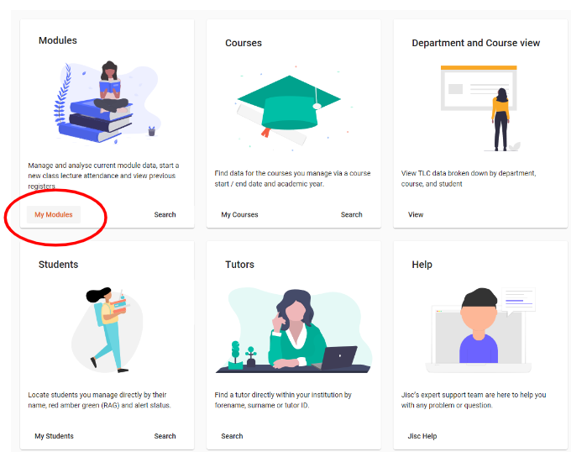
Click: Return to instructions
In the tutor tab go to 'My Modules' and select the module for the session you are about to teach.

Slide 3
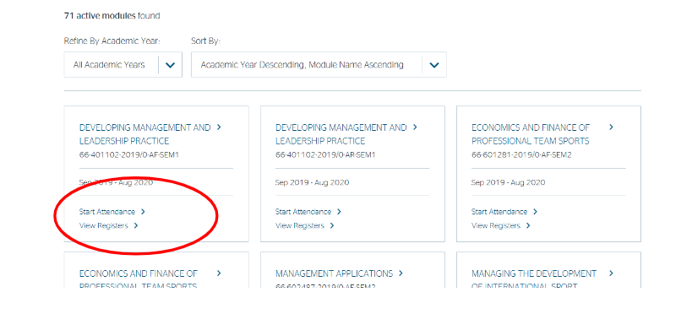
Generate and provide specific codes for each group of learners on their occurrence of a module
Click “Start Attendance” to begin a new register
Click: Return to instructions

Slide 4
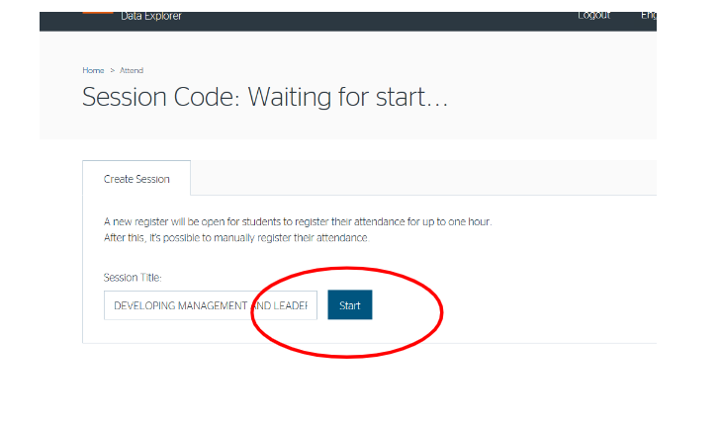
You can (optionally) change the session title, then click the “Start button”
Click: Return to instructions

Slide 5
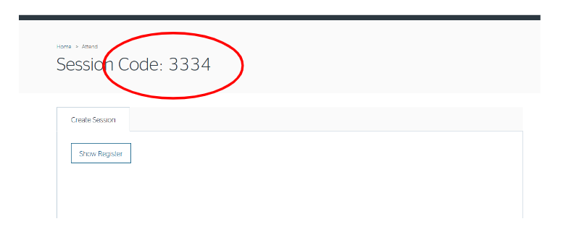
Whether on campus or on-line, learners must enter the 4-digit pin in the browser
Click: Return to instructions

Slide 6
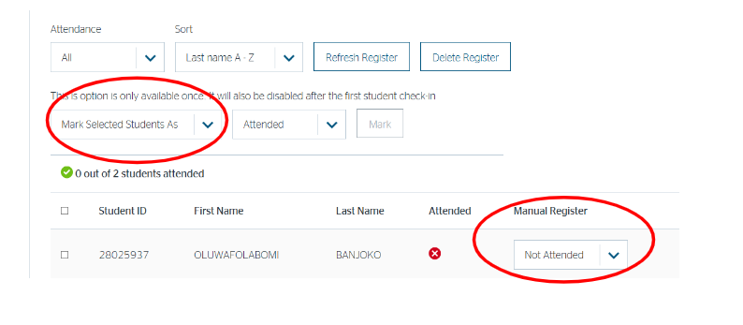
If necessary you can use “manual register” for any individual student struggling to access or use the system
Click: Return to instructions

Slide 7
For sessions like seminars, where only a sub-group needs to attend, you can select individual, or multiple students from the register and mark their records as 'not required’ – but do this at the start of the session, before learners access the register.
Click: Return to instructions

Slide 8
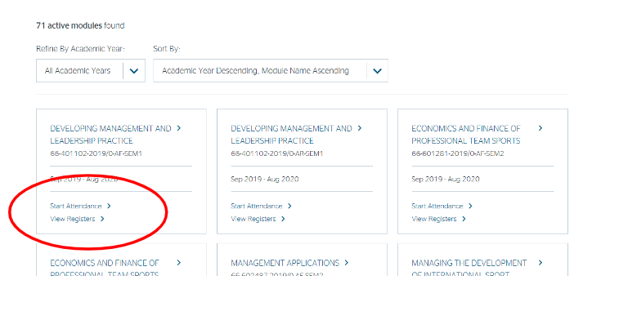
To view Attendance registers from previous sessions use the 'View register' link found in 'My Modules’
Click: Return to instructions

Slide 9
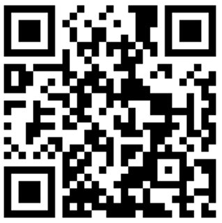
Student access
Students must scan the qr code below or go to studygoal.jisc.ac.uk then log in using your usual SHU log in details.
You must then record your attendance at taught sessions by entering a 4-digit PIN provided by your lecturer at each session into the browser.
Study Goal is part of the Jisc Learning Analytics Service. It provides an interface for students to be able to view data and access other features that support study.
Click: Return to instructions
Notes:
THIS IS AN INDUCTION SLIDE FOR APPRENTICE STUDENTS

Slide 10
Contingency
In the event that you are unable to record attendance in JISC a contingency process is in place.
A central team will provide support to ensure that attendance is recorded and will look into the reasons as to why you were unable to record attendance in JISC, with a view to resolving system problems.
Access the manual register template - (found here)
Download a local copy (open in desktop app) – do not overwrite the template with student data for all to see (you may want to keep a copy of this document on your OneDrive for easy access)
Complete the manual attendance register, including identification of JISC issue
You may choose to manually type in the student names or use another tool to download the details and copy over, such as using a Grade Centre Export
The register should be returned on the same day but that may be after the session, to facilitate detail completion etc. Colleagues could take a screen shot of online learning platforms to note attendance to aid register completion immediately after the session.
Return the manual register to apprenticeships@shu.ac.uk on the same day as delivery
Click: Return to instructions

