Slide 1
Welcome
Apprenticeship Safeguarding and Support
Introduction and Update for Academics
Sam Moorwood
Head of Work Based Learning
Designated Safeguarding Officer for Apprenticeships at SHU

Slide 2
Student Support Fundamentals
Supporting Students in Distress
Sheffield Hallam At Risk Pathway (SHARP)
Clear advice to staff on what to do if they come into contact with a student in distress, whether they have specific responsibility for pastoral support or simply work with students in the course of their job
Supporting Students in Distress Guide (sharepoint.com)
SHARP provides holistic support to exceptional student circumstances that cannot be managed through the standard student support model.
SHARP oversees complex student cases for students who are considered at risk to themselves or others. The pathway contains three stages of escalation where students are managed in conjunction with other support services within the University.
Sheffield Hallam At Risk Pathway (SHARP) (sharepoint.com)

Slide 3
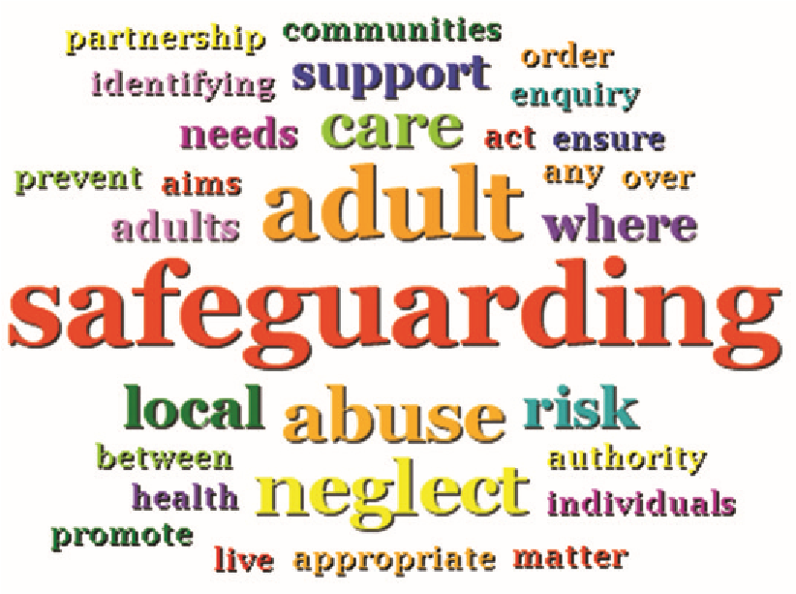
This session
Apprenticeship Safeguarding and Support
Introduction and Update for WBL Academics

Slide 4
Apprenticeship Safeguarding and Support
Introduction and Update for WBL Academics
This session
Safeguarding - Key concepts
Designated Safeguarding Officer
Staff Obligations (duty of care)
Cause for Concern – SHARP
Resources & Practice Guidance
Further Actions + SUMMARY

Slide 6
Categories of possible abuse in Adults
Key Concepts
Safeguarding is a term we use to describe how we protect adults and children from abuse or neglect.
An adult at risk is anyone over the age of 18 who is deemed as vulnerable, being at risk of abuse or neglect.
They potentially:
maybe in community care
have a mental or other disability
unable to take care of themselves or avoid harm/exploitation by others
Types of Harm include:
Physical Abuse
Sexual Abuse
Psychological abuse
Modern slavery
Financial or material abuse
Self neglect
Domestic Violence
Discriminatory abuse
Organisational abuse
Female Genital Mutilation
Human Trafficking

Slide 8
Designated Safeguarding Officer (DSO)
For Apprenticeships
Sam Moorwood, Head of Work Based Learning
To lead the organisation on effective safeguarding practices
Helping to prevent harm from occurring
Ensuring ‘fit for purpose’ systems are in place
Raising awareness and educating others
Managing referrals
Supporting others
Reviewing and appropriately recording information
Deputy DSO: Andy Womble, WBL Manager

Slide 9
SHU Staff Obligations
So, as a member of staff:
Read, understand and follow safeguarding policies and procedures
Prevent, recognise and respond to types of harm
Understand responsibilities and raise concerns in a timely manner.
Seek appropriate help and support
Know how to raise a concern
Contribute to an effective safeguarding culture
Continual professional and personal development

Slide 10
Student Support Fundamentals
Supporting Students in Distress
Sheffield Hallam At Risk Pathway (SHARP)
Clear advice to staff on what to do if they come into contact with a student in distress, whether they have specific responsibility for pastoral support or simply work with students in the course of their job
Supporting Students in Distress Guide (sharepoint.com)
SHARP provides holistic support to exceptional student circumstances that cannot be managed through the standard student support model.
SHARP oversees complex student cases for students who are considered at risk to themselves or others. The pathway contains three stages of escalation where students are managed in conjunction with other support services within the University.
Sheffield Hallam At Risk Pathway (SHARP) (sharepoint.com)

Slide 11
Contextualised Safeguarding
Homelife
Work-place
Neighbourhood
Education
Peer-group
Staying Safe On-Line:
https://blog.shu.ac.uk/apprenticeship-resources/wellbeing-and-support/staying-safe-online/

Slide 12
Possible signs to look out for in adults (N.B. You need the whole picture)
Indiscriminate contact or affection-seeking.
Being over-friendly to strangers.
Excessive clinginess and persistently seeking attention.
Habitual body rocking.
Being withdrawn and reluctant to communicate.
Dislike or lack of cooperation.
Lack of interest or low responsiveness.
High levels of anger or annoyance.
That they are passive or withdrawn.
Excessive cash or expensive gifts
Most causes for concern at SHU are well-being matters
Few qualify as Safeguarding concerns
BUT - Any adult can become vulnerable - never hold back from raising a concern

Slide 13
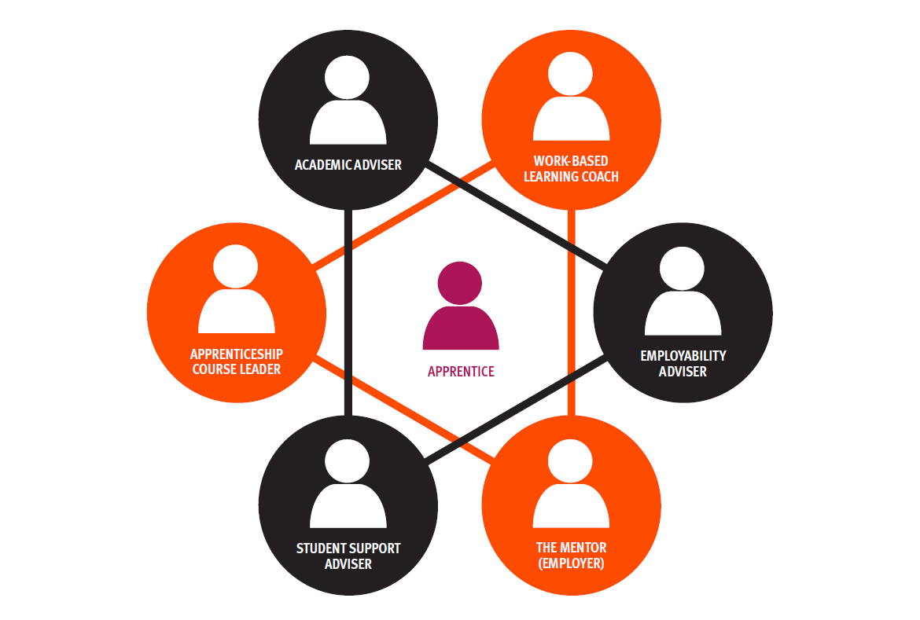
Student Support Triangles

Slide 14
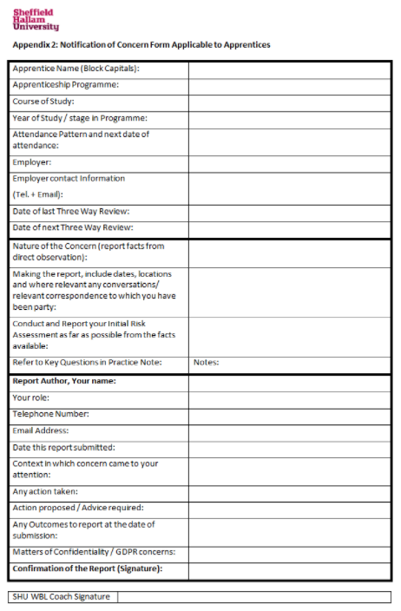
Mainly for WBL Coaches: Notification of Cause for Concern Practice Guidance on Sharepoint
Why is there a specific form for Apprentices?

Slide 15
COVID - Institutional Response Briefing Paper
Institutional Response:
Key issues identified – wellbeing of apprentices / students, wellbeing of staff, a safe return to campus
DfE Guidance on re-opening campus. Tiered approaches mapped to SHU Tiered approach
Senior Leaders work with external partners such as Sheffield City Council, NHS, UoS, PHE in regards to Safeguarding (creation of Gold and Silver group)
CHART - Covid Help and Response Team connection across the City
Keeping Learners Safe
Wellbeing support for those self-isolating (e.g. check-ins, food deliveries, online resources)
Student wellbeing service for mental health support
Study support (e.g. no detriment)
For apprentices - Support triangle (with the extra layer of support from ACL, Mentor and Coach – APRs and monthly meetings strengthened and development of Departmental Ops Groups).
Safe Return to Campus (Pre-Lockdown II)
Extended Campus (online delivery, limiting entrants to support social distancing, controls at entrance and exit, temperature checks, hand sanitisers, face coverings, protective screens)
Clear process to report CV-19
Staggered start and finish times
Process for filling up rooms
2m rule, adaptations to classrooms, technical facilities (1m + in teaching spaces, mitigations around room layout)
Building Ambassador Roles

Slide 16
COVID - Institutional Response Briefing Paper
Support for Staff
Student Support Triangle web page and Blackboard training module
Beyond Covid-19 Sharepoint Beyond Covid - Guidance
Improved infrastructure: Student Support Referral– On-line referral form - links to CRM + SSA case officer, communications via student portal. (Sarah Smart)
Constructive work with Unions regarding safe campus.
Staff guidance on keeping safe on campus - Return to Work/campus Modules
University guidance on remote working
Employee Assistance Programme
Risk Assessments
Provision of face coverings
HoWBL: Contextualising Safeguarding for Apprenticeships (Including Online Safety)

Slide 17
COVID - Institutional Response Briefing Paper
Programme Delivery
Course Delivery Principles Wellbeing on P7
Apprenticeship Section in response to AWBL and through Action Research with academic practitioners: https://blog.shu.ac.uk/teachingdelivery/course-delivery/#2
...Note - apprenticeships section on Community
Inclusivity and Accessibility On-line
ADD team delivering additional training including inclusivity, through Digital Thursdays
Scheme to Embed Essentials has a wellbeing strand
Development of AIIR for online safety - AIIR - Wellbeing and Support, including AIIR – Risk of redundancy
Support Triangles for Apprentice: HoWBL undertaking review of Apprentice Progress Reviews and referral case studies to better understand any developmental needs and risks posed by using solely on-line platform. Dissemination back to Coaches on 29th October.
Updated principles for respecting confidentiality during WBL conversations in AIIR + revisions to commitment statement as well.
Staying Safe On-Line:
https://blog.shu.ac.uk/apprenticeship-resources/wellbeing-and-support/staying-safe-online/

Slide 18
In Summary Key points for Academics
Safeguarding is how we protect adults and children from abuse or neglect.
An adult at risk is anyone > the age of 18, deemed as vulnerable (e.g. care requirements, mental health)
Designated Safeguarding Officer for Apprenticeships is Sam Moorwood, s.moorwood@shu.ac.uk, 07787 006 340.
Academics should be familiar with safeguarding policies procedures, practice and resources (see slide 12)
Prevent, recognise and respond to types of harm ... Know how to raise a concern...seek appropriate help and support in a timely manner.
Only share learner data if needed by others to implement effective support
BUT: GDPR/confidentiality must NEVER block appropriate risk mitigation
Contribute to an effective safeguarding culture - know your learners, reflect on your interventions, support each other.
Be aware of the University’s response to wellbeing and delivery during Covid (Slides 13-15)
Play any relevant role to embed Wellbeing in the curriculum (SEE) and using AIIR
https://staff.shu.ac.uk/prevent.asp (Staff Prevent Training – be up to date)
Learner Analytics Training Video
User Guides (including attendance monitoring in JISC)
Professional Services Supporting our Students Module
Supporting-Students-in-Distress (for staff)
https://www.shu.ac.uk/myhallam/help-and-support (for learners)

Slide 19
Student Support Fundamentals
Supporting Students in Distress
Sheffield Hallam At Risk Pathway (SHARP)
Clear advice to staff on what to do if they come into contact with a student in distress, whether they have specific responsibility for pastoral support or simply work with students in the course of their job
Supporting Students in Distress Guide (sharepoint.com)
SHARP provides holistic support to exceptional student circumstances that cannot be managed through the standard student support model.
SHARP oversees complex student cases for students who are considered at risk to themselves or others. The pathway contains three stages of escalation where students are managed in conjunction with other support services within the University.
Sheffield Hallam At Risk Pathway (SHARP) (sharepoint.com)

