Slide 1

Designing an Apprenticeship
SHU Academic Essentials resource to support new or revised programme development

Slide 2

Designing an Apprenticeship
SHU staff resource in Academic Essentials
Home page: “Apprenticeship Essentials”

Slide 3
Designing an Apprenticeship
SHU staff resource in Academic Essentials
Should we do this Apprenticeship?

Slide 4

Should we do this Apprenticeship?
Fast Facts sheet
The SHU Model
KSB Mapping Template
20% Off the Job Training
Apprenticeship Journey

Slide 5
Designing an Apprenticeship
SHU staff resource in Academic Essentials
End Point Assessment

Slide 6
SHU Apprenticeship Design
The Standard
QAA
Benchmarks
PSRBs etc.
Commitment Statement
Programme Learning Outcomes
Duties and
KSBs
Core Apprenticeship Modules
Discipline and Specialist Modules
Module Learning Outcomes
Assessment
EPA
Indicative content
Delivery Method

Slide 7
SHU Apprenticeship Design
The Standard
QAA
Benchmarks
PSRBs etc.
Commitment Statement
Programme Learning Outcomes
Duties and
KSBs
Core Apprenticeship Modules
Discipline and Specialist Modules
Module Learning Outcomes
Assessment
EPA
Indicative content
Delivery Method

Slide 8
Illustration:
Integration of WBL Ethos and Modules
Undergraduate Example: INTEGRATED EPA
Commitment Statement
WBL Coaches
Level 4
Intro Module | Intro Module | PPD WBL | Project WBL Discipline Focus | Discipline Mod
Level 5
Specialist Module | Specialist Module | PPD WBL | Project WBL Discipline Focus | Discipline Mod
Gateway Module
Level 6
Specialist Module | Specialist Module | PPD WBL | Project WBL
Specialist Module | Specialist Module | PPD WBL | Project WBL
EPA
Nb. Each award is design to meet the Apprenticeship Standard and so the structure of the course and support offer will vary
PPD = Personal and Professional Development

Slide 9
Designing an Apprenticeship
SHU staff resource in Academic Essentials
Apprenticeship & Work based Learning Framework

Slide 10
Apprenticeship and Work Based Learning Framework
Bespoke Apprenticeship templates:
Preliminary Meeting
Course Overview
Course Descriptor
Apprenticeship module templates
KSB mapping
20% Off The Job Training Schedule (etc.)

Slide 11
Designing an Apprenticeship
SHU staff resource in Academic Essentials
Work Based Learning Assessment

Slide 12
Work Based Learning Assessment Review
Good Practice Guidance:
Menu of Approaches
Explanation of different approaches
Course review checklist
Exemplars
Also in the Resources Section:
Blended Delivery of Apprenticeships – Guidance here

Slide 13
Designing an Apprenticeship
SHU staff resource in Academic Essentials
Embedding Apprenticeship Essentials

Slide 14
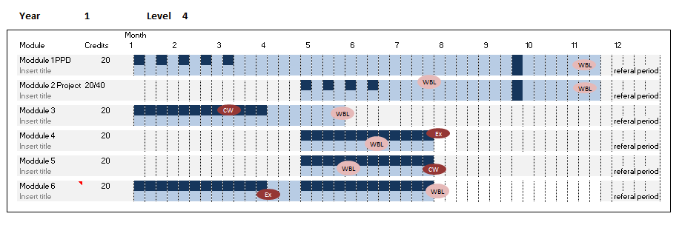

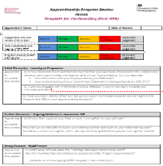
Scheme to Embed Essentials
SEE: 6 themes for structure
Integrated Implementation...
3 methods:
Curriculum
Essentials contextualised by subject
On-Boarding
Wellbeing and Safeguarding
Succeeding in your OTJT
Equality Diversity and Inclusion
British Values and Prevent
Careers Guidance
AIIR (on-line resource)
Developmental tools, linked to job role
APR - Annex documents
Discussion
Reflection
Action

Slide 15

...in Preparation:
Designing an Apprenticeship
SHU Academic Essentials resource to support new or revised programme development

