Slide 1
Preparing the Portfolio for Inspection Lessons Learned and Applied
Sam Moorwood
Head of Work Based Learning
Designated Safeguarding Officer for Apprenticeships

Slide 2
Preparing the Portfolio for Inspection Lessons Learned and Applied
What are the challenges in aligning the OfSTED approach and the HE agenda? ... Is there a culture clash and do we have clear expectations of each other?
Reflections on the journey for Sheffield Hallam University ...What was the value of the Interim visits during Covid?
Interpretation of the Education Inspection Framework... From 3 to 30…
As OfSTED expand to cover all Apprenticeships, how do you prepare in a large and diverse university?

Slide 3
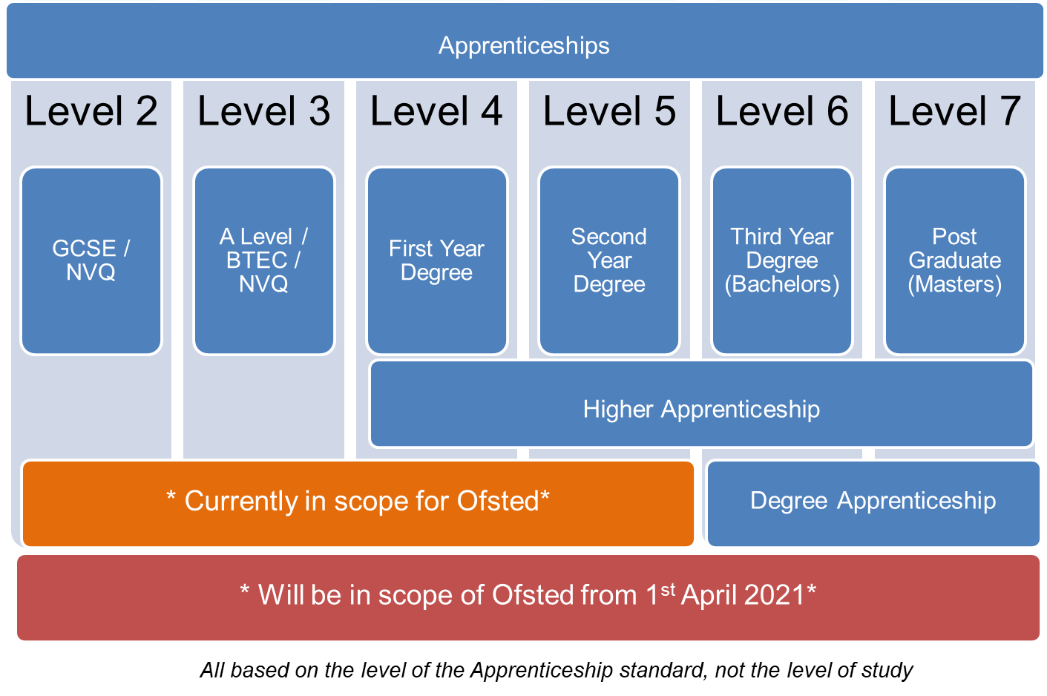
The Ofsted Landscape

Slide 4
Cultural Alignment and Expectations
Adult Learners
Andragogy, See Knowles 1983
Self-directed, autonomous and internally motivated
Learn by experience and problem-centred
Informal situations and equal status
Heutagogy: self constructed learning in a context of social, economic and technological flux
(e.g. see Hase & Kenyon, 2000)
The OfSTED perspective?
Are you an active citizen?
Q. Who is your Safeguarding Officer?
Where is mutual respect in the curriculum?
Q. Are you mentally Healthy?
Q. Do you receive careers advice?
Notes:
No I am on Furlough, or alternatively, managing the logistics for PPE distribution across England - bit busy
Has he got the vaccines?
If I mute my camera can I send a work email?
How can I increase my Wifi bandwidth?
I already have a job... Can anyone help my child with GCSE maths – He hasn’t got an exam coming up so needs to prepare.

Slide 5
Reflections on the journey Value from the Interim visits during COVID-19?
Intent – Implementation – Impact
Overcoming Challenges:
Digital Delivery: Innovation -v- Inertia
Staff Priorities: Initiatives -v- Retrenchment
On-line Progress Reviews: Transparency -v- Tick-box
On-Line Safety: Contextualisation -v- Token gesture

Slide 6
Reflections on the journey Value from the Interim visits during COVID-19?
Action Research: Stepping up to on-line delivery
Key Considerations:
On-Boarding and Building Community
Maintaining Trust and Confidentiality
Balancing Flexibility with Compliance
Teaching Models for Blended Delivery of Work-Based Learning:
Experiential Workshops for KSB Evidence
Peer to Peer Story Telling
Simulation for Work-Based Learning

Slide 7
As OfSTED scope expands, how do you prepare in a large and diverse university?
Leadership & Management
Operations/Departmental Manager
Chartered Manager
Senior Leader
Supply Chain Leader
Building & Surveying
Quantity Surveyor
Building Surveyor
Commercial Property / Valuation Surveyor
Chartered Town Planner
Construction Site Supervisor & Manager
Construction Design Manager
Architect
Town Planner
Health & Social Care
Health and Social Care
Social Worker
Occupational Therapy
Physiotherapy
Healthcare Science Practitioner
Advanced Clinical Practitioner
Diagnostic Radiography
Academic Professional
Post Graduate Academic Award
Digital & Technology
Digital & Tech Solutions Professional
Software Engineer
Business Analyst
Cyber Security Analyst
Data Analyst
IT Consultant
Network Engineer
Digital & Tech Solutions Specialist
Software Engineer
Data Analyst
Food & Drink Sectors
Food Technologist
Food Engineering
Packaging Professional
Policing
Police Constable DA
Engineering
Mechanical
Electrical
Manufacturing
Materials
Rail Engineering
Under development
(subject to approval)
Paramedic Practice
Registered Nurse
Teacher
Creative Digital

Slide 8
Education Inspection Framework (EIF) Extract:
The curriculum should support learners to develop their knowledge and skills beyond the purely academic, technical or vocational. This judgement evaluates the provider’s intent to provide for the personal development of learners, and the quality of the way in which it does this.
developing responsible, respectful and active citizens who are able to play their part and know how to become involved in public life
developing and deepening learners’ understanding of the fundamental British values of democracy, individual liberty, the rule of law and mutual respect and tolerance
promoting equality of opportunity so that all learners can thrive together, understanding that difference is a positive, not a negative, and that individual characteristics make people unique
promoting an inclusive environment that meets the needs of all learners, irrespective of age, disability, gender reassignment, race, religion or belief, sex or sexual orientation, relationship status or pregnancy
developing learners’ character, which we define as the set of positive personal traits, dispositions and virtues that informs their motivation and guides their conduct so that they reflect wisely, learn eagerly, behave with integrity and cooperate consistently well with others. This gives learners the qualities they need to flourish in our society
developing learners’ confidence, resilience and knowledge so that they can keep themselves mentally healthy
developing learners’ understanding of how to keep physically healthy and maintain an active lifestyle
providing an effective careers programme that offers advice, experience and contact with employers to encourage learners to aspire, make good choices and understand what they need to do in order to reach and succeed in their chosen career
supporting readiness for the next phase of education, training or employment so that learners can make the transition to the next stage successfully.
Ofsted will look for that integration by asking your Apprentices
We need to SEE this in curriculum

Slide 9
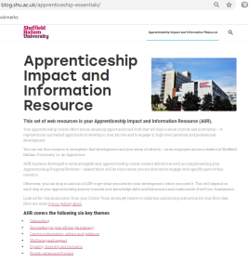
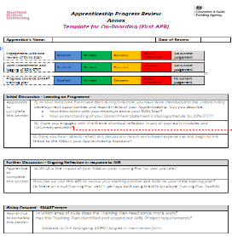
Scheme to Embed Essentials SEE: 6 themes for structure
Integrated Implementation...
3 methods:
Curriculum
Essentials contextualised by subject
On-Boarding
Wellbeing and Safeguarding
Succeeding in your OTJT
Equality Diversity and Inclusion
British Values and Prevent
Careers Guidance
AIIR (on-line resource)
Developmental tools, linked to job role
APR - Annex documents
Discussion
Reflection
Action

Slide 10
Easy wins to build on...
Town Planner: British values including Democracy and rule of law
Engineering: professional reports to be written - targets for Literacy development.
The use of statistics in quantitative research
Mathematical angle in anatomy (Physiotherapy)
Mathematical development in finance modules
Mathematical development in statistical research support
Prevent in Police Constable!!
Safeguarding in all Healthcare
Law (British Values) crops up everywhere!
On-Line Safety in research methods
EDI in all reflective Practice modules
Values in 360 ECR reports
Career Development (advice) in Professional Development / E-portfolio sessions

Slide 11
OfSTED Feedback: Staying Safe On-Line in Curriculum... L4 Construction ongoing work:
Professional Practice Module
WB Project
(Safe & ethical research)

Slide 12
Apprenticeship Progress Review Annex Documents
WBL Coaches use one Thematic Annex for each review to drive coaching conversations that build and strengthen the impact from curriculum
Connect to curriculum
Reflect on experience (AIIR)
E.g. Democracy
Drive KSB Development

Slide 13
Integration of Delivery through SEE Toolkit
Agree Curriculum Scheme to Embed Essentials
WBL Coach schedules the proposed themes for APRs
ACL and WBL Coach meet to agree how to release AIIR
Notes:
The SCHEME enables a Course Leader to utilise what is already happening, to identify module leaders who can adjust their delivery and language with minimal work, but good communication.
The SCHEME enables a WBL Coach to reinforce messages and actions. They can reflect the curriculum and ongoing work place experience to set thematic targets which link back to the KSBs.
The SCHEME is supported by the timely release of AIIR to help draw the links through activities and information.

Slide 14
Preparing the Portfolio for Inspection Lessons Learned and Applied
Some conclusions:
OfSTED are learning to adapt a child-centred compliance framework to a fluid academic community that may sometimes has less vocational knowledge than the “learners in the room”.
HE Adaptation is resource intensive, but it can have remarkably positive impact
(“... Hey we should do this for all 30,000 learners!”)
The interim visit during COVID-19, was proportionate and acted as a focus for review and evaluation. Some staff may now think they are OfSTED ready, but have yet to experience full “triangulation”.
Embedding EIF in 50 courses has meant creating a strategic approach that drives the minutiae in it’s implementation... Academic community are key to realising impact.

