Slide 1
Apprenticeship Delivery Internal and External IAG
Sam Moorwood
Head of Work Based Learning
Designated Safeguarding Officer
Objectives for this session
Propose and start a Subcontractor Compatibility Review, to:
Introduce SHU guidance documents / resources
Review the level of compliant / consistent delivery
Gather feedback to enhance the resources and shared practice
Identify SMART actions for all parties

Slide 2
Apprenticeship Delivery Internal and External IAG
Sam Moorwood
Head of Work Based Learning
Apprenticeship Delivery Guide

Slide 3
Teaching Assessment Essentials
A suite of staff blogs
Course Delivery Guide
- Blended Learning
Apprenticeships
Apprenticeship Delivery Guide
Apprenticeships

Slide 4
Teaching Assessment Essentials
A suite of staff blogs
Course Delivery Guide
- Blended Learning
Apprenticeships
Apprenticeship Delivery Guide
Apprenticeships
Apprenticeships
Sharepoint Site
(Governance & Operational)
Attendance
Safeguarding
Reporting
WBLC resources
etc.

Slide 5
Teaching Assessment Essentials
A suite of staff blogs
Course Delivery Guide
- Blended Learning
Apprenticeships
Apprenticeship Delivery Guide
Apprenticeships
Apprenticeships
Sharepoint Site
(Governance & Operational)
Attendance
Safeguarding
Reporting
WBLC resources
etc.
SEE
(Scheme for Embedding Essentials)
Preparing for OfSTED:
On-Boarding, BV, Prevent, Careers, Safeguarding, 20% OTJT, EDI...
AIIR
(external)

Slide 6
Apprenticeship Resources and IAG
Internal:
Here is the SHU Apprenticeship Delivery Guide found in the Apprenticeship Teaching and Assessment Essentials page.
This is internal guidance particularly aimed at Apprenticeship Course Leaders and Work Based Learning Coaches, but relevant for all academic and professional service staff.
Within the TAE you can find the specific resources for the Scheme To Embed Essentials.
For advice and guidance documents in relation to Governance and Operational matters such as Furlough, Breaks in study, latest news, etc. BESE Apprenticeships Sharepoint Site
The Apprenticeship Reporting page is the location to check your cohort / individual learner progress – this data supports the monthly ACL / WBL-Coach meetings and also drives Assessment Board (Apprenticeship) outcomes. HARD COPES DISCUSSED WITH SUB-Cs
For specific guidance on how to embed On-line activities in a blended delivery model, see the University Course Delivery Guide and be sure to visit the Apprenticeship section
External (for Apprentices and Employers):
Finally, here is the Apprenticeship Impact and Information Resource (AIIR) - This is an external facing web-page for Apprentices and their employers, to support them through On-Boarding and their whole Apprenticeship Journey. Apprenticeship Course Leaders and WBL Coaches plan the release of specific aspects of AIIR in a timely way, right through to Gateway and End Point Assessment.
Also note we produce a monthly News-letter promoting specific aspect of AIIR.

Slide 7
Apprenticeship Delivery Guide (as at Feb 2021)
Introduction - Purpose of the Handbook
SHU Apprenticeship Delivery standards
Planning for Delivery
Agreeing workload and Cohorts for WBL Coaches
On-boarding - Skills Scan, RPL, Commitment Statement
Welcome Evenings (and Information Evenings)
Apprenticeship Essentials for Course Induction
SHU Standards During Delivery
Apprenticeship Progress Reviews
Monthly Apprentice Progress Meetings (B-R-A-G)
Gateway Sign-offs and Progression Boards
Withdrawal of Apprentices
Safeguarding Matters and Wellbeing
Additional Learning Needs
Apprenticeship Essentials – Compliant Curriculum
Assessment Practice for Work Based Learning
ACLs and Academic Advisers in Apprenticeship Delivery
20% Off-The-Job-Training
Gateway Period and End Point Assessment - Delivery
Course Review, Assessment Boards - Quality
Employer Feedback
Celebrating Success
Appendices:
A- Course Leader Role Description
Work Based Learning Coach Job role
Apprentice Progress Review Template
Template for 20% OTJT Calculation
Peer Observation Template
Attendance Monitoring Baseline Process
Template for Apprenticeship Case Studies
Apprenticeship Withdrawal Form
Standard Letter / Email for Withdrawal
Assessment Board (Apprenticeship) Agenda
KSB Milestones
Academic Adviser Model for Apprenticeships
PROPOSED: Adjustments to duration & TNP

Slide 8
SHU Apprenticeship Delivery Guide
Notes on continual improvement
Updated Attendance Baseline
Safeguarding Practice note to follow on (nb. New on-line referral process!)
APR forms – going to MAYTAS form on line
DG Section 15: Now part of SEE (APR Annex docs available/ may go on-line)
Mentor section of AIIR – area for development
Revised Induction Slides build on the delivery guide (found in TAE)
Also new employer transfer form
Separate guide on WBL Assessment Practice (in TAE)
Peer Observation form – important for SubC!
Separate Access to Safeguarding Practice for DSO and WBL Coach
Adjustments to duration and TNP going through governance
Apprenticeship CL role descriptor to be reviewed
Apprenticeship withdrawal form – under review for on-line forms and process
Assessment Board (Apprenticeship) Agenda – now called Apprenticeship Progression Boards – amendments required.
Sub Contractor Community of Practice
NCEDA: 2 X conference delivery / monthly letters
EPA grading criteria?

Slide 9

Teaching and Assessment Essentials (TAE) for Apprenticeships:
Main structure
Apprenticeship Delivery Guide hosted here
Sub-structures under each tab

Slide 10
“Course Delivery Principles” - Blended Learning
Apprenticeship section
Key Considerations:
On-Boarding and Building Community
Maintaining Trust and Confidentiality
Balancing Flexibility with Compliance
Teaching Models for Blended Delivery of Work-Based Learning:
Experiential Workshops for KSB Evidence
Peer to Peer Story Telling
Simulation for Work-Based Learning

Slide 11
Apprenticeships
Scheme for Embedding Essentials (SEE)
Apprenticeship Essentials
What are they?
These are matters which need to be included in the apprenticeship to comply with rules that are established to protect the Apprentice and secure a positive learning journey to the End Point Assessment.
They are driven by:
ESFA Funding rules and the Training Provider Delivery Contract
External Quality Assurance requirements
(Office for Students = OfSTED and QAA) - Education Inspection Framework
SHU Delivery Guide (Agreed at AWBL Steering Group)
Support ACIP - 9th October 2020

Slide 12
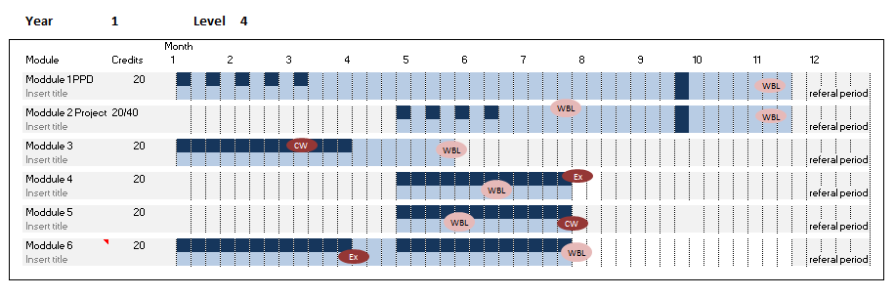

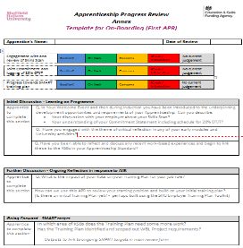
The Essentials are structured for implementation under 6 themes
SHU Delivery Guide states:
The Scheme to Embed Essentials (SEE) is through integrated 3 methods:
Curriculum
Essentials contextualised by subject
On-Boarding
Wellbeing and Safeguarding
Succeeding in your OTJT
Equality Diversity and Inclusion
British Values and Prevent
Careers Guidance
AIIR (on-line resource)
Developmental tools, linked to job role
APR - Annex documents
Discussion
Reflection
Action

Slide 13
Integration of Delivery through SEE Toolkit
Embedding Apprenticeship Essentials | Higher and Degree Apprenticeships (shu.ac.uk)
Agree Curriculum Scheme to Embed Essentials
WBL Coach schedules the proposed themes for APRs
ACL and WBL Coach meet to agree how to release AIIR
The SCHEME enables a Course Leader to utilise what is already happening, to identify module leaders who can adjust their delivery and language with minimal work, but good communication.
The SCHEME enables a WBL Coach to reinforce messages and actions. They can reflect the curriculum and ongoing work place experience to set thematic targets which link back to the KSBs.
The SCHEME is supported by the timely release of AIIR to help draw the links through activities and information.

Slide 14
AIIR
Apprenticeship Impact and Information Resource
This is an external facing web-page for Apprentices and their employers, to support them through On-Boarding and their whole Apprenticeship Journey.
Apprenticeship Course Leaders and WBL Coaches plan the release of specific aspects of AIIR in a timely way, right through to Gateway and End Point Assessment.

Slide 15
AIIR
Apprenticeship Impact and Information Resource
key response to EIF:
KSBs in curriculum
Citizenship
British values of democracy, individual liberty, the rule of law and mutual respect and tolerance
Equality of opportunity
Inclusive environment
Personal development
Confidence, resilience mental health
Physically healthy and active lifestyle
Careers programme and choices
Progression and transition
We need to SEE this in curriculum
Ofsted will look for that integration

Slide 16


Slide 17
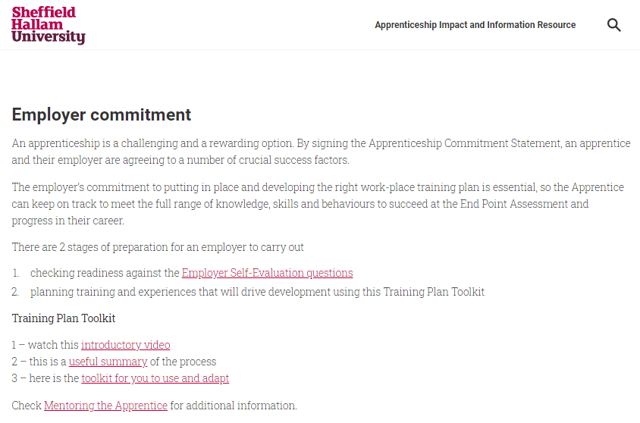

Slide 18


Slide 19
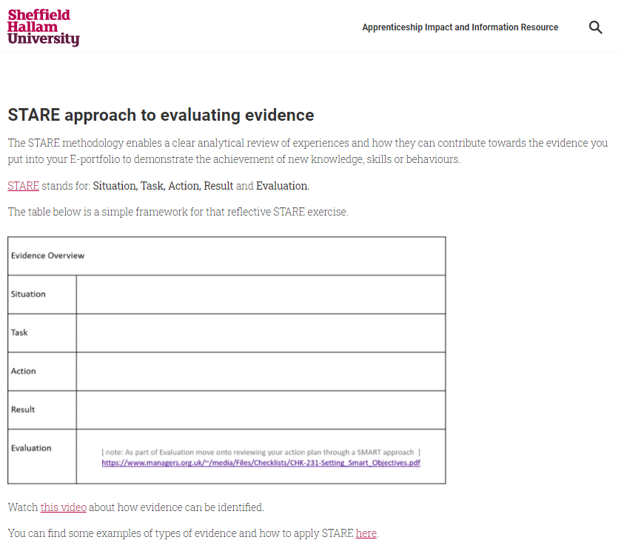

Slide 20
Teaching Assessment Essentials
A suite of staff blogs
Course Delivery Guide
- Blended Learning
Apprenticeships
Apprenticeship Delivery Guide
Apprenticeships
Apprenticeships
Sharepoint Site
(Governance & Operational)
Attendance
Safeguarding
Reporting
etc.
WBLC resources
SEE
(Scheme for Embedding Essentials)
Preparing for OfSTED:
On-Boarding, BV, Prevent, Careers, Safeguarding, 20% OTJT,
AIIR
(external)

Slide 21
Next steps
Please complete the form here:
Subcontractor compatibility check (TAE)
Please return the form to s.moorwood@shu.ac.uk
Focus on the SHU Delivery Guide
All other aspects flow from there to provide more detail at academic delivery, operational compliance and WBL best practice.
Form is designed to enable an overview of consistency, but...
This is a two way process:
SHU responsibility as the main provider
Subcontractor to meet baseline standards.
Community of practice to enhance collaborative delivery

Slide 22
Apprenticeship Delivery Guide
Introduction - Purpose of the Handbook
SHU Apprenticeship Delivery standards
Planning for Delivery
Agreeing workload and Cohorts for WBL Coaches
On-boarding - Skills Scan, RPL, Commitment Statement
Welcome Evenings (and Information Evenings)
Apprenticeship Essentials for Course Induction
SHU Standards During Delivery
Apprenticeship Progress Reviews
Monthly Apprentice Progress Meetings (B-R-A-G)
Gateway Sign-offs and Progression Boards
Withdrawal of Apprentices
Safeguarding Matters and Wellbeing
Additional Learning Needs
Apprenticeship Essentials – Compliant Curriculum
Assessment Practice for Work Based Learning
ACLs and Academic Advisers in Apprenticeship Delivery
20% Off-The-Job-Training
Gateway Period and End Point Assessment - Delivery
Course Review, Assessment Boards - Quality
Employer Feedback
Celebrating Success
Appendices:
A- Course Leader Role Description
Work Based Learning Coach Job role
Apprentice Progress Review Template
Template for 20% OTJT Calculation
Peer Observation Template
Attendance Monitoring Baseline Process
Template for Apprenticeship Case Studies
Apprenticeship Withdrawal Form
Standard Letter / Email for Withdrawal
Assessment Board (Apprenticeship) Agenda
KSB Milestones
Academic Adviser Model for Apprenticeships
Adjustments to duration & TNP

Slide 23
Degree of delivery compliance
The form asks for a response on the Sub-contractor’s Prospects for Implementation:
We are well aligned and precise
We have a good equivalent
Small adjustments needed
Significant work needed
Feasibility under question
Feedback regarding rationale and process
Proposed / potential action

Slide 24
Next steps
Please complete the form here:
Subcontractor Compatibility Review (TAE)
Please return the form as agreed to s.moorwood@shu.ac.uk
Proposed Agenda for next workshop:
Feedback
Overall consistency
Areas to address
opportunities
Jointly agree priority actions
Process for collaborative support and community of practice

