Slide 1
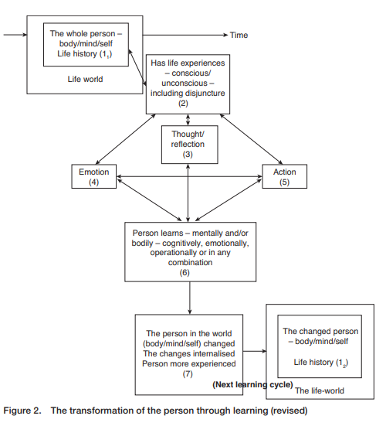
On Line Distance Learning for Work Based Learning - Preparatory activity Reflections from Jarvis...
Jarvis offers his version of learning expertise
A revised visual is found in this 2016 paper:
https://doi.org/10.1080/02660830.2015.11661676
One becomes an expert not simply by absorbing explicit knowledge of the type found in text-books, but through experience, that is, through repeated trials, ‘failing, succeeding, wasting time and effort ... getting a feel for the problem, learning when to go by the book and when to break the rules’. Human experts gradually absorb ‘a repertory of working rules of thumb, or “heuristics”, that combined with book knowledge, make them expert practitioners’. This practical, heuristic knowledge, as attempts to simulate it on the machine have shown, is ‘hardest to get at because experts – or anyone else – rarely have the self-awareness to recognize what it is. So it must be mined out of their heads painstakingly, one jewel at a time.’
Nyiri, J. (1988) ‘Tradition and practical knowledge’, in J. Nyiri and B. Smith (eds)
Practical Knowledge: Outlines of a Theory of Traditions and Skills. London: Croom Helm.
Consider this proposition (for discussion in a facilitated section of the event):
You are an expert in Work Based Learning and already have the skills to develop great on-line delivery, whilst the University has the platforms and support infrastructure to enable an outstanding transition…

