Slide 1
First Batch: Introducing Apprenticeships

Slide 2
FOR FURTHER CONSIDERATION...
WHAT ABOUT TAE stuff?
EMPLOYER TRAING PLAN TOOOLKIT
FAQ ON RPL...

Slide 3
Mentor Induction
Welcome
Apprenticeships
What are they?
How do they work?
Structure of Delivery
Roles and responsibilities
etc
etc
Close
Review content according to time and purpose

Slide 4







Slide 5
Work Based Learning
Higher and Degree Apprenticeships

Slide 6


What's available?
Leadership & Management
Operations/Departmental Mgr
Chartered Manager
Senior Leader
Supply Chain Leader
Building & Surveying
Quantity Surveyor
Building Surveyor
Commercial Property / Valuation Surveyor
Chartered Town Planner
Construction Site Supervisor & Manager
Construction Design Manager
Architect
Town Planner
Health & Social Care
Health and Social Care
Social Worker
Occupational Therapy
Physiotherapy
Healthcare Science Practitioner
Advanced Clinical Practitioner
Diagnostic Radiography
Academic Professional
Post Graduate Academic Award
Digital & Technology
Digital & Tech Solutions Professional
Software Engineer
Business Analyst
Cyber Security Analyst
Data Analyst
IT Consultant
Network Engineer
Digital & Tech Solutions Specialist
Software Engineer
Data Analyst
Food & Drink Sectors
Food Technologist
Food Engineering
Packaging Professional
Policing
Police Constable DA
Engineering
Mechanical
Electrical
Manufacturing
Materials
Rail Engineering
Under development
(subject to approval)
Paramedic Practice
Registered Nurse
Teacher

Slide 7
The Apprenticeship Landscape
Level 2
GCSE / NVQ
Level 3
A Level / BTEC / NVQ
Level 4
First Year Degree
Level 5
Level 6
Level 7
Second Year Degree
Third Year Degree (Bachelors)
Post Graduate (Masters)
intermediate Apprenticeship
Advanced Apprenticeship
Higher Apprenticeship
Degree Apprenticeship

Slide 8
The Apprenticeship Landscape
Level 2
GCSE / NVQ
Level 3
A Level / BTEC / NVQ
Level 4
First Year Degree
Level 5
Level 6
Level 7
Second Year Degree
Third Year Degree (Bachelors)
Post Graduate (Masters)
intermediate Apprenticeship
Advanced Apprenticeship
Higher Apprenticeship
Degree Apprenticeship

Slide 9
Apprenticeships
Apprenticeships estimated to have started in the 12th Century in Britain, Wikapaedia
Born in 1475 Michelangelo considered to be one of the greatest artists of all time learned his craft as an apprentice, Britannica
England's National Apprenticeship System was introduced in 1563
Various re-purposing and rebranding during 20th century moving into "modern apprenticeships, 1993. Commonslibrary.parliament.uk
Germany consistently outperforms Euriopean neighbours in terms of productivity and employment rates - nearly two thids of shool leavers progress through Apprenticeships, BBC News 2011
Higher Apprenticeships 2010-11 ... and then Degree apprenticeships introduced in 2015 IFATE

Slide 10
What is an Apprentice?
Who will you become?
How will get there?
Sometimes apprenticeship can be as simple as asking a senior executive to interview a few VP level candidates on your behalf and observing, learning from the process, and starting the process of developing judgement.
Figuring out how to become an apprentice time and again is a key to developing great judgement.
https://tomtunguz.com/apprenticeship/

Slide 11
Batch 2:
The Apprenticeship Journey

Slide 12

What is an Apprentice?
Who will you become?
How will get there?
?
e
Commitment
Statement

Slide 13




On the job training
and experience
e

Slide 14
e

Slide 15
EPA
120
e
120
20+ 20 + 20 + 20 + 20 +20 = 120

Slide 16
e
Attendance:
Day release:
Surveying
Engineering

Slide 17
e
Attendance:
Block release:
Management

Slide 18
EPA
6 month
Gateway
120 credits
Level 6
18 months
EPA
120 credits
Level 5
18 months
e
6 months Gateway
120 credits
Level 4
18 months
Attendance:
Blocks of learning
Construction

Slide 19
e
Attendance:
Accelerator then
Block release:
Digital

Slide 20
e
Attendance:
Block release
+
Placement
Occupational Therapy
Physiotherapy

Slide 21
e
Attendance:
Block release
+
Placement
Occupational Therapy
Physiotherapy

Slide 22
Quarterly reviews to support progress and find the links between your job role and the degree learning and assessment
e

Slide 23

Work-place Mentor
(Possibly your line manager)
e
Work-Based-Learning Coach
(SHU)

Slide 24
Work place Mentor
e
Work-Based-Learning Coach
(SHU)

Slide 25
Work-place Mentor
Placement Supervisor
e
Work-Based-Learning Coach
(SHU)

Slide 26

e
Assessment is both theoretically rigorous
and integrated with your Work-Based Learning

Slide 27
Work-place
Mentor
Work-Based-Learning Coach
(SHU)

Slide 28
Work Based Learning
Higher and Degree Apprenticeships
Welcome and Good Luck

Slide 29
What does great delivery look like for an Apprentice?
Line Manager
HR
Work based mentor
Friends, family (RotW)
Apprentice
Student
pastoral support
Professional Body
WBL coach/tutor
Notes:
Note. RotW = Rest of the World.
Brief discussion on the challenges facing a modern degree apprentice.
Potential for confusion. Strong and clear support networks are needed.
A joined up approach to delivery with genuine employer - provider partnership.

Slide 30
What does great delivery look like for an Apprentice?
This shape?

Slide 31
Agile and flexible facilitation
for great delivery...
I can discuss a target with my coach
This tells me I am developing
I can negotiate some new experience with my mentor
My experience compares to the theory and I can evaluate both
Story telling
I can make mistakes, learn and form better judgements
I can see my KSBs, their evidence and am confident about EPA
This gives me confidence to work with peers

Slide 32
Batch 3:
Apprenticeship Compliance
DO NOT REMOVE FROM INDUCTION

Slide 33
E-Portfolios Support
Gateway requirements
Specific to Apprenticeship (KSBs /Case Studies)
Employer and Provider (SHU) sign off readiness
Incudes:
Safeguarding obligations
Prevent Duty
British Values
English and Maths Certificates
20% off the job learning

Slide 34
E-Portfolios Support
Gateway requirements
Safeguarding obligations
Safeguarding is about knowing how to keep yourself and others safe from physical, psychological, emotional and sexual harm and free from bullying and intimidation (including on-line).
You can contact: your employer safeguarding officer, your WBL Coach, an academic, your course leader or student support services...
Staying Safe On-Line - Information in Induction

Slide 35
E-Portfolios Support
Gateway requirements
Safeguarding obligations
An employer is legally responsible for Health and Safety at work.
In some instances ("vulnerable adults") (or for any other reason) SHU will exercise a duty of care and is required to ensure the employer has the appropriate measures in place, offering the apprentice the opportunity to raise any concerns.
Stay safe on-line - Guidance in your induction

Slide 36
E-Portfolios Support
Gateway requirements
Prevent Duty
Apprenticeship funding requires all parties to work together in support of the Prevent Agenda. This is a Government initiative to address extremist behaviour and radicalisation of people to consider, encourage or commit illegal an violent acts against other people in society.
This is not limited to any single group in society, but extends to all "hate crimes".

Slide 37
E-Portfolios Support
Gateway requirements
British Values
...underpin the principles of a democratic and free society:
Recognition and respect for the democratic process
Respect for the rule of law
Freedom of speech
Respect and tolerance of others

Slide 38




Equality Diversity & Inclusion
https://www.shu.ac.uk/about-us/equality-and-diversity
https://www.shu.ac.uk/about-us/governance-and-strategy/governance/our-student-charter
Our Equality Objectives set our vision to be recognised as a University that adds value to the futures of all our students, staff and partners by drawing on their unique and diverse talents and providing an environment that allows everyone to flourish and succeed

Slide 39
Equality Diversity & Inclusion
Learning Opportunities:
Read the SHU Student Charter
Research and discuss Barratt policies
Awareness: The Equality Act in construction
Quarterly Review: Behaviours in the standard...
When have you felt challenged?
WBL Module: Unconscious bias

Slide 40
Behaviours in the Standard:
Equality Diversity & Inclusion
INSERT
INSERT
INSERT
Quarterly Review:
Discuss a situation when judgement was needed... How did you feel?... What did you do?... What was the impact?... What evidence for E-portfolio?... What plans/targets for development?
WORK TO DO

Slide 41

Careers IAG:
At the start:
Build on your Suitability Interview (Skills Scan and career aspirations...)
During the Apprenticeship
Development of KSBs & PPD modules
Sector leading careers guidance:
https://www.shu.ac.uk/current-
students/careers-and-employability
Bespoke Apprenticeship resource: https://www.abintegro.com/u/rbrzg7ou
At the end
WBL2 Project submission: Organisational context and aspirations
Adviser workshop (1:1 bookings...
Alumni access to support for 5 years:
https://www.shu.ac.uk/alumni/careers-support

Slide 42

20% off the job learning
Formal Guidance from Government
Flowchart PDF
Off-the-job-Myths-Facts-130919.pdf
20% Government Guidance and Examples

Slide 43
Batch 4:
Explanation / Illustrations for 20% Off the Job training

Slide 44
DATA COLLECTION FORM...
UNDER CONSTRUCTION
STANDARD INDUCTION APPROACH SEE DELIVERY GUIDE
SLIDES AVAILABEL ON TAE

Slide 45
Off the Job Training -
Standard Assumptions
Where and when (and how?)
will this take place?

Slide 46

20% Off the Job Learning Breakdown
WORK TO DO - EXAMPLE ONLY

Slide 47
Off the Job Training -
Standard Assumptions
Attendance based 100%
WBL Project activity 50%
Planned Training or shadowing dedicated to KSBs 100%
Planned experience (deeper/broader than getting job done) 25-75%
Incidental and responsive experience (breadth and depth) 25-75%

Slide 48
Off the Job Training, Category 1
Attendance / Study Based
Attendance at the Provider, including lectures, seminars, use of library, 1:1 tutor activity. Also time set aside to work on assignments
Assumption:
Log 100% of time in attendance and learning.

Slide 49
Off the Job Training, Category 1
Attendance / Study Based
Attendance at the Provider, including lectures, seminars, use of library, 1:1 tutor activity. Also time set aside to work on assignments
Example:
Following a lecture (1 hour) several learners met independently to talk about a group project (30 mins). Later in the working week the apprentice was allowed 1 hour to draw up an assignment structure and engage in a collaborate session with peers (1 hour)

Slide 50
Off the Job Training, Category 2
WBL Project Activity
Projects that are undertaken in the work place that are a key feature of a work based learning module with the Provider.
Assumption:
Log 50% of work place time engaged with the work project.

Slide 51
Off the Job Training, Category 2
WBL Project Activity
Projects that are undertaken in the work place that are a key feature of a work based learning module with the Provider.
Example:
A construction apprentice is conducting an academic project to evaluate the impact of a new process to engage subcontractors in a considerate construction scheme. During the week the apprentice reviews responses to a consultation survey. These will have an impact on the employer's process to manage site activities. Of the ten hours spent on this activity 50% (5 hours) are logged as off the job learning.

Slide 52
Off the Job Training, Category 3
Planned Training or Shadowing
The activity would not have taken place at all in the job role if the activity was not helpful in addressing some competence area of the standard (knowledge, skills, behaviours).
Assumption:
Log 100% of work place time engaged with the activity.

Slide 53
Off the Job Training, Category 3
Planned Training or Shadowing
The activity would not have taken place at all in the job role if the activity was not helpful in addressing some competence area of the standard (knowledge, skills, behaviours).
Example:
A health care professional takes time out from his duties to observe a procedure and the way in which colleagues are able to use skills and behaviours to support the medical team. The whole two hours are attributed as time spent learning critical skills and behaviours to progress towards the End Point Assessment

Slide 54
Off the Job Training, Category 4
Planned Experiential Learning
The activity has been made available in a planned way, to a greater depth and scope than would have normally occurred in the role, so the apprentice can ensure one or more knowledge, skills and/or behaviours are progressed.
Assumption:
Log between 25% and 75% of the hours
depending on how much additionality took place beyond simply getting the job done.

Slide 55
Off the Job Training, Category 4
Planned Experiential Learning
The activity has been made available in a planned way, to a greater depth and scope than would have normally occurred in the role, so the apprentice can ensure one or more knowledge, skills and/or behaviours are progressed.
Example:
An engineering apprentice spends one day of her week on a rotation scheme working with colleagues in the design team to understand and gain knowledge of how the business commercialises its product development. 40% of the time is judged to be getting the job done, so 60% is attributed to off the job learning as the activity is wider in scope than the apprentice's day job. They progress towards the End Point Assessment.

Slide 56
Off the Job Training, Category 5
Incidental Experiential Learning
The activity was responsively extended beyond what was necessary to get the job done, to ensure that naturally occurring attainment of KSBs was enhanced and assured.
Assumption:
Log between 25% and 75% of the hours
depending on how much additionality took place beyond simply getting the job done.

Slide 57
Off the Job Training, Category 5
Incidental Experiential Learning
The activity was responsively extended beyond what was necessary to get the job done, to ensure that naturally occurring attainment of KSBs was enhanced and assured.
Example:
A management apprentice conducts financial analysis of a restructure. His manager spontaneously invites the apprentice to join her at a senior management team where the data will be reported and discussed. It is not necessary to attend, but the apprentice is able to continue his ongoing analysis with a deeper knowledge of the context in which he is to conduct his work. He records 75% of the 2 hour meeting as off the job learning. (25% was spent reviewing the data he produced in the first place!)

Slide 58
Batch 5:
What to expect from SHU
(Generic)

Slide 59
Your Apprenticeship -
What to expect from SHU
Access to our excellent facilities and expert staff - an excellent experience
Sector focussed Work Based Learning Coaches
Regular Information events to discuss how we can work together
Our Work Based Learning Approach:
Personal and Professional Development embedded combined with 3-way review to embed portfolio work for the End Point Assessment
Project based learning to help learners gain additional off-the job training through their work role and to encourage early work-place impact
Notes:
Employers:
Access to recruitment expertise and talent matching, including eligibility advice and free exhibition space at our recruitment events and web-based presence (for starters)
Take your training to the next level and identify a range of skills needs and bespoke solutions -Explore placements, internships, knowledge partnerships and consultancy options

Slide 60
Your Apprenticeship -
What to expect from SHU
E-Portfolios bespoke to each apprenticeship to record evidence of progress
We will provide advice and guidance to help identify 20% off the job learning
Free on-line mentor development resource to support your apprenticeship supervisors
Join our Apprenticeship Ambassador scheme to support engagement and reputation
For employers, Expertise on funding and support to agree our apprenticeship contract and commitment statement as well as support recruiting your next Apprentice, or other skills/ business needs
Notes:
Employers:
Access to recruitment expertise and talent matching, including eligibility advice and free exhibition space at our recruitment events and web-based presence (for starters)
Take your training to the next level and identify a range of skills needs and bespoke solutions -Explore placements, internships, knowledge partnerships and consultancy options

Slide 61
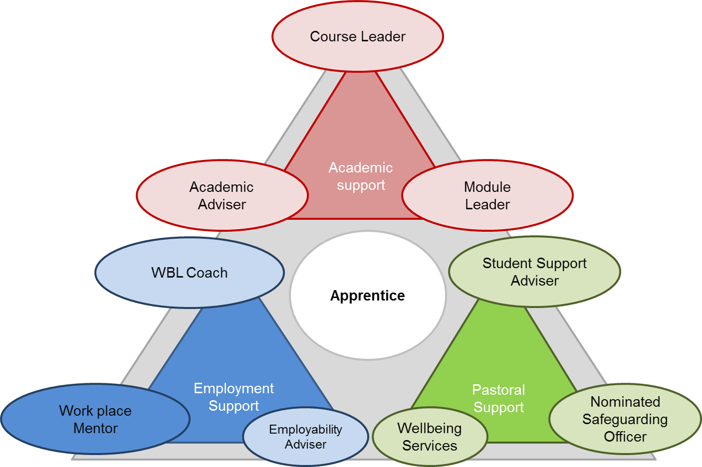
Help is there
(Information
Advice and
Guidance)
https://students.shu.ac.uk/lits/it/documents/pdf/Staying%20Safe%20Online.pdf

Slide 62
NOTE: NEW DIAGRAM UNDER PRODUCTION

Slide 63
INSERT EMPLOYER LOGO,
KEY ROLES AND NAMES
People Managers
Line Managers
WORK TO DO

Slide 64
INSERT EMPLOYER LOGO,
KEY ROLES AND NAMES
People Managers
Line Managers
WORK TO DO

Slide 65
Special Educational Needs
INSERT FROM DELIVERY GUIDE

Slide 66
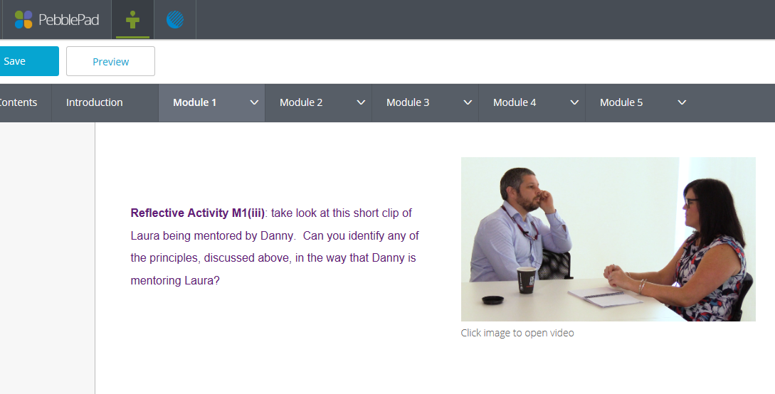

Your role as Mentor ...
Free Resource
Link
Please complete the feedback form
to receive an email from Pebblepad
Notes:
The SHU Mentoring Handbook
Hello Ian,
The password for your account on PebblePad at SHUMOOC has been reset.
Your updated account details are:
username: ianglover
password: jJ6LHHz9

Slide 67


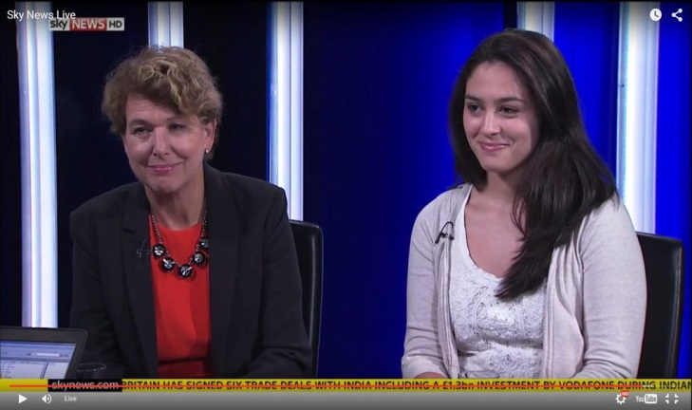
SHU Apprenticeship
Ambassador Scheme
Celebrating and promoting Apprenticeships
Your input can contribute towards 20% off-the-job learning
We can support applications for Apprenticeship awards

Slide 68
SHU Apprenticeship
Ambassador Scheme
This work could include:
Being interviewed for the local press/social media
Talking to Y13 students at a sixth form
Talking to employers at a business event
Is it a regular commitment?
How do I register my interest?

Slide 69
Planning Apprenticeship Progress
WORK TO DO - EXAMPLE ONLY

Slide 70
Planning Apprenticeship Progress
WORK TO DO - EXAMPLE ONLY

Slide 71
Batch 6:
What to expect from the programme
(AMMEND for Apprenticeship Standard)

Slide 72
The Standard:
https://www.instituteforapprenticeships.org/apprenticeship-standards/academic-professional/
End-point Assessment Methods The EPA uses the following assessment methods and should be undertaken in this order:
Academic Professional Practice Assessment
Professional Conversation
Written Submission
INSERT Link and INFO FOR SPECIFIC APPRENTICESHIP

Slide 73
Academic Practice Postgraduate Diploma
Pg Cert
Pg Cert
Pg Dip
Pg Dip
M1
M2
M3
M4
Taught Provision
Research+
CPD Unit
Dept. Based Learning and Project(s)
(supporting resources, mentoring, leadership development, conferences, specialist development)
Dept. Based Learning
INSERT DIAGRAM FOR SPECIFIC APPRENTICESHIP
On-boarding
Three Way Reviews and E-portfolio completion
Gateway
EPA
Apprenticeship Mechanisms
Hallam Academic Programme Apprenticeship
Progress Check Points
Three way review

Slide 74
Commitment Statement
WBL Coaches
  Digitally Supported
  Blended Delivery
Level 4
Intro Module | Intro Module | PPD WBL | Project WBL Discipline Focus | Discipline Mod
Level 5
Specialist Module | Specialist Module | PPD WBL | Project WBL Discipline Focus | Discipline Mod
INSERT DIAGRAM FOR SPECIFIC APPRENTICESHIP
Level 6
Specialist Module | Specialist Module | PPD WBL | Project WBL
Gateway
EPA

Slide 75
Delivery Schedule
INSERT DIAGRAM FOR SPECIFIC APPRENTICESHIP

Slide 76
Core Knowledge
1. A range of teaching, assessment and feedback methods used in higher education to support learning and achievement
2. How students learn and how research is conducted, within their own and related disciplines and in inter-disciplinary or transdisciplinary contexts.
3. The regulatory, administrative, financial and planning procedures, risk management, quality assurance and enhancement, and technological processes associated with effectiveness in their role in higher education.
4. Methods for evaluating the effectiveness of academic activities, such as teaching or the quality and impact of research.
5. How to engage with relevant professional bodies and other external organisations to support their work.
6. Innovative approaches to undertaking their work to create interest, understanding and enthusiasm among their students, funders or stakeholders
7. The application of technological processes associated with effectiveness in their role within the HE sector.
8. How to adapt delivery methods to support a range of needs.
9. The principles of reflective practice and the methods for applying reflective practice to their own professional development.
INSERT CORRECT KSBs IF REQUIRED FOR REFERENCE

Slide 77
Core Skills
1. Deliver higher education teaching of high quality through lectures, tutorials, practicals or seminars.
2. Use varying teaching styles depending on the learning environment and students’ needs.
3. Developing research questions and hypotheses prior to undertaking research.
4. Analysing, synthesising and using critical thinking in the conduct of research.
5. Supervision and mentoring of students and peers to develop knowledge in their subject discipline.
6. Manage their own continuing professional development (CPD) in subject disciplines and pedagogy, incorporating research, scholarship and professional practices.
7. Self-management through preparation and prioritisation, time management, responsiveness to change, and achieving a work-life balance.
8. Communicate orally and in writing and collaborate effectively, to manage people, processes or teams.
9. Use digital technologies effectively to develop and disseminate knowledge and understanding of subject disciplines.
10. Share ideas and evidence with students, peers, policy makers, private and public organisations, as well as collecting evidence of the impact of their work.
11. Implementing approaches to academic practice informed by equality and diversity.
INSERT CORRECT KSBs IF REQUIRED FOR REFERENCE

Slide 78
Core Values & Behaviours
1. Consider ethical, sustainable and inclusive practices and equality of opportunity to a professional standard.
2. Be mindful of one’s CPD in relation to career management, responsiveness to opportunities, networking, reputation and esteem.
3. Commit to CPD in relation to relevant contemporary issues such as: student employability and graduate employment destinations; ethics and sustainability, academic integrity, legal compliance and intellectual property, respect and confidentiality, and health and safety.
4. Consider evidence- informed approaches and the outcomes from research, scholarship and CPD to inform their own professional practice.
5. Be mindful of the wider context (policy, economic, societal, technological, legal, cultural and environmental) in which higher education operates, recognising the implications for professional practice.
6. Seek opportunities to network, to practise public engagement and to communicate effectively.
7. Be enthusiastic, self- confident, and self-reflective.
8. Persevere, have integrity, be prepared to take responsibility, to lead, mentor and supervise.
INSERT CORRECT KSBs IF REQUIRED FOR REFERENCE

Slide 79
Apprenticeship:
Rail and Rail Systems Senior Engineer (Degree)
All routes - Your choice of project and WBL assessments will provide focus and flavour during Level 4
INSERT CORRECT KSBs IF REQUIRED FOR REFERENCE

Slide 80
Apprenticeship:
Rail and Rail Systems Senior Engineer (Degree)
Route:
Electrical and Plant
(Includes Mechanical focus)
INSERT CORRECT KSBs IF REQUIRED FOR REFERENCE

Slide 81
Apprenticeship:
Rail and Rail Systems Senior Engineer (Degree)
Route:
Signalling &Telecommunications
INSERT CORRECT KSBs IF REQUIRED FOR REFERENCE

Slide 82
Apprenticeship:
Rail and Rail Systems Senior Engineer (Degree)
Route:
Track Pathway / Civil Pathway (Amey to confirm)
INSERT CORRECT KSBs IF REQUIRED FOR REFERENCE

Slide 83
Apprenticeship: Rail and Rail Systems Senior Engineer (Degree)
Level 4: Your choice of project and WBL assessments will provide focus
INSERT CORRECT KSBs IF REQUIRED FOR REFERENCE

Slide 84
Batch 7a:
Role of the Coach:

Slide 85

Work Based Learning Coaches

Slide 86
Work Based Learning Coaches (SHU)
Supporting the quality and efficiency of our Apprenticeship portfolio
Works with colleagues in departments to support sector-focussed programmes
Pre-join suitability interview: skills scan; career discussion - Is this the right programme?
The Skills Scan informs the starting position - Feeds PPD module + Review 1
Manage Progress Reviews - three-way discussions to support and plan
E-Portfolios: Focus on evidence of impact, targets for EPA and development
Negotiation, planning and monitoring of WBL Projects
Help employers to understand and meet their obligations
Feedback into academic practise and work place impact

Slide 87
WBL Coaches
- Apprenticeship Progress Reviews
We understand your starting point (Skills Scan)
We plan for and monitoring 20% Off The Job Training
Reviews set appropriately challenging targets (individualised SMART action plans).
linking up to careers advice in the employer and SHU (Abintegro)
welfare support, including attendance, safeguarding, staying safe online - referrals
opportunity for literacy and numeracy development
engagement with British Values, Prevent, Equality Diversity & Inclusion
E-portfolio supports progress to EPA

Slide 88
Discussion
The Journey to End Point Assessment
Chart progress against your Commitment Statement
Review progress of KSBs and actions at 3-way review
Support from SHU WBL Coach and work place mentor
Review at the Gateway period
Submit E-Portfolio for End Point Assessment
Some specific differences in each sector
What does good evidence look like?

Slide 89
Batch 7b:
Discussing Evidence, Projects and E-portfolios for EPA

Slide 90
What does good evidence look like?
Addressing each competency (KSB) in the standard:
Artefact 1
Thing 2
Stuff 3
Critical Reflection
+
+
+
E- Portfolio
End Point Assessment

Slide 91
What does good evidence look like?
Addressing each competency (KSB) in the standard:
Artefact 1
Thing 2
Stuff 3
Critical Reflection
+
+
+
Annotated Module Review form
HAP Assignment on LTA design
Discussion of learning and future action
Department (WBL) Project to address problem module
Problems were made in delivery!?
E.g. 65% mark for 30 credits on PGCert.
Evidence of further development and application in work ; showing leadership.
Reflective evaluation of own competence and sector issues; using material from WBL;
uploaded to E-Portfolio

Slide 92
What does good evidence look like?
Addressing each competency (KSB) in the standard:
Artefact 1
Thing 2
Stuff 3
Critical Reflection
+
+
+
Annotated photo of H&S on site
SHU Assignment e.g. H&S law & practice
Apprentice Designed Training Programme
Discussion of learning and future action
Possibly errors were made!?
E.g. 65% mark for 20 credits at Level 5.
Evidence of further development and application in work ; showing leadership.
Reflective evaluation of own competence and sector issues; using material from WBL;
uploaded to E-Portfolio

Slide 93
Using STARE to Evaluate Experience and Evidence
STARE stands for: Situation, Task, Action, Result and Evaluation
Situation - sets the context within which you performed a job or faced a challenge
Task - describes your responsibility in the situation. What was required? What was the aim?
Actions - what did YOU do? Describe how you completed the task or endeavoured to meet the challenge
Results - what was the impact/outcome as a result of YOUR actions?
Evaluation - how does this meet the criteria for the learning outcomes (Knowledge, Skills, Behaviours)

Slide 94
STARE Analysis?
Evidence Overview
Situation
Task
Action
Result
Evaluation

Slide 95
STARE Analysis?
Evidence Overview
Situation
Task | INSERT PANTOMIME PICTURE!!!
Action
Result
Evaluation

Slide 96
STARE Analysis Example:
Apprenticeship Standard: Pantomime Musical Director
?
Evidence Overview Note: This Case Study may be useful for EPA, combined with future experience to demonstrate KSBs to Level 4 or 5. Evidence Appended to upload to E-portfolio: Emails sent to chorus and responses from individuals Proactive schedules from last 5 rehearsals Musical notation for revised harmonies f Feedback Email from Confidence Coach Voice message from Artistic Director thanking me for this extra effort and impact Photograph of opening night and reviews from Critics
Situation | Putting on the Panto: Most people in the chorus are forgetting their lines due to the complexity of the song, the lyrics and the pressure to get the big finale right and bring the house down. This is not normally a problem, but tis has been going on for three weeks and despite rehearsals at normal intervals things are not getting much better.
Task | It was my responsibility to make sure everyone knows their lines and is confident to perform them under pressure in time for the dress rehearsal S Specific? - Yes, it is a single song, the problem is clear and the outcome is definable M Measurable? - Yes, the target is for everyone to deliver the same lyrics and the artistic director knows what they are looking for and can determine if the quality is good enough A Achievable? In theory yes, this is not a knew show and we are a relatively experienced Operate Society. We need to go back a few steps and build up confidence. If we break this down and work collaboratively we can get this back on track in time R Relevant? Yes, this is critical to the success of the organisation and our continued residence at the City Hall T Time bound Yes, we need to have addressed this in time for dress rehearsals, now 4 weeks away
Action | Identify champions for sections of the song to ensure good demonstration in rehearsals (next rehearsal) Prepare take away practice sheets and individual targets (within one week) Bring in a confidence coach to reset our mind-set on this (Do this in week 2 then review) Ensure sufficient warm up before tackling this song (ongoing). Set up encouraging email reminders to keep minds focussed (following session with confidence coach) Further action to be agreed in week 3.
Result | The initial Actions were largely successful, but two or three individuals were still struggling and this was evidently affecting overall confidence levels. These individuals have agreed to mime the lyrically difficult part of the song, but we have given them individual harmonies in the closing bars where they can really impact the performance and focus on their vocal contribution - where they are all strong.
Evaluation | Knowledge: Understand the factors, both internal and external that can affect a performer's confidence (to level 2/5 - I have learned how an artist, or group can lose confidence, but due to the time pressures we never really understood the underlying factors - The Confidence Coach explained some of this, but we had to move too quickly to really develop strong knowledge in this area. I plan to follow up with further reading in preparation for any future problems like this. Understand the relative importance of music within the overall performance: (Level 3/5: The focus on the final chorus provided a strong learning vehicle to highlight the importance of music in the context finale and dramatic tension. We were able to borrow harmonies from the opening song to add more depth and impact as part of the solution. Skills Be able to work with a wide range of artists and experts to enhance performance: (Evidence at Level 4/5: The feedback from the confidence coach is strong evidence of my adaptability to different experts). Be able to cast people in the right roles and help them adapt to the new challenges of their role (Evidence 2/5: I was not part of the casting, but I did find ways of helping members of the chorus adapt to their role) Be able to communicate and influence motivational factor's to enhance performance (L4/5: I needed support to deliver the task, but this shows my ability to collaborate to achieve objectives in this area. Behaviours Always be supportive of pantomime participants: (Level 3/5. I found ways to engage all the chorus, whilst not excluding those that were struggling Prioritise the performance: I was wiling to adapt the material, spend extra time and effort, negotiate change in order to ensure strong performance in time for the Dress Rehearsal (Level 4/5)

Slide 97
What does good evidence look like?
Addressing each competency (KSB) in the standard:
Artefact 1
Thing 2
Stuff 3
Critical Reflection
What next? - agreeing challenging targets
+
+
+
Annotated photo of H&S on site
SHU Assignment e.g. H&S law & practice
Apprentice Designed Training Programme
Discussion of learning and future action
Possibly errors were made!?
E.g. 65% mark for 20 credits at Level 5.
Evidence of further development and application in work ; showing leadership.
Reflective evaluation of own competence and sector issues; using material from WBL;
uploaded to E-Portfolio

Slide 98
Batch 7C
Scheduling reviews

Slide 99
Work place mentor
Commercial / Construction Director
e
  Focus on the Progress Review
  Quarterly
  Tripartite
Work-based-learning Coach
(SHU) - Stuart Evans

Slide 100
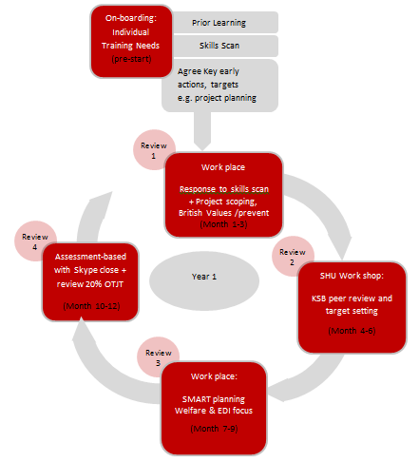
Review Cycle

Slide 101
Review Cycle
R1 during months 1-3
Work Place
Review Skills Scan
KSB starting position
Initial targets
British Values follow up
Scope projects

Slide 102
Review Cycle
R2 during months 4-6
SHU Workshop
Employer mentor feeds in
KSB starting peer review
Review targets
Focus on 20% OTJT
E-portfolio work

Slide 103
Review Cycle
R3 during months 7-9
Work Place
SMART Planning
EDI and Welfare Focus
Revisit British Values

Slide 104
Review Cycle
R4 during months 10-12
Assessment Based with Conference Call/on-line meeting
Planning continues
e.g. Project actions?
Focus on 20% OTJL

Slide 105
Review Cycle

Slide 106
Planning Apprenticeship Progress

Slide 107
Batch 7 d
Focus on Reviews

Slide 108
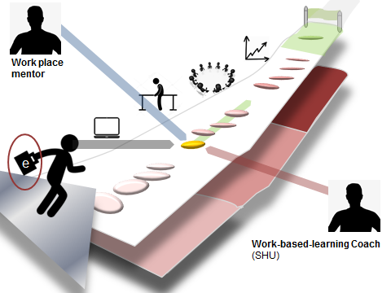
Planning Apprenticeship Progress
Apprentice Progress Reviews

Slide 109
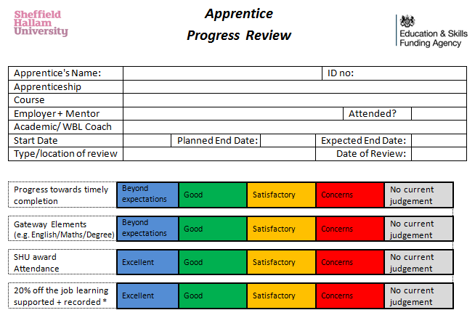
Planning Apprenticeship Progress

Slide 110
Planning Apprenticeship Progress
Apprentice Progress Reviews
Three way perspective on:
Progress towards timely completion
Other Gateway elements, E.g. English and Maths quals
SHU award attendance
20% off the job learning supported and reported
(Also Mentor attendance and relationship tracked)

Slide 111
Planning Apprenticeship Progress
Apprentice Progress Reviews
Coaching and mentoring conversations:
Curriculum: Give examples of how module(s) learning has allowed you to demonstrate KSBs required to fulfil your role. (Be specific – Improved performance, project management, new tasks etc.)
Alignment to Apprenticeship: Recognition of KSB development / Key areas of learning since last review. (Skills developed, impact at work, new learning)
Impact: Do you have examples of work-based activity that you feel could be used in your portfolio? Think impact! – Use e-portfolio to log/store progress against KSBs

Slide 112
Planning Apprenticeship Progress
Apprentice Progress Reviews
Mentor / Line Manager Summary
General feedback on Apprentice progress/performance:
What impact has the apprentices learning had on the workplace?
Are the apprentice’s development areas for focus over the coming period? (Link to actions list)
What specific actions will you take to support the apprentice over the next period? (Link to actions list)

Slide 113
Planning Apprenticeship Progress
Apprentice Progress Reviews
Work Based Learning Coach Summary
Work-based impact, application of learning from SHU course, general comments.
Would the Apprentice benefit from a referral to an advisor (Academic, Support, Employability) or Course/Module Leader?
Actions and Targets
Target/ issue (s) | Action | When | Who | Completed / Reviewed Date
1. | Confirm previous actions and carry any forward
2.
3.
4.

Slide 114
Batch 7 e
E-Tracker Screen shots

Slide 115
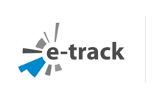
E-portfolio

Slide 116
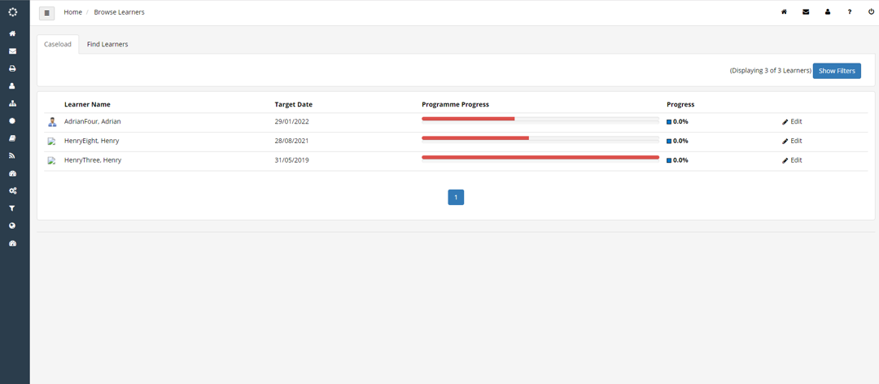
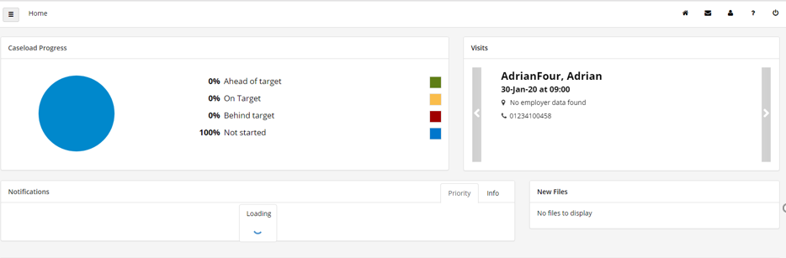
Cohort overview tracking
Caseload Management

Slide 117
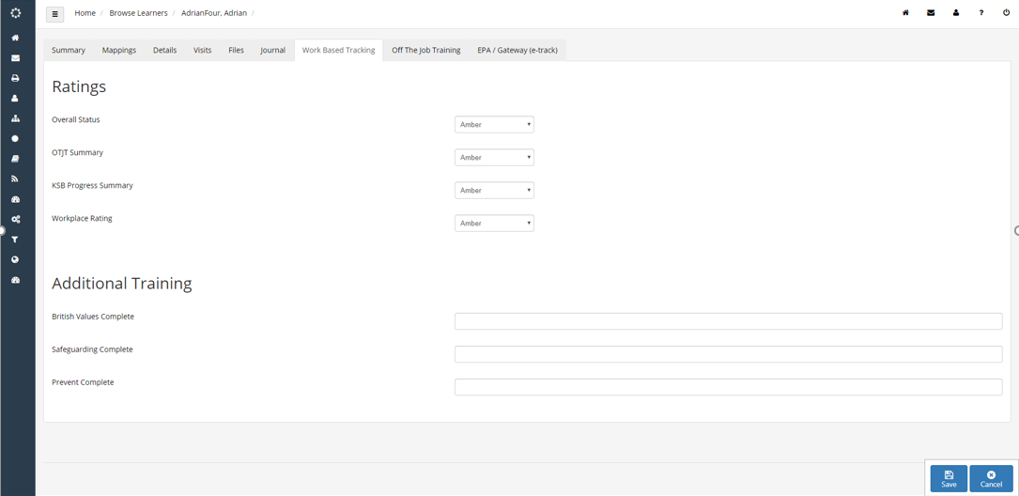
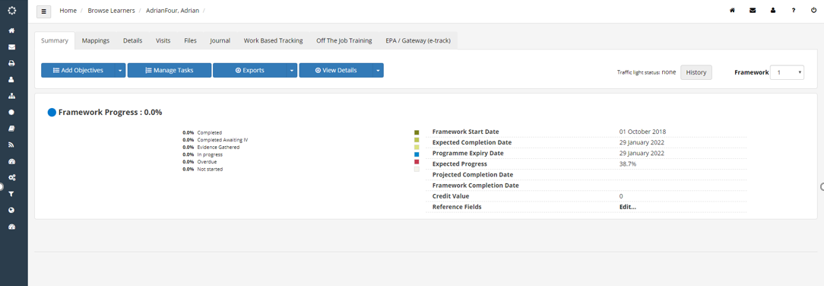
Individual Status Monitoring
(Headline Measures)
Individual Status dashboard
(Overall KSB progress)

Slide 118
Gateway requirements: Additional Training
Include English / Maths GCSE
Include Mandatory H&S where relevant (see Degree Appretniceship Standard

Slide 119
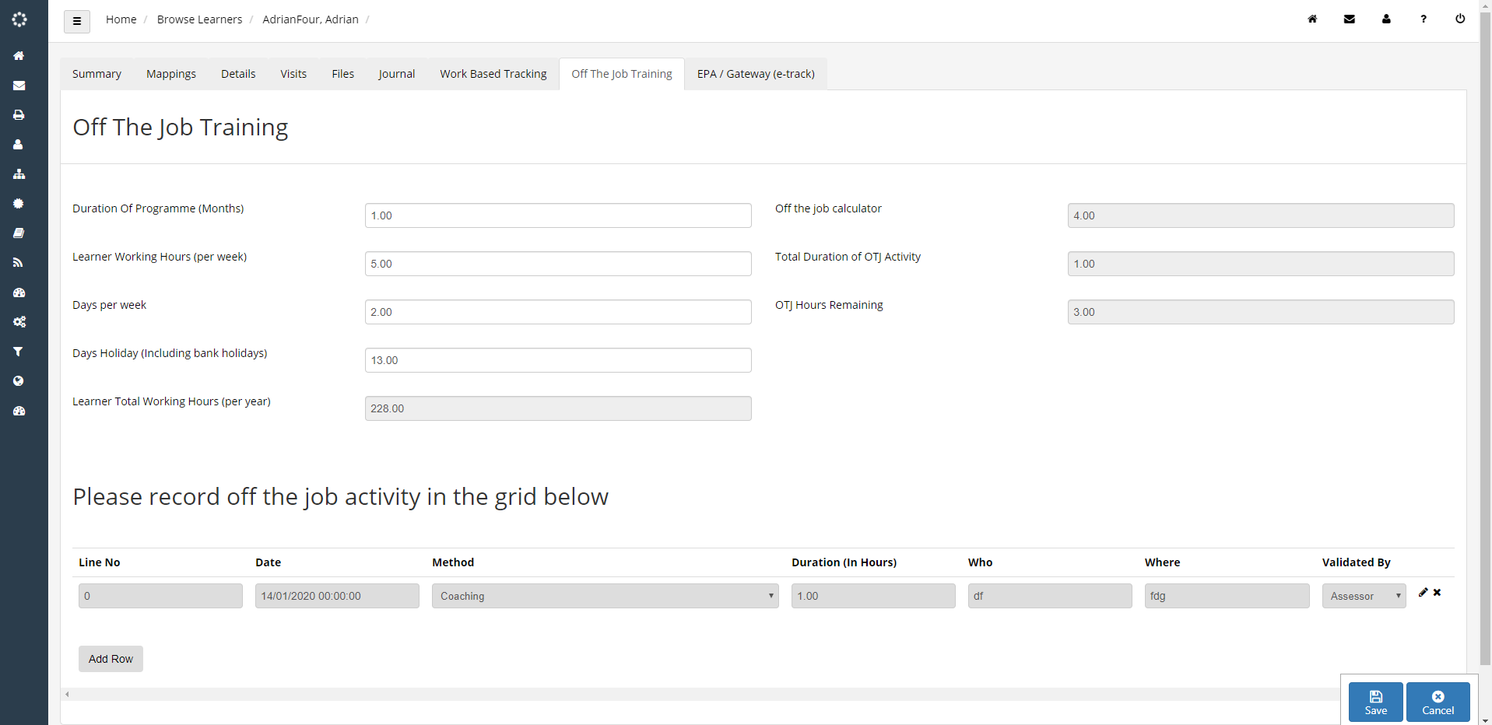

Slide 120
Batch 8:
Work Based Projects

Slide 121
Purpose of the projects
To facilitate the connections between:
The programme and the job role
the organisation and the individual
The knowledge, skills and behaviours
Intention, implementation and impact

Slide 122
Discussion
What makes a good project?

Slide 123
A good project...
should
should not
stretch the mentee in their role
develop Knowledge, Skills and Behaviours (KSBs)
be feasible
be manageable (scope and timescale)
be of interest to the mentee
be useful to the employer - impact
have both definition and structure
be beyond their capability or expertise
require support or resources beyond their/your control
be too ambitious/complicated
be a pet project/naval gazing
be amorphous

Slide 124
Projects:
Case Study Exemplars
What was the context?
What were the objectives?
How was it delivered?
Did it deliver?
What was learned?
How did the participants develop?

Slide 125
Batch 9:
Coaching, Mentoring and Learning

Slide 126
Question - Learning and Mentoring
What is coaching and what is mentoring?
Your are your experiences?
What did you put into it?
What did you get out of it?
Any more questions?

Slide 127
Learning to Learn
Concrete Experience
Reflective Observation
Abstract Concept-ualisation
Active Experiment-ation
Growth

Slide 128
Developing for Impact
Impact
Review
Inquire and collaborate
Deliver
Growth

Slide 129
Supporting for Growth
Impact
Review
Inquire and collaborate
Deliver
Recognising achievement
Active Listening
Growth
Supporting & resourcing
Setting Challenging Targets

Slide 130
Batch 10:
Getting Event Feedback...
Adjust and consider the feedback you want

Slide 131
Thank you for attending our welcome evening.
Here is a brief reminder of what we have covered.
What is an Apprenticeship? - the journey is characterised by the three-way commitment and supported by a process of three way review to hep the apprentice work towards the End point Assessment
E-Portfolios to build, store and refine evidence of knowledge, skills and behaviours to complete the apprenticeship End Point Assessment
Support for the learner from academics and the WBL Coaches
Support for the mentor (any time) and access to our free on-line mentoring resource
Being an Ambassador apprentices and employers
20% off-the-job training - this is a funding requirement. SHU can support this and we will send our log book
Please get in touch - let's work together.

Slide 132
Thank you for attending our welcome evening.
Here is a brief reminder of what we have covered.
Your apprentice will receive a course specific induction and training to use their e-portfolio.
Employers: Seek impact in the work place by identifying projects that will support achievement of knowledge, skills and behaviours
We will help you to identify an End Point Assessor
the Evidence is there - understand what the course is covering, engage with reviews and employers need to develop the commitment statement to ensure that on the job activities support development
Each Apprentice has full information on their study and the apprenticeship - please use reviews to be engage.
Evidence should be from a combination of sources and can be enhanced through degree-level critical reflection and evaluation
Please get in touch - let's work together.

Slide 133
Please complete the form
Expression of interest to be part of the SHU Apprenticeship Ambassador scheme
What else did I want from this event?
What else do I need going forward?
As a mentor I would like the log on information for the On-line Mentor Support Resource
Other feedback/ Questions
Thank you

Slide 134
Batch 11:
Spare slides covering the components of an apprenticeship

Slide 135
Components of the
Apprenticeship
The Standard
Training Needs - Commitment Statement (3-way)
Induction information
The award: discipline modules, specialist modules, project modules, PDP modules
Three-way review
20% off-the job learning
The Gateway period and requirements
End Point Assessment

Slide 136
Components of the
Apprenticeship
The Standard
This reads like a job role. Two sides of A4 paper
Knowledge: I know, understand...
Skills: I can do...
Behaviours: I act and contribute...
Meeting the standard: I am competent to become a professional practitioner...

Slide 137
Components of the
Apprenticeship
Training Needs - Commitment Statement (3-way)
Is the (whole) Apprentice right for you?
Three way: Apprentice; employer; provider
Sets out the journey ahead
A working document - anticipates change (e-portfolios)
Accompanied by a contract (two way) and an Apprentice Agreement (two way)
Discussed in three-way reviews
Defines your journey and status as an Apprentice

Slide 138
Components of the
Apprenticeship
Induction information
A clear explanation of the course
Sets out the duration and delivery pattern
Clear overview of the prescribed content
Identifies Work Based Learning opportunities (project modules and portfolio modules)
Support - academic mentoring and work-place
Identifies Apprentice fundamentals: British Values, Safeguarding, Equalities, English and Maths, etc.
Open discussion, please get the foundations in place

Slide 139
Components of the
Apprenticeship
The Award (e.g. University Degree)
discipline modules
specialist modules
project modules
PDP modules
Three Way Reviews
Support
Where are the opportunities for meeting
knowledge, skills and behaviours?

Slide 140
Components of the
Apprenticeship
Three-way review:
Apprentice + Employer + Provider
i.e. You + Work-place mentor + WBL Coach (SHU)
Quarterly, or at least once per study block
Includes 20% off-the job learning
RAG (Red, Amber, Green)
Honest, transparent review - action based
Track progress against knowledge skills and behaviours and meeting the Gateway requirements

Slide 141
Components of the
Apprenticeship
20% off-the job learning
Includes attendance at Sheffield Hallam University
Employer has committed to providing/allowing this
Includes Work-place activities that are targeted at gaining knowledge, skills and behaviours
Method for calculating
Look to projects and review time
Keep on top of your recording (e.g. Maytas, Excel, or Pebblepad)
.

Slide 142
Components of the
Apprenticeship
The Gateway period and requirements
Includes passing the University modules
End Point Assessment Organisation will connect through SHU
Mostly independently assessed after the degree
Some are integrated within the degree
What additional support after the degree?
Maths and English
Prevent, Equalities, Safeguarding, British Values
Who will sign off readiness?
What other stepping stones? - e.g. NVQ, completion of major project, portfolio of evidence and 20% off-the-job learning, English and Maths certificates - see the standard

Slide 143
Components of the
Apprenticeship
End Point Assessment
Gateway Requirements?
Be familiar with the method and timing - Opportunities to practice?
Role of E-portfolio / Case Studies?
Integrated or independent?
Be aware of conflicts of interest
Further support beyond the degree?
Second Chance?
What is it for? - What do you stand to gain?

Slide 144
Discussion
The Journey to End Point Assessment
Chart progress against your Commitment Statement
Review progress of KSBs and actions at 3-way review
Support from SHU WBL Coach and work place mentor
Review at the Gateway period
Submit E-Portfolio for End Point Assessment
Some specific differences in each sector
What does good evidence look like?

Slide 145
Batch 12:
How SHU builds an apprenticeship

Slide 146
SHU Apprenticeship Design (UG Specification)
The Standard
QAA
Benchmarks
PSRBs etc.
Commitment Statement
Programme Learning Outcomes
KSBs
Core Apprenticeship Modules
Discipline and Specialist Modules
Module Learning Outcomes
Assessment
EPA
Indicative content
Delivery Method

Slide 147
Model 1 (Built on £27,000 funding band)
Integration of WBL Ethos and Modules
Undergraduate Example:
Commitment Statement
WBL Coaches
Level 4
Intro Module | Intro Module | PPD WBL | Project WBL | Discipline Module | Discipline Module
Level 5
Specialist Module | Specialist Module | PPD WBL | Project WBL | Discipline Module | Discipline Module
Level 6
Specialist Module | Specialist Module | PPD WBL | Project WBL
Gateway
EPA
Nb. Each award is design to meet the Apprenticeship Standard and so the structure of the course and support offer will vary
PPD = Personal and Professional Development

Slide 148
Model 1 (Built on £27,000 funding band)
Integration of WBL Ethos and Modules
Undergraduate Example: INTEGRATED EPA
Commitment Statement
WBL Coaches
Level 4
Intro Module | Intro Module | PPD WBL | Project WBL | Discipline Module | Discipline Module
Level 5
Specialist Module | Specialist Module | PPD WBL | Project WBL | Discipline Module | Discipline Module
Gateway Module
Level 6
Specialist Module | Specialist Module | PPD WBL | Project WBL
Specialist Module | Specialist Module | PPD WBL | Project WBL
EPA
Nb. Each award is design to meet the Apprenticeship Standard and so the structure of the course and support offer will vary
PPD = Personal and Professional Development

Slide 149
Model 2:
For potential use at lower funding bands
Commitment Statement
WBL Coaches
Level 4
Intro Module | Intro Module | PPD WBL | Project WBL | Discipline Module | Discipline Module
Level 5
Specialist Module | Specialist Module | PPD WBL | Project WBL | Discipline Module | Discipline Module
Level 6
Specialist Module | Specialist Module | PPD WBL | Project WBL
Gateway
EPA

Slide 150
Model 2:
For potential use at lower funding bands
Commitment Statement
WBL Coaches
Level 4
Intro Module | Intro Module | PPD WBL | Project WBL Discipline Focus | Discipline Mod
Level 5
Specialist Module | Specialist Module | PPD WBL | Project WBL Discipline Focus | Discipline Mod
Level 6
Specialist Module | Specialist Module | PPD WBL | Project WBL
Gateway
Gateway
EPA

Slide 151
Illustration:
Integration of WBL Ethos and Modules
Undergraduate Example: INTEGRATED EPA
Commitment Statement
WBL Coaches
Level 4
Intro Module | Intro Module | PPD WBL | Project WBL Discipline Focus | Discipline Mod
Level 5
Specialist Module | Specialist Module | PPD WBL | Project WBL Discipline Focus | Discipline Mod
Gateway Module
Level 6
Specialist Module | Specialist Module | PPD WBL | Project WBL
Specialist Module | Specialist Module | PPD WBL | Project WBL
EPA
Nb. Each award is design to meet the Apprenticeship Standard and so the structure of the course and support offer will vary
PPD = Personal and Professional Development

Slide 152
Batch 13
Apprenticeship Case Studies
Template

Slide 153
INSERT TIMESCALE FOR AWARDS FROM KENT

Slide 154
Apprenticeship
Case Study Template

Slide 155
Apprenticeship Case Study:
Background Information
Official Job Title:
employer's organisation:
type of business/activity:
size:
(e.g. number of employers, scope of locations, turnover
- Spend 5 minutes on the employer's website)
structure:
What divisions, geographic arrangements, functional activities form the context in which the apprentice works?
Does the Apprentice wish to be considered for the Apprentice of the Year Award?

Slide 156
Apprenticeship Case Study:
Background Information
Please tick 1 box from list below:
Agriculture, Horticulture, and Animal Care
Arts, Media and Publishing
Business, Administration and Law
Construction, Planning and the Built Environment
Education and Training
Engineering and Manufacturing Technologies
Health, Public Services and Care
Information and Communication Technology
Leisure, Travel and Tourism
Retail and Commercial Enterprise
Science and Mathematics

Slide 157
Apprenticeship Case Study:
The Apprentice
Input from the Apprentice to cover:
Why you chose your apprenticeship and how you applied for it.
An outline of your role (including key duties and responsibilities) and how it fits within the organisation.
A description of the team you operate in and your personal contribution to team objectives and performance.
A summary of your personal aspirations and planned career path.

Slide 158
Apprenticeship Case Study:
Apprentice Personal Achievements
Prompts:
An outline of the skills you have developed since you began your apprenticeship.
How your apprenticeship has impacted on you, especially in terms of your ambitions and motivation.
Why you believe that others can learn from your apprenticeship experiences.
Details of your activities as an ambassador for apprenticeships and vocational education both within, and outside, your organisation.
Details of your greatest personal achievements to date, and why you believe these are noteworthy.

Slide 159
Apprenticeship Case Study:
Impact on organisation
Prompts:
How your apprenticeship helps your employer meet organisational objectives/goals.
What specific skills have you developed that benefit your employer?
Tangible examples of ways in which you can demonstrate your personal impact and contribution.
How your personal performance has benefited others in your employer’s organisation.
How have you contributed to the success of your organisation?

Slide 160
Batch XX
For additional resources see:
- Apprenticeship Delivery Guide
- Embedding Apprenticeship Essentials
(both found in Apprenticeships T&AE web page

