Slide 1
EMBEDDING WELLBEING
INTO THE CLASSROOM

Slide 2
ELIZABETH MULLENGER

Slide 3
FIRST IMPRESSIONS
The importance of introductions

Slide 4
FIRST IMPRESSIONS
The importance of introductions
CREATING CONNECTIONS
Bonding with peers... and tutors!

Slide 5
FIRST IMPRESSIONS
The importance of introductions
CREATING CONNECTIONS
Bonding with peers... and tutors!
SUPPORTING WELLBEING
Conquering barriers and building resilience

Slide 6
FIRST IMPRESSIONS
The importance of introductions
CREATING CONNECTIONS
Bonding with peers... and tutors!
SUPPORTING WELLBEING
Conquering barriers and building resilience
CHANGING LIVES
Co-creation, confidence and empowerment

Slide 7
THANK YOU
FOR LISTENING
ELIZABETH MULLENGER

Slide 8
Introducing Education for Mental Health

Slide 9
Wellbeing and the curriculum
Research has shown a need for whole university approaches to address the wellbeing of the university community
Curriculum and academics are the only guaranteed contact points between students and their university

Slide 10
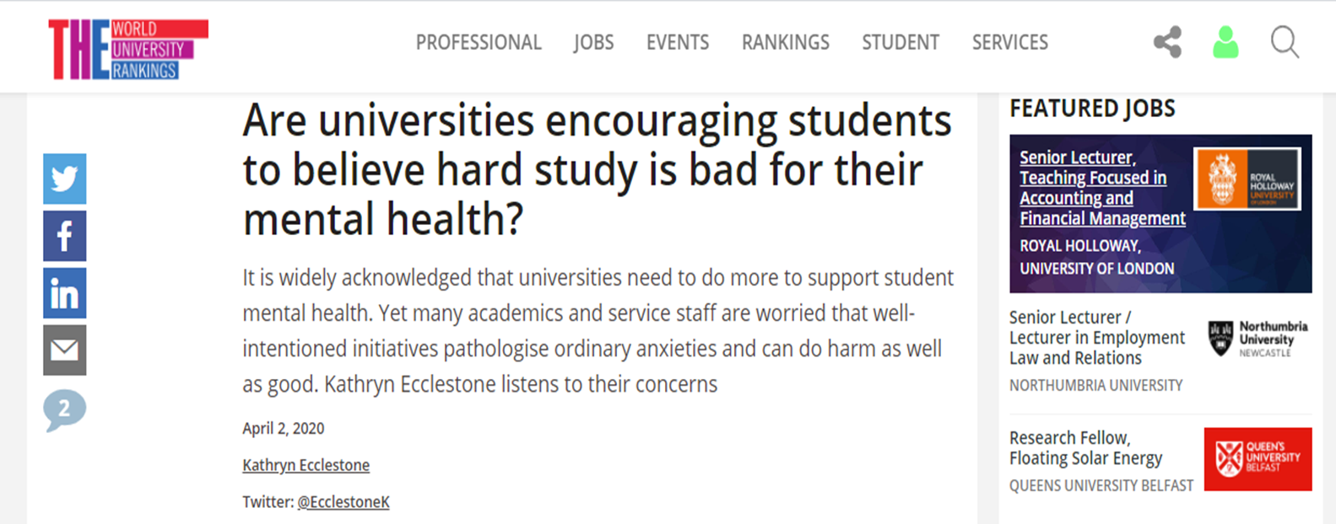
Academic integrity

Slide 11
Learning and wellbeing
Learning Wellbeing

Slide 12
Wellbeing and learning
There is a transactional relationship between learning and wellbeing
Different aspects of wellbeing have been shown to impact on learning and performance
How students engage in learning and the design and delivery of curriculum also impacts on wellbeing

Slide 13
Education for mental health project
Primary research
Students
Academics
Quality staff
Learning Development Teams
Student Services

Slide 14
Education for mental health project
Consultation
PFs HEA
Colleagues outside UK – particular thanks to those in Australia
Weekly online webinar with experts from across the world

Slide 15
Education for mental health project
Literature and review
Consulted relevant literature across disciplines
Shared ideas and approach with colleagues across the sector as it they developed
Peer review

Slide 16
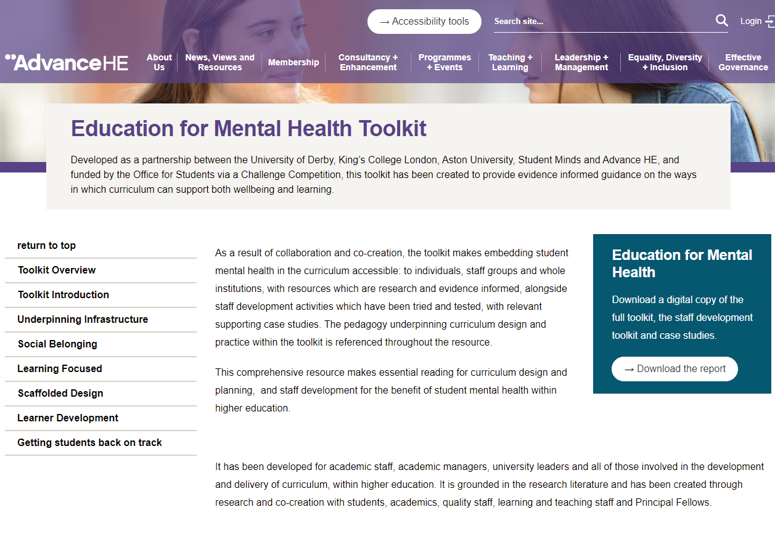
Education for mental health

Slide 17
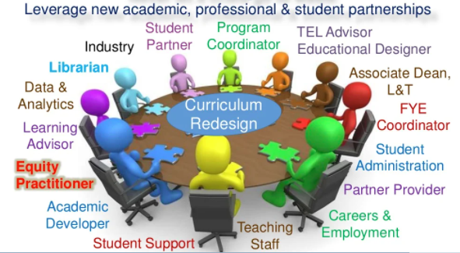
1. Underpinning infrastructure
Kift, 2019

Slide 18
Staff development
Resources and CPD activities

Slide 19
UK Quality Code Advice and Guidance (Learning and Teaching) Strategic Principle 4: Effective learning and teaching is informed through reflective practice and providers enable staff to engage in relevant, timely and appropriate professional development that supports students’ learning and high-quality teaching.

Slide 20
Staff development resources and CPD activities
Designed for application and use in teacher development programmes and related learning and teaching qualifications.
Recognising the diversity of teaching and associated CPD activities.
Structured around the toolkit themes and sub-themes.
Aligned with Level 6/7 of the UK Quality Code.
Signposted to the UKPSF.
Including defined aims and learning outcomes.
Linked to evidence, relevant case studies, and further reading.
Constructed so as to be accessible, flexible, and adaptable.

Slide 21
Activities and resources insights
Collaborative learning activities: E.g.,
Welcome to Curriculumland: The curriculum as territory and terrain.
The Hero’s Journey exercise.
Practically focused: E.g.,
What, when, how much?
Stakeholder mapping in curriculum development.
Considering an inclusive practice framework.
Staff and student experience focused: E.g.,
Staff wellbeing: Key questions for curriculum design.

Slide 22
Thank you

Slide 23
2. Social belonging

Slide 24
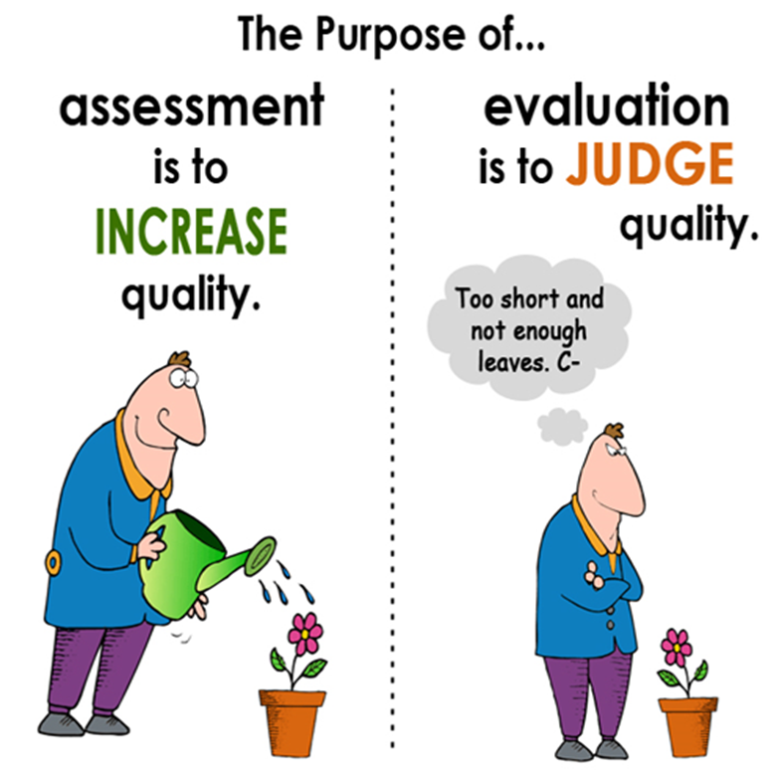
3. Learning focussed

Slide 25
Deep and surface learning
Deep learning
Surface learning
Focus on subject
High achievement
Good wellbeing
More satisfied with teaching and learning
Focus on intrinsic motivation
Focus on grades
Lower achievement
Poor wellbeing (high anxiety)
Less satisfied
Focus on extrinsic motivation
(Postareff, et al, 2016; Asikainen, et al, 2019)

Slide 26
Sustainable challenge - What is hard and why?
Helpful challenge
Stress inducing difficulty
Know what to do
Understand how to do it
Have or can develop necessary skills
Understand how to use strengths
But the task remains challenging to complete
Don’t know what is required
Don’t understand process
Lack necessary skills
Weaknesses are highlighted
Actual task may not be difficult when understood

Slide 27
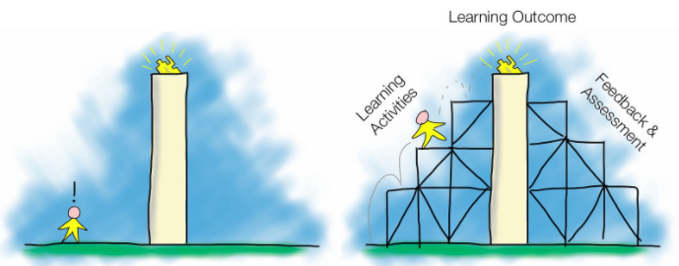
5. Scaffolded Design

Slide 28
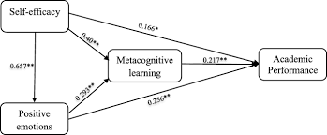
6. Learner Development
Hayat et al, 2020

Slide 29
7. Getting students back on track

Slide 30
What you will find
Summary
Key lessons
Top tips
Other resources
References
Staff development pdf
Case studies pdf

Slide 31
Evaluation
The entire site has been peer reviewed
We have a short survey we would like relevant university staff to complete to help us evaluate the toolkit
Link to Academic Evaluation Survey
bit.ly/3uGDQsP

Slide 32
Be Well Learn Well
Being well and learning well are not in opposition
You can support student wellbeing by developing inclusive, scaffolded curriculum
We need academics and student services to work together for everyone’s benefit
Subliminal message – available now

Slide 33
Student Mental Wellbeing and the Curriculum: Advance HE
Professor Sally Bradley PFHEA,
Executive Coach and formerly Senior Adviser, Advance HE
Notes:
Good afternoon colleagues.
And could I reiterate, isn’t it great to be back with colleagues face to face! My new mantra is “you never appreciate what you have until it’s taken away”.
It is a great delight to be with you for the launch of this invaluable toolkit.
It is also a pleasure to be able to share with you, on behalf of Advance HE, their commitment to ethos espoused within the toolkit on many levels, from their strategic plan and vision, through the student success frameworks, collaborative projects and delivery of the inclusive curriculum, alongside my long standing personal commitment, my long standing passion for improving the student experience and involvement with the project.

Slide 34
Advance HE: Who we are
Notes:
So let’s take a look at Advance HE and it’s commitment to student mental wellbeing. It has a long track record for this.
Advance HE, formerly the HEA, Higher Education Academy, Leadership Foundation for Higher Education and the Equality Challenge Unit (ECU), has a strategy and a vision which aligns with the models proposed in the toolkit.
Our purpose is that - We help higher education be the best it can be
• Drive progress in equality, diversity and inclusion
o identify and scale up effective practices to advance equality and enhance dignity, respect and wellbeing for all
• Enhance teaching and learning for student (and institutional) success promote inclusive student success strategies that enhance the student experience and outcomes
And for me, the Toolkit provides resources for staff at all levels of the organisation to embed wellbeing within their work and role. And by employing the guidance within the toolkit, advice, tips, scholarship we can enhance the student experience.
Vision: Higher education providers and systems that are inclusive (sustainable and high performing) in all that they do
I would say that all of us should be inclusive in what we do, and for any in the audience who holds an HEA fellowship, which is aligned to the Professional Standards Framework for teaching and supporting learning then we have signed up to the values of inclusive practice (V1 and V2!)

Slide 35
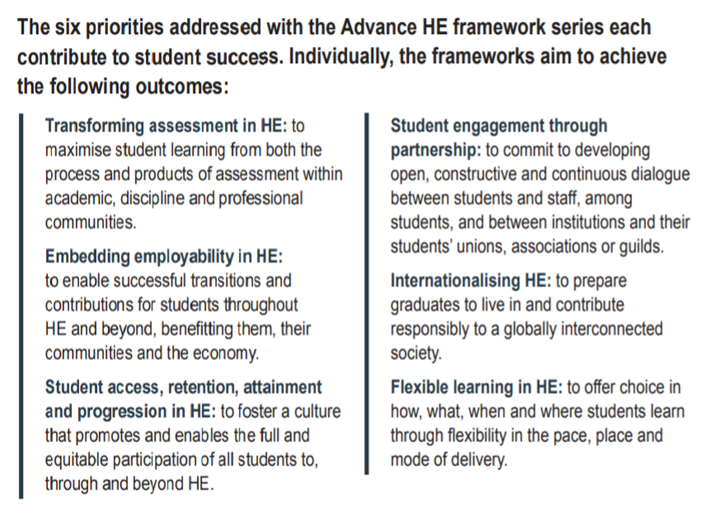
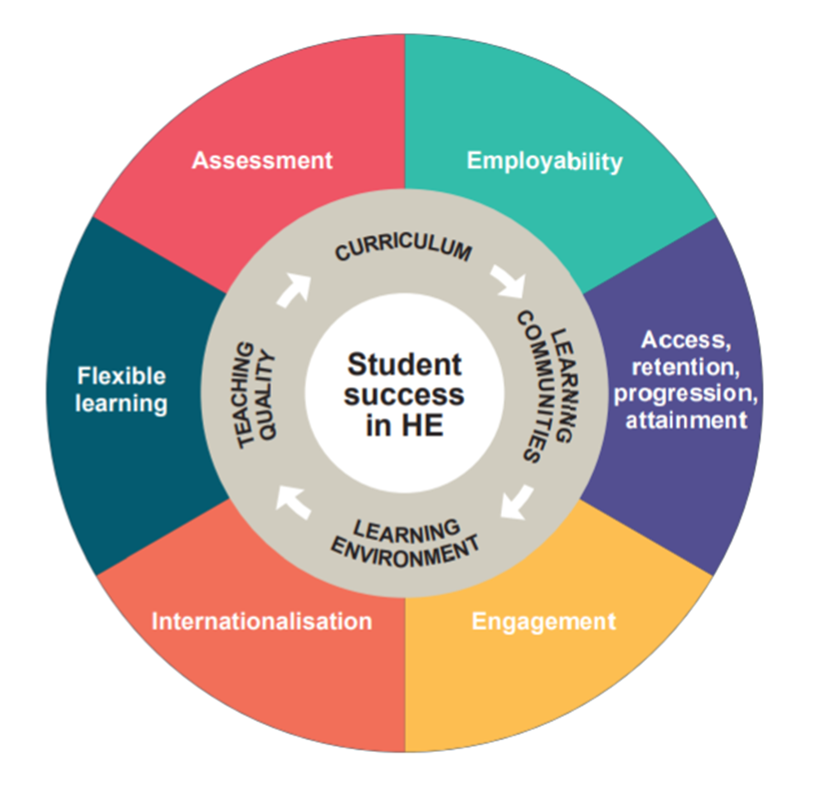
Advance HE: Student Success Frameworks
.
Notes:
Advance HE is also committed to student success through resources such as the Student Success Framework
Enhancing Student Success Frameworks – realising their potential
“Student success can encompass students’ academic achievement; their progression through HE or into employment, self-employment or further study; their deepening engagement with their programme and/or discipline area; the acquisition and development of skills, and their wider co-curricular achievements. It is the combination of these that helps students realise the potential of HE to transform their lives. Advance HE also recognises that student success is highly personalised and individual. What represents success for one student may not be for another. Individuals will have different motivations for, and expectations of, studying in HE and thus will want (as well as take) different things from the experience.”
The toolkit provides not only ideas but offers ways of using the resources, underpinning pedagogy, research and scholarship behind interventions (for those of you ticking the Professional Standards Framework off, V3!)
Let me highlight some of the priorities within the Enhancing Student Success Frameworks which compliment the toolkit
Transforming assessment in HE: to maximise student learning from both the process and products of assessment within academic, discipline and professional communities. The key here being Assessment for learning
Student access, retention, attainment and progression in HE: to foster a culture that promotes and enables the full and equitable participation of all students to, through and beyond HE.
Student engagement through partnership: to commit to developing open, constructive and continuous dialogue between students and staff, among students, and between institutions and their students’ unions, associations or guilds.
Flexible learning in HE: to offer choice in how, what, when and where students learn through flexibility in the pace, place and mode of delivery.
The sections in Education for Mental Health on Learning Focussed, Scaffolded Design and Learner Development section can be complemented by the work of Advance HE.
And not forgetting the comprehensive Employability resource

Slide 36
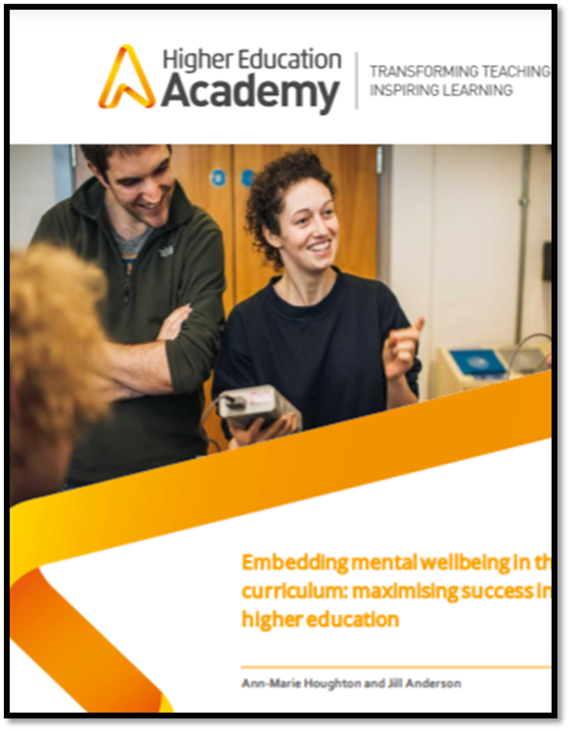
Advance HE’s commitment to student mental wellbeing
Some of our earlier work :
Embedding mental wellbeing in the curriculum;
Learning from our Teach Well initiative;
"The governor view" - Mental health support emerges as a key factor in the student experience
Our development funded projects on mental health and wellbeing of students;
Work with the UK Department for Education and Institute for Employment Studies advising DFE on the development of measurements for a potential survey of student mental health
Notes:
Some of you will be familiar with the work of my former colleague, Dr Pauline Hanesworth. She led many of these initiatives:
Embedding mental wellbeing in the curriculum;
Learning from our Teach Well initiative;
Our development funded projects on mental health and wellbeing of students;
Work with the UK Department for Education and Institute for Employment Studies advising DFE on the development of measurements for a potential survey of student mental health.

Slide 37
Key messages from our UK Collaborative project
Planning, with students central to this – anticipation of their needs
Wellbeing should not be seen as an afterthought
Coordinated approach to curriculum design
Predictability and alignment of content – linking lectures
and tutorials, assignments and feedback
Ensuring communication is clear and timely – don’t just mention something which is important once at induction and expect everyone to remember!
Notes:
Planning, with students central to this – anticipation of their needs.
Wellbeing is not seen as an afterthought.
Coordinated approach to curriculum design
Predictability and alignment of content – linking lectures and tutorials, assignments and feedback
Ensuring communication is clear and timely – don’t just mention something which is important once at induction and expect everyone to remember!

Slide 38
Advance HE: Global collaborative project on student mental wellbeing and the curriculum
Consolidation of previous work and to enhance the inclusion of mental wellbeing
School wide focus on student mental health
Identification of key courses to develop the embedded support resources
Design of reusable modules which can be applied broadly and then tailored
To promote and improve student and staff self-management, success and wellbeing
Exploring interventions to support student mental wellbeing into the curriculum and student training
Identifying common concerns
.
Notes:
Embedding mental wellbeing in the curriculum, was developed into a global collaborative project which highlighted the issue transcends continents. Many of the issues were ones that we were also wrestling with
At the same time, I was working globally initially with 10 HEIs, sadly 2 pulled out due to COVID, however this provided a shared experience and brought the 8 international partners together in finding positive ways of working. My colleague Dr Michelle Morgan was one of the consultants working with me. What struck me, which should not have been a surprise, was that everyone was wrestling with similar problems it didn’t matter if you were in Peru, New Zealand, Australia or USA embedding student wellbeing in the curriculum required engagement from colleagues
• Consolidation of previous work and to enhance the inclusion of mental wellbeing;
• School wide focus on student mental health;
• Identification of key courses to develop the embedded support resources. In the toolkit we have resources which can be used locally, as well as at an institutional level. Stand alone staff development as well as themed programmes.
• Design of reusable modules which can be applied broadly and then tailored; again the toolkit offers flexibility and reusability
• To promote and improve student and staff self-management, success and wellbeing; There are resources It even has a section on Staff wellbeing: key questions in curriculum design
• Exploring interventions to support student mental wellbeing into the curriculum and student training; This is what the whole of the toolkit is about
• Identifying common concerns. And the evidence and research informed approach taken to the design of the toolkit identifies common concerns.
My message to you is that this is not a UK problem but a global issue, which colleagues are wrestling with right now.
But the challenge remains, when something is a project:
Actions and implementation
Supporting staff, to in turn improve the student experience
Developing a clear vision and realistic action plan plus building in evaluation – what difference has this made (does that sound familiar?)
Sustainable development…. Talk about the work. You cannot afford wellbeing to be dependent on one person, it has to be embedded within the curriculum
Taiwan
Colleagues in the audience will be aware of the pressure high achieving student put on themselves and I worked with strategic leaders within Taiwan who had put in place external curricular activities so that the students could experience life outside academic study and switching off the internet so that the students had to sleep! Students were having problems with time management and addiction to online games (their words)
They introduced Service Learning and International volunteering.
Capable of kindness: Every one, every day, Every where
We are all trying to give our students the best experience.

Slide 39
But how does this fit within the UK Professional Standards Framework for teaching and supporting learning?
Notes:
So how does student mental health link to the Professional Standards Framework for teaching and supporting learning… there is a clue in the title!
The PSF underpins a lot of continuing professional development CPD within HEIs and also Advance HE accredited programmes such as PGCert Learning and Teaching or Academic Practice. The comprehensive documentation provides an evidence informed and tried and tested activities from programmes covering diverse participants to self study.
The resource can be used to support PGCert/PCAP, embedding student mental wellbeing within those courses. These activities have been tried and tested within HE context and are conveniently mapped to the PSF.

Slide 40
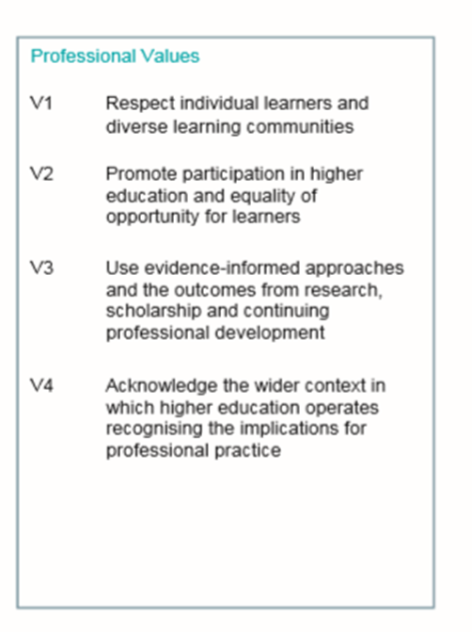
Advance HE: Student Mental Wellbeing and the UKPSF
.
Notes:
But you may be saying, these are accredited we can’t change the content. But the toolkit complements the PSF.

Slide 41
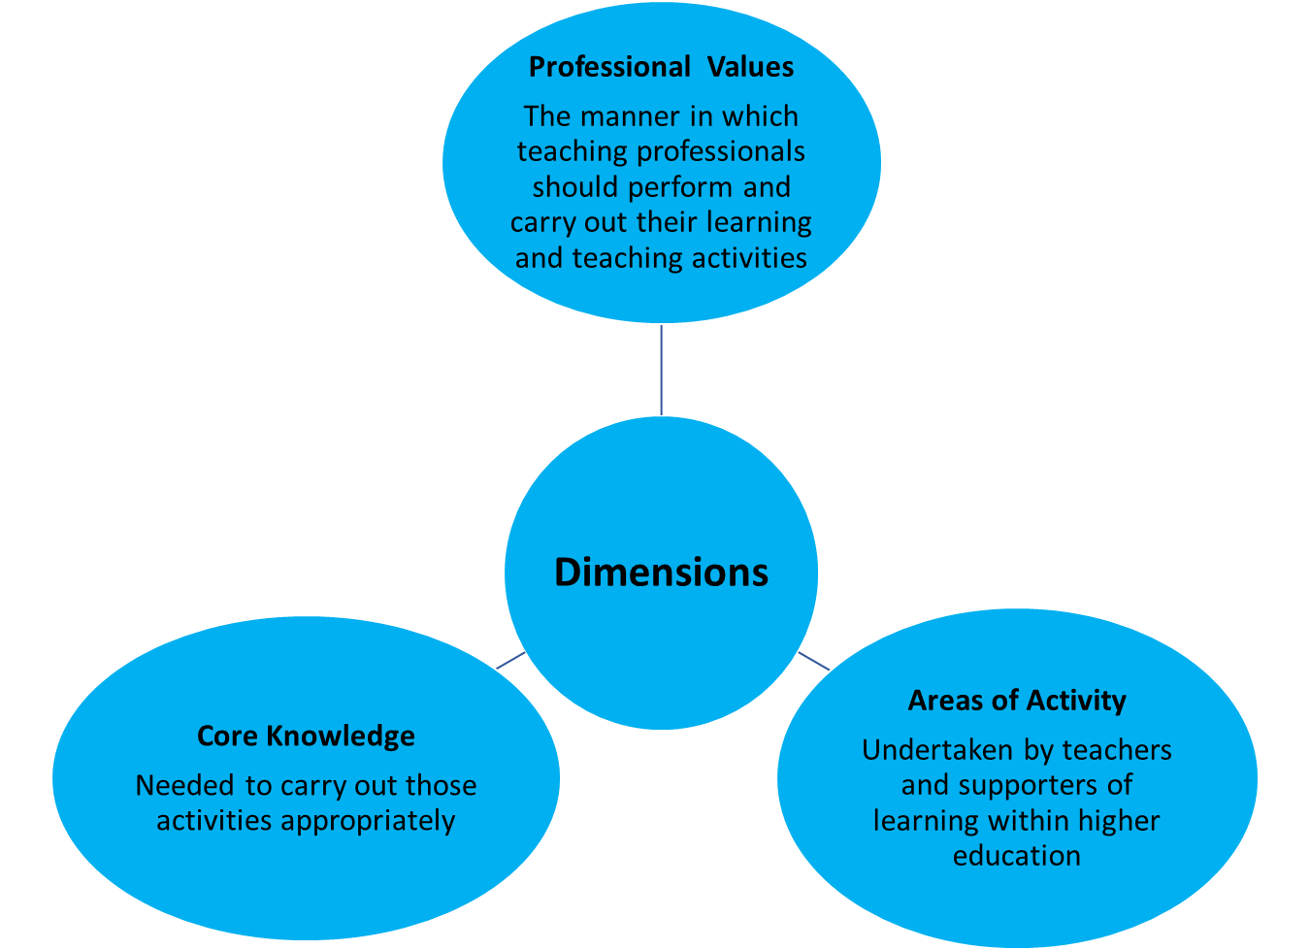
Advance HE: Student Mental Wellbeing and the dimensions of the UKPSF
.
Notes:
Professional values, is quite deliberately placed at the top
Because to me, the values are our professional ethos by which we work

Slide 42
Advance HE: Student Mental Wellbeing and staff development
Comprehensive resource from colleagues at Aston University
Designed for Level 6/7 of the UK Quality Code(1), activities and resources are presented for application and use in university teacher development programmes and related postgraduate learning and teaching qualifications.
Linked to evidence, case studies, and relevant secondary literature and further reading, details are included outlining possible approaches to integration within existing programmes or use as elements for new programmes or CPD activities.
Tried and tested activities - From self directed to group workshops
.
Notes:
Comprehensive resource from colleagues at Aston University
Designed for Level 6/7 of the UK Quality Code(1), activities and resources are presented for application and use in university teacher development programmes and related postgraduate learning and teaching qualifications.
Linked to evidence, case studies, and relevant secondary literature and further reading, details are included outlining possible approaches to integration within existing programmes or use as elements for new programmes or CPD activities.
The staff development toolkit provides self study and reflection, with prompts and scaffold, to structured activities with guidance for facilitators, these are adaptable to meet your institutional needs as well as flexible as a standalone activity or structured programme of CPD and are tried and tested activities – conveniently mapped to the UKPSF

Slide 43
Closing thoughts: Call to action
Design a curriculum which enables students to thrive and flourish
Notes:
• There will be students who are getting on with their course, against the odds.
• There will be students who haven’t had the same educational experience as you
• Everyone has a right to achieve at university
•
And so my call to action is :
Design curriculum so that students can thrive and flourish by embedding student mental health within the core.

Slide 44
References
Bradley, S. (2022) A brief history of the Professional Standards Framework for teaching and supporting learning in higher education: Stages of development, Advance HE . Last accessed 3/2/22 Available from https://www.advance-he.ac.uk/knowledge-hub/brief-history-professional-standards-framework-teaching-and-supporting-learning-0
Clegg, S. and Bradley, S.,(2006). Models of Personal Development Planning: practice and processes. British Educational Research Journal, 32(1), pp.57-76.
Clegg, S. , Bradley, S. & Smith, K. (2006). ‘I've had to swallow my pride’: help seeking and self‐esteem, Higher Education Research & Development, 25:2, 101-113.
Houghton, Ann-Marie and Anderson, Jill (2017). Embedding mental wellbeing in the curriculum: maximising success in higher education Last accessed 29/05/19, available from https://www.heacademy.ac.uk/system/files/hub/download/embedding_wellbeing_in_he.pdf
Lister, K. (2019) ‘How to make learning support mental wellbeing’. Imagine What’s Next? Open University TEDx event, Milton Keynes, UK: TEDxOpenUniversity, 8 November. Last Accessed: 3/2/22.Available from : https://www.youtube.com/watch?v=u9Tvbftg9-A
Nordmann E, Küepper-Tetzel CE, Robson L, Phillipson S, Lipan GI & McGeorge P (2020) Lecture capture: Practical recommendations for students and instructors. Scholarship of Teaching and Learning in Psychology.

