Slide 1
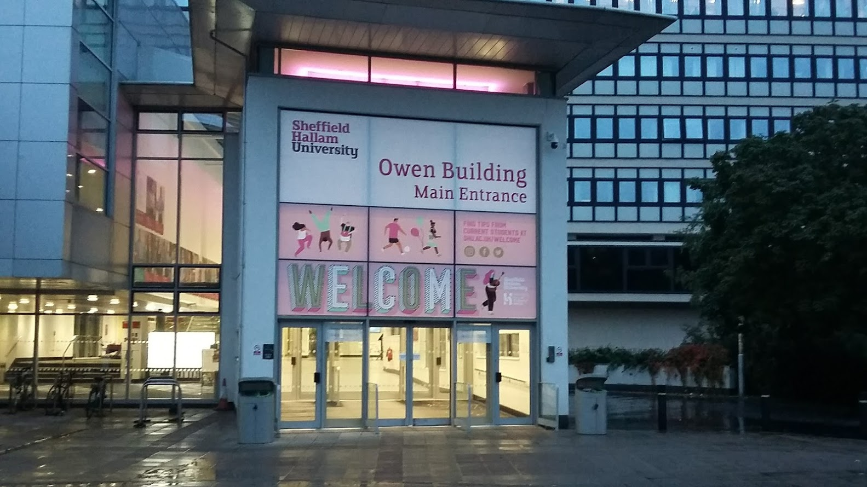
Research Induction for Staff 4 June 2019

Slide 2
Today's session
discover the support available to you from centralised services
meet other new colleagues
hear insights from senior academics
09:00 | Welcome and introduction to the research community at Hallam | Prof Roger Eccleston, PVC Research and Global Engagement
09:20 09:40 | Discussion of research support available from central services (2 topics) | supported by staff from RIO, HROD, LEAD, LRST
10:00 | Break
10:30 10:50 | Discussion of research support available from central services (2 topics) | supported by staff from RIO, HROD, LEAD, LRST
11:10 | Tips on building a successful research career at Hallam | Prof Doug Cleaver, Doctoral School Director and Researcher Concordat Chair
11:30 | Close

Slide 3
Creating Knowledge - implementing our strategic goals
Professor Roger Eccleston
PVC (Research and Global Engagement)

Slide 4
Discussion table hosts
Table | Topic | Table host(s) | Room
1 | Professional development | Elizabeth Scanlon & Richard Hughes | 12.4.18
2 | Support for ECRs | Julie Skilbeck & Xu Xu | 12.4.18
3 | Academic Careers Framework | Sam Coulby | 12.4.18
4 | Research Funding & Grant Support | Sarah Johnson-Mitchell | 12.4.12
5 | Knowledge Exchange | Matt Hall | 12.4.12

Slide 5
Discussion table hosts
Table | Topic | Table host(s) | Room
6 | REF & Research Impact | Jenny Dunn | 12.4.17
7 | Library Research Support | Pete Smith | 12.4.17
8 | Academic Development & Professional Recognition | Paddy Turner | 12.4.17
9 | Doctoral School | Doug Cleaver & Sarah Smith | 12.4.12
10 | Research Ethics | Keith Fildes | 12.4.12

Slide 6
A reminder of timings
09:20 | Discussion topic 1
09:40 | Discussion topic 2
10:00 | Break
10:30 | Discussion topic 3
10:50 | Discussion topic 4
11:10 | Closing plenary
20 minutes for each (including moving time)
based on your selections when booking
groups and rooms indicated on the reverse of your name badge
please come back here for 11:10

Slide 7
Tips on building a successful research career at Hallam
Professor Doug Cleaver
Doctoral School Director Chair of the Researcher Concordat Operations Group Professor of Materials Modelling

Slide 8
The (Lone) Researcher
Do Great Research
Have new ideas
Write it up
Get it Published / Presented

Slide 9
Active Researcher to Research Leader
Optimising Quality
Raising Profile
Building Capacity
(Spotting and) Taking Opportunities
Finite time / energy
Subject to:
Research Plan (PDR)
Gaining Funding
Supervision
Key Enablers:
CPD
New skills
&
Experiences
Research Mentor
How things work
&
How “the world” sees you
Peer Support
Thinking through ideas
Communicating across disciplines
Working through rejection
External networks
Advice:
Go with your gut
Be bloody minded (occasionally)
Reflect on and Learn when things don’t go as hoped

Slide 10
Any questions?
https://blogs.shu.ac.uk/creating/
SHaRD Research Induction page (see online guide)
ECR network page
shard@shu.ac.uk

