Slide 1
September 2019

Slide 2
What is the Hallam Model?
Based around four principles; - engage - challenge - collaborate - thrive
It outlines our distinctive curriculum and learning experience for all of our students and ensures excellence and consistency in the way we deliver our academic curriculum and co-curricula activities.

Slide 3
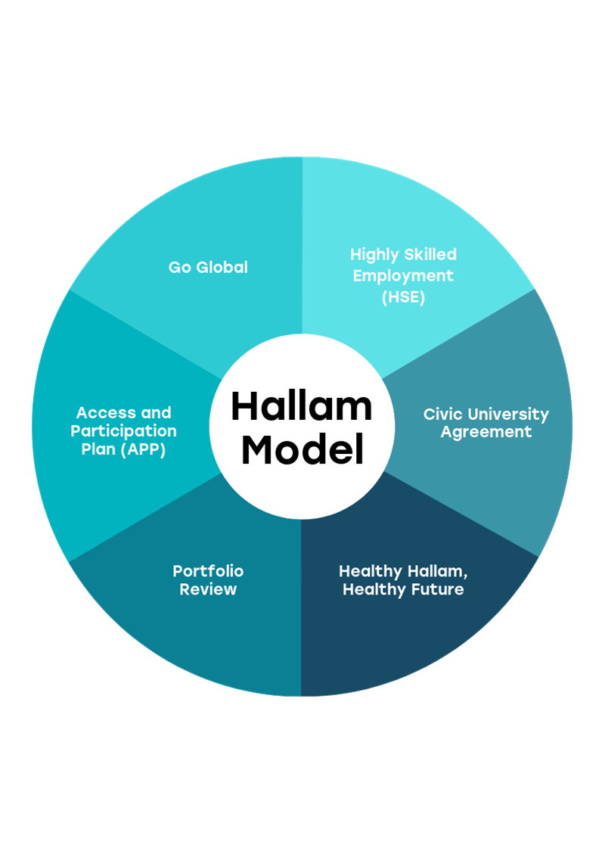
Related projects
The Hallam Model is one of the University’s most ambitious initiatives but importantly, it does also incorporate a number of complementary strategic projects that are already underway.

Slide 4
What are the principles?
Engage
Learning engages with the world beyond the University.
Challenge
Learning is intellectually stretching.
Collaborate
Learning with, from and alongside others.
Thrive
Learning enables students to thrive personally, culturally and professionally.

Slide 5
How will the Hallam Model be applied?
Embedded across the University in all foundation, undergraduate and postgraduate taught courses.
Applies to all levels of study (full-time, part-time, distance learning or apprenticeships).
Covers academic curriculum & co-curricula activities.

Slide 6
Governance
Steering Group Chair - Kevin Kerrigan | Operations Group Chair - Elaine Buckley
Elaine Buckley Natalie Day Neil McKay Samantha Giove Christine Smith Julie Brunton Claire Gandy Clare Boot Jacqui Robinson Alison Metcalfe Esther Kent Lisa Reidy Rebecca Hodgson Conor Moss Leopold Green Kay Simpson Claire Ward Nicola Rawlins Adam Wilkinson Fiona Fisher | Adam Wilkinson Clare Boot Samantha Giove Esther Kent Michael Cambell Claire Gandy Krassimira Teneva Juliet Hinrichsen Natalie Day Julie Brunton Leopold Green Conor Moss Neil McKay

Slide 7
Consultation and engagement
The Hallam Model principles have been shaped following consultation with and input from academic and professional colleagues, as well as from students and graduates.
Involving over 100 stakeholders, a programme of engagement activity is being planned as we lead to implementation. The first event is on Monday 21 October.
There will be monthly communications to all staff via SLG and We Are Hallam to update on progress.
Feedback is encouraged via the ! Hallam Model email address.

Slide 8
Implementation
The project team will develop and deliver a coherent framework ready for implementation, which has already started through projects such as Highly Skilled Employment (HSE) and will continue throughout 20/21.
What's next?
Engaging with relevant stakeholder groups to test and refine the principles (Oct-Dec)
Identify activities required to embed the Hallam Model consistently across the University (Nov-Feb)

