Slide 1

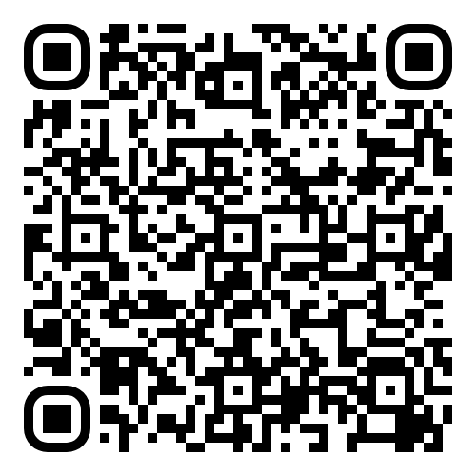

WELCOME TO PGCE SECONDARY EDUCATION Jodie Booth and Bernadette Edge
Notes:
The Sheffield Institute of Education (SIoE) is a leading, national Centre ofEducation, recognised for its excellence and innovation in pedagogy, CPD,research and knowledge transfer. Its provision is embedded in practice andinformed by research, scholarship and deep partnership working. It isresponsive to employer needs, flexibly developed and underpinned by a depthand breadth of outstanding, academic and practitioner expertise.

Slide 2
MORNING AGENDA 11:30 – 13:00 Post Application Event – Dorothy Fleming Lecture Theatre
11:30 – Introduction to the event – Jodie and Berni
11:35 - Introduction to the SIoE - Sue O Brien
11:45 – Hallam Teachers - Caroline Smart
11: 55 - Introduction to Secondary Education - Sarah Williams
12:05 – Secondary Experience Nicole Cooper – PE
12:10 – Secondary Experience Ryan Tweddell – Computing
12:15 – Introduction to SHU Student Union - Tayo Magulike
12:35– Secondary and Student Rep Experience – Emma Levick – Business
12:40 – Sarah Williams – The Netherlands Experience video
12:50 - Edward Briars – Previous Trainee who took part in the Netherlands Experience April 2024
12:55 Q&A Afternoon information
13:00 Close

Slide 3
AFTERNOON AGENDA
13 :00 – 13:30 | Refreshments served outside Dorothy Fleming Lecture Theatre
13:30 – 14:30 | Subject Specific Sessions/Thriving in the PGCE year | See separate list of room allocation
14:30 – 15:30 | DBS and Degree Certification Checks Policy & Compliance Team | Please return to the area outside Dorothy Fleming Lecture Theatre.

Slide 4
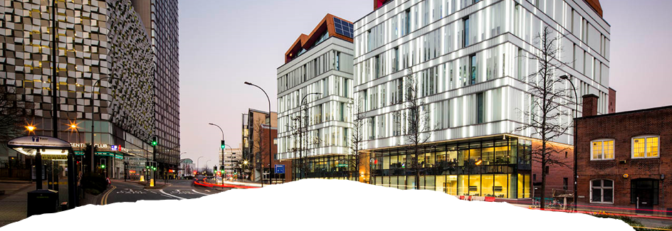

Sue O’Brien Head of the Sheffield Institute of Education

Slide 5

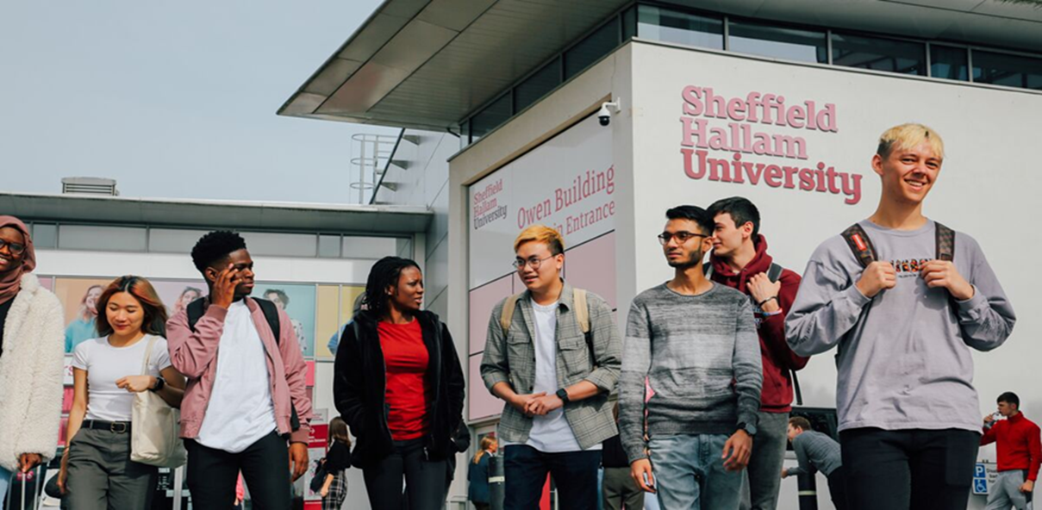
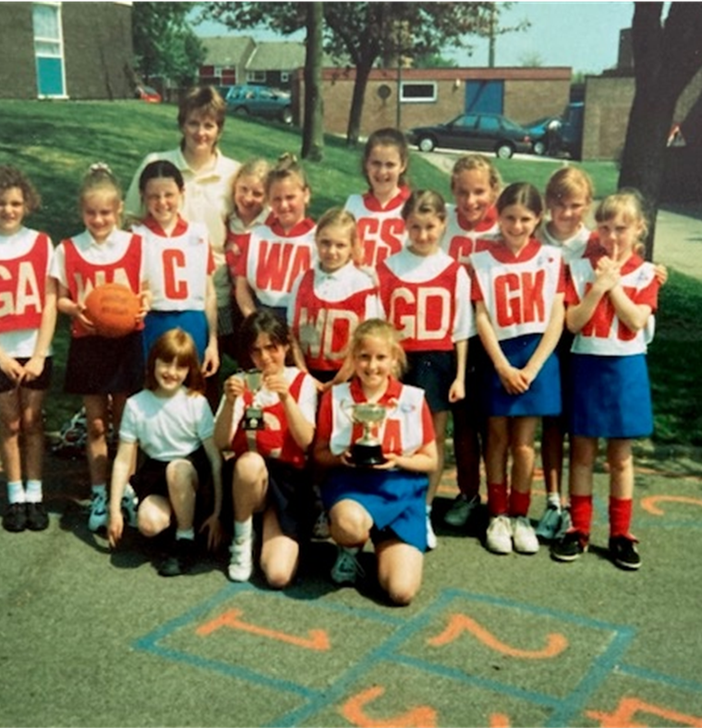

Why are we all here?

Slide 6

Trainees across all phases experience an exemplary quality of education and training – Ofsted 2024
The first university to achieve outstanding across all four age phases. An unprecedented outcome.
Trainee teachers at Hallam are ‘given impressive opportunities to challenge, develop and embrace new and existing ideas, Trainees access training that is highly ambitious in its vision
Trainees and early career teachers from Sheffield Hallam University are valued highly by local employers. School leaders commend the considerable insight trainees bring that enriches the settings in which they teach.
The Hallam Teacher identity is recognised and understood …….The sense of pride that is felt in being part of this institution and sharing this identity came across in all aspects of the inspection.

Slide 7
Becoming a Hallam Teacher
Caroline Smart
Deputy Head of Institute
Deputy Head Institute of Education

Slide 8

The Hallam Teacher
We have identified four pillars or dimensions which we think are important to establish a climate in which our trainees can not only survive, but thrive, as they engage in their professional learning.

Slide 9
Hallam Teacher Key Principles
Pupil centred-educating the whole person
Strong subject knowledge
Strong subject pedagogy
Reflective, research informed practitioners
Treating pupils, trainees and colleagues with dignity and respect
Supporting mental well-being for pupils, trainees and colleagues
All trainees will receive Trauma Informed Training
Commitment to Social Justice

Slide 10
What are the pillars?
Notes:
Social Relationships – Everyone brings their own personal story, cultural background, strengths, life experiences and circumstances. We value this and our provision takes in to account the diversity within the region. We ensure we support all our trainees, and this is specific to their own needs and circumstances.
Critical reflection – thinking deeply is essential to support you in becoming a reflective practitioner. Critical reflection is integral to our courses.
Emotional dimension – We recognise the many emotional experiences which you will undergo as a trainee teacher. We understand that there will be challenges and will support you in managing these as and when the arise. Working with children can lead to intense relationships and experiences, we support you through these and celebrate the joy that these relationships also bring.
Celebrating success – Receiving feedback is an emotional process and we believe the positive feedback should significantly outnumber the negative. We highlight the positives, we ensure that these are recognised and appreciated. We all perform better when we know we are appreciated. With this in mind there are points throughout the year where we ensure we do celebrate the positives.

Slide 11

Introduction to Secondary Education
Teaching is a profound privilege that comes with great responsibility and reward.
"Teachings true components blossom and thrive when it awakens imaginations, stimulates curiosity, taps unknown potentials, encourages creativity, inspires a desire to learn, communicates a passion for learning, and shares knowledge joyfully, transforming lives and inspiring in others a personal quest for meaning and purpose".
Reilly, M. J., & Spears, L. C. (2018). Make your life extraordinary: The teacher as servant-leader. The International Journal of Servant-Leadership, 12(1), 57–84.
Sarah Williams – Associate Head of Institute, Secondary Initial Teacher Education
Notes:
A teaching journey usually starts with a desire to inspire learning and to serve children.
Throughout the course of your PGCE you will have rich and varied opportunities to develop your skills and an outstanding teacher.
You will be supported throughout by a Course Leader who has a passion for their subject but first and foremost a desire to support your development and love of teaching.
Over the course of the year you will spend 140 days in school working alongside highly skilled teachers and mentors. We work with a large number of schools across our region and have a thorough programme of training for mentors so they have the skills and support needed to help you to develop.
We are incredibly proud of our reputation and Ofsted rating as an outstanding provider of teacher education and the quality of our curriculum.
This building is the home of Sheffield Institute of Education. It is a beautiful building that is about to go quiet so we look forward to you welcoming you in September and the vibrance, colour and diversity that you will bring to it.

Slide 12
PGCE Experience 2024/25 Nicole Cooper – PE Trainee The DO’s and DONT’s before you start your PGCE
Prioritise open communication with your mentor (both Hallam and school).
Always plan your lessons the week before and give at least 2 days prior to lesson delivery(take in to account weekends).
Use your AA, they are there for a reason. Don't be scared to ask!
Show initiative with extra-curricular – this is your training year, use every opportunity you can to learn and develop and dive in. Lead/umpire/referee… Learn on the job. Make mistakes.
Attend lectures and seminars. Subject specific or not. It allows you to mingle with different subjects and maybe even develop new ways of teaching. Speakers are very inspiring and educational.
PebblePad does get checked. Own professional development, useful reflection tasks. Do not leave it until the last minute!
TDS - Upload lesson plans with reflections, observations, weekly reflection and actions. Prioritise.

Slide 13
PGCE Experience 2024/25, Ryan Tweddell – Computing Trainee
Make sure you're organised. There is going to be so much going on (between school, university assignments, lesson planning and keeping up with the admin etc.) It helped me so much to write a detailed plan of each day, keeping ahead of myself and not forgetting to do anything. I did this by weekly reminders on my phone, writing down a plan of each day in a diary and sticking to timetables that you create with your mentor.
On the other side of the coin, make sure you give yourself time to relax as well, enjoy the half term as the break it is intended to be, A BREAK. You don't want to burn out, make sure you still live your life too!
Bring your passions into the school, I began running an afterschool club centered around computer creation and once a week taught students about A.I. and video editing skills and they have benefited massively from it. Some pupils may not have access to a lot of technology/books/equipment at home, could you be the person that can inspire them and help them with access to this?
Go and view other subjects, I teach computer science but have proper enjoyed viewing Spanish, History and Business lessons, go and make the most of the people with experience in your school, you'll probably learn a thing or two yourself :)

Slide 14
Introduction to SHU Societies
Tayo Magulike, Outreach and Engagement Co-Ordinator
Prospective Education Student Presentation.pptx
Steven Brookfield, Education Society (President)
•Social Societies

Slide 15
PGCE Experience 2024/25 Emma Levick - Computing and Business Trainee
Placement 1 (September – December): Fir Vale School
Placement 2 (January – June): Meadowhead School
Student Course Rep
X3 meeting.
Feedback taken onboard. The university do listen and make changes (ITAP weeks).
Speak with your course lead(s) to provide feedback — they have meetings too.
Be honest.
If you are unsure keep asking.

Slide 16
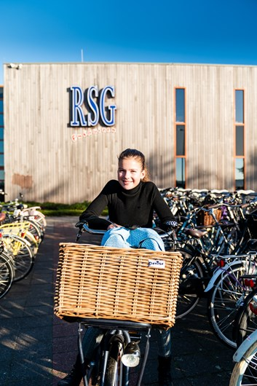


Netherlands Placement Experience
Secondary PGCE Initial Teacher Education An Opportunity to Teach your Subject in the Netherlands.

Slide 17

Overview of Experience
3-week placement in a Netherlands school of college.
Opportunity to teach your subject in a Netherlands school or college.
Arrive in Amsterdam 15th March and return 4th April
Initiated and led by Trevor Lewis RSG TTO Enkhuizen’s Dual Language Co-ordinator
Accommodation is arranged by host school.
Travel Insurance provided by SHU
Costs to you
€125 non-refundable participation costs
€300 contribution towards accommodation
€275 refundable deposit
Return travel to Amsterdam
Train from the airport to/from your host school.
Living costs
Personal travel insurance
Opportunity to teach your subject in one of 8 Netherlands school/colleges

Slide 18

Overview of Experience
Teaching community are passionate about providing their students with an outstanding education.
The Dutch education system is renowned for its innovation and strong focus on individual student development.
Learn interesting comparisons and alternative teaching methods
High quality accommodation is sourced and subsidised in beautiful parts of the Netherlands, and you are provided with the main form of transport – a bicycle!
SHU Trainees have thoroughly enjoyed their time whilst in the Netherlands. Many have said how much the experience has built their confidence.

Slide 19

What next:
Further information will be provided during September 2025, and a call for expressions of interest.
The subjects schools and colleges have offered will be confirmed. Last year we had 28 placements across 14 subjects at 8 different schools
Trevor visits the UK and meets all applicants in January 2026.
Selection pending your progress on the course.

Slide 20
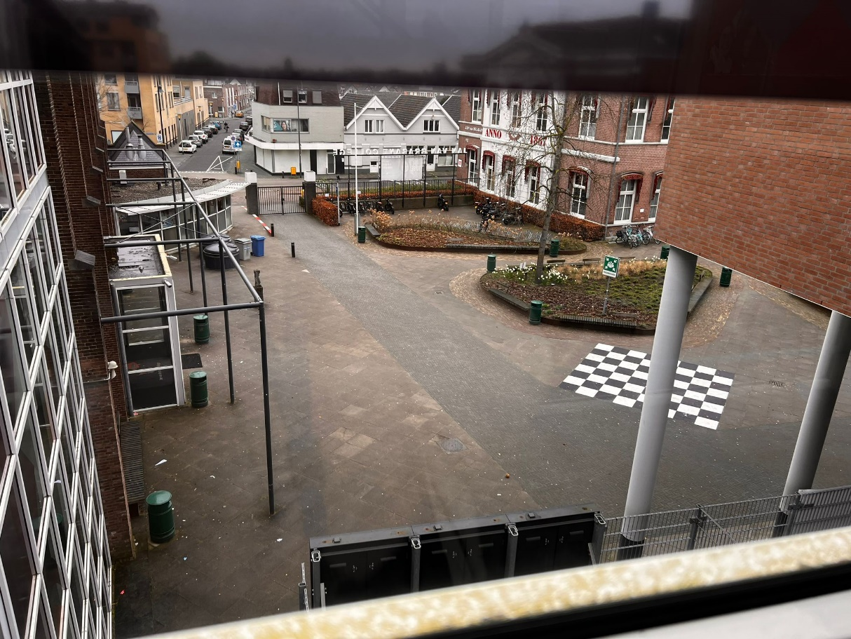
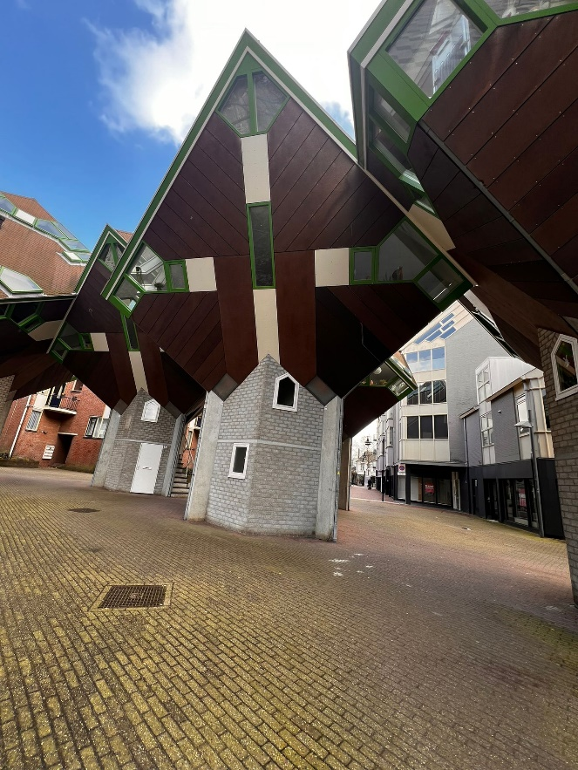
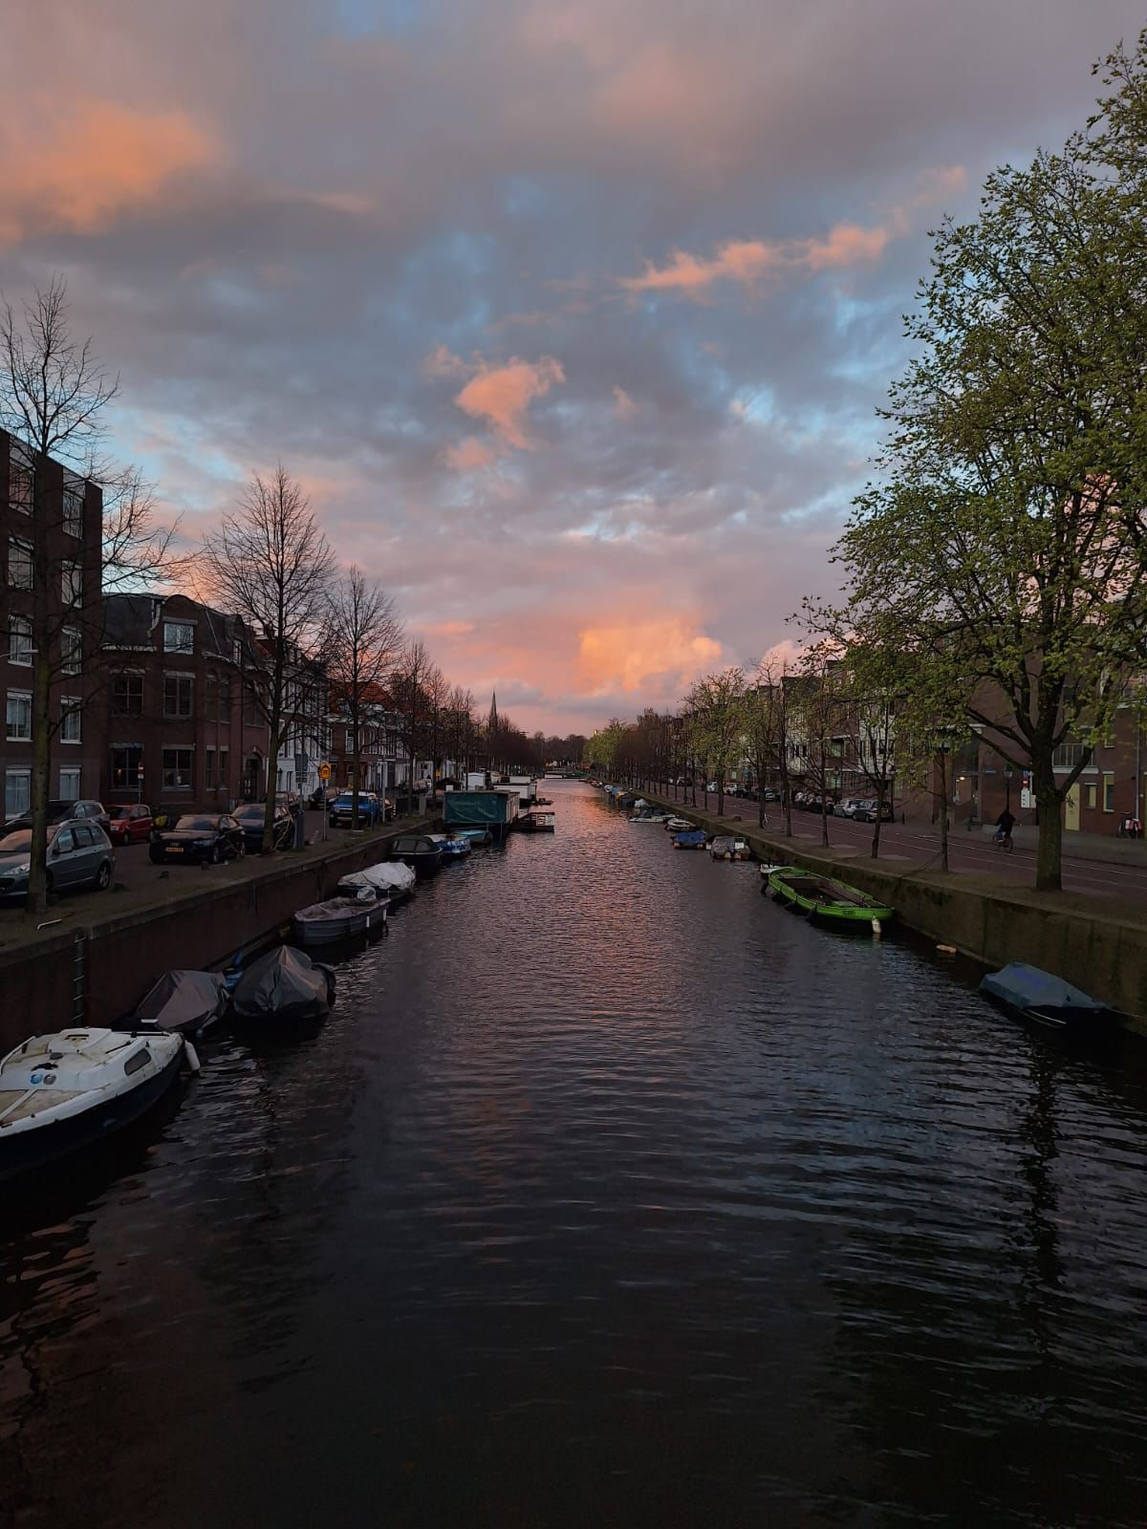
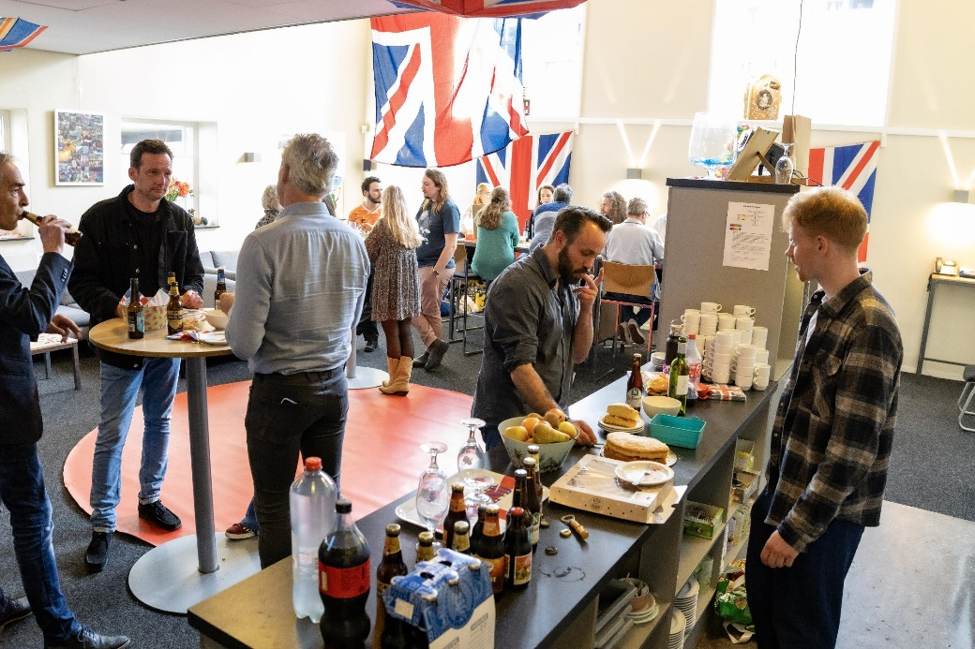
PGCE Experience 2023/24 Ed Briars – Business PGCE Graduate Helmond, Netherlands – March 2024

Slide 21
Any Questions
Thank you for listening.
Now - Break 30 mins
Drinks and Biscuits served
Professional Checks Reminder
Rooms for afternoon session

Slide 22
Subject | Session lead | Room No
Science (Biology, Chemistry and Physics) | Jodie Booth/Fiona Leonard | 12.2.20
Mathematics | Melissa Celi/ Amy Birk | 12.3.18
Business Education Computing | Berni Edge | 12.3.16
Physical Education | Dave Ridley | 12.2.18
Design and Technology Food Art and Design Music | Tony Cowell/ Lucy Bolsover/Sam Stewart/ Charlotte Harrison | 12.5.01
Religious Education Social Sciences PSHE and Citizenship Geography History | Helen Sheehan/ Vicki Pountney/ Andy Bull | 12.6.02
English | Deborah Niven | 12.2.11
Drama | Malcolm Lomax | 12.2.11
MFL | Melissa Celi | 12.3.18

