Slide 1
What does it mean to be an inspirational teacher?
Andrew Middleton
Caroline Heaton
Nathaniel Pickering
Learning and Teaching Conference, Sheffield Hallam University
19th June 2014
#SHULT14

Slide 2
What is good, inspirational teaching?
What do we mean by 'excellent teaching'? Gunn & Fisk 2013, Tomlinson 2014, UKPSF 2012, HEA Code of Practice 2013
What do principles for learner engagement tell us? Chickering & Gamson 1987, Mann 2002, Solomonides et al 2012, etc
What do inspirational teachers do? our survey of Inspirational Teachers
What do students say is important? our NSS analysis
Comparing like with like? Is there correlation?

Slide 3
What is excellent teaching? External context
Global teaching quality in HE agenda (e.g. UKPSF)
Teaching excellence understood through definition, practice, evaluation and reward systems (Gunn & Fisk, 2013, HEA):
sector-wide,
institutionally
disciplinary
students
A reality? - 'contractual engagement' e.g. (Tomlinson, 2014)

Slide 4
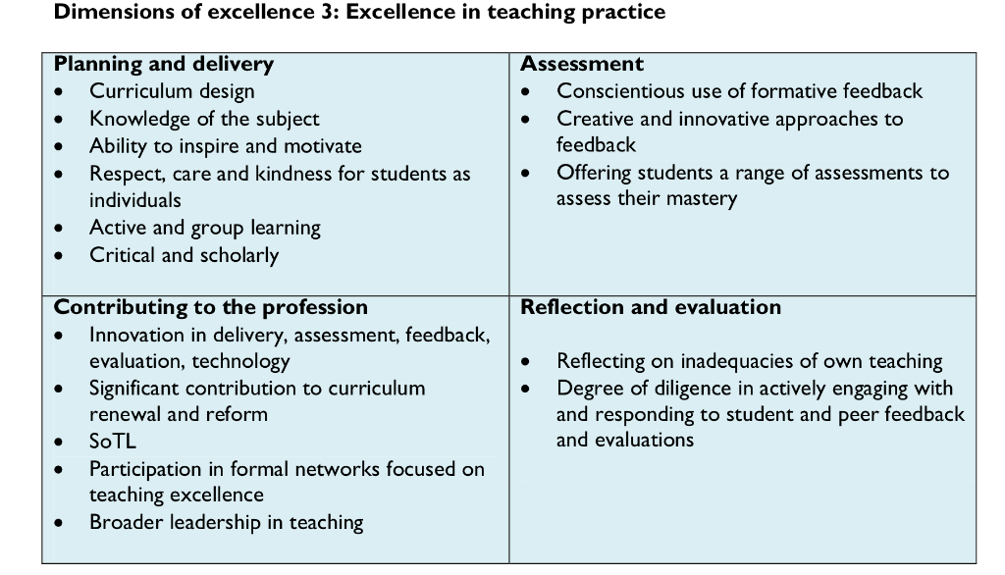
What is excellent teaching? Dimensions of excellence
(Gunn & Fisk, 2013 - HEA report)

Slide 5
What is excellent teaching? Current and emerging themes
Research Informed Teaching
Research Informed Learning (e.g. co-production, EBL, group work, PAL, authentic learning,...)
Assessment for Learning
Flexibility
Course-wide
SoTL - being evidence-based
Teaching leadership - hierarchical and distributed
(Gunn & Fisk, 2013 - HEA report)

Slide 6
Student Engagement
Kahu 2012
See handout
Ways of thinking about engaging students to promote learning
what people do - behavioural perspectives
how students think and think about themselves - psychological perspectives
how we value each other - socio-cultural perspectives
Or, all of these: taking care of different perspectives in an holistic way

Slide 7
How teaching engages learners
See handout
e.g. Chickering & Gamson 1987
Good Practice Encourages...
Encourages Student-Staff Contact
Encourages Co-operation among Students
Encourages Active Learning
Gives Prompt Feedback
Emphasises Time on Task
Communicates High Expectations
Respects Diverse Talents and Ways of Learning

Slide 8
A Relational Model of Student Engagement
Sense of Being a Professional
Sense of Discipline Knowledge
Sense of Being
Confidence
Happiness
Imaginative Self Knowledge
Sense of Transformation
Learning
Understanding
Thinking
Sense of Engagement
Solomonides, Reid & Petocz (2012)

Slide 9
UK Quality Code for Higher Education
QAA, Chapter B5
Student Engagement in Quality Enhancement
"Create and maintain an environment within which students and staff engage in discussions that aim to bring about demonstrable enhancement of the educational experience"

Slide 10
What inspirational teachers say... (2013)
Practice: | Values:
Clarity Challenge Context Contribution | Community Communication Confidence Caring

Slide 11
NSS Comments 2013 - Good Teaching
Good Teaching
Staff that offer a personalised and supportive experience who provide students with guidance and positive feedback that develop their understanding and confidence in their own ability and knowledge.
Staff with high quality, up to date subject knowledge and expertise that they have gained through practice or research that they can apply in their teaching, along with real world application and examples.
Staff that are friendly, personable, approachable, helpful, and professional who are inspiring, engaged, and enthusiastic about their roles and subject.
Effective and appropriate use of learning environments, tools and materials both physical and virtual.
Learning Environments
Staff Expertise & Knowledge
Support & Guidance
Staff Attitude & Attributes
Content Delivery & Assessment
Staff that are confident, consistent and clear in their delivery of course content and assessment information. Challenging content and assessments that have clear expectations and outcomes.

Slide 12
Positive Learning Experiences – Building Confidence
Students need to feel confident in staff members' knowledge, and abilities.
Students need to develop confidence in their own abilities and knowledge, so they can develop and take risks.
Building Student Confidence
a personalised experience, even in large cohorts
positive ongoing feedback (not just on assessments)
clear understanding of content, assessment requirements and expectations
staff who continually check student understanding and progress

Slide 13
Conclusions
The secret of good and inspirational teaching
Common factors to ensure teaching is inspirational, informing and fosters a sense of engagement
Course Context:
Good Teaching
Challenge
4 Cs
Clarity
Consistency
Confidence
Confusion

