Slide 1
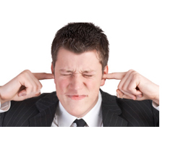
Audio Feedback - one size does not fit all!
Michelle Blackburn - Sheffield Business School
Claire Taylor - Sheffield Business School
Simon Warwick - Sheffield Business School

Slide 2
Overview
HEA Individual Teaching Grant
Background to study
Brief findings
Emotions
Different and defined learners
Good Practice

Slide 3
HEA Individual Teaching Grant
Advertised by HEA once or twice a year
Competitive (1 in 3 chance)
Buy out your teaching time - my award £6981
Reporting - interim and final report
Get your research support team involved early!
Email me if you want to see what my proposal and plan looked like: m.blackburn@shu.ac.uk

Slide 4
Audio feedback - one size does not fit all!
Feedback
NSS 2012 - less than 60% of student satisfied with their feedback
“fraught with challenges” Vorvick, et al. (2008: p.540)
Audio
Reinforces “professional bond between tutor and tutee” Evans & Palacios (2010: p.4)
Research on audio feedback (eg Merry & Orsmond, 2008) indicated audio feedback generates a positive reaction from 'students'
Diversity
Diverse student profile (HESA 2012)
Mature students: “getting formative feedback… is essential to feelings of confidence” Shanahan (2000: p.153)
Which students?
Traditional undergraduates; mature learners; those with a learning disability.

Slide 5
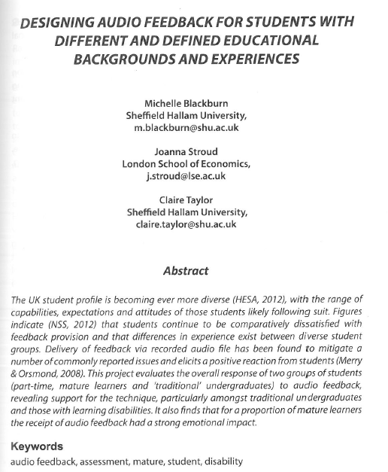
Findings
Brief snapshot

Slide 6
Results: Understanding and Recollection
Has the provision of audio feedback files made it easier for you to recall or remember the feedback you have received?
Notes:
Understanding and recollection
Just over two thirds (68%) of all students felt that audio enabled them to remember more of the feedback they received, with traditional and students with a learning contract rating just above average in this area (71%). Those with improved recollection focused on the increased potential for detecting meaning and the more impactful nature of a person’s voice. However, the affective nature of spoken feedback was cited as being both constructive and damaging in terms of self-esteem, confidence and memory.

Slide 7
Results: Emotional Impact
How will the feedback you received impact upon your performance in similar types of assessment in future?
Notes:
Emotional impact
Three quarters of mature and just under half of traditional learners felt that audio prompted a different response to written feedback due to its emotive context, albeit with differing perspectives. Some students felt it was more personal and that their work was more valued, but others found the emphasised connection emphasised the negative context of a tutor’s critique.
More than half of trad (57%), mature (58%) and LC (63%) students felt that hearing their tutor’s voice had a positive impact on their understanding. Mature students were a standout group here in that while 58% thought their tutor’s voice had a positive impact, 25% felt the opposite and registered a negative impression. This trend was mirrored in a question around changing perceptions of the student-teacher relationship, in that 67% (9) of mature students perceived a negative change.
Just under three quarters of all students felt the feedback would improve future attainment. LC students felt very strongly here, with 88%. In terms of improving motivation students were less sure, with over a third stating it would have no impact.

Slide 8
Results: Overall Satisfaction
On a scale of 1-5 with 1 being very negative and 5 being very positive, please tell us how you feel about use of audio feedback in general.
Notes:
Overall satisfaction
Just over ¾ regarded having received audio feedback as a positive experience.
83% of traditional learners, 84% of LCs and 65% of mature students felt positively. Mature students more inclined to respond negatively.

Slide 9
I'm not very good at shutting up
Twice the work - write it down and then record it
What about the external?
Editing
It'll take ages
What if I swear?
What about our international students
Our students seem happy enough with what we produce
Getting it to the students will be nightmare
I don't do technology

Slide 10
Read the work
Evaluation criteria - 'gut reaction'
Students will have received 'how to...' guide
Recording feedback
Use student name & ID
Introduce self
Feedback approach - how you deliver
Recommend having work available
Give feedback
'inhabit the student persona' and listen back...
Debrief
Signposting
Being yourself
'Appropriate' length

