Slide 1
Welcome

Slide 2
Virtual meeting and tutorial spaces

Slide 3
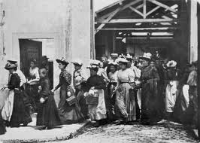
http://www.youtube.com/watch?v=gCkJBdRCcPI
Notes:
Workers leaving the lumiere factory 1895 by the lumiere brothers

Slide 4
Space to think? (together)

Slide 5
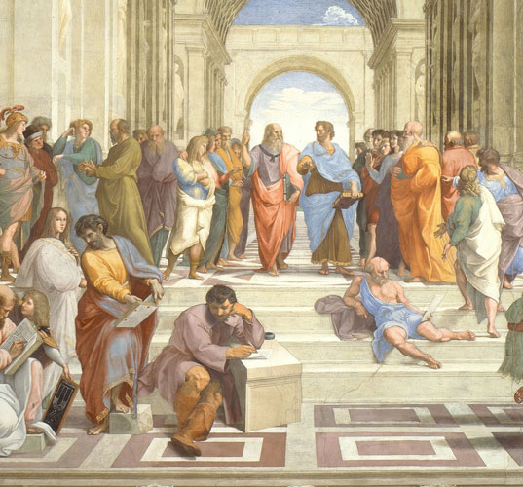

Slide 6
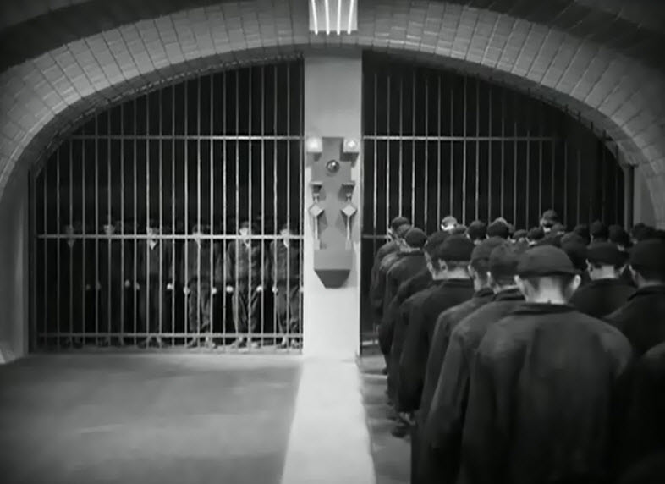

Slide 7
par·kour: the sport of traversing environmental obstacles by running, climbing, or leaping rapidly and efficiently

Slide 8
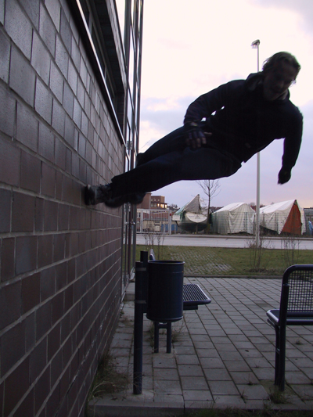
Notes:
Ed Parkour -

Slide 9
edparkour.com - Learning around, over, and beyond the walls
Ed Parkour is not a person or a movement. It is people on the move. In parkour, the structures of the world are not taken as they were meant, but how they might be used. Walls, obstacles, and barriers become objects to be leveraged, harnessed, and sometimes altered. The practitioner of parkour sees the world as a playground of possibility. Likewise, the practitioner of Ed Parkour tries to leverage and harness the “walls” and “structures” that try to control learning. Ed Parkour is learning around, over, and outside the walls.

Slide 10
41 level 5 Graphic design students specialising in Advertising
Specialist blog to support discussions in the studio
Separate individual module blogs to document work in progress

Slide 11
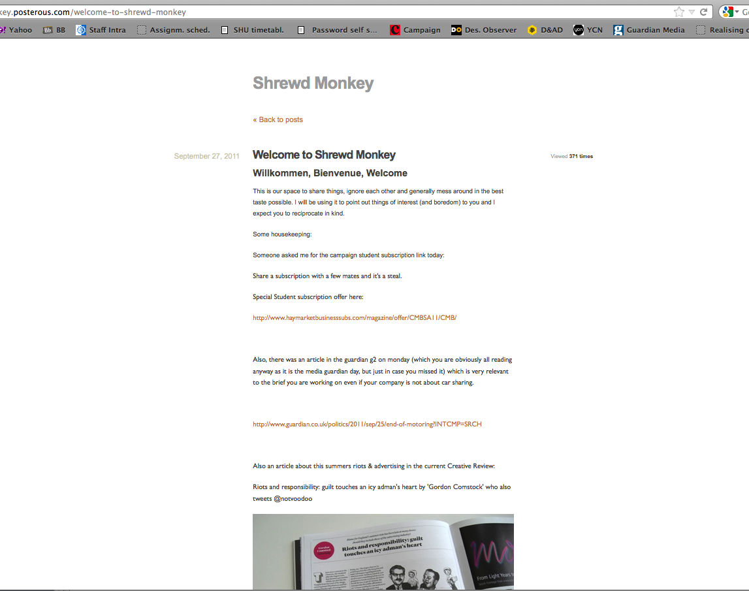
http://shrewd-monkey.posterous.com/archive/9/2011

Slide 13
Space to think? (together)

Slide 14
Space to not think! (together)

Slide 15
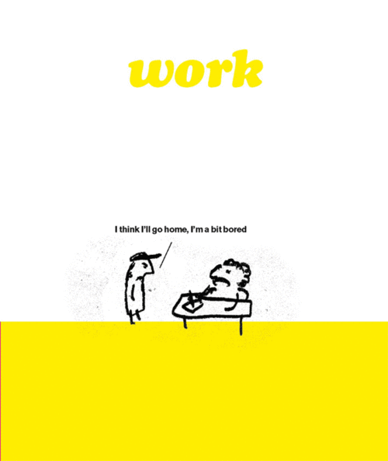

Slide 17
The importance of being idle.

Slide 19
Thank you

