Slide 1
'It's easier to use my phone': An exploration of the use of mobile technology with Trainee Teachers
Dr Alison Hramiak
Sheffield Hallam University

Slide 2
Overview
Background/context
Participants
Methods and Data
Contradictions
Solutions and Futures
Questions

Slide 3
Small piece of research
Time and funding restrictions
So...not over run with data
But it raises questions about the way we work
And it is probably going to be scaled up nationally through TeachFirst later this year

Slide 4
Background and Context for Research
Mobile learning is beginning to deliver on its long-promised potential for enhancing learning.
Technology Enhanced Learning wants to promote a culture of exploration in this exciting area, and also capture good practice as it emerges.
Small amount of funding available from Hallam to explore ways to use mobile technology in class
Applied for it and got it...

Slide 5
Background and Context for Research
With knowledge of funding came knowledge of fact that all my trainees had Smartphones of some kind.
And all used them all the time.
So...decided to trial a new way of communication with them during their PGCE course

Slide 6
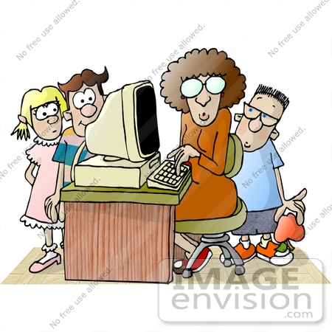
Participants
All Teach First 'trainee' ICT teachers
All placed in challenging secondary schools
6d in university over the year
1y course but with an 18h timetable and salary
All have Smartphones
All use them frequently (constantly!)

Slide 7
Why do the research?
Requested BB as a means of communication and resource sharing amongst themselves
Dutifully set one up (there is a generic TF one for them but they wanted an ICT one for their group).
Then discovered that they were not actually using it - at all - despite their requests for it
So decided to investigate why and also trial an alternative of using their phones for same purposes

Slide 8
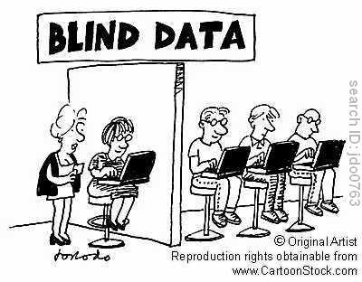
Data collected
Questionnaire focussing on how often they used their phones compared with the BB site, what they used each for.
Also explored reasons for their choices and preferences.
And gave them space to add ideas for future uses.
Focus group with all participants looking in more detail at answers given in questionnaires.

Slide 9
Some initial analysis: Questionnaire data
Access their phones every day
Access the BB site much less frequently if at all
Use phone as main means of communication with tutor and other trainees
Rarely (if at all) do this with BB
Phones are easier to use and more convenient
BB is cumbersome, old style and hard to find info on

Slide 10
Some initial analysis: Focus Group data
BB interface is difficult to use (this from IT graduates?!)
BB is temporary and the site goes when they finish
Find dropbox easier to use for sharing resources.
Time as a barrier for some -BB is at bottom of their list

Slide 11
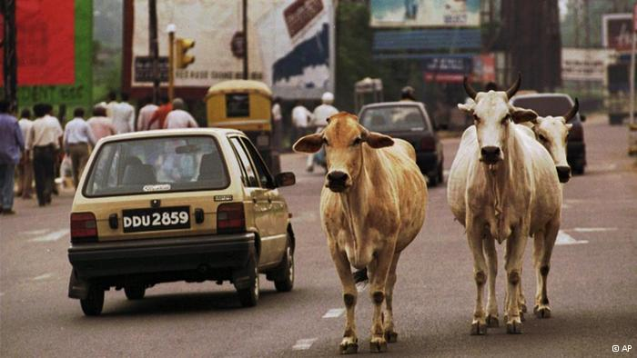

Slide 12
Some contradictions too...
ALL preferred the phone to BB and used it as a reminder to access email as well as to access email
But this was not about preferring the phone over BB (as per the questionnaire data) it was more that it was a convenient reminder to access email
But some can't use phone in school as there are different policies on this so this did not apply?
They were more inclined to share via dropbox - especially as BB is temporary

Slide 13
Solutions and Futures
Some ideas from the participants...
Use big dropbox area for all to access and share resources
Get trainees into habit of sharing straight away
Phone to be used as a reminder only

Slide 14
Solutions and Futures: Some things to think about...
From the university's point of view...
A lot of £ goes into BB - should we aim to improve the mobile apps?
Should we allow trainees access for longer than they are with us as students?
Can we suddenly start to ignore our VLEs and move into using phones and cloud technology?
If we don't will students leave us behind?

