Slide 1
Developing computing students’ in a partner college
From COBOL to Mahara
From computer archaeology to the frontier of thought
Joyce Drake Bill Esmond Mike Smith
SHU Collaborative Provision Applied Computing

Slide 2
Engaging with College and WP students
Provision attracting students from vocational backgrounds and adults returning to study
Following disappointing retention in 09-10, we introduced a pre-entry assignment task to challenge and engage students from the start
Drawing on HEI’s experience, asked students to research early computer systems and report findings
Emphasised use of appropriate sources
Subsequent retention has risen significantly, although the courses still recruit from the same areas

Slide 4
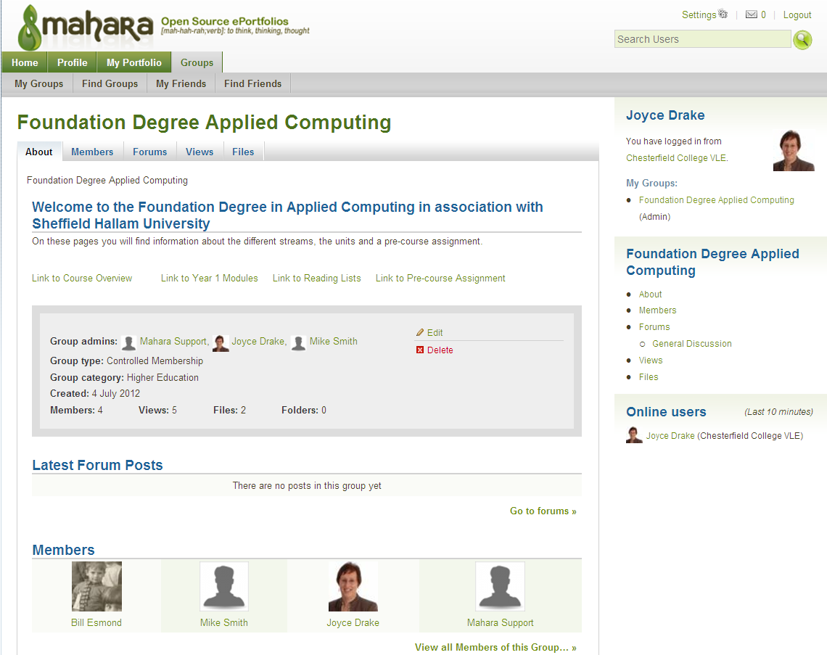

Slide 5
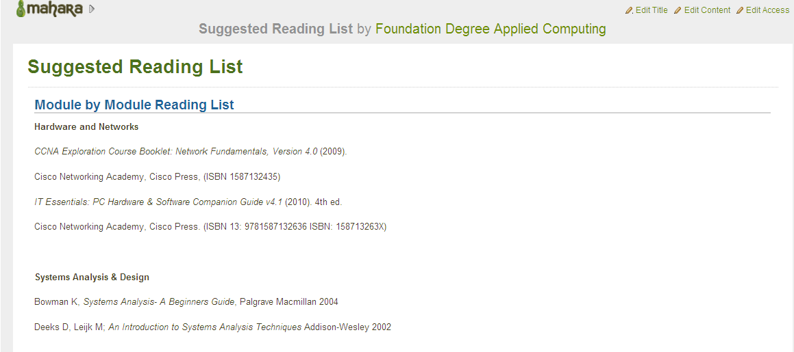
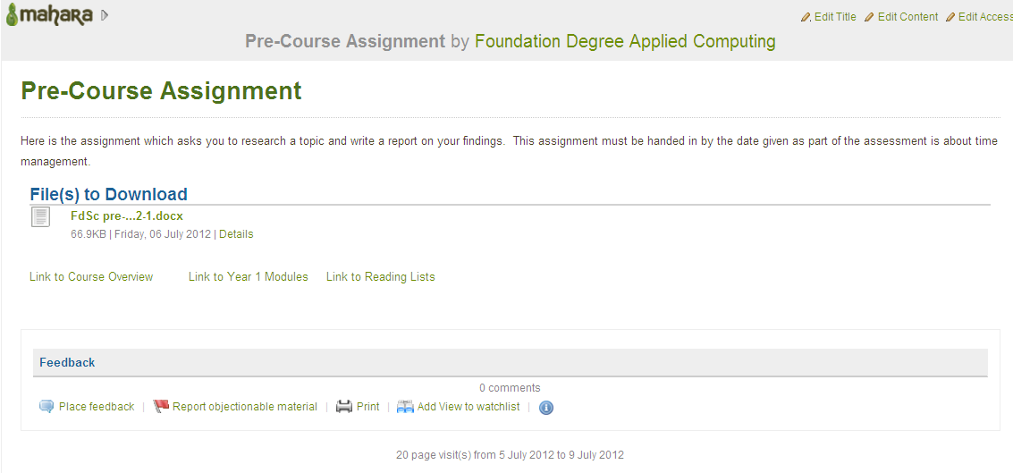
What do you feel to be the biggest gaps in the ability of new students to engage with academic concepts/writing?
How have you dealt with this in your own practice?

