Slide 1

What do Pride events mean to LGBT people in the UK?
Eleanor Formby
e.formby@shu.ac.uk

Slide 2
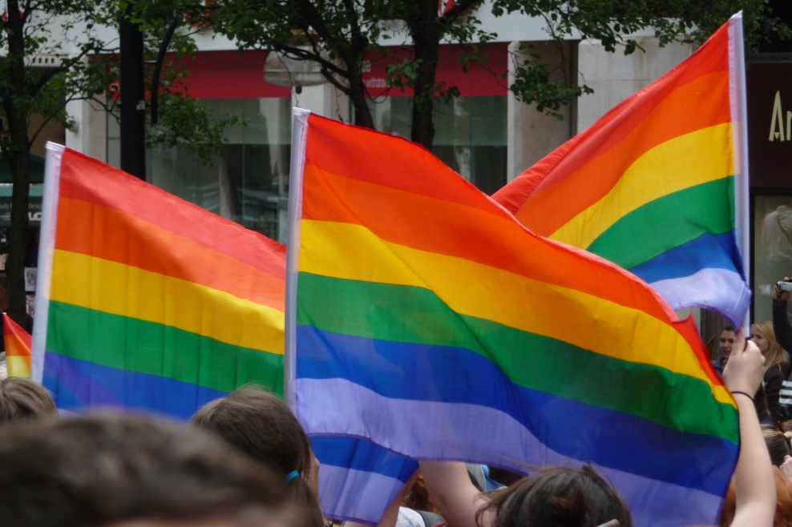
Introduction
Viewed as particularly significant temporary ‘LGBT spaces’
Presentation:
  Literature
  Key themes
  Conclusions

Slide 3
The study
Formby, E. (2017) Exploring LGBT spaces and communities: Contrasting identities, belongings and wellbeing. Abingdon: Routledge
Funded by the Arts and Humanities Research Council
Survey of 600+, 44 in-depth participants

Slide 4
Existing literature
Howe, 2001: ‘transformations of self’
Kates and Belk, 2001: 420: “unapologetic expression[s] of identity, and a claiming of space”
Browne, 2007: 66: “temporary LGBTQ public”, “visible presence of sexual otherness”
Browne and Bakshi, 2013: 166: “dancing on a float... or tentatively watching from the street, can be ‘life affirming’, even life changing”

Slide 5
Safety and freedom
“Tak[ing] over some street and act[ing] like every other straight person could on any other day of the week is important to us, because we can’t do that on a Monday through Sunday usually” (Jackie)
“On the Friday night I wouldn’t have felt comfortable walking down Regent Street with my partner, kissing and holding hands, whereas on the Saturday it was more than acceptable - and we relished every minute of it” (Timothy)
“It’s liberating sometimes to be able to [hold hands at Pride], but it’s quite a sad reflection on our society that we still have to think, you know, there’s certain days of the year when we can be ourselves and do our thing” (Tony)

Slide 6
Celebration
“The thing I like the most about Pride, especially London Pride, was that it was a celebration, it was joyous, and it’s on a huge scale… I remember when my brother got married in India... the whole family came together in celebration... I remember thinking at that time I would never have this, and Pride is sort of a substitute because you can celebrate who you are, and your relationships” (Shourjo)

Slide 7
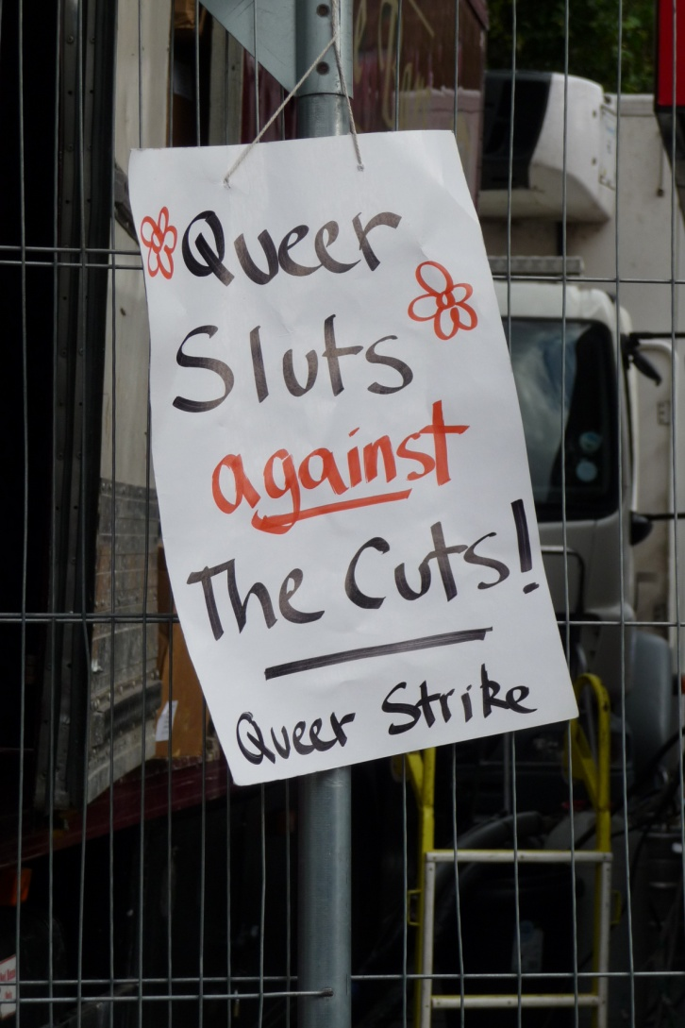
Protest
“It could be, and should be, more politicised. I think that you have the march for 45 minutes to an hour and then after that it’s a good piss up… I would like to see more political awareness raising and consciousness building” (Ben)
“Prides maybe do need to be reclaimed back into something a bit more tangible or meaningful... There is stuff which needs to be campaigned on, and there’s a danger of people becoming too apathetic” (Matt)

Slide 8
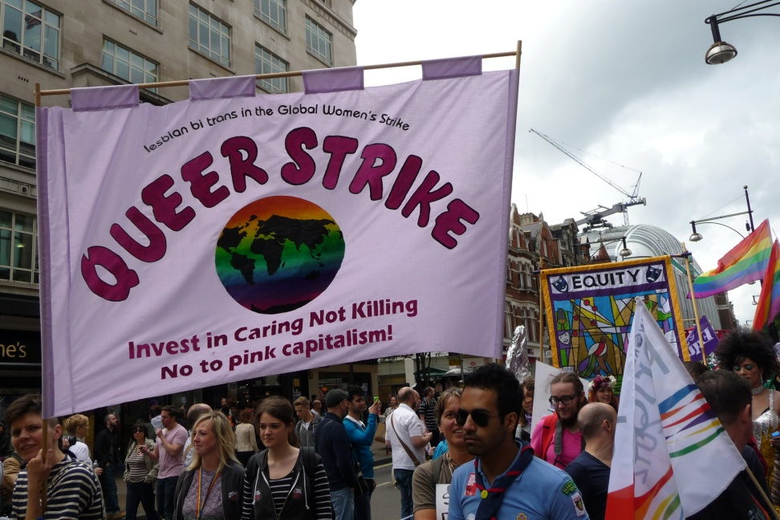
Partying with politics
“It’s very easy to go to London Pride and think that the war’s been won and it quite clearly hasn’t… I had a fantastic day, but it wasn’t political at all… It’s so easy to be dour and political all the time, but I think that people need to be reminded of why it’s a celebration… It’s easy to forget what underlies this whole thing” (Petra)

Slide 9
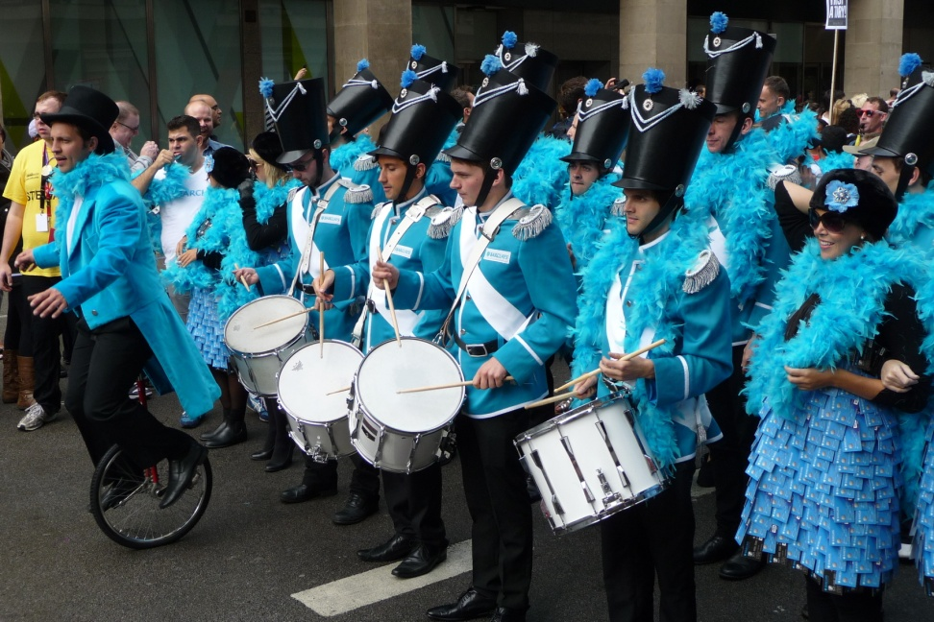
Commercialism
“There’s nothing more horrendous than locking down [a] street with a metal gate around it and paying 20 quid a day... It’s not that it’s not political, there’s just nothing. That’s not even a celebration of diversity or culture, it’s an exclusive party to make lots of money” (Matt)

Slide 10
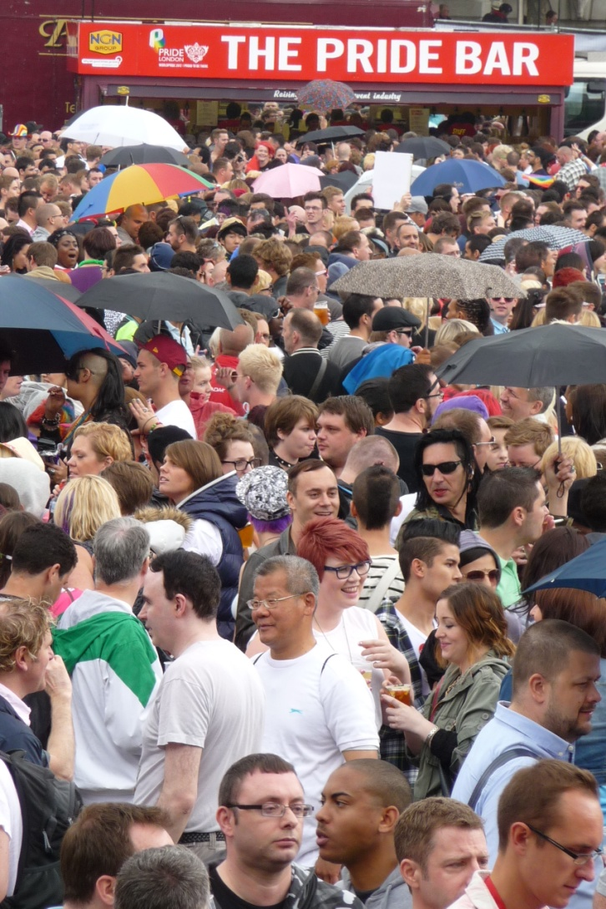
Alcohol
“It’s lost its sense of pride. It’s ridiculous, it’s called Pride, but it’s nothing to do with pride... it is about piss up and it’s about a chance to pull... Pride has changed into the scene, that’s all it is” (Julie)

Slide 11
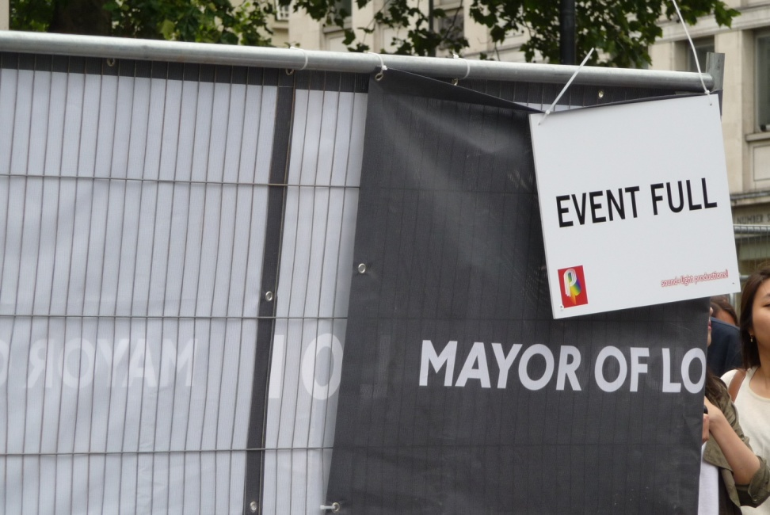
Exclusions
“You saw a lot of East Asian people and Latin American people but very few black or people from the subcontinent... It was quite a pleasant surprise to see a bunch of South Indians in a group and we hooked up with them... It would be nice to see more Asian people and black people” (Shourjo)

Slide 12
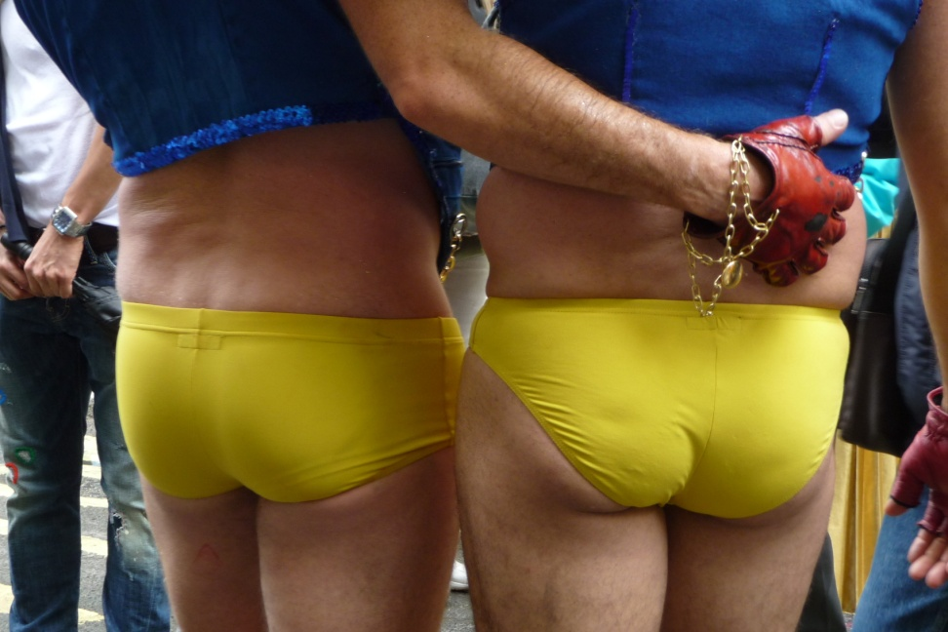
‘Excess’ and ‘extremes’
“The danger is that if it does become too much of a spectacle, it becomes a freak show and then it doesn’t become a celebration, it becomes a place for people to come and point and laugh, because it does become too extreme and it does become too extravagant, and then people start and look at it from the wrong angle” (Colin)
“That’s the danger... Whilst visibility in public can normalise things, it can also create an impression in certain aspects of the public that this is what it is, and I suppose I’m as guilty as anybody else because I associated LGBT with men in hot pants” (Shourjo)

Slide 13
Conclusions
Prides are not homogenous... mean different things to different people
Ideas about celebration, protest, commercialism... not pride!
Time-limited, spatially-specific feelings of safety and freedom
Those who do not drink alcohol, who cannot afford to participate, or who do not ‘fit’ in some other way, can feel - or are literally - excluded
Others not physically excluded but feel in a minority
‘Flamboyant’ displays of ‘queerness’ can be unsettling
Feelings of safety can be simultaneously allied with feelings of exposure (being ‘different’)
Important part in some people’s lives - experientially and/or symbolically
Once a year they represent a visual or imagined LGBT community

