Slide 1
Trans Training
LEE LESTER

Slide 2
What we will be covering
Trans Stats/Media
The Fear Factor
Sex, Gender and Gender Expression
Terminology
Barriers
Case Studies
Inclusivity, Top tips and the Law
Questions

Slide 3
But first..........a quick game!

Slide 4
How did we come up with our answers?
Appearance
Classification
Gut instinct
Prior Knowledge
Comparisons
Someone in my group sounded confident
Complete Guess

Slide 5
Sex, Gender and Gender Expression
Sex is simply about genitals and hormones….no more no less
Gender is about how you feel, it’s your sense of self. What feels right and wrong to you
Gender Expression is what you show to the rest of the world, your family, friends
THESE THREE DO NOT ALL HAVE TO MATCH

Slide 6
Stonewall
Two in four trans young people say they first thought they were TRANS aged 11 or under
Two in five secondary school teachers said they would not be confident to support young people who came out to them as Transgender (one in five if they were gender fluid/non binary etc)
Six in ten Professionals wouldn’t know how to support a Trans person in their organisation.
Only 8% of primary school teachers, 17% of secondary school teachers and 6% of other professionals report received specific training on tackling Transphobic bullying/issues.
92% of LGBT students report being bullied at throughout their education because of their gender expression

Slide 7
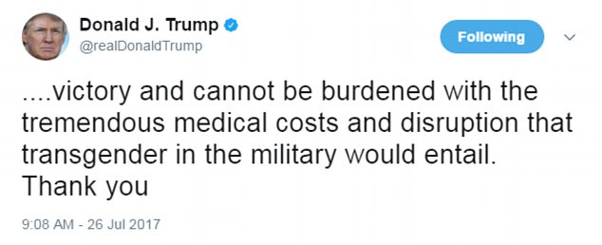
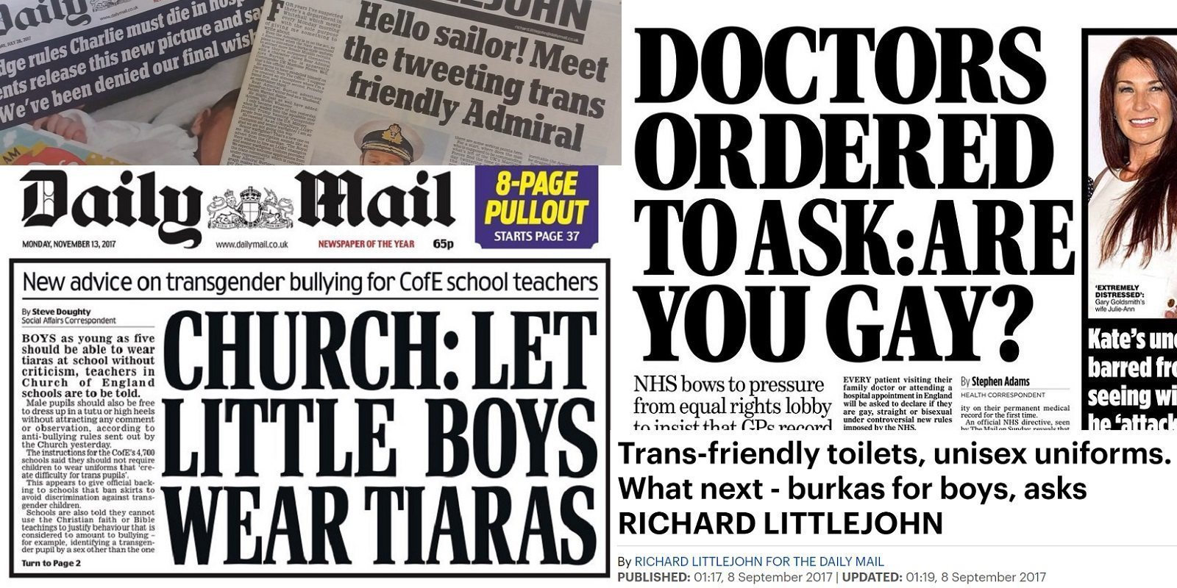

Slide 8
Mrs Malone - Pastoral Lead
“I just feel overwhelmed by it all. I want to support young people who identify as trans but just when I thought I had got my head around what trans even was –I feel like it changed, or got wider or something. Its not a simple topic!
I have come across so many different ways that young people identity as in terms of gender and I don’t know what half of them mean and how to go about supporting them. If a young person is actively wanting to change their gender then I have a pretty good idea of what I need to do i.e change name on register, use the right pronouns etc but if they are non binary??? I can just foresee so many issues. We have a child who is male some days and female some days and I find that impossible to manage. Does that count as trans? At what point do we say its mental health related or attention seeking behaviour? Are young people just striving to be different and should we encourage this????
I saw that Piers Morgan interview about Gender Fluidity and it got me thinking. We have to have boundaries in schools for students safety and some of these are gender restrictive. We just cant have young people identifying however they want willy-nilly - it would be chaos. Don’t get me started on the parents…..”

Slide 9
Professional PANICKER!!!
MTF
Non Binary
Demi-gender
TOILETS
PANGENDER
Fluid
androgynous
FTM
Hormone replacement therapy

Slide 10
Terrifying Terminology!
Open Packs and have a look at these words and see if you can match them up to their description
These are all words that young people from our charity have highlighted as important that professionals know!

Slide 11
Barriers

Slide 12
Case Studies
A Acceptance/Ask
C Challenge
E Empower

Slide 13
Inclusivity

Slide 14
TOP TIPS created by Trans young people
Use the correct pronouns when referring to me – if you aren’t sure please ask! THEY is an acceptable choice
Don’t assume I want surgery or need to look a certain way to be authentic
Avoid terms such as ‘sex change’ as they are out of date
Don’t make assumptions about my sexual orientation
Respect my right to Privacy
If you misgender me, apologise and move on
Don’t fixate on getting everything right

Slide 15
Peers - Indirect and Direct Transphobia
Consider what you can do to highlight issues faced by Trans people in your organisation
Celebrate diversity using various different platforms
Ensure you are challenging transphobia exactly the same way you would racism
Put your own insecurities, concerns or relucatance to one side (people will sense it!)
Posters – get them from Stonewall and put them up! We have loads of leaflets too!
Plan carefully how you will tackle cases of Transphobia to ensure consistency.

Slide 16
Toilets
Toilets don’t have to cause stress!
The LAW states people can use the toilet that is most appropriate to their gender
Consider changing the signage on your disabled toilet to “accessible”
Have an open and honest conversation with Trans people about these changes and potential barriers.
Ensure your bullying policy reflects these changes
Challenge others by using evidence based research and the law (all can be found online)

Slide 17
Remember a person’s safety and happiness is paramount above everything else.
Open and honest conversation about binding and packing
Providing a safe space/ emergency person for young person if in danger or distress
Be mindful of exploitation, bullying, self harm, mental health issues and other difficulties faced by Trans people
Ensure anti bullying policy is up-to-date and enforced
Just be there!

Slide 18
Getting Support
DON’T GO IT ALONE!
SAYiT are here to support you!
www.sayouthtrust.org.uk
Lee.Lester@sayit.org.uk

Slide 19
ANY QUESTIONS?

