Slide 1


Making your Teaching Materials Accessible
Marissa Hill - Head of Sheffield Regional Assessment Centre
Rich Nind- Technical Advisor
Notes:
Introductions
Raise awareness of the new legislation
Main implications
Timeline
What it means for SHU
What it means for individuals
RICH - Practicalities - What are accessible formats? How to make documents etc. accessible
Other sources of support
Next steps for the community - group - SHU
Questions.

Slide 2
The Public Sector Bodies (Websites and Mobile Applications) Accessibility Regulations 2018
https://www.legislation.gov.uk/uksi/2018/852/contents/made
Notes:
To widen access and participation for Disabled people to public sector information
To prevent isolation and segregation
To promote independence and participation through use of assistive technologies
To improve the experience for all

Slide 3
Main implications
Responsibility to
Make websites and mobile app content accessible to all
Provide a public accessibility statement
Provide a feedback mechanism for users to report inaccessible content
Provide a link to the enforcement procedure
Notes:
Content includes
• Websites
• Libraries
• Student portals
• Staff systems
• Apps
• Documents hosted on websites
• Videos & multimedia content
• Intranets and extranets VLEs
• Purchased 3rd party content and tools

Slide 4
Timeline for Implementation
Sept 2019
Websites and content on intranets and extranets (e.g. Blackboard) created after 23rd September 2019
Sept 2020
Websites created before 23rd September 2018
Sept 2021
Mobile Apps

Slide 5
What does it mean for me?
Think about accessibility when designing and creating new content
Use style guides to aid navigation through documents
Use strong colour contrast
Describe images, tables, graphs etc.
Use captions, transcripts and audio descriptions on videos
Notes:
Content includes
• Websites
• Libraries
• Student portals
• Staff systems
• Apps
• Documents hosted on websites
• Videos & multimedia content
• Intranets and extranets VLEs
• Purchased 3rd party content and tools
THERE ARE SOME OPT-OUTS so some reasonable adjustment will still exist

Slide 6
Who are Accessible Formats For?

Slide 7
How Would you Read these Texts?
Notes:
The Assistive Technology service are a group of small team of specialist advisors who provide technical advice and guidance to SRAC and the Disability Advisory service.
Our missions aims are:
To support students and staff access to education and achieve success through the use and implementation of assistive technologies
To provide advice and guidance on assistive technologies
To support students learning and engagement through the promotion and awareness of assistive technologies.
The slide illustrates three aspects of our service offer
The Equipment Loan Service
Technical Guidance
Assistive Technology Group training sessions
I'll talk through all of these in more detail

Slide 8
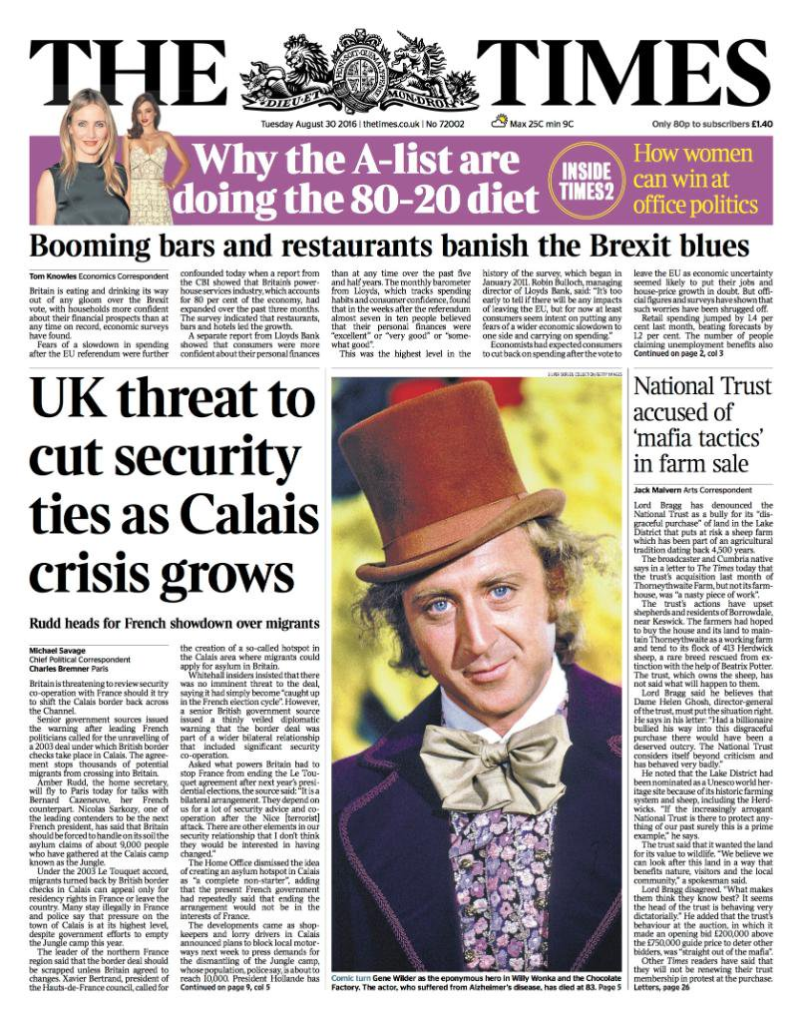
Example 1
Notes:
If you are visually impaired, what order do you read it in?
Bonus point for mention of images
If you're Dyslexic the font and spacing may give you problems.

Slide 9
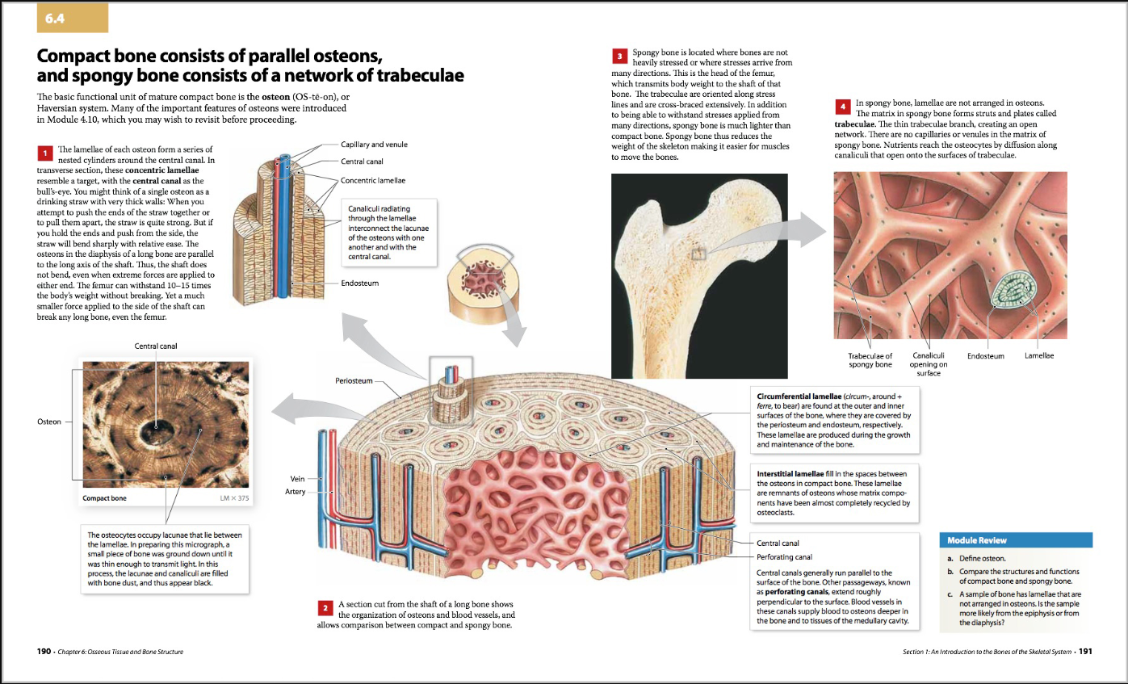
Example 2
Notes:
Similar issues to first page - order and text
images - very detailed, may need better description.
Personal aside - very overloaded.

Slide 10
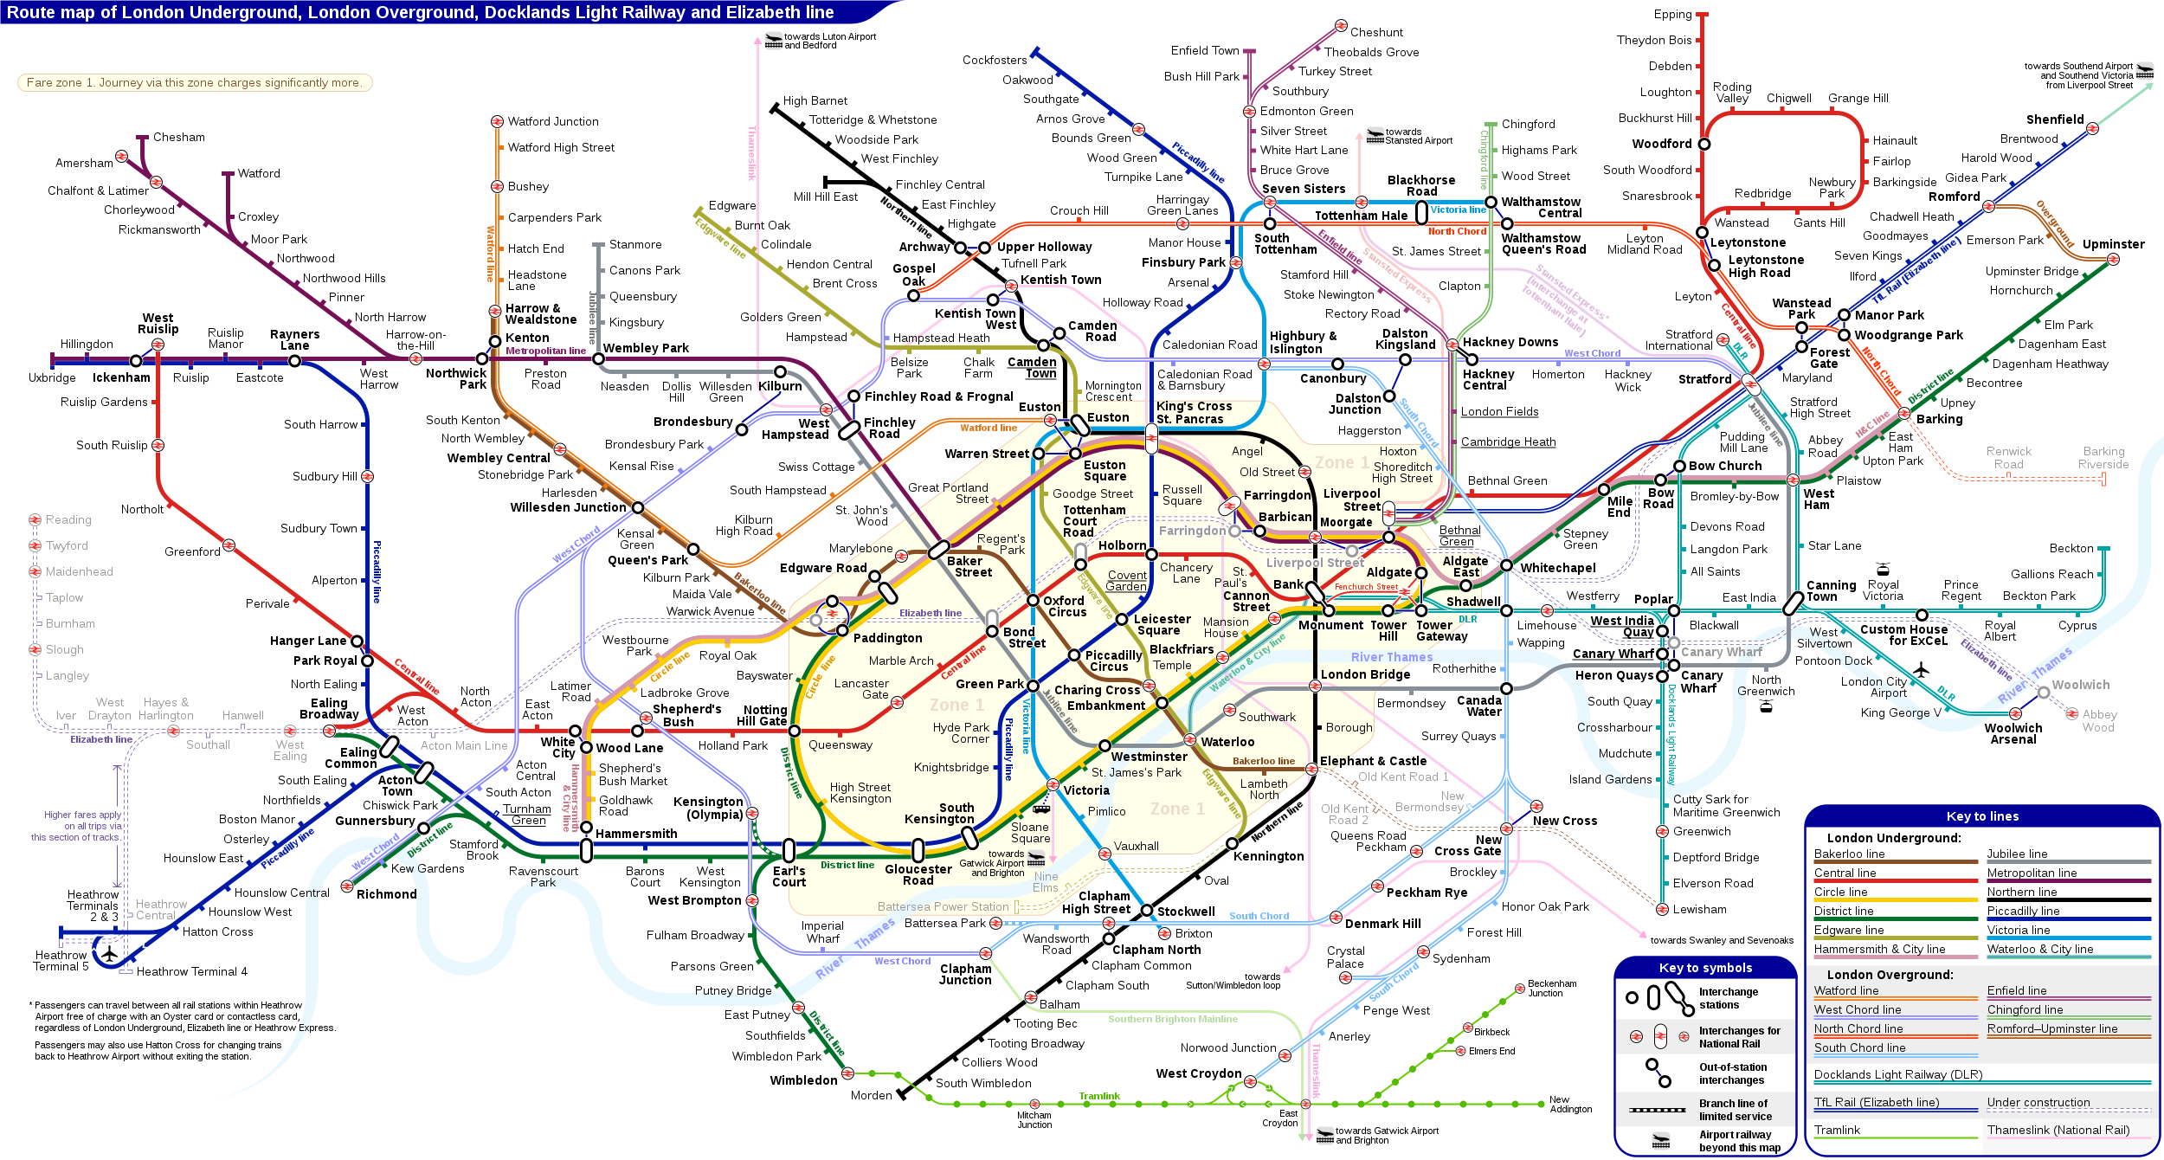
Example 3
Notes:
Would have to be completely redone for a person with no or little sight.
Colour blindness
Dyspraxia / issues with visual discrimination

Slide 11
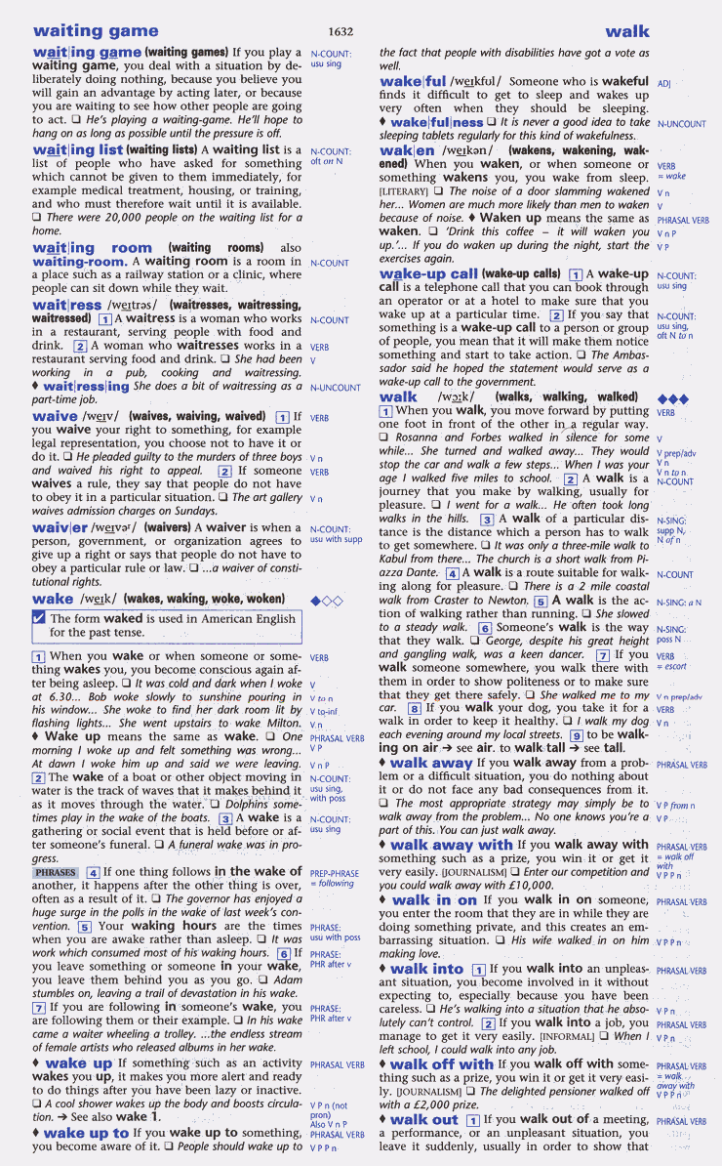
Example 4
Notes:
What is it we actually want to read? certainly not all of it.
Problems finding the information.
Text very close together
Some text is tiny.
Reading order.

Slide 12
POUR Principles
P
Perceivable
O
Operable
U
Understandable
R
Robust

Slide 13
POUR Principles 2
P
Is the text readable?
Is the contrast acceptable?
O
Are headings set up for navigation?
Are interactive elements keyboard-accessible?
U
Is the content in a logical, consistent order?
Do the tables have headings?
R
Is the document in a format useable with assistive technology?

Slide 14

What accessibility doesn't mean
Your teaching materials have to be 'ugly'
You can't use images, video, or sound.
You'll spend all your time doing 'accessibility stuff'
You have to please everybody, all of the time.

Slide 15

Accessibility Tips
  Use a sans-serif font.
  Use alt tags for images.
  Good line and paragraph spacing.
  Don't insert pictures of text.
  Don't use colour to convey meaning.
  Always check reading order.
  Ensure good colour contrast.
  Make hyperlinks meaningful.

Slide 16

Accessible Word Documents
  Use styles - don't just manually format headings!
  Use paragraph spacing and margins - don't use the enter key or space for formatting!
  Use simple table structures, and make sure you use table headings.
  Be cautious with equations and refer to appropriate guidance.
  Use bulleted or numbered lists where appropriate.

Slide 17

Accessible PowerPoint
Give every slide a unique title
Use a larger font size and sufficient white space.
Use built-in slide designs to ensure reading order.
If you're using shapes, group them together and give the group an alt tag.

Slide 18
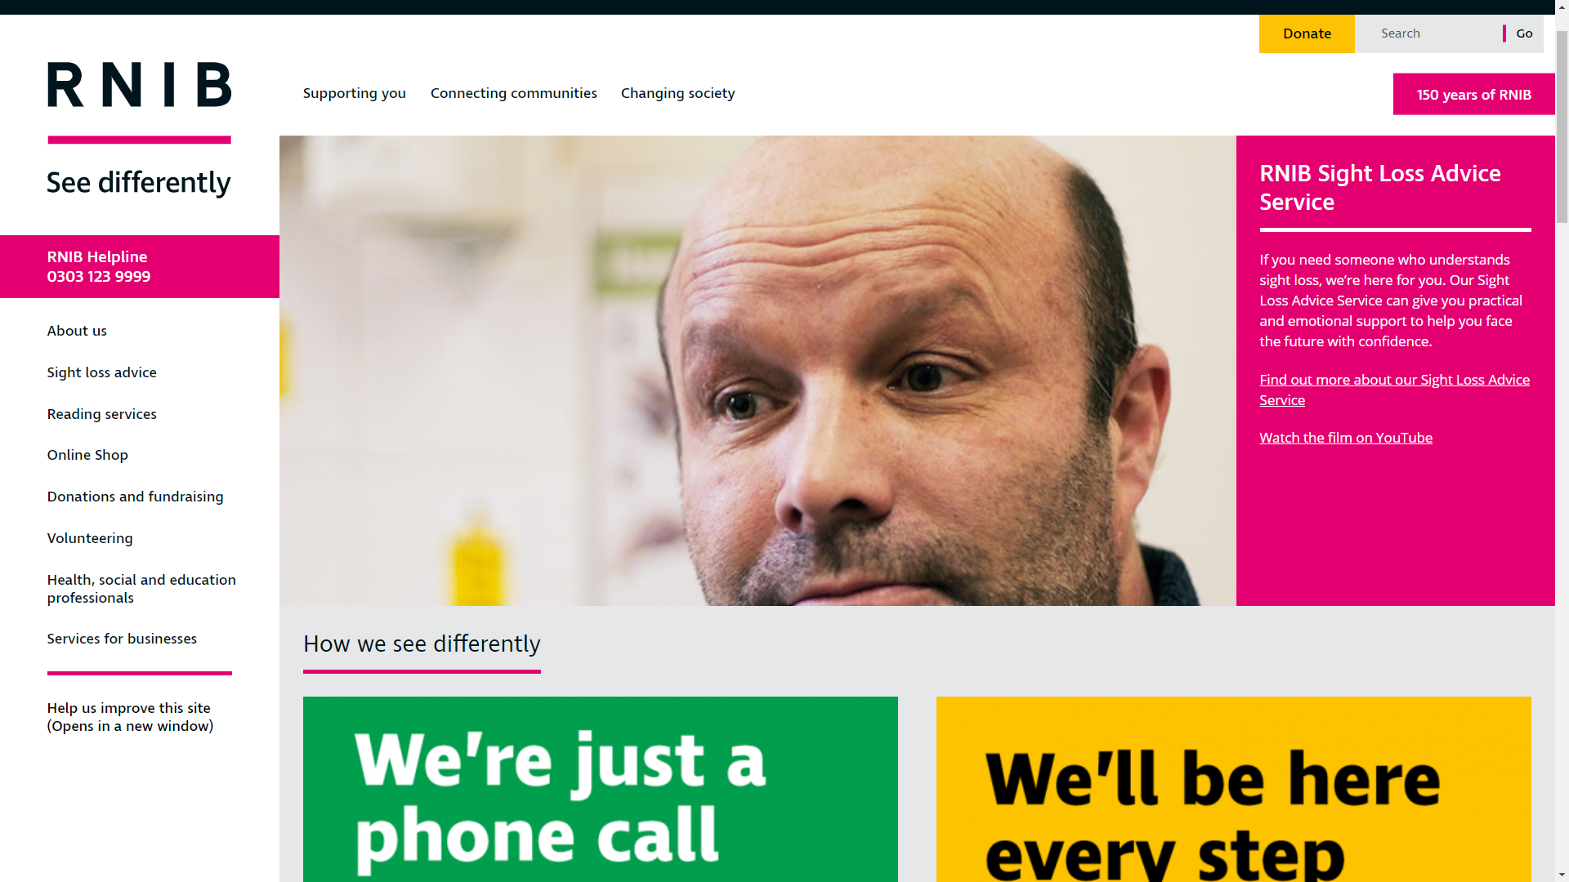
Example 1 - Accessible Website
Example
Notes:
Front page of the RNIB website
The site uses a modern design style and language, but is still completely accessiible.

Slide 19
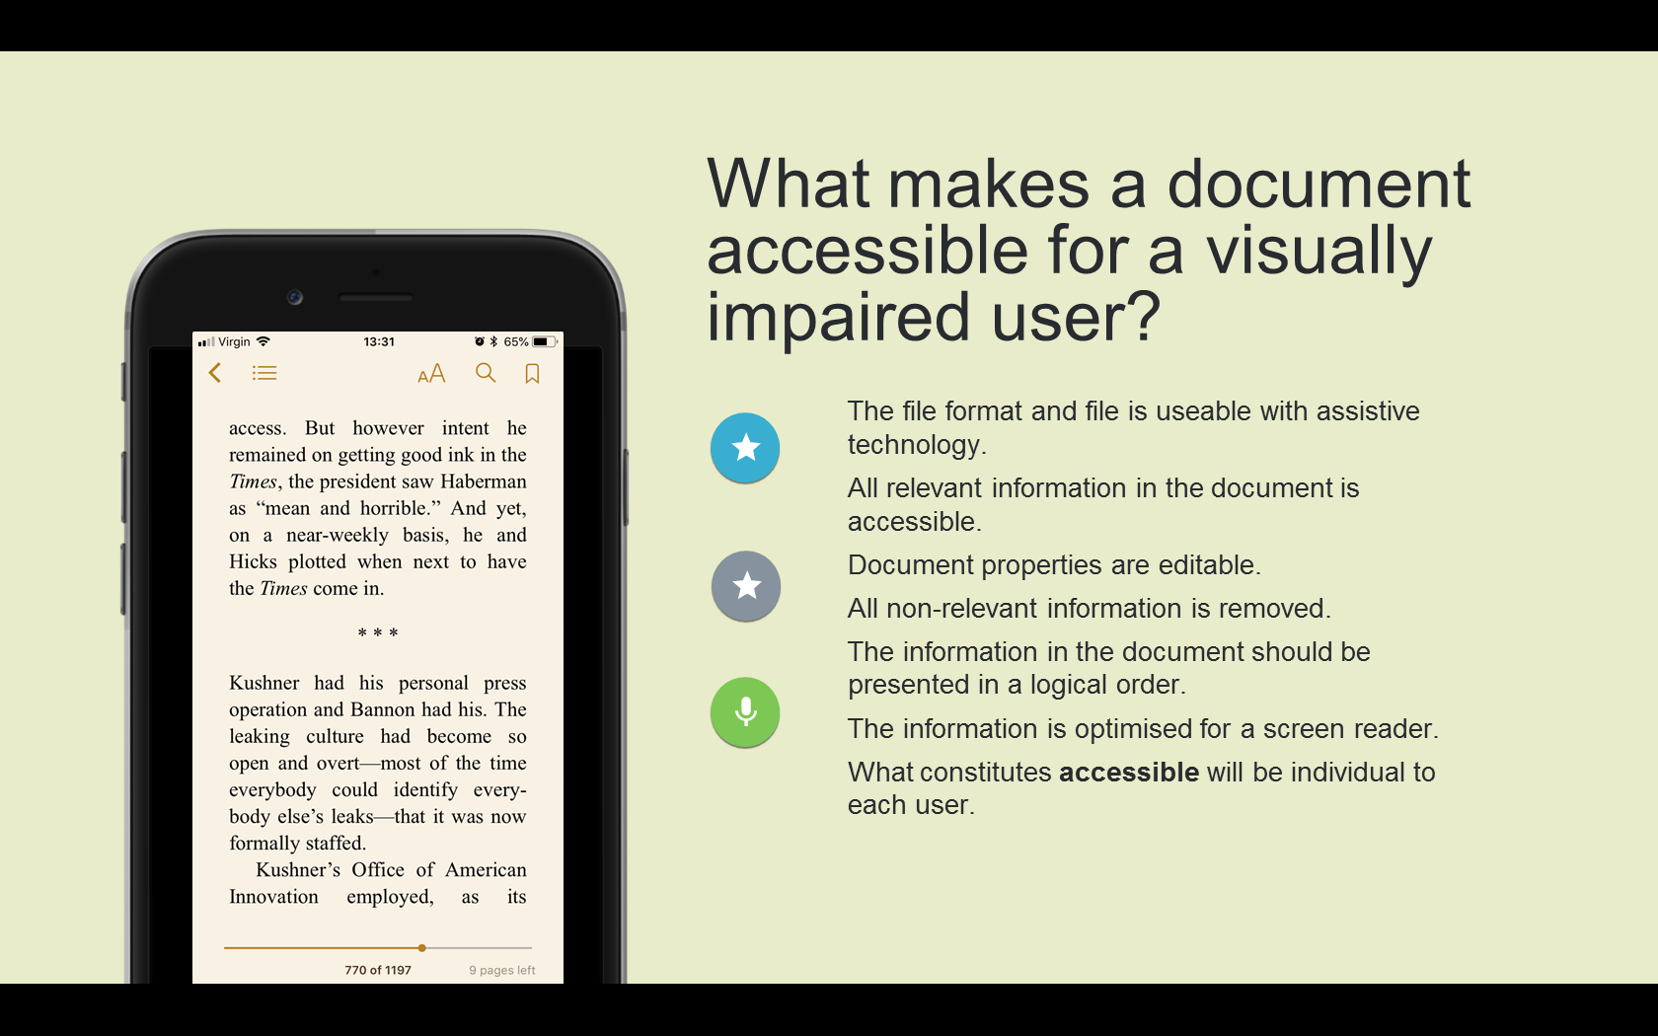
Example 2 - Accessible Powerpoint Slide
Example
Notes:
Image of a Powerpoint slide (accessible)
This Powerpoint slide uses shapes and a modern style, but is still accessible. The reading order is set, the 'phone image' has a suitable alt tag and the icons have a 'decorative' alt label.

Slide 20
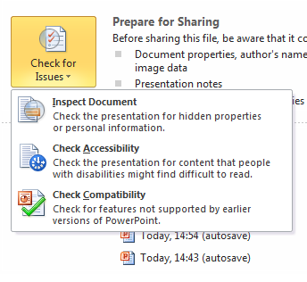
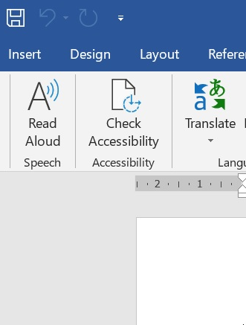
Use the Office Accessibility Checker
Office 2010
Office 2017
File > Check for Issues
Review tab

Slide 21
But....
Accessibility checkers can at best pick up about 50% of issues:
Source: AlphaGov

Slide 22
Where to Get Support
'Create accessible Office documents' by Microsoft
'Creating Accessible Content' site by UCL
Huddersfield University Digital Accessibility Pages
Birkbeck for All (includes interactive quizzes)
Inclusive Design Principles
WebAIM Contrast Checker

Slide 23
Next steps
SHU Group Set Up
Paper being presented to the Shaping Futures board in July

Slide 24

Questions?
Questions ?

