Slide 1

Leadership & Management Essentials: Health & Safety Module

Slide 2
Structure & Objectives
We will therefore aim to help you understand:
Why this is important.
What do we mean by sensible and effective safety management.
How to do this in practice
Where to get information and support.
What next?

Slide 3
Section 1 - Why is this important?
'Alton Towers operator fined £5million after horror crash on Smiler rollercoaster' 'which left thousands at risk of death' Daily Mirror
'No amount will ever compensate the victims' Daily Mail
Judge Michael Chambers QC called the accident a ‘catastrophic failure’ by the company involving basic health and safety measures. Metro
Chief Executive "the far bigger punishment is that we let people down with such devastating consequences"
Alton Towers

Slide 4
Why is H&S important?
Group exercise 1
Why am I here?
In groups use the flipcharts to discuss this and nominate someone to report back.
Why is this important to the University?
What's in it for me?
Section 1

Slide 5
Why is health and safety management important?
Financial Impact
Reputation
Duty of Care
H&S Management
H&S management adds value
to what we do!
Do your staff appreciate that H&S Management is more than legal compliance?
Prosecution & Litigation
Absence & Staff Turnover
Section 1

Slide 6
What happens when things go wrong?
Nottingham University Corporate Manslaughter Video
Group Work
Based on what you’ve seen from the video, what are the legal implications of an incident like this?
Don't just think about Corporate Manslaughter. What other charges could the University or individuals face? What about civil law?
Section 1

Slide 7
Health & Safety Offences Sentencing Guidelines
Introduced in 2016
Significantly increased penalties for H&S Offences
Offence | Pre 2016 | Post 2016
H&S Offences (non Fatalities) | For all organisations fines typically in tens of thousands | Potential fines in millions
H&S Offences (Fatalities) | Recommended starting point £100,000 | Starting point of £4m, depending on level of culpability. Max £10m
Corporate Manslaughter | Fine starting point £500k | Starting point of £7.5m. Up to £20m for very serious offences
In November 2018 new guidelines come in for Gross Negligence Manslaughter.
Offence Range now 1-18 years
Section 1

Slide 8
Northumbria University- Jan 2018
The University admitted breach of S3(1) HSWA 1974, accepted failure to manage the risks
Income: £247 million (for 2015-16)
Sentence: £400,000 fine, plus £26,468.22 costs.
Commentary:
HSE spokesperson said that they were happy with the fine and that they hoped it would send out the right message to other organisations that conduct similar experiments
Key theme: last minute change of plan!!
Section 1

Slide 9
Section 2 - Sensible and effective Risk Management? What are your responsibilities as a Manager?
Group work
In groups discuss your responsibilities as managers regarding health & safety and legal compliance.
What about your duties regarding students?
Section 2

Slide 10
What are your responsibilities as a Manager?
STA Policy
Academic, Technical & Professional Services Managers are responsible for implementation of the policy at operational level, including:
assessment of risks, implementation and maintenance of effective control measures;
competence with regard to the health and safety risks encountered at work;
provision of information to all staff, students, visitors, partners and contractors within the manager’s influence or control;
effective monitoring processes are in place including inspections, so that the workplace remains safe; and
effective arrangements for foreseeable emergencies.
Section 2

Slide 11
Responsibilities of Academic Managers
BEFORE the project/activity is commenced - Ensure that student projects and other activities are
risk assessed and that the risks are controlled as necessary
approved by academic supervisors and, where necessary, by technical staff
Ensure necessary training and information to enable students them to carry out the activities safely
Ensure that students are adequately supervised - based on the level of risk and the competence of the student
Ensure appropriate emergency arrangements are in place
Section 2

Slide 12
Section 3- A good H&S management system
holds people to account;
promotes understanding of health and safety risk profile;
clear responsibilities and accountabilities;
communication and consultation on health and safety;
health and safety competency;
is integrated into planning;
Allocates sufficient resources;
Measures and reviews performance;

Slide 13
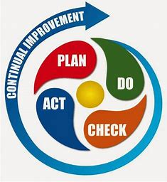
How do you make it happen?
Basis for OHSAS 18001/ISO 45001
Section 3

Slide 14
What do managers need to do?
Keep records and update
Risk
assessments
Housekeeping
inspections
Risk
controls
Manager
Communicate information
Emergencies
Training, competence, supervision
Report
accidents

Slide 15
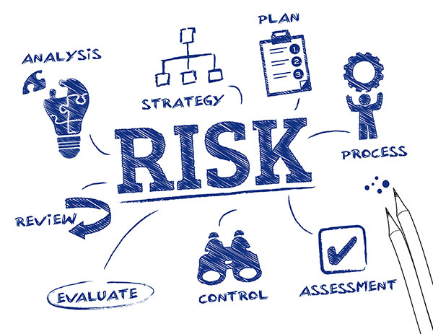
Section 3

Slide 16
Section 3 - Key components of a health and safety culture
Visible commitment;
informing and consulting;
everyone has a role to play;
co-operation between employees;
two-way communications, and
high quality of training.

Slide 17
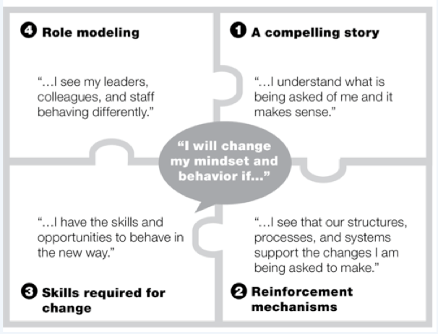
Section 3 How to do this in practice - Group work 3
Group work - What do the four stages of this diagram suggest you could or should do to improve health and safety management?
Work through the steps, in groups, to identify the compelling story around H&S, the reinforcement mechanisms required, the new skills required and how you can role model this.
Influence Change
Section 3

Slide 18

Information and support?
Health, Safety and Wellbeing Corporate site
Health and Safety Faculty Site
Brian Trevelyan​ Harmer 2418 Weds,Thurs & Fri X4222 Trevor Cooper 1-11 X2805
Other sources of information
Health and Safety Executive
UCEA
Section 3

Slide 19
What Next?
Spend 10 minutes as individuals completing the personal Commitments form. Then join together with the people from the previous group and identify any common actions and things that need a joined up solution.

Slide 20
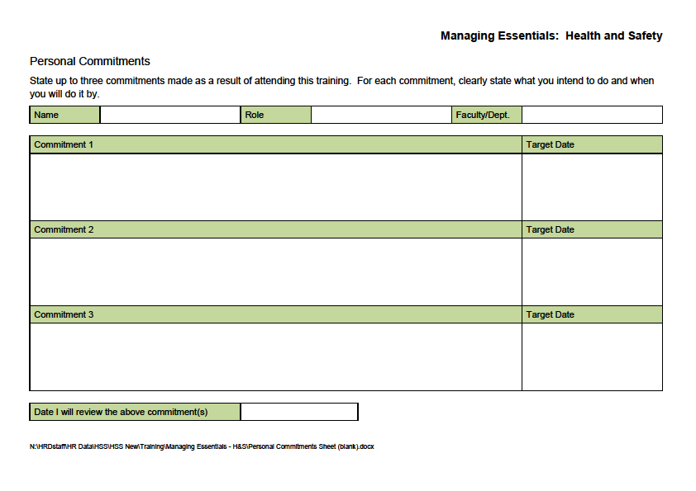
Section 4

Slide 21
Structure & Objectives
We will therefore aim to help you understand:
Why this is important.
What do we mean by sensible and effective safety management.
How to do this in practice
Where to get information and support.
What next?

