Slide 1

Training for Chairs of Panels in the Recruitment and Selection Process

Slide 2
Context
New Transforming Lives Strategy
Launch of the new Equality Objectives
Competitive Market - increasing competition for quality staff

Slide 3
Core Principles - Recruitment and Selection at Sheffield Hallam
Equality, diversity and inclusion - All of our recruitment and selection activity will be designed to identify the best person for the job, eliminate bias or discrimination and make sure all applications are considered on merit.
A positive candidate experience - It's vital that we think about recruitment and selection as a two-way process which should give candidates a positive impression of Sheffield Hallam as an employer whether they are successful or not.
Effective selection - Shortlisting, robust and appropriate selection and effective appointment decision-making.

Slide 4
Equality, Diversity and Inclusion
31.12.17 - Existing staff
Notes:
All Staff: Sector: 12.3%% of FT staff and 10.5% of PT staff were from a BAME background
Yorkshire & Humber (Y&H): 9.4% of FT staff and 8.6% of PT staff were from a BAME background
SHU: 7.5% of FT staff and 4.6% of PT staff were from a BAME background
Academics: Sector: 14.7% of FT and 10.6% of PT academics were from a BAME background.
Y&H: 12.9% of FT and 6.5% of PT academics were from a BAME background.
SHU: 10.4% of FT and 5.1% of PT academics were from a BAME background.
Non-Academics: Sector: 10.1% of FT and 10.5% of PT non-academics were from a BAME background.
Y&H: 6.1% of FT and 9.9% of PT non-academics were from a BAME background.
SHU: 4.9% of FT and 4.2% of PT non-academics were from a BAME background.

Slide 5
Statistics - the current recruitment position

Slide 6
Unconscious bias
Unconscious biases are social stereotypes about certain groups of people that individuals form outside their own conscious awareness.
Unconscious bias is a quick and often inaccurate judgment based on limited facts and our own life experiences. These judgments can give individuals and groups both unearned advantage and unearned disadvantage in the workplace

Slide 7
Q1. A study done by the DWP using false identities concluded that jobseekers with ‘white-sounding names’ could expect to receive one positive response for every nine job applications. How many CVs did they find a candidate with ‘Asian or African sounding names’ had to distribute in order to obtain an interview?
Nine – the same as those with ‘white sounding names’.
12 CVs in order to obtain one interview.
16 CVs in order to obtain one interview.
19 CVs in order to obtain an interview

Slide 8
Q2: What percentage of recruiting managers in the UK admit to negative biases towards individuals with certain regional accents?
a 15%
b 37%
c 55%
d 80%

Slide 9
Q3: Women begin to be discriminated against as a result of their weight when their BMI is 27. Men are at risk of discrimination when their BMI is
a. 25
b. 27
c. 31
d. 35

Slide 10
Q4 In the U.S. 15% of the population is over 6 feet tall. What % of CEO`s in the U.S are over 6 feet tall?
a. 5%
b. 25%
c. 45%
d. 60%

Slide 11
The Unconscious Bias Toolkit
Implicit Association Test
Individual self-reflection activities
Team Activities
Materials from Academic Leaders session - Jennifer Saul
Reading materials - literature review and case studies

Slide 12
Exercise Unconscious Bias
What stages of the recruitment process at SHU do you think unconscious bias could come in?
How might it manifest itself?
What is your role as panel chair to ensure unconscious bias is not a factor in recruitment decisions?

Slide 13
The Candidate experience
A positive candidate experience - It's vital that we think about recruitment and selection as a two-way process which should give candidates a positive impression of Sheffield Hallam as an employer whether they are successful or not.

Slide 14
Manage the overall Candidate Experience by :
Responding to candidates' queries quickly
Shortlisting in a timely manner
Letting all interviewed candidates know their selection outcome as soon as possible
Providing quality and timely feedback
Chairs sending HROD the information required to send a formal offer within days of the candidate accepting verbally.
Ensuring that appropriate "onboarding" activities are carried out

Slide 15
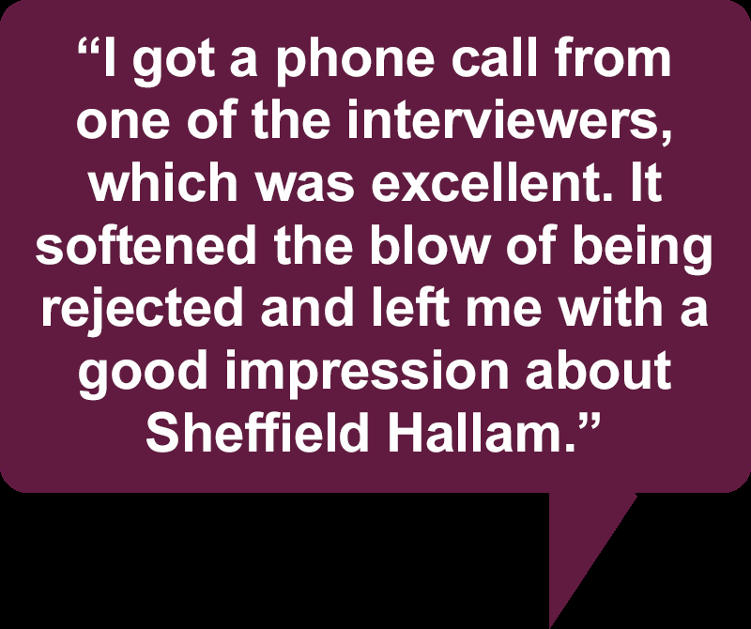
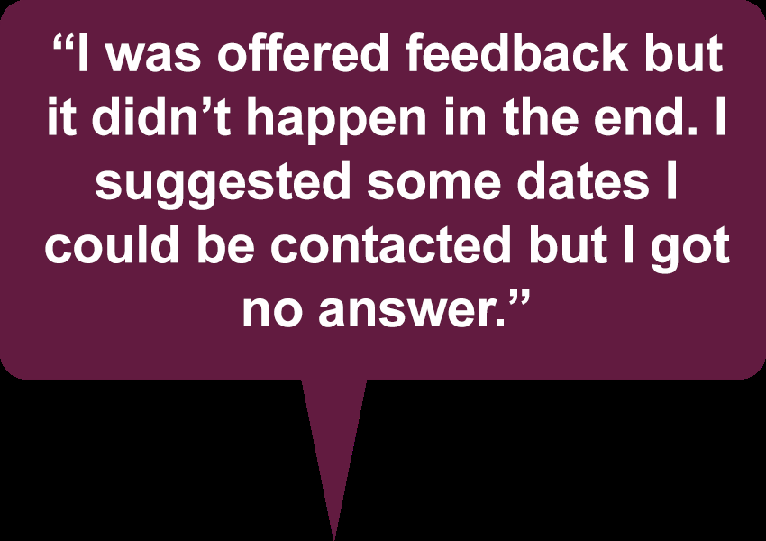
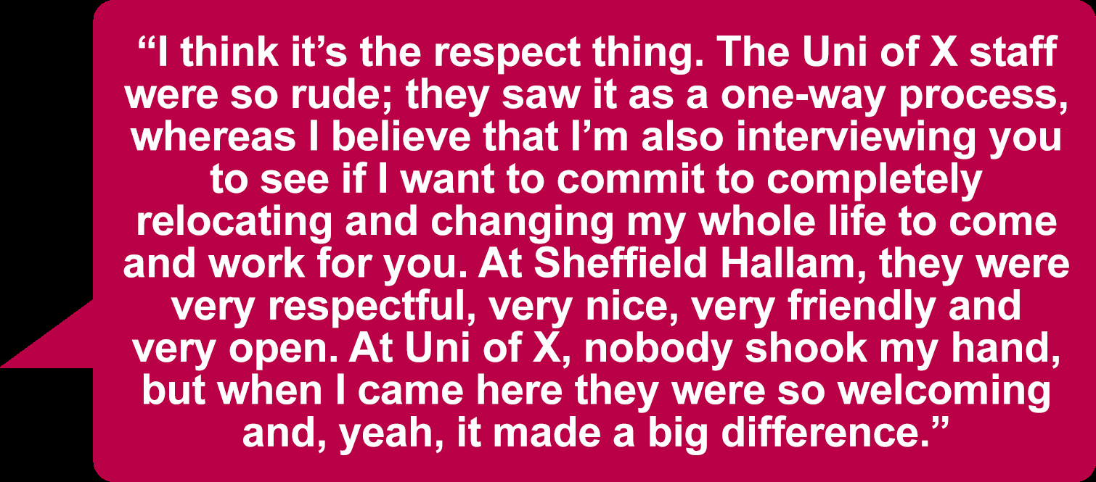
A Positive Candidate Experience?

Slide 16
Effective Selection -
Selection Event Planning
Exercise :
What do we do as chairs to ensure the selection event is as inclusive as possible ?

Slide 17
Effective Selection-
Job Information
How can we ensure the job information we provide appeals to a diverse audience?

Slide 18
Effective Selection -
Advertising & Attracting
Our Employee Brand
http://www.shu.ac.uk/jobs/people/profiles.html
Our Adverts
Keep it upbeat, simple, short
Don't repeat information
Be specific
Reflect the job requirements

Slide 19
Effective Selection -
Shortlisting
As a Chair you can make the final decision
You don't need to interview everyone.
The shortlisting matrix is your evidence that the decision about who to invite to interview was fair and equitable.
Ensure that any candidate who declares a disability / is a concurrent redeployee and meets the minimum (i.e. essential) criteria is invited to interview.
Chairs must read (or forward electronically if the panel is shortlisting separately) an agreed equality, diversity and inclusion statement to all staff on the shortlisting panel before shortlisting begins.

Slide 20
Effective Selection -
Overcoming Shortlisting Bias
Don't shortlist by yourself
Each panel member shortlists independently and meet to discuss decision
Do not compare candidates with each other - assess against the criteria
Do not make assumptions about gaps in service
Allow sufficient time - time pressures or other distractions may increase bias
Those people shortlisting are the members of the selection panel

Slide 21
Effective Selection -
Overcoming Interview Bias
Pre meet to prepare questions and scoring
Make sure everyone involved in scoring, or making selection decisions based on the assessment tool is clear on how the scoring system works.
Make sure all candidates are asked the same questions

Slide 22
Effective Selection . Making the Offer - Chairs Responsibility
Contacting successful/unsuccessful candidates
Paperwork to be returned to HROD

Slide 23
Your responsibilities summarised
Understand the make up of your existing staff group
Consider advertising strategies - for example, targeting underrepresented groups, using specific media ( e.g. social media)
Ensure assessment methods are appropriate for the position and candidates are assessed against the person specification
Encourage a diverse selection panel representation and panel members have completed the online unconscious bias training
Challenge inappropriate behaviour and practice (within the panel)
Adhere to the Disability Confident scheme.
Ensure that Chairs read the diversity statement at each stage of the recruitment process
Shortlisting in line with the identified criteria for the role
Summarise interview notes onto the interview assessment forms
Agree who will give feedback (if not you)
Ensure all actions related to "Making the Offer" are carried out
Delivering a positive candidate experience throughout

Slide 24
Further Information
https://implicit.harvard.edu/implicit/uk ( a set of short questionnaires to assess an individuals disposition to a variety of characteristics)
https://portal.shu.ac.uk/departments/HRD/development/yourself/Pages/Unconscious-Bias.aspx
https://portal.shu.ac.uk/departments/HRD/development/yourself/Pages/UB-Toolkit.aspx

Slide 25

Final Questions?

