Slide 1
Shaping Futures
Digital Enhancement Projects

Slide 2
WISEflow from UNIwise
Digital exam & assessment
– more than paperless

Slide 3

What is UNIwise?
Customers
Universities
Technical Universities
University Colleges
Business Schools
Vocational University Colleges
- in 7 countries in Scandinavia, UK, Germany & South Korea
      UNIwise
      Provider of WISEflow
      Leading assessment platform
Started 2010 as a governmental project lead by University of Aarhus and the Aarhus School of Engineering
Prototype had digitized 10% of exams after 2 yrs
IP acquired and company spun out 2012
Today serves 60+ institutions in HEI in Europe

Slide 4







References:

Slide 5
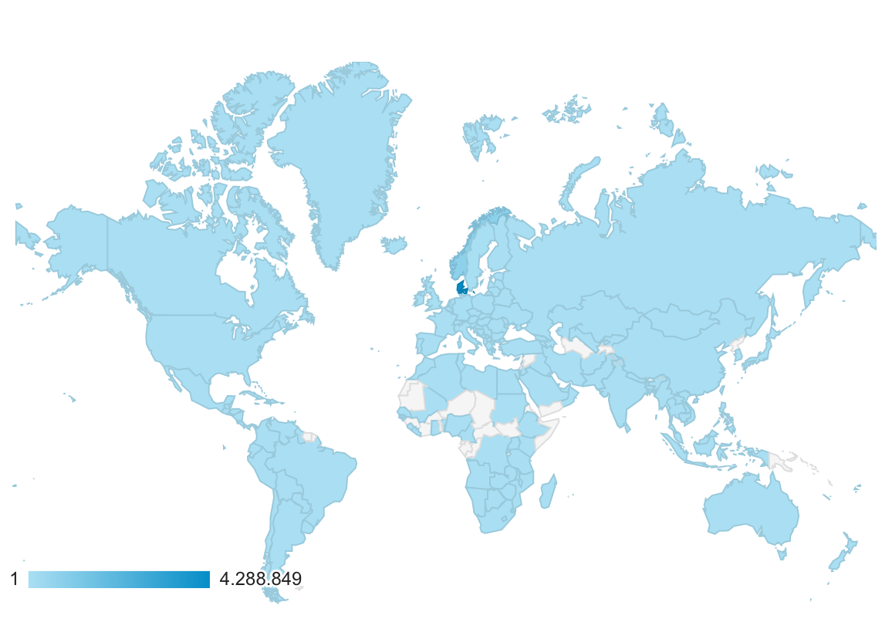
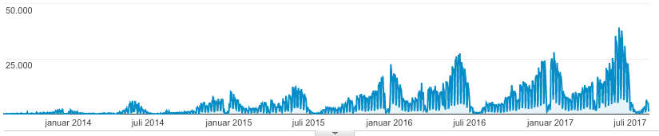
WISEflow in use
- Globalized Education
Accessed from more than 170 countries
Peak periods render 35-40.000 users daily
WISEflow has been tested live with load of 70.000 concurrent users

Slide 6
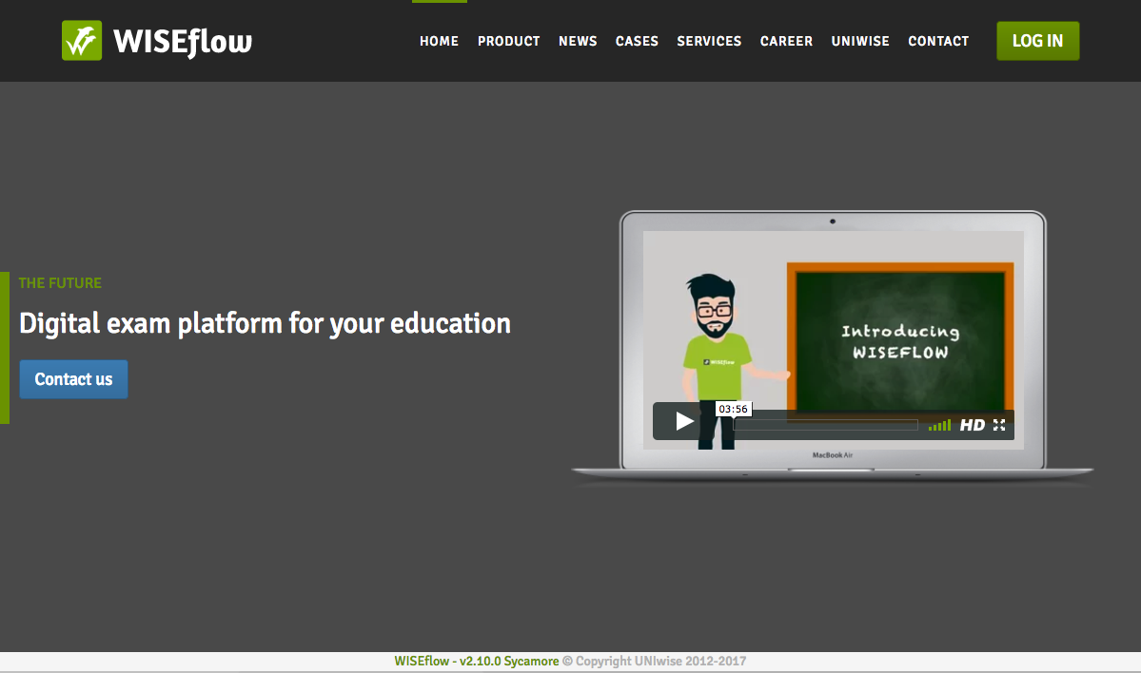
What is WISEflow?
- End to end system
Full workflow support for all jobs
          administrating
          authoring
          participation
          assessing
          proctoring
          monitoring
          reviewing
          supporting
Support all assessment formats
          Practical / Portfolio
          Thesis
          Combinations / Series
          Prerequisites
          Open book
          Closed book
          MCQ – adv. Questions
          Oral (on camp/remote)

Slide 7





Exam modules
 | FLOWassign | Assignments Open book exams (on-/off-site) Any material as appendix/additional material
 | FLOWhandin | For tests where the primary submission is not text Videos, music files and almost all other digital formats Upload up to 1gb (or 5gb) per participant
 | FLOWlock | Closed book exams on-site Fully locked down environment with no aids Internet resources may be allowed
 | FLOWmulti | Multiple choice Advanced question types Open or fully locked down environment with no aids
 | FLOWoral | Oral exams Screen sharing and presenter mode Assessment and written feedback to participants Easy scheduling of individual examination periods

Slide 8





Tools
 | Invigilate | Sign in participant for exams Administrate participants during lock down mode Make live changes and comment for all
 | Monitor | See status and progress of participants See detailed log and trails of participants actions Sort participants by status etc.
 | Review | Internal or external access to exams and handins Monitor process and results
 | Author | Create multiple choice and advanced questions Create MCQ series Question Bank (personal & institutional)
 | Assess | Make notes and comments Provide feedback to participants (written & spoken) Scoring, Marking, Moderation & Grading Rubric scoring & point giving

Slide 9
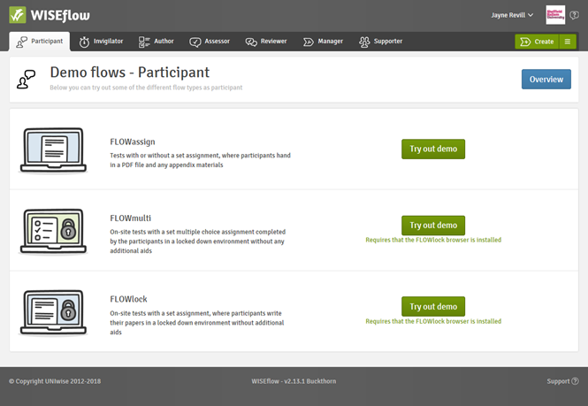
Roles - Participant

Slide 10
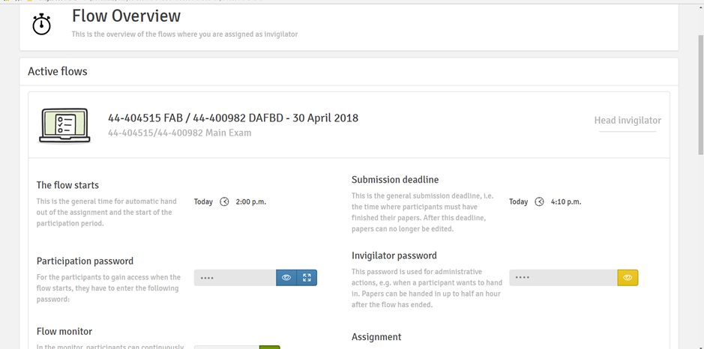
Roles - Invigilator

Slide 11
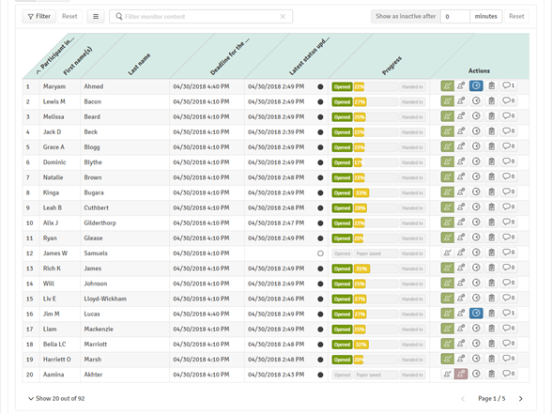
Roles - Invigilator

Slide 12
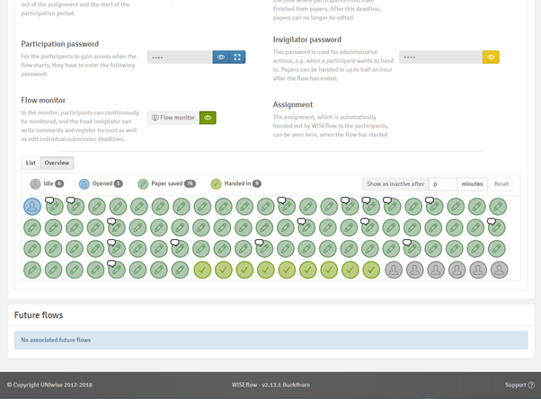
Roles - Invigilator

Slide 13
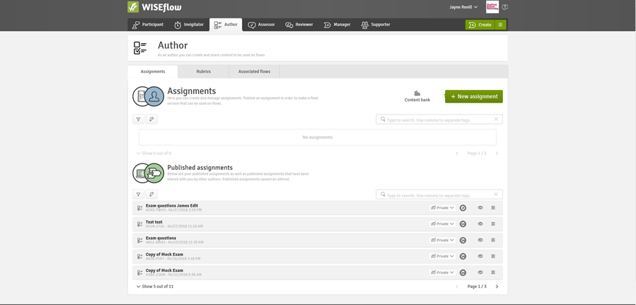
Roles - Author

Slide 14
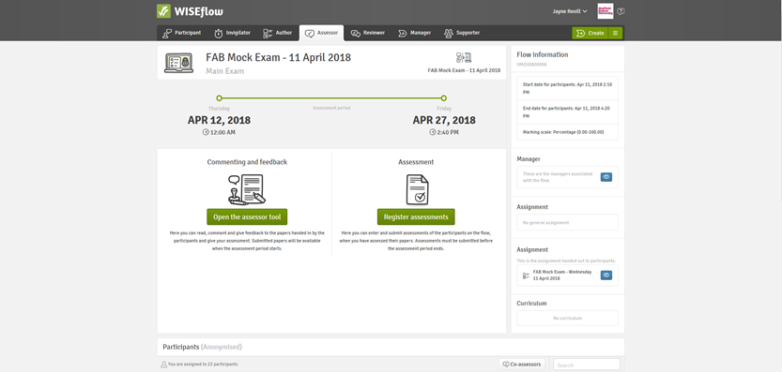
Roles - Assessor

Slide 15
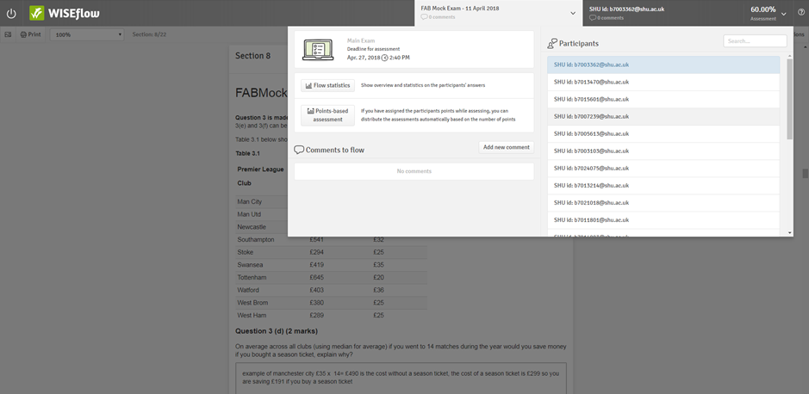
Roles - Assessor

Slide 16
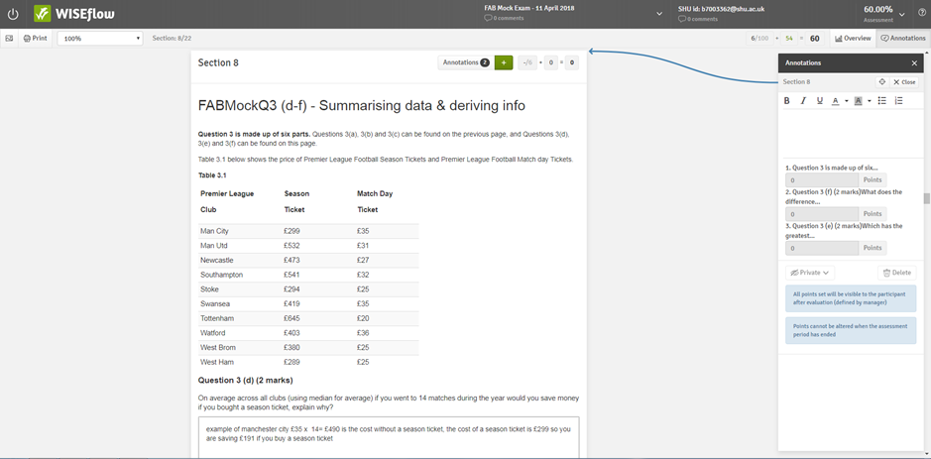
Roles - Assessor

Slide 17
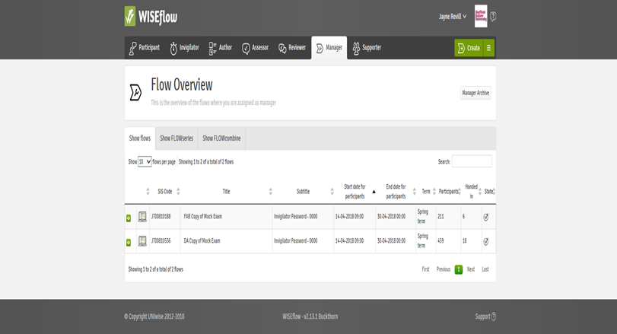
Roles - Manager

Slide 18
Recommendation
- Regarding digital assessment
By implementing a digital assessment platform like WISEflow, our HEI clients have shown they were able to:
Enhance quality
Raise student satisfaction
Provide better feedback
Strengthen transparency
Align test strategies
Reduce cheating and plagiarism
Heighten diversity
Expand assessment methods
Raise accessibility
Provide easier and global availability
Lower cost
Decrease manual labour by 75%
Eliminate paper & manual distribution costs
Lower human errors and reduce stress
Quality
Diversity
“Digitalisation makes it possible to stretch the iron triangle!”
Sir John Daniel, former Vice Chancellor of Open University, UK
(Referring to Adam Smiths The Pin Factory - 1776)
Cost

Slide 19
Experienced benefits of WISEflow
Students
Over 95% say “it’s easier and better” and it “improves the quality of the assignments”
Administrators
100% believes that “it’s easier and better and a lot less stressful”
Assessors/Faculty
Over 80% responded that WISEflow is “easier or at least not worse”
University Managers
Responded that WISEflow provides “better planning, control” and “the means to save resources”
Higher Educational Institutions
Studies at client universities show that by digitising their exams, they can save more than 75% of the labour force going into carrying out manual pen-and-paper-exams.
On top of this are additional savings for paper, copies, distribution, archiving, invigilators and more

Slide 20

Business model
Software as a Service model
Including hosting, maintenance & development
  PILOT
  Pay for consultancy
  Limited number of students and exam
  OPERATION
  Yearly license based on student count
  Consultancy and training after t/m
  Integrations after t/m
  Select/deselect major modules

Slide 21

IT Security
Processes and IT Security Policy based on ISO 27001
  Documented processes, access logs, controls & risk log
  Reviews, Q&A processes and controls on intervals
ISEA 3000 certified
Data Processing Agreements with clients
Sub contractors comply to same requirement/regulation as UNIwise
  Comply to ISO 27001 & more
Prepared for the new EU Data Protection Act (May 2018)

Slide 22




Technical requirements and constraints
WISEflow in general: modern browser across basically all devices
  Any OS
  Any device
  => Modern browser ie.: Chrome, Firefox, Safari, Opera, Internet Explorer 10/11/Edge
WISEflow with locked down functionality for on site exams
  Windows (7 or newer)
  Mac OS (10.10 Yosemite)
  iPad (iOS 7+)

Slide 23

Mock Exam
Wednesday 11th April
Final Summative Exam
Monday 30th April

Slide 24

What did we learn?

Slide 25

Where now?

Slide 26

Thank you

