Slide 1
From Academic Content to Professional Practice in an hour: A discipline-specific teaching & learning model to support employability & transition
Charmaine Myers - Senior Lecturer (Academic Development) Sheffield Hallam University

Slide 2
Starting Point
Transition into H.E (L & T) & Retention (Thomas, 2002)
Sheffield Hallam demographic - Sheffield City Region includes some of the most economically and educationally deprived areas in Europe
Sheffield Hallam puts the employability of its graduates at the heart of its strategy.
Sheffield Hallam ethos of Applied Learning

Slide 3
Philosophy underpinning the framework design
Learning & Teaching "issues" at L4 (Backward Design, McTighe & Wiggins, 89)
Discipline-Specific (Shahabudin, 2018)
Pedagogy for authentic learning -authentic context & task (Herrington et al, 2006)
Reflects the learner's own experience (Freire, 1968)
Roles & Perspectives (Herrington et al, 2006)
A "nod" to academic skills
Developing graduate capitals - aspirations (Tomlinson, 2017)

Slide 4
Philosophy underpinning the framework design
Orientate
Learning & Teaching "issues" at L4 (Backward Design, McTighe & Wiggins, 89)
Discipline-Specific (Shahabudin, 2018)
Apply
Pedagogy for authentic learning -authentic context & task (Herrington et al, 2006)
Reflects the learner's own experience (Freire, 1968)
Connect
Roles & Perspectives (Herrington et al, 2006)
A "nod" to academic skills
Developing graduate capitals - aspirations (Tomlinson, 2017)

Slide 5
Aim - The Model
To develop teaching and learning environments to support transition into Higher Education
specific discipline focus
introduce notion of applied learning
link academic content and professional practice
To recognise the different backgrounds of our learners and recognise the valuable insight this can bring

Slide 6
Pilots - Will anyone engage?
pre-arrival online with Sociology
welcome week activity with Education Studies (day 2)

Slide 7
i) On-line Pre Arrival Model "A Taste of Sociology at SHU"
Orientate - Authentic context
TED-esq Talk (7 mins) by Head of Sociology (with note-taking) - allows learners to experience a "bitesize" topic/theme from their discipline.
Apply - Authentic Tasks
Here students are invited to engage with an authentic task(s) using some of the same skills and tools that are relevant to their discipline/used in the professional domain. The task(s) reflect the "Orientate" topic/theme. (approx. 45 minutes)
Reflection questions
Connect - Expert performance in a real-world context
Videos of professional practitioners, who talk about what relevance the "Orientate" topic/theme has on their day-to-day roles and how it informs their services and organisational delivery (4 minutes each)

Slide 8
ORIENTATE ~ On-line Pre Arrival Model "A Taste of Sociology at SHU"
Orientate - Authentic context
TED-esq Talk (7 mins) by Head of Sociology (with note-taking) - allows learners to experience a "bitesize" topic/theme from their discipline - Social Inequality & Research Methodology.

Slide 9
APPLY ~ On-line Pre Arrival Model "A Taste of Sociology at SHU"
Apply - Authentic Tasks
Here students are invited to engage with an authentic task(s) using some of the same skills and tools that are relevant to their discipline/used in the professional domain. The task(s) reflect the "Orientate" topic/theme. (approx. 45 minutes)
Reflection questions

Slide 10
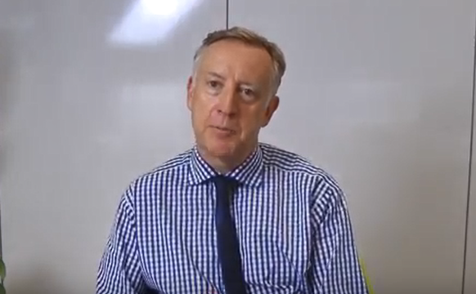
CONNECT ~ On-line Pre Arrival Model "A Taste of Sociology at SHU"
Connect - Expert performance in a real-world context
Videos of professional practitioners, who talk about what relevance the "Orientate" - Social Inequality topic/theme has on their day-to-day roles and how it informs their services and organisational delivery (4 minutes each)
Mike Garnock-Jones Director - HEPP https://www.youtube.com/watch?v=6u8y2A7ISyc
Chris Hill CEO - Element Society https://www.youtube.com/watch?v=y257nVWhg9E

Slide 11
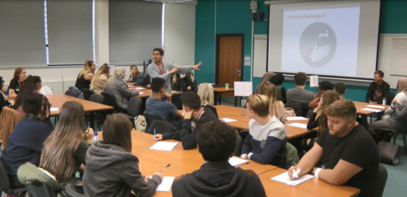
ii) Welcome Week Activity "Being & Becoming an Educationalist"
Orientate - Authentic Context
Form (pizza) groups
TED-esq Talk (10 mins) by Head of Education Studies (with note-taking) - allows learners to experience a "bitesize" topic/theme from their discipline.
Apply - Collaborative Authentic Task Here the student groups are asked to carry out authentic task(s) in Sheffield City Centre. The task(s) reflect the "Orientate" topic/theme. (1 hour)
Reflection questions
The student groups build on their findings with their own experience of the topic/theme (Over pizza lunch)
Connect - Expert Performance The student groups present their findings/poster to professional practitioners from across the Sheffield City Region and receive formative feedback

Slide 12
Sociology - i) Pre arrival (on-line) model - Evaluation & Findings
(On-line model sent to n>62 pre-arrival students. Between 14-25 September 2018 the site received the following hits)
Main Finding: Helped to set expectations from a teaching & learning perspective

Slide 13
Education Studies - ii) Welcome week activity - Evaluation & Findings
I noticed that the students were taking on board the formative feedback and adapting their plans as they went from professional to professional.
Professional Educationalist
"It made me feel like I belonged and was making a positive contribution. We received a lot of compliments (from professionals) which made us grow in confidence"
Education Studies Student
I really saw the value in this session. I wish I’d have had this on my induction week. There was the same amount of energy at the start of the session as there was 6 hours later. The students were really engaged. Alumni Observer
Transition into H.E and Enhancement of Social & Cultural Capital
Cultural - Learners presenting themselves in a credible way Identity - Learners recognising their value Social - Building professional networks and having the confidence to talk to people they don't know
Psychological - Learners adapted their presentations after feedback from educationalists
Human - developing discipline knowledge (and applying it) from the get-go
(5 Graduate Capitals- Tomlinson, 2008)

Slide 14
What would the model look like for your course?
Workshop – Discussion & Design
Orientate: Authentic Context - that reflects the way knowledge, skills & attitudes are used in real life
Apply: Authentic Activities - engaging in real world situations, or simulating them to heighten relevance and meaning (including Reflection)
Connect: Roles & Perspectives - appreciating & making use of different perspectives or roles and having or developing an analysis of stakeholder requirements

Slide 15
Next Steps - 19/20
 | Pre- Arrival | Welcome Week | L4 | L5
Sociology | Social inequality in you town or city | Social inequality in Sheffield | Core module Graduate Development 1 | Core module Under discussion
Education Studies | Education in your Town or city | Education in Sheffield | Core module Under discussion | Core module Thinking Differently (20/21)
6 x other course areas | √ | √ | √ | √

Slide 16
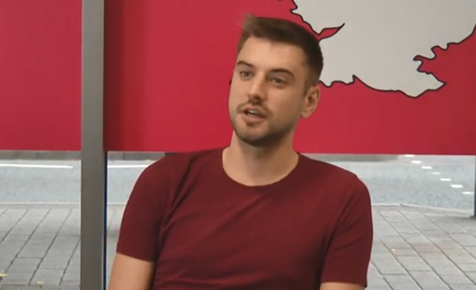
Into Level 4 - Transition through H.E
Sociology
Chris Hill CEO - Element Society
Provides a live project brief
Assessment task: ???
Authentic Assessment - Performance of relevant or real-world tasks that demonstrate the meaningful application of essential knowledge, skills or attitudes (Herrington et al, 2000)

Slide 17
Thanks for Listening
Charmaine Myers c.e.myers@shu.ac.uk

Slide 18
References
Freire, P. (1995) Pedagogy of Hope. Reliving Pedagogy of the Oppressed, New York: Continuum.
Herrington, J., Reeves, T. C., & Oliver, R. (2002). Authentic activity as a model for web-based learning. 2002 Annual Meeting of the American Educational Research Association, New Orleans, LA, USA. http://authenticlearning.info/AuthenticLearning/Home.html
Herrington. J (2006). Authentic e-learning in higher education: Design principles for authentic learning environments and tasks, World Conference on E-Learning in Corporate, Government, Healthcare, and Higher Education, Chesapeake.
McTighe, J., & Wiggins, G. (2004). Understanding by design: Professional development workbook. Alexandria, VA: Association for Supervision & Curriculum Development
Shahabudin. K et al. (2018). Right Time, Right Space? Developing an online transition course for new graduates. Journal of learning development in Higher Education. Special Edition: 2018 ALDinHE Conference.
Thomas. L, (2002). Student retention in higher education: the role of institutional habitus. Journal of Education Policy, 17, (4), pp. 423-442
Tomlinson. M, (2016). The degree is not enough’: students’ perceptions of the role of higher education credentials for graduate work and employability. British Journal of Sociology of Education. Vol. 29, No. 1, January 2008, pp49–61.
Wilcock, A. (1999). Reflections on doing, being and becoming. Australian Occupational Therapy Journal, 46(1), 1—11.

