Slide 1
International work placement research ‘Spreading Your Wings’ LTA Conference 2017

Slide 2
Project aim
To broaden the horizons of students in the Academy of Sport and Physical Activity and create new opportunities for students to live, study and work abroad

Slide 3
University context
"Our strategy has been developed against a backdrop in which today's universities are invigorated and challenged by international mobility and an increased emphasis on the importance of working across national borders."
“We will work towards all Academy students having an opportunity to be involved with international sport experiences.”
“We will provide students and staff with a wide variety of real world experiences that reflect the global sport industry.”

Slide 4
International placements
Year | Number of international placements
2010-11 | 13
2011-12 | 18
2012-13 | 23
2013-14 | 22
2014-15 | 35
2015-16 | 25
2016-17 | 20

Slide 5
Project activities
Online survey
Semi-structured interviews
Literature review
Student as researchers (data analysis)

Slide 6
Lines of enquiry
Motivations for pursuing an international work placement
How the placement was secured
Key learning, personal and professional development experiences and challenges
Advice and support received from the University
Ideas for extending opportunities to other students (expanding horizons)

Slide 7
Data collection methods
Online survey - 32 responses (16 males and 16 females)
10 in-depth semi-structured student interviews
Semi-structured interviews with 2 Academy colleagues with responsibility for employability and UG work placement
2 students employed for data analysis
Literature review underway

Slide 8
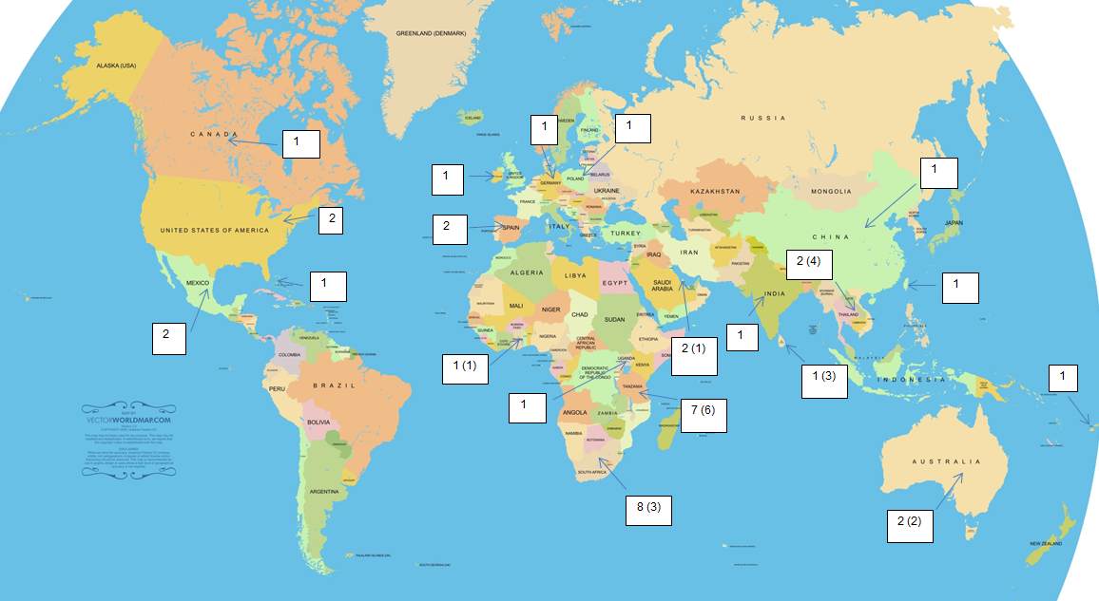

Slide 9
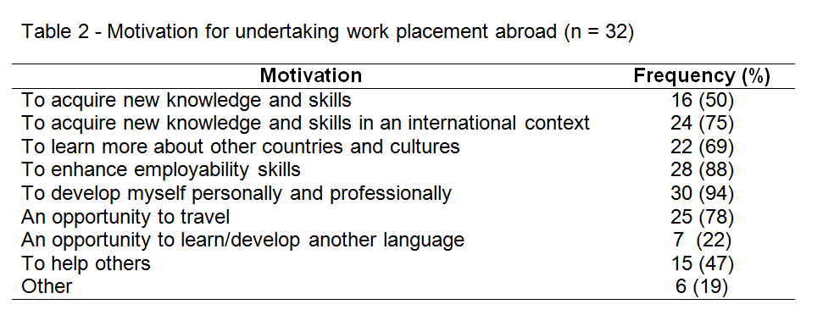

Slide 10
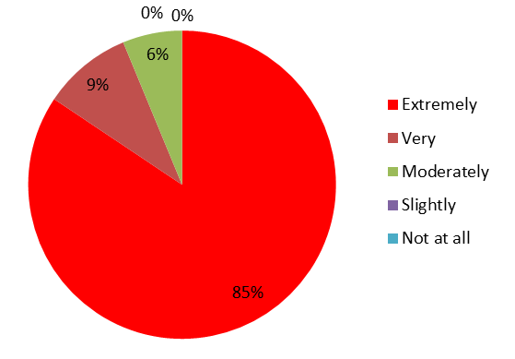
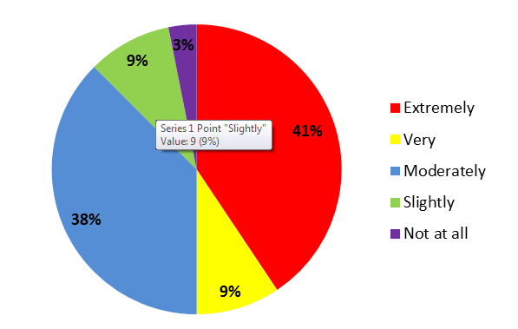
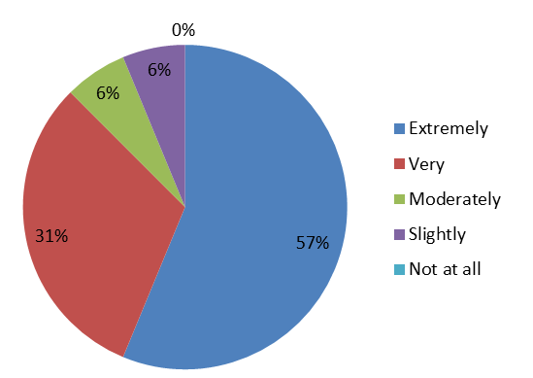
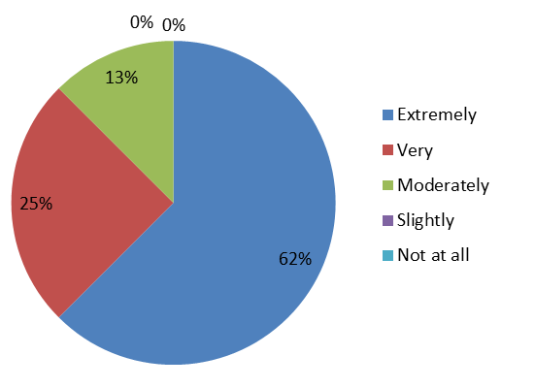
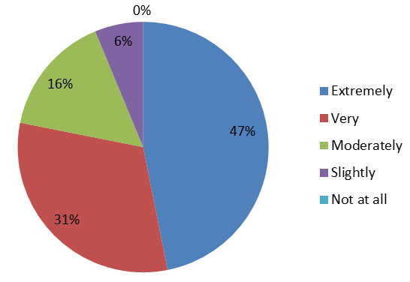
Online survey - key findings
Enjoyable
Challenging
Professional relevance
Personal relevance
Significance of learning

Slide 11
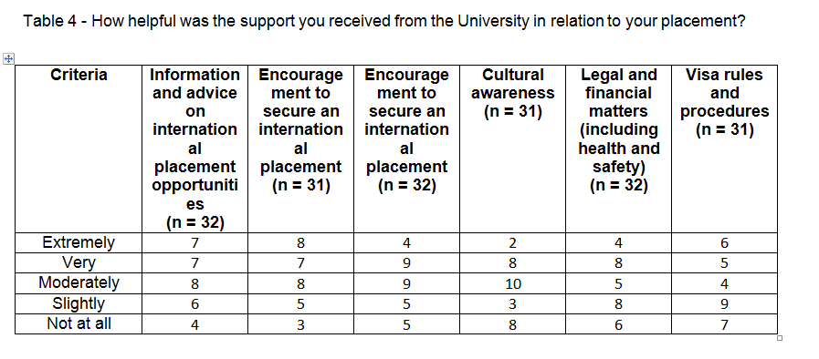

Slide 12
Additional student feedback
All students felt the Academy should encourage students to go on international placement with 78% of students feeling SHU should be securing more international placement opportunities

Slide 13
Additional student feedback
21 students commenting the placement had 'very much' influenced their life choices with 75% of respondents’ aspirations for the future changing

Slide 14
Student interviews
Some highly significant learning experiences
Evidence of transformation in some students
Learning from challenge and adversity
Experiences which in some cases have influenced students’ attitudes, beliefs, career and life decisions
A belief that the University could do more to encourage and support international work placements

Slide 15
Staff interviews
Institutional context/direction of travel is positive (Global engagement strategy)
Significant barriers remain: - financial - insurance - staff attitudes and motivation - resourcing the work - consistency of approach - institutional procedures and attitudes to risk - inflexible placement model
Turning University ambitions and rhetoric into reality

Slide 16
Development opportunities
Students and alumni as IWP advocates/ambassadors
Post-placement mentoring
Home-based placements – challenging communities, exposure to ‘other’
IWPs outside of sport?
Consistent information, advice and support
Exploiting international partnerships/business opportunities
More flexible placement models/options
Resourcing the work
Marketing opportunities
Performance measures?

Slide 17
Project outputs
DVD resource and written case studies – July/August 2017
Final report - September 2017
Explore publication opportunities - 2017/18

Slide 18
Points for discussion
Shared or different experiences?
How can the research findings be enhanced?
Further opportunities for dissemination?
Additional research opportunities?

Slide 19
Contact
Chris Cutforth, Academy of Sport and Physical Activity
01142255626
c.cutforth@shu.ac.uk

