Slide 1
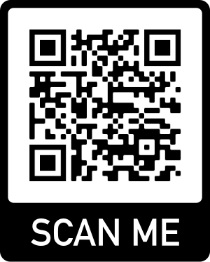
https://forms.office.com/r/5XRFPGmivk

Slide 2
Culture Connect
Information session
with Samantha Logan and Holly Stark

Slide 3
What is Culture Connect?
University-wide
Support for new students
Semester based
Benefits
Intercultural
Progression

Slide 5
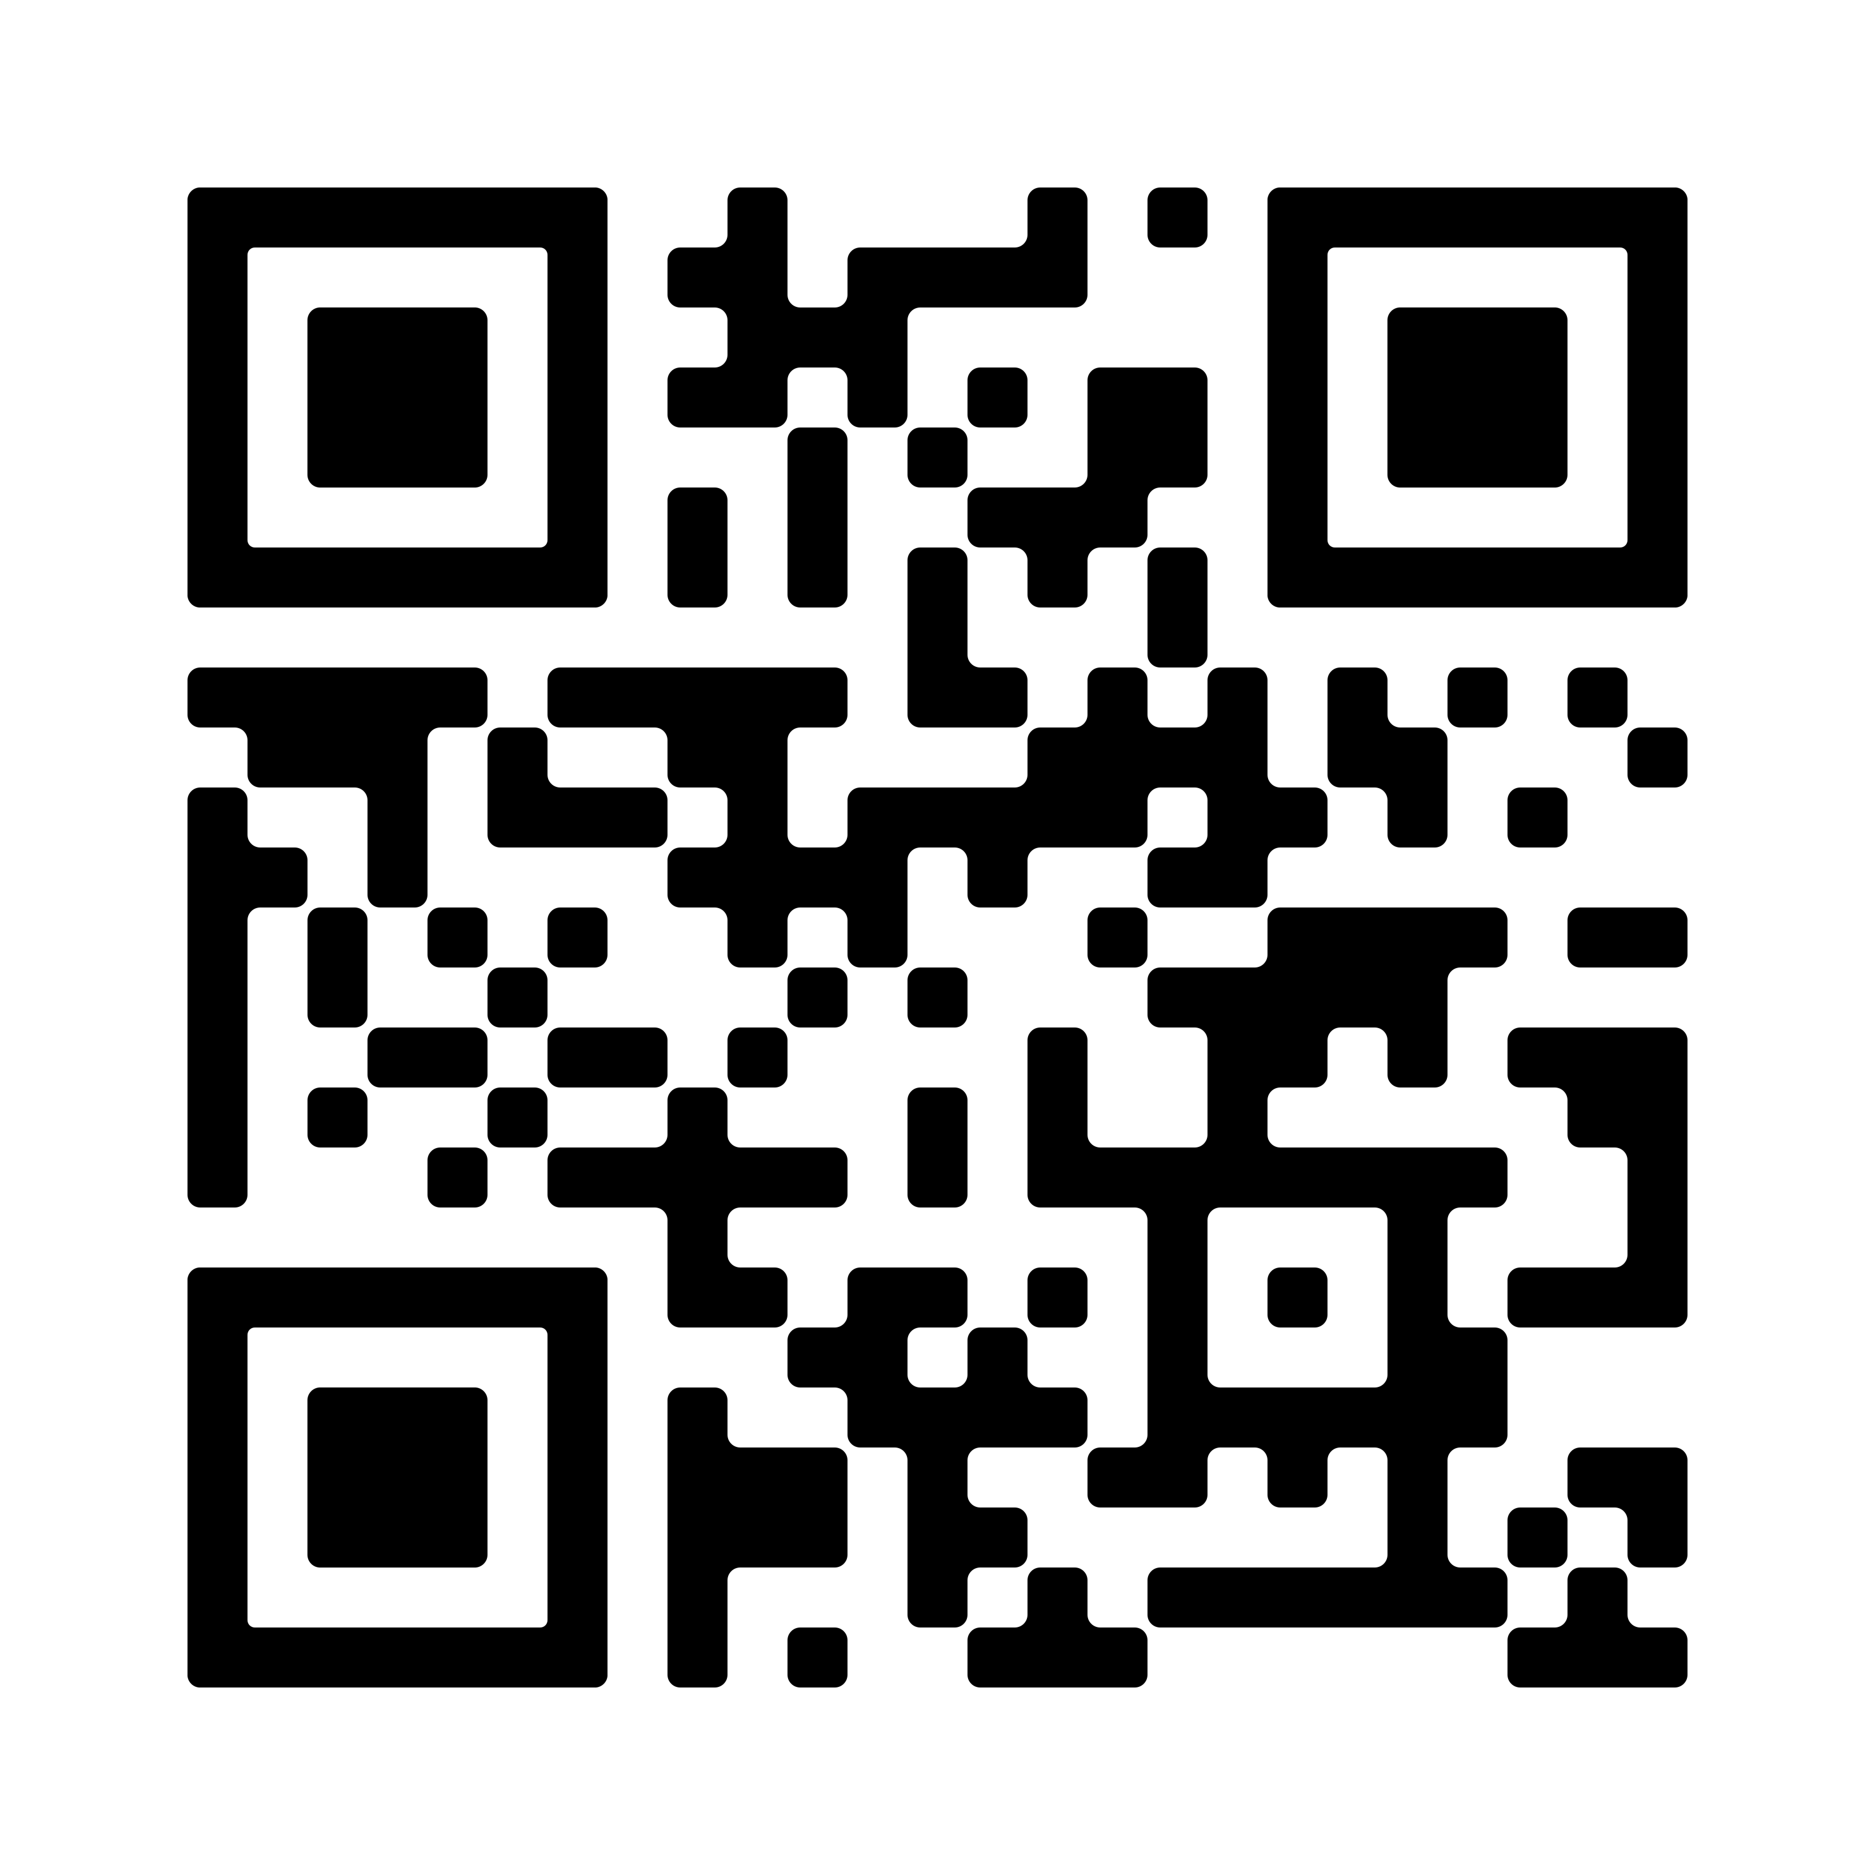
How to join?
Go to link
https://tinyurl.com/ccmentee22
Sign up
by Sunday 30 January
Get matched
by Friday 4 February

Slide 6
Scheme format
Important to get in touch with your mentor
Assigned a Super Mentor
3 meetings from February-April
Online or face-to-face
Boundaries
Log meetings online
Keeping in touch

Slide 7
Student perspectives...

Slide 8
https://forms.office.com/r/5XRFPGmivk

Slide 9
Thank you
Any questions?

