Slide 1
Landscape Lab Wednesday lunchtimes
Note all material here is entirely informal, exploratory and used as prompt for discussion and debate!
12/10/22

Slide 2
Landscape Lab – AIM Day follow-up
Some really wide-ranging discussions
Lots of enthusiasm from staff across disciplines
Strong incentive from SHU to support follow-up with identified potential
What are our priorities in the short/medium term?
12/10/22

Slide 3
Quick wins / clear outcomes
Projects possibilities identified from AIM Day:
What | Who… (plus others!)
Review of YW 6 capitals tools | Peter Wells / CRESR / SBS
Communications and engagement | Becky Shaw +++
ARK project | Tom Payne / Julia Udall
‘Future Catchments’ visioning | Jon Bridge +++
Update/collate baselines on key landscape metrics* | SHU ORRG / SRWT M&E
*this feeds into broader theoretical underpinning for Landscape Lab
12/10/22

Slide 4
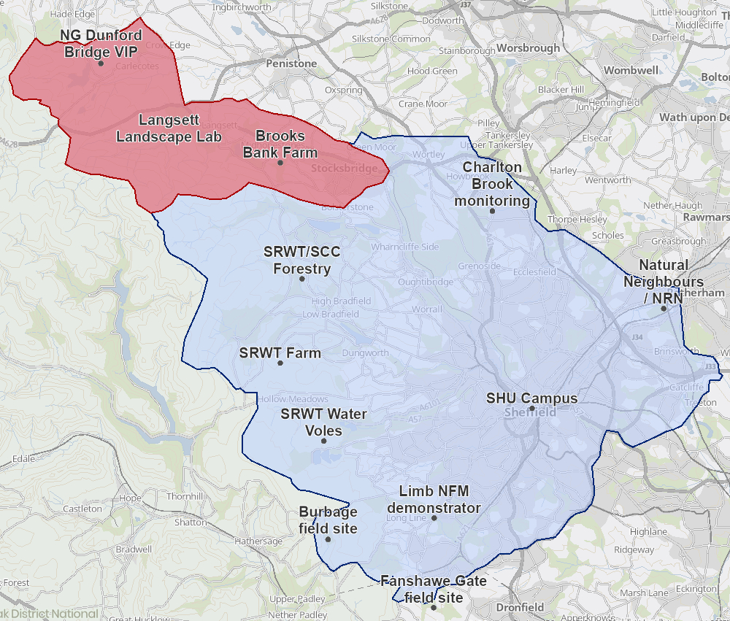
Spatial scale: Langsett in context
Landscape Lab as a component of a Living Landscape Research Hub (??!)
longitudinal data
reference standard
experimental controls
technology/practice demonstrator
knowledge sharing
12/10/22

Slide 5
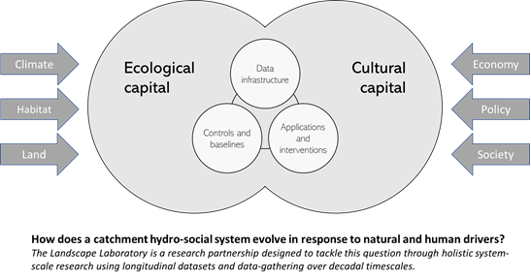
What could we do in a Landscape Lab?
12/10/22

Slide 6
How can we use these meetings?
12/10/22

