Slide 1

Finance & Planning Team Brief
13th September 2018

Slide 2
Agenda
Student Recruitment Update - Jayne Taylor
Starters & Returners - Deborah
CFPO Update - Deborah
PSOM Update - Tom
Financial Position 2017/18 - Emma
Non-pay- Emma
Your Views Survey - Simon
Charity Update - Simon

Slide 3
Student Recruitment
Jayne Taylor
Head of UK Student Recruitment Operations, Admissions and UK Student Recruitment

Slide 4

Student Recruitment

Slide 5
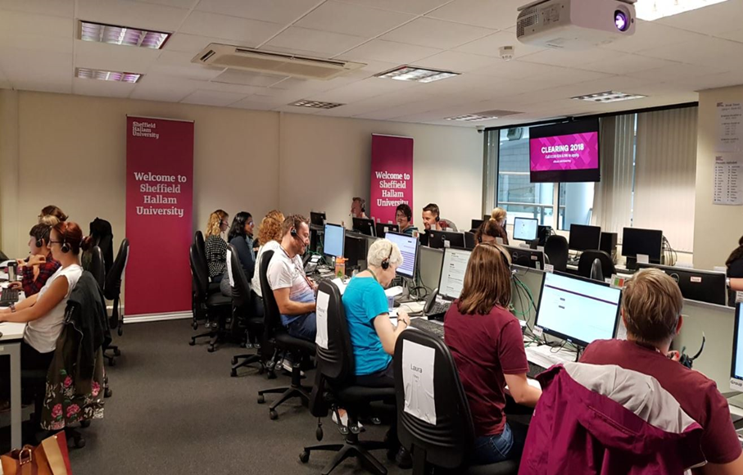
Student Recruitment

Slide 6




Student Recruitment
Competitors and Clearing

Slide 7

Student Recruitment

Slide 8

Student Recruitment
Questions?

Slide 9
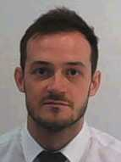
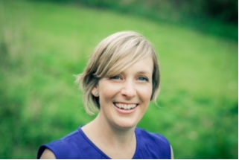
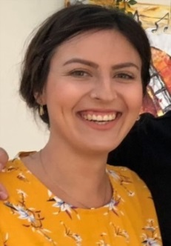
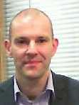
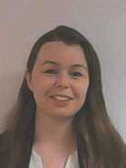
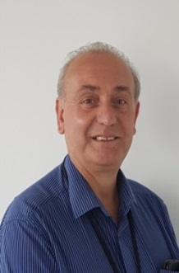
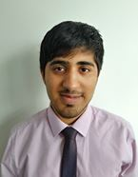
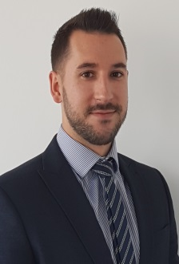

Starters & Returners
Starters
Andrew Heeley - Corporate Project Manager (SPBC)
Natalie Day - Head of Strategy and Policy Insight (SPBC)
Emma Robinson - Business Analyst (SPBC)
Michael Clark - Corporate Project Manager (SPBC)
Rebecca Baker - Business Analyst (SPBC)
Steve Silverstone - Procurement Officer (Strategic Procurement)
Tayab Fayaz - Assistant Management Accountant (Social Sciences & Humanities)
Matthew Bell - Assistant Management Accountant (Directorates)
Returners
Joanne Roberts - Communications Manager (SPBC)

Slide 10
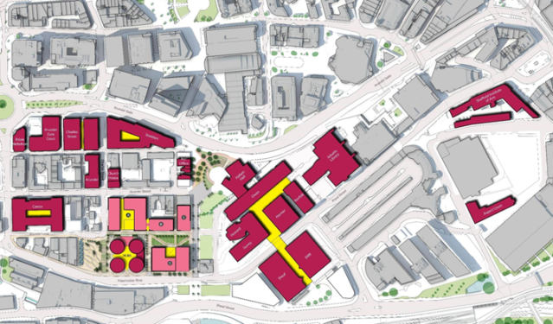













CFPO Update

Slide 11
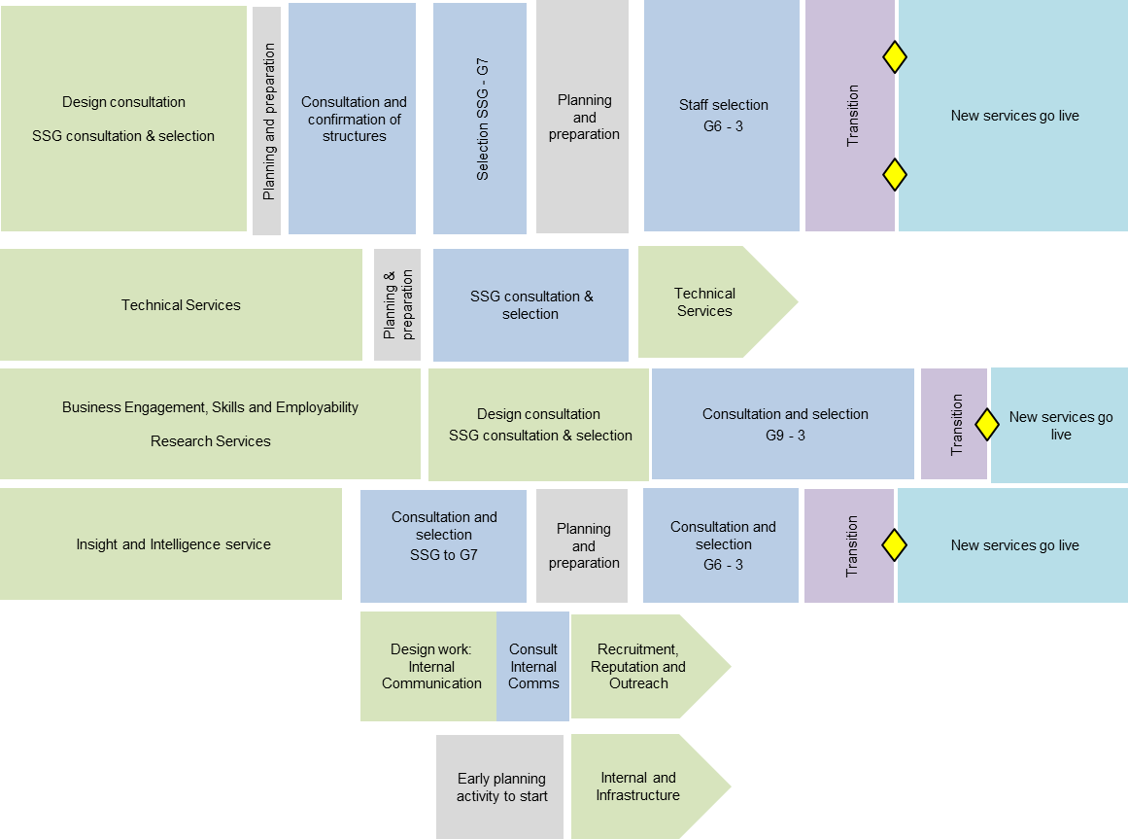

PSOM Programme Overview
Year | 2018 |  |  |  |  |  |  |  |  |  |  |  | 2019
Month | Jan | Feb | Mar | Apr | May | Jun | Jul | Aug | Sep | Oct | Nov | Dec | Jan | Feb | Mar | Apr
Student and Academic Services
Faculty Central Services
Technical Services
Business & Outward Engagement
Institutional and Leadership
Recruitment, Reputation and Outreach
Infrastructure and Internal Services
Notes:
Overview of where the different PSOM projects are.....

Slide 12
PSOM Overview
What is the project?
PSOM Design projects
Business and outward engagement
Academic services
Institutional and leadership services
Recruitment, reputation and outreach
Student facing services
Strategic insight and data

Slide 13

PSOM Programme
What are the aims of the project?
Make data more accessible
Change the culture around data quality and usage
Create an agile service model which can flex to meet demand
Enhance self-service options
Increase capabilities across the University
Allow staff to make evidence based decisions

Slide 14
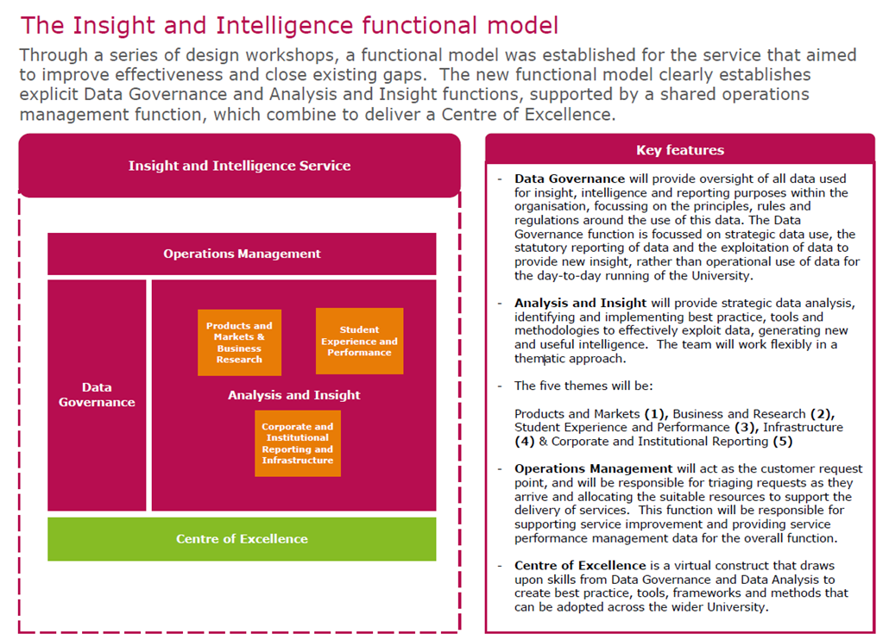
PSOM Programme
What will the new service do?

Slide 15
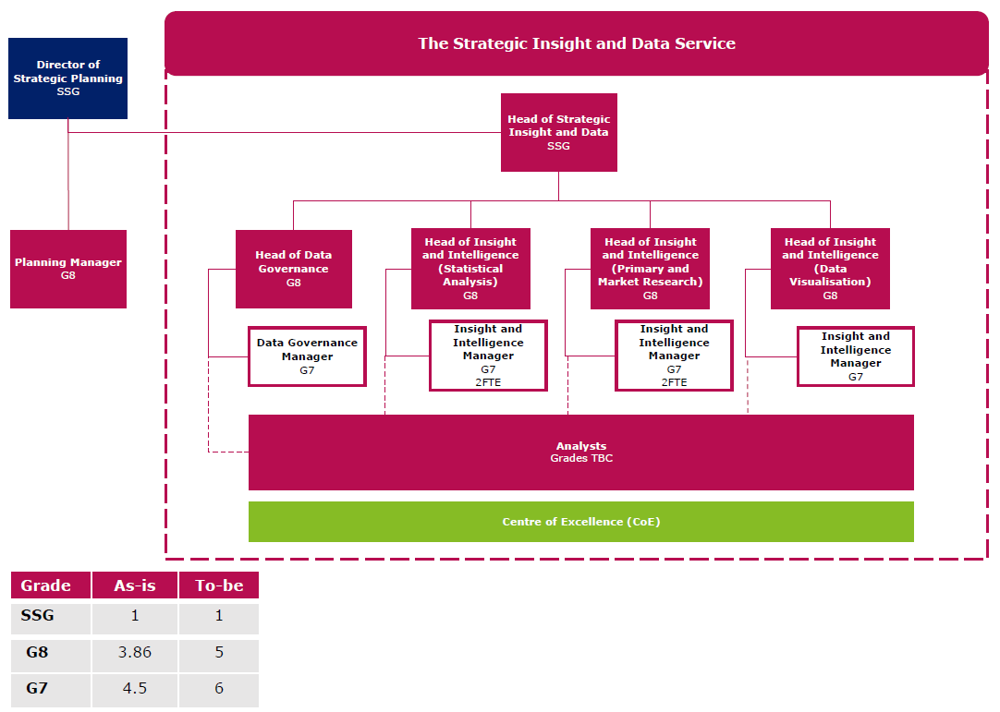
PSOM Programme
How will it be structured?

Slide 16

PSOM Programme
How does it feel?
Photo: Hamza Hydri Syed - https://creativecommons.org/licenses/by-nc-nd/2.0/

Slide 17
Financial Position 17/18
CORE Operating Activities
STA (ACES)
SSH (DAS)
Budget contribution
Budget contribution
£27.1m
£33.8m
Operating Budget
£1.3m
HWB
SBS
Budget contribution
Budget contribution
£31.6m
£23.7m
Professional Services costs £85.3m
Central costs £29.7m

Slide 18

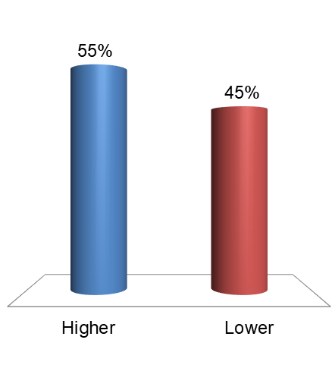

Were we higher or lower than Budget?
Financial Position 17/18
Financial Position 17/18
Higher
Lower

Slide 19
Financial Position 17/18
CORE Operating Activities
STA (ACES)
SSH (DAS)
£1.7m
£1.5m
Operational Activities Surplus
£4.2m
Full time UG students lower
FT UG & international students higher
HWB
SBS
£1.3m
£0.2m
consultancy income - savings on staff costs
International students - more home UG
Professional Services £0.3m
Asbestos Provision £1.9m
Central costs £3.7m

Slide 20

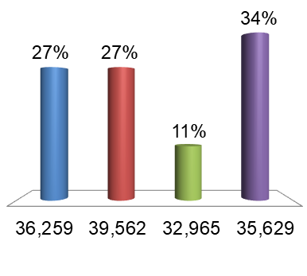
How many tuition fee invoices & credit notes did we issue?
Financial Position 17/18
Financial Position 17/18
Total income 2017/18 = £276.7m +£0.5m (0.2%), BUT.........
36,259
39,562
32,965
35,629

Slide 21

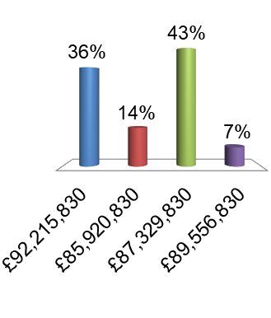
How much of this did we pay using the BACS payment system?
Financial Position 17/18
Financial Position 17/18
FACT: We spent £102.5 million on non-pay in total in 17/18
£92,215,830
£85,920,830
£87,329,830
£89,556,830

Slide 22
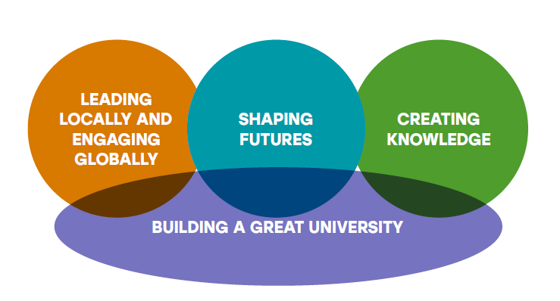
Financial Position 17/18
Strategic Investments
Planned Spend £9.6m

Slide 23
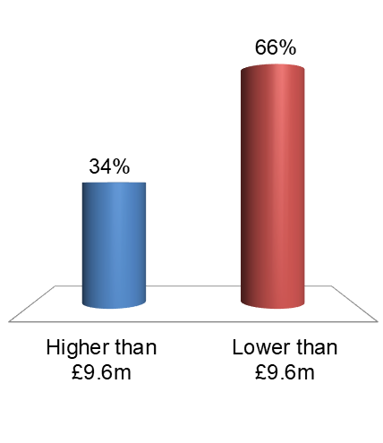
What did we actually spend on investments?
Financial Position 17/18
Financial Position 17/18
Higher than £9.6m
Lower than £9.6m

Slide 24
Financial Position 17/18
 | Actual vs. Budget
Operating Activities | £4.2m + £2.9m
Strategic Investments | (£7.6m) + 1.9m
Operating Deficit | (£3.4m) + £4.8m
Pension Adjustment | (£9.5m) - £5.5m
Profit on Disposal | £4.7m + £0.2m
Reported Deficit | (£8.1m) + £3.1m
Cash Increase + £ 7.8m

Slide 25
Participant Leaders
Financial Position 17/18
Points | Participant | Points | Participant
4 | 3D1EB4
4 | 3D57DC
4 | 3E98BA
4 | 3E9925
3 | 3D57A9

Slide 26
Non-pay
July
August
September
October
Email from VC to SLG
All staff communication
Intranet page
Local cascade
Workshops for
key user groups

Slide 27
Non-pay
FAQ
Ideas and Suggestions
How can you help ?
Comms and Engagement Meeting 19th September
email !Non Pay Initiatives

Slide 28

Your Views Survey
As a result of last year's survey.....................
Strategic narrative
Communications
Developed a mission, vision and set of values for Planning as well as Directorate level
Increased number of team updates in the All Team Brief
Continuation of "Meet the Team" blog posts
Standing items have been added to ATB's
  What's happening out there
  Key dates/activities
  Connecting to impact on F&P
Introduction of name cards on desks and structure charts
Produced a communications channel matrix outlining:
  The comms channels used
  What they should be used for
Involvement
Directorate away afternoon in Stoddart
Joint Comms and Engagement group
LICC staff reps from across the Directorate

Slide 29

Charity update

Slide 30
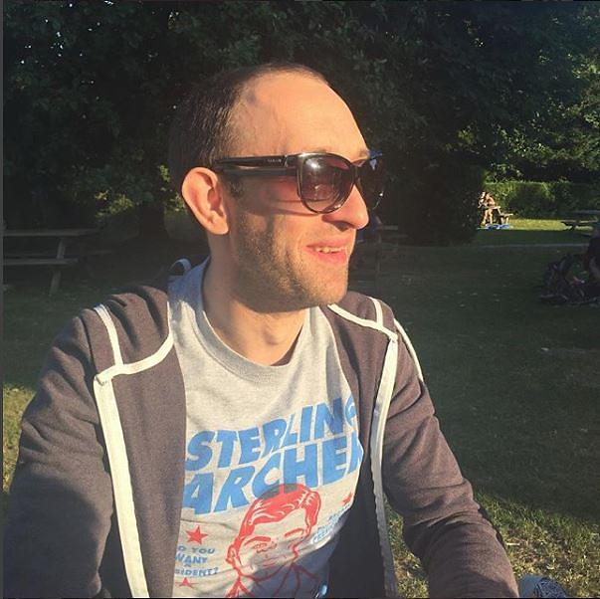
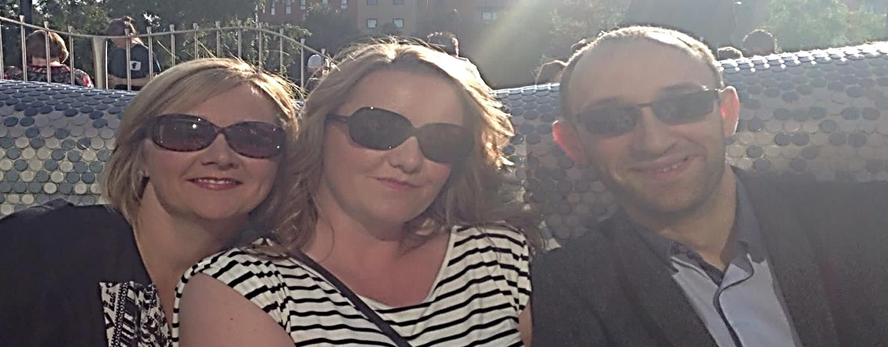
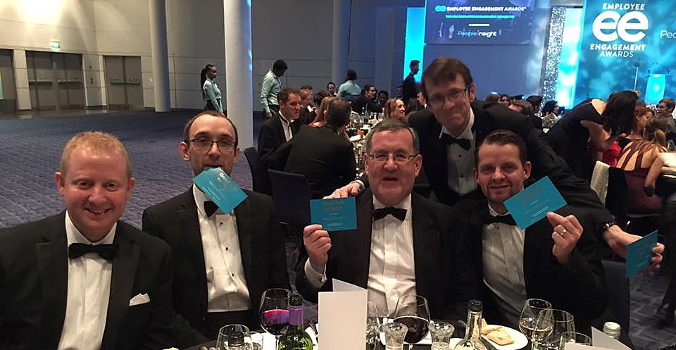
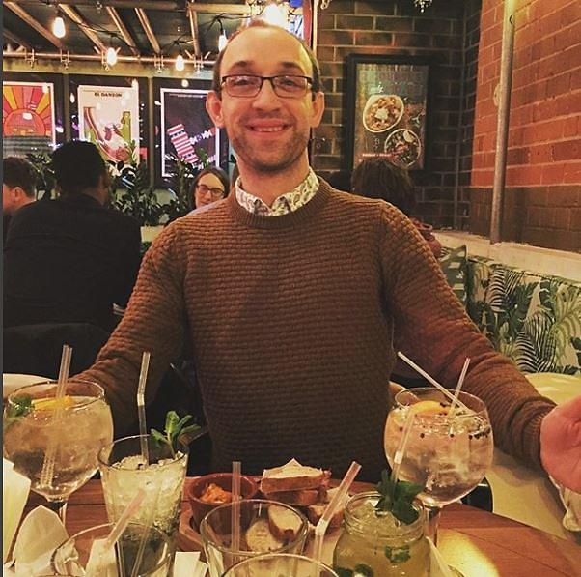

Slide 31
Next ATB - 30/01/2019

