Slide 1
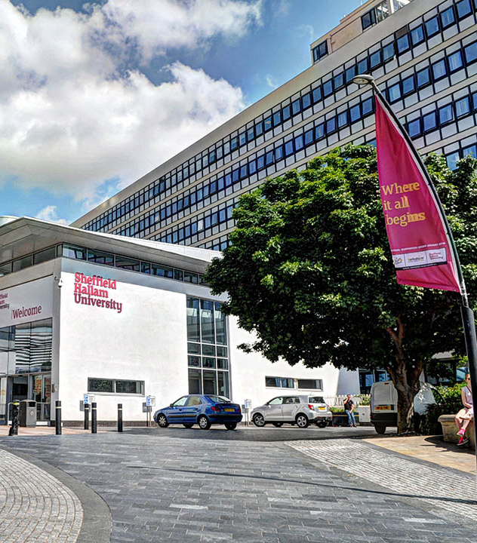
Professional Services Operating Model
Introduction to the Corporate Services Project - Finance & Planning LICC
November 2018

Slide 2
Why are we doing PSOM?
Not currently organised to support the strategy - we need to do more to align strategy and service delivery
Not maximising our potential to deliver excellent and efficient services - we need to build on strengths and stay committed to continuous improvement
Need to design our services around the needs of users and not organisational silos
Need to be able to deliver a consistent, joined-up and efficient set of services, right across the University

Slide 3
Operating model design principles
Ambitious | The University must be ambitious for its people, its services, and its service users, if it is to deliver the service excellence expected of the world's leading applied University.
User-centric | Solutions that support the academic mission of the University and meet the needs of tomorrow's students, staff and external partners.
One University, one model | The University will create a single model within which services connect together as parts of a coherent end-to-end design, creating a consistent and logical experience for students, staff and external partners.
Proportionate and appropriate | Each function will be designed to deliver the quality and impact that is appropriate and proportionate to the service area.
Agile, trusting and performance focused | An agile and responsive culture will be created through a combination of clear organisational design and enhanced professional development, careers paths and a culture of trust and empowerment.

Slide 4
Programme Overview
Phase 1 May 2017 - August 2017
Current state assessment and case for change.
Phase 2 September 2017 - August 2019
Delivery of organisation change through thematic projects
First group of projects focused on key student and external-facing functions.
Corporate Services to be reviewed once the student and external-facing model is designed
 | Sept - Dec '17 |  | Jan - Dec '18 |  |  |  |  |  | Jan - Aug '19
Student and Academic Services
Business & Outward Engagement
Strategic Insight and Data
Recruitment, Reputation and Outreach
Corporate Services
Service Design
and Delivery
Service Design
and Delivery
Service Design
and Delivery
Service Design
and Delivery
Service Design
and Delivery
PSOM Phase 2 - High level plan

Slide 5
Things that we have done so far
    Through the PSOM projects to date we have:
      brought together similar functions into single cross-University services to improve consistency and coherence of user experience
      sought better value from our data, for example by:
                introducing a student CRM system
                establishing a Strategic Insight and Data service
      introduced more self-service functionality to support user access to services
      designed roles to reduce unnecessary process steps and 'hand-offs' between people/teams

Slide 6
Student and Academic Services
New services focused on user needs, with an emphasis on delivery within academic departments
Student Support Services
Unified support model from initial contact through to specialist support
Improved intervention and tracking through use of CRM case management capability
Enhanced self-service whilst still enabling face-to-face engagement where needed
Academic Services
Course Administration to be delivered within a departmental team
New Department Manager to support the Head of Department and ensure operational excellence and consistency of course support

Slide 7
Business Engagement, Skills and Employability
New services focused external engagement and levering connections and opportunities to support graduate employability and new business opportunities.
Key elements of BESE:
    Employability and enterprise opportunities for students and graduates
    High-level skills solutions and innovation opportunities for employers
    A focal point for the University's input to the regional economic and skills development agenda
    Operational support and 'incubation' for new types of delivery; support for partnerships and contracts

Slide 8
Business Engagement, Skills and Employability
The Business Engagement, Skills and Employability Directorate will bring together specialist functions with a shared operational function to ensure a directorate-wide approach to operational processes and business support - including service development, planning, data and systems.
Business Engagement, Skills and Employability
Specialist functions
Student and Graduate Employability
Business Development
Work Based Learning
Educational Partnerships and Skills
Group Planning and Development
Cross-cutting operational delivery and support
Business Gateway & Careers Connect Service

Slide 9
RRO future state
We are proposing to create three functional areas:
Global Engagement which will be strongly focused on partnerships and delivering the global engagement ambitions of the University Strategy, leveraging the operational expertise within other areas to ensure consistent operational delivery
Recruitment, Marketing and Communications which will deliver widening participation, international & UK recruitment, reputation and outreach-enhancing work and will be organised around the key strategic drivers and user groups
Development and Alumni Relations which will be positioned close to the VC's Office to maximise relationships and profile with potential donors
Global Engagement
Development and Alumni Relations
Global Partnerships & Programmes
Global Opportunities and Experience
Graduate & Alumni relations
Major gifts
Fundraising and campaigns
Recruitment, Marketing and Communications
Widening Participation & Access Services
Student Recruitment & Admissions Services
Student Marketing Services
Digital & Creative Production Services
External Engagement, Marketing & Comms
Services
Internal Comms
Service

Slide 10
Current work - Corporate Services
    Scope
    Finance and Planning, Human Resources and Organisational Development, Digital Technology Services, Governance Services, Facilities Directorate
    Work to date
    Small steering group has been meeting fortnightly since the start of the academic year. Focus has been on:
      identifying key drivers and objectives for the project
      understanding the opportunities across the different services areas
      thinking about readiness for future system or technology changes
      looking at examples from within public and private sector
    Completion of a Service Catalogue has commenced which will capture all processes and activities undertaken within each team and will be used to support the design work for future services

Slide 11
Drivers for Change
    Based on initial analysis, the key drivers for the Corporate Services project relate to:
    Putting user experience at the centre of our operational service delivery
    Developing a stronger self-service approach and greater self-service functionality
    Reducing the need for the user to self-diagnose which service or team a query relates to, thereby improving the user experience
    Strengthening our capability to drive process and system integration
    Increasing our understanding of which processes need to improve further, as well as having the capability to deliver the required system and process improvement and integration
    Ensuring our specialist services can focus on supporting and driving delivery of the University Strategy

Slide 12
How might we do this?
    Looking across the whole of Corporate Services, there are opportunities to standardise ways of working, share data and systems more effectively, and make it easier for users to access services.
    In particular, we would like to explore further:
      creating a common gateway or online portal to support self-service access to corporate services (policies, processes, requests etc.)
      creating approaches to support holistic process and service improvement across of all corporate services, rather than looking at processes in isolation
      creating a shared approach to query resolution and the first-line administration associated with different specialist services within the Corporate Services scope
      creating an integrated, cross-cutting operational support service

Slide 13
Corporate Operations
    During this period of analysis, we are using the words 'Corporate Operations' to describe the frontline operational delivery activities that might benefit from a more joined up approach cross-Corporate Services.
    This allows us to start thinking not just about what specialist functions are needed within the different Corporate Services, but also about the quality of our processes and the quality of the user experience right across the service areas.
    This goes hand-in-hand with our commitment to look at how we can improve the design and delivery of each specialist service.

Slide 14
What are we doing next?
    Over the forthcoming 4-6 weeks we will be focused on creating a Service Catalogue of all the processes and who currently delivers within each of the in scope services.
    We are working with local leaders to identify how best to do this within each area.
    The Service Catalogue will help us to do several things:
        Identify where the user experience or service quality could be improved by processes and ways of working being more co-ordinated and joined-up across Corporate Services
        Identify the opportunities for greater self-service
        Identify where improvements could be made to processes, data or roles within each specialist Corporate Service

Slide 15
Questions to think about through local team meetings
    Some questions that you might like to discuss about your local area:
    Do we have activities that we could deliver more effectively through self-service? What are the barriers to doing this at the moment?
    Are there things that we should start doing that we do not currently do?
    Are we managing the flow of work through the service effectively or do we have peaks/troughs or bottlenecks?
    Do we have shared processes with other parts of professional services and how effectively do we manage these?
    What are our greatest strengths as a service?

Slide 16
How to feedback and next steps
    You can submit feedback via your local manager or direct to the PSOM team by emailing ! Prof Serv Op Model
    We welcome your feedback over the next few weeks whilst we create and compile the Service Catalogue.
    The deadline for feedback as a part of this exercise is Friday 7 December.
    We will then review feedback alongside the Service Catalogue to support creation of:
    functional models (which functions should be delivered in each area)
    service models (how each service will operate)
    service designs (what teams and roles are needed).

