Slide 1


Slide 2
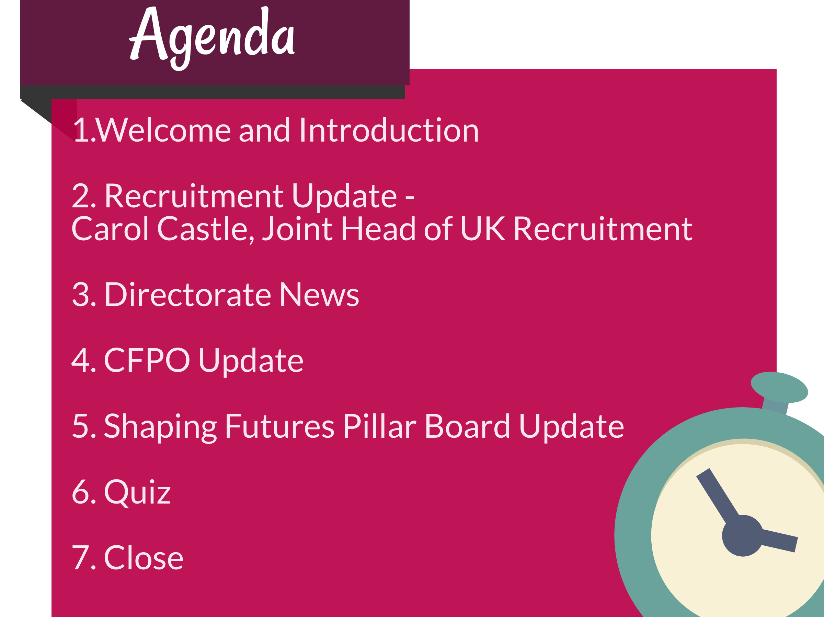

Slide 3


Slide 4
Student Recruitment update
19th October 2017
Carol Castle, Joint Head of UK Student Recruitment,
Admissions and UK Student Recruitment

Slide 5


Slide 6
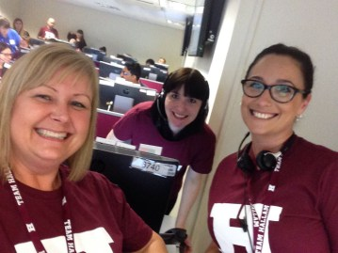
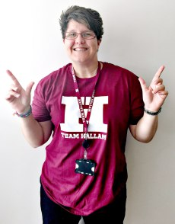
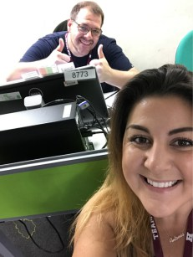
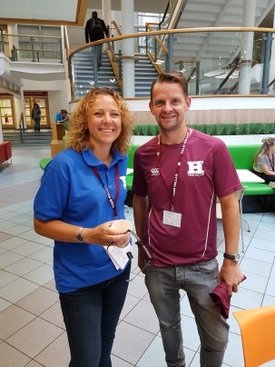

Slide 7
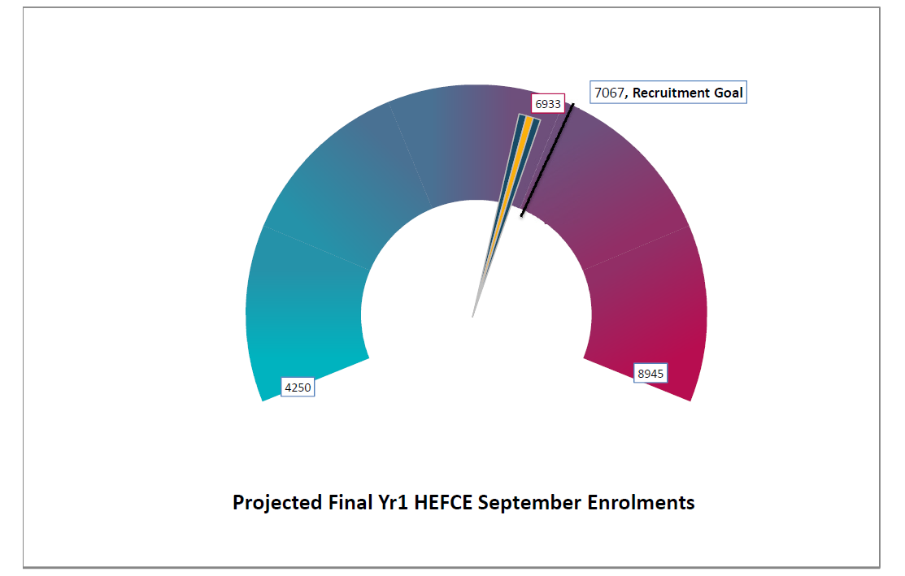

Slide 8
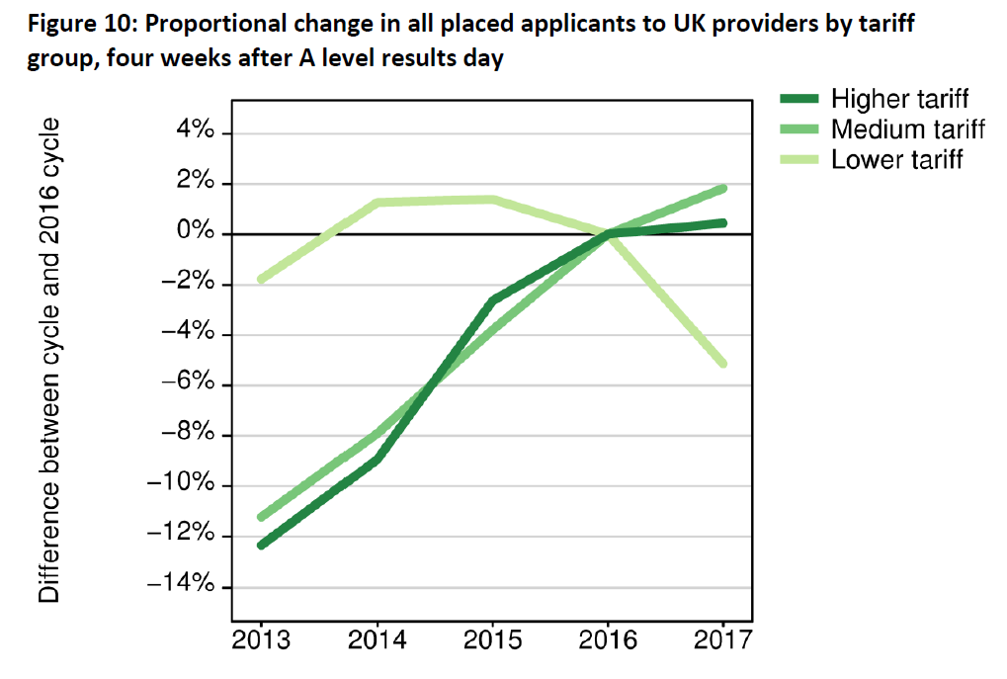

Slide 9


Slide 10
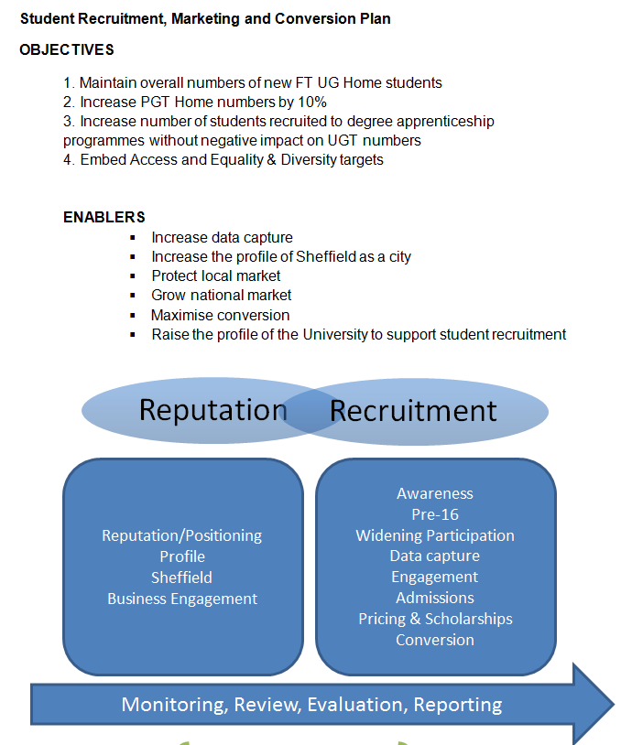

Slide 11

Questions?

Slide 12


Slide 13



Slide 14


Slide 15

Teaching Excellence and Student Outcomes Framework (TEaSOF or TEF3)
Knowledge Exchange Framework (KEF)
HESA Data Futures
Tuition Fees
Notes:
TEF - changing focus towards student outcomes with some tweaked metrics and new additions of supplementary metrics and a grade inflation measure. http://wonkhe.com/blogs/farewell-tef-hello-teasof-year-3-digested/
KEF - A new metric was announced to sit alongside the Teaching Excellence and Student Outcomes Framework (TEF) and the Research Excellence Framework (REF). It is the centrepiece of a range of proposals designed to focus university attention on “the third leg of the HE stool” – knowledge transfer and commercial outcomes. The KEF is backed up by £40m of further Higher Education Innovation Funding (HEIF) investment and further Science and Innovation Audits - http://wonkhe.com/blogs/a-new-framework-is-born-meet-kef/
HESA Data Futures - Sheffield Hallam are "alpha pilot" participants in the collection design project which will help HESA to transform the way in which the data collection process works for the sector as a whole through the Data Futures Programme. The ambition of the HESA Data Futures Programme is to modernise and improve the efficiency of collecting HE data for the sector as a whole. The main benefit of the programme is that "The overall number of data collections required throughout the year from different parties will be reduced. While the move to in-year data collection will increase the number of student data returns, these will be used for a wider range of purposes and will replace some of the existing collections. This is great opportunity for the University to influence the way that this process is used across the sector and for that reason is a very prestigious project to be involved in.

Slide 16

Political backdrop
Student loan interest 6.1% (RPI + 3%)
Fees of £7,500 - £31m
Compensating funding for high cost courses?
Change loan support level to below max fee?
Future inflation increases

Slide 17

Increased importance of SHU strategic plan
Pressure on 'OFFA agreement' access
Weakens appetite of funders to lend
Other areas:
  national pay bargaining
  pensions
  portfolio review
  sector failures/merger

Slide 18

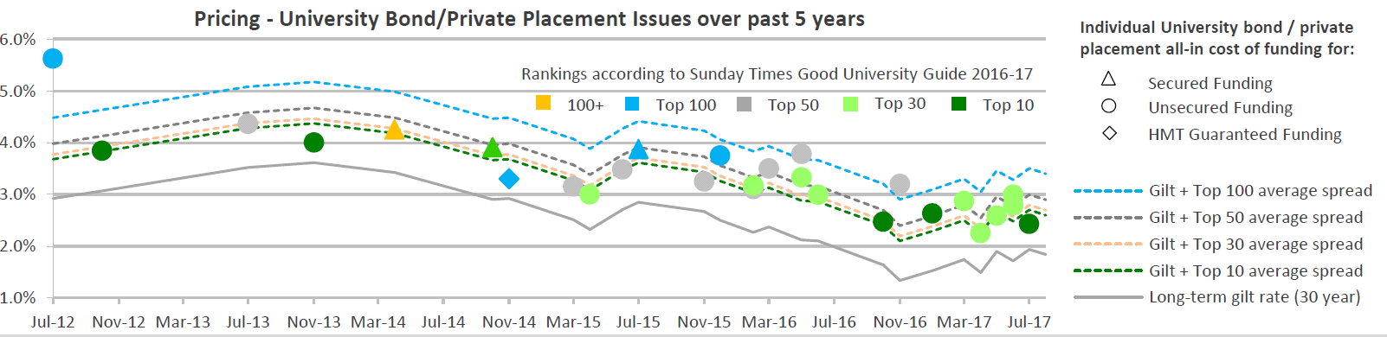

Slide 19

Local Government Pension Scheme
FRS102 (accounting) year end valuation ≠ Actuarial Valuation for purpose of calculation of contributions
Balance sheet liability reduces from £135m to £123m
Reduction in discount rate
Current service cost
  budget assumption £4m pa
  revised forecast £8m 2016/17, £9m 2017/17 and 2018/19

Slide 20

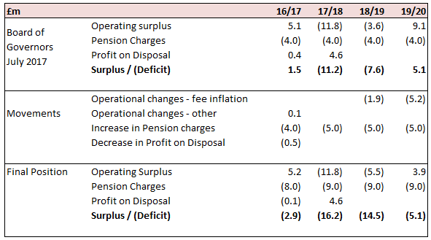
.....before remediating action

Slide 21

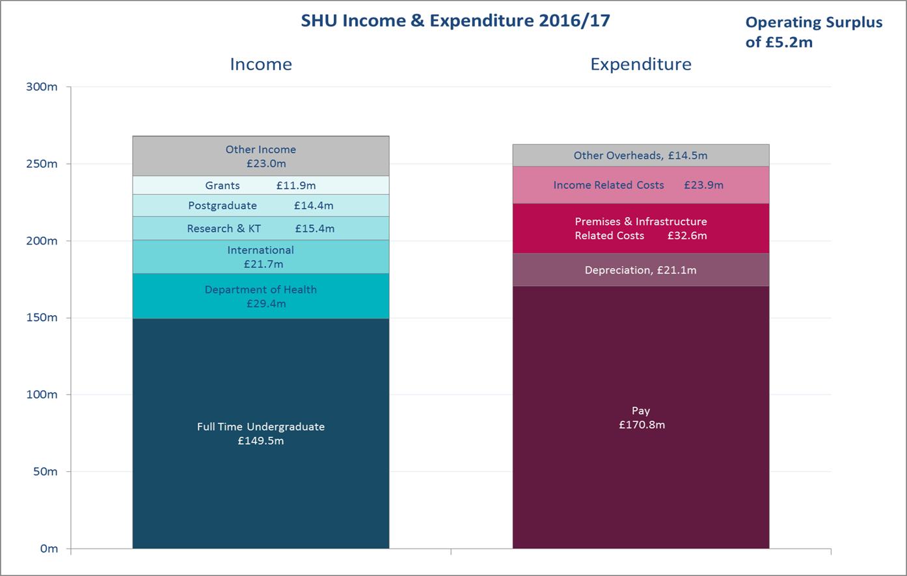
Creating
Knowledge
£1.7m
LLEG
£3.5m
BaGU
£7.2m
DTS
£7.5m
Shaping Futures
£4.1m

Slide 22


Slide 23


Slide 24


Vision, Outcomes and Deliverables

Slide 25
Shaping Futures Board - who is involved?
Board Chair: Professor Christina Hughes (Pro Vice-Chancellor for Student Experience) | Dr Rebecca Khanna (Assistant Dean, Academic Development for the Faculty of Health and Wellbeing)
Helen Best (Deputy Dean of the Faculty of Health and Wellbeing) | Professor Kevin Kerrigan (Pro Vice-Chancellor for Enterprise and Dean of Sheffield Business School)
Professor Simon Bromley (Assistant Dean, Academic Development for the Faculty of Development and Society) | Sarah Swales (Assistant Director of Human Resources)
David Laughton (Assistant Dean, Academic Development for the Sheffield Business School) | Dr Graham Holden (Director of Innovation, Learning and Teaching)
Nuala Devlin (Director of Library and Student Support) | Professor Nasser Sherkat (Head of Department Engineering and Maths, Faculty of Arts, Computing, Engineering and Sciences)
Professor Roger Eccleston (Pro Vice-Chancellor for Global Engagement and Dean of the Faculty of Arts, Computing, Engineering and Sciences) | Leopold Green (Head of Academic Quality and Standards)
Joe Rennie (Director of Registry Services) | Simon Thompson (Head of Careers and Employability)
Dr Neil Mckay (Dean of Students) | Conor Moss (Director of Education and Employer Partnerships)
Linda Mason (Director of Strategic Planning and Business Improvement Services)
Nicola Rawlins (Director of Admissions and UK Recruitment)
Bernie Marshall (Head of Finance - Directorates) | SUPPORT: Claire Ward (Strategic Portfolio Manager, Strategic Portfolio and Business Change, Finance and Planning)
Daniel Ladbury (Director of Estates) | SUPPORT: Helen Roberts (Board Secretary, Strategic Portfolio and Business Change, Finance and Planning)

Slide 26
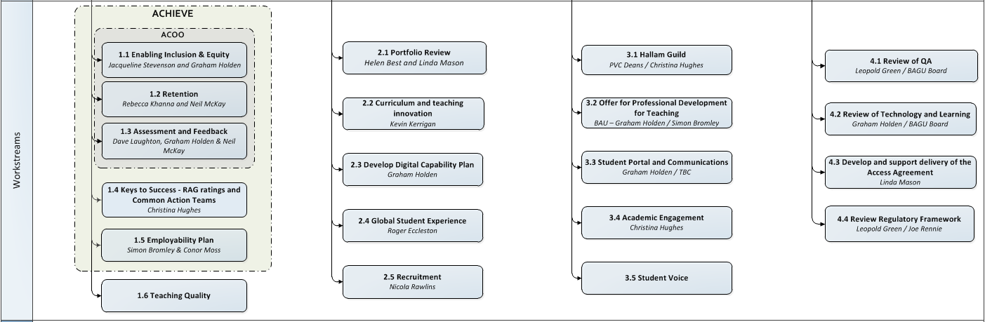

Slide 27
KPIs: What does success look like over the next 2-3 years?
1. Increase retention rate to 95%
Source: HESA (retention at same provider after first year). Current score: 92%. First-year target: 93%
It measures: Our ability to retain students, satisfaction, success, also has financial aspect. Benchmarkable.
2. Increase percentage of our graduates gaining professional employment to 75%
Source: DLHE survey. Current score: 70%. First-year target: 73%
It measures: How well we are preparing students for a career after University. To some extent it measures our 'appliedness' and how we transform lives.
3. Increase percentage of students satisfied with their University experience to 90%
Source: NSS. Current score: 84%. First-year target: 87%
It measures: Student satisfaction with teaching - mixture of customer satisfaction and quality. Used externally in TEF and league tables - benchmarkable.
4. Close the BME attainment gap
Source: NSS. Current gap: 16%. First-year target: 10%
It measures: Ability to support students from different backgrounds and transform lives.
5. Maintain no. of new home FT UG students enrolled over 7,000 without reducing quality
Source: NSS. Current score: 7,000 (tariff (305). First-year target: 7,000
It measures: Appeal and reputation, as well as effectiveness of recruitment and marketing.

Slide 28
What are the outputs and priorities for the next twelve months?
ACHIEVE
A PROGRAMME OF WORK DESIGNED TO ACHIEVE CONSISTENTLY OUTSTANDING OUTCOMES
Strategic priority - "Clear, targeted, comprehensive actions to deliver consistently excellent performance across the whole student lifecycle"
ACHIEVE Steering Group
SRO and Chair: Christina Hughes. Support: Strategic Portfolio Manager - Claire Ward
ACOO Proof and Scale
Programme Manager: Leanne Rowland, Business Analysts: Emma Richardson & Annette Buchwald, Graduate Interns x 4
Employability Steering Group
Chair: Conor Moss
Keys to Success Group
Chair: Christina Hughes
Impact & Evaluation Advisory Group
Chair: Jill Lebihan
Retention
SRO: Rebecca Khanna & Neil McKay
Enabling Inclusion & Equity
SRO: Jacqueline Stevenson & Graham Holden
Assessment & Feedback
SRO: Dave Laughton & Graham Holden
Employabil-ity Plan
SRO: Simon Bromley & Conor Moss
Common Action Teams
SRO: Christina Hughes & HoDs
Pilot groups and work stream teams
ACHIEVE Communications
Rachel Parnham
SPBC Sept 2017

Slide 29
Shaping Futures Board
How can the Finance & Planning Directorate contribute to the Shaping Futures strategic aims?
Further Info: https://portal.shu.ac.uk/sites/shustrategy/Pages/shaping.aspx

Slide 30

The Finance and Planning student number

Slide 31


