Slide 1


Slide 2
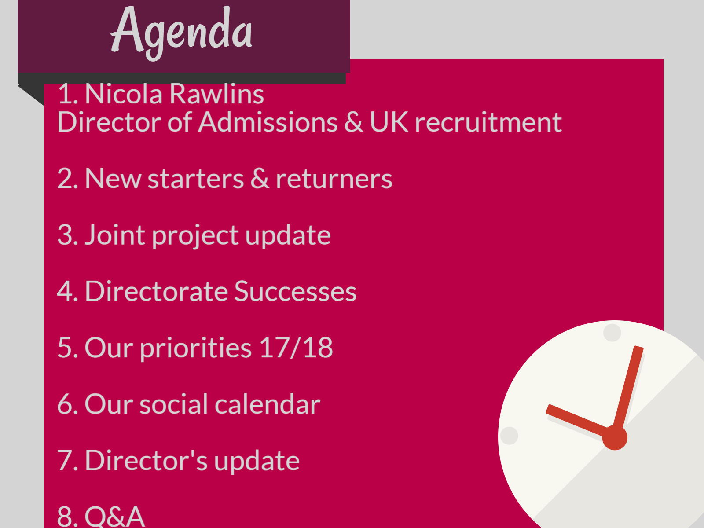
Notes:
DH

Slide 3


Slide 4

FT UG Student Recruitment

Slide 5

Objectives
To maintain the number and quality of students FT UG we enrol
  Stop the decline in applications
    Increase data capture
    Increase the profile of Sheffield as a student city
    Protect local market
    Grow national market
  Maximise conversion
  Raise the profile of the University
  Embed access and equality and diversity targets

Slide 6
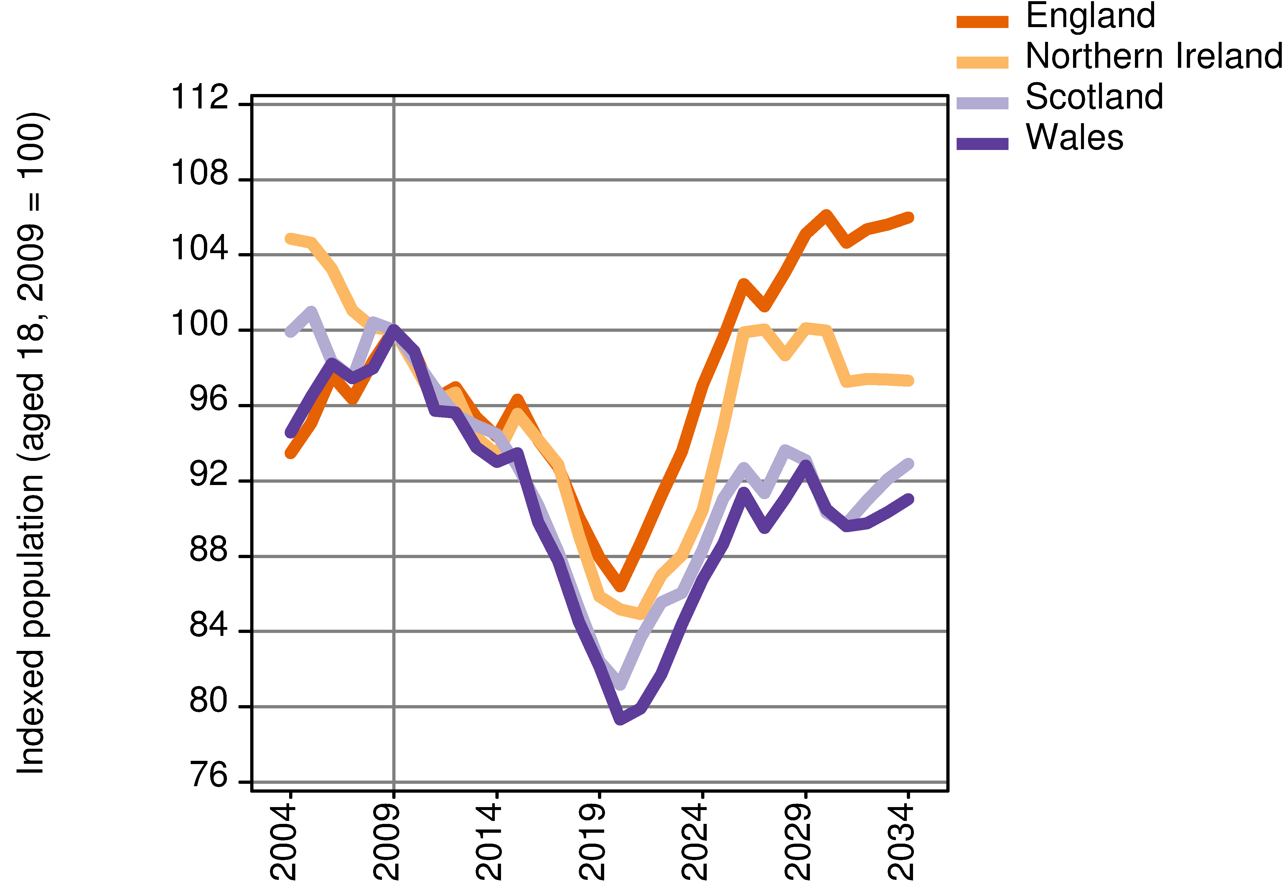
Demographics

Slide 7
2016 FT UG Key year on year changes
Extended Degrees
Changes in demand for subjects
Losing '3 A Level' students?
Gaining good BTEC students
Maintaining core markets in falling demographic

Slide 8

2016 sector outcomes for FT UG
Sector headline growth in the number of students accepted was 1%
Mixed performance within the market indicating the increasing polarisation across HEI's performance

Slide 9

Where was SHU?
Sheffield Hallam remains a large and popular university and in 2016 accepted the third highest number of UK/EU students in the UK
Sheffield Hallam increased its total acceptances by 40 (0.6) % through increased recruitment of Clearing students.
Coventry University has become the second largest University in relation to Home / EU UCAS accepts and increased these by 580 (8%).

Slide 10
2016 Winners & Losers
  Newcastle University: + 660 (13%)
  Anglia Ruskin London: +610 (87%)
  Coventry University +580 (8%)
  University of Portsmouth: +545 (10%)
  University of Surrey: +525 (18%)
  University of Leicester: +520 (16%)
  De Montford University: +515 (9%)
  University of Derby +450 (13%)
  York St John +440 (28%)
  University of Lincoln +425 (12%)
  MMU: -770 (-8%)
  University of Southampton: -715 (-13%)
  University of Central Lancashire: -700 (-11%)
  University of Westminster: -635 (-14%)
  Leeds Beckett University: -620 (-9%)
  Kingston University: -583 (-12%)
  BPP: -570 (-61%)
  The University of Manchester: -540 (-7%)
  University of Wolverhampton: -515 (-11%)
  Southampton Solent University: -435 (-14%)

Slide 11

So what is the picture looking like now....?

Slide 12
Current Position
We are in approx. the same position re: absolute numbers
However targets are higher
We are in worse position in terms of performance to target
Mixed performance across departments

Slide 13
Challenges and Opportunities
Maximising the institutional position whilst maintaining quality and responding to capacity challenges in popular subjects
New extended degree offer
Changed competitor behaviour
Media stories as to value of degrees etc
Changes to Nursing etc funding already impacting
New A Levels
Falling demographic - less people in Clearing?

Slide 14
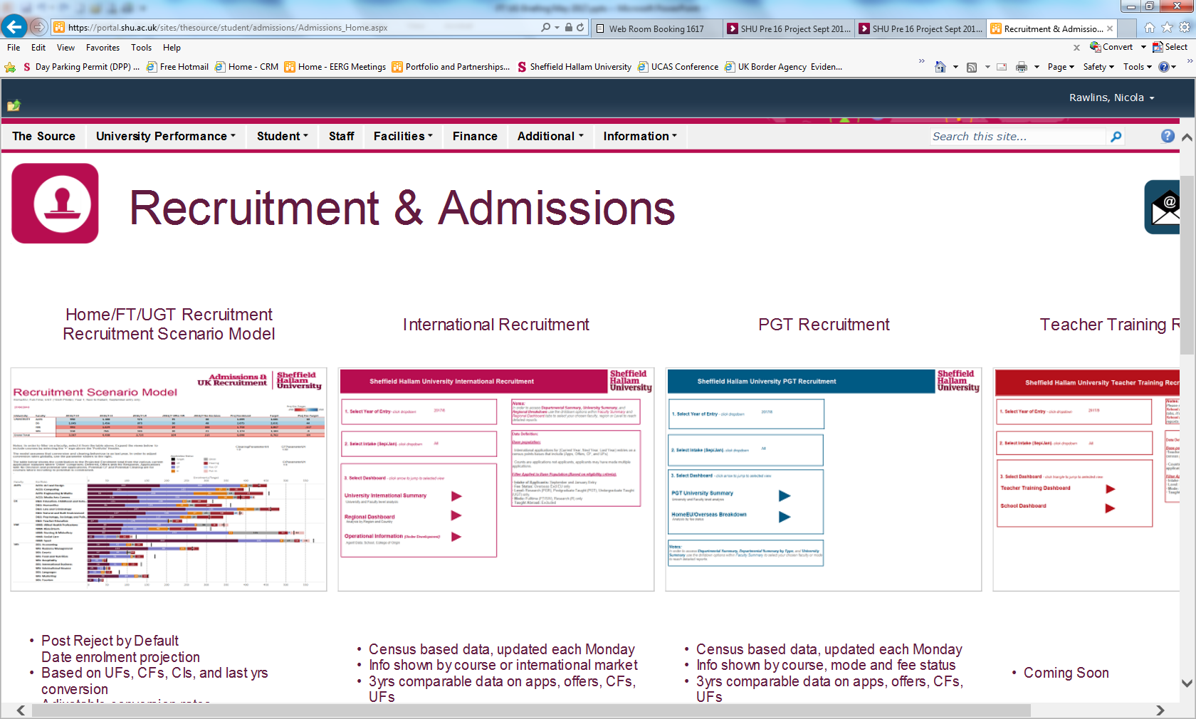
Models and Reports

Slide 15
So what are we doing?
Joint Recruitment, Marketing and Communications
Press and PR
Competitor Scanning
Confirmation and Clearing tactics

Slide 16

Amber's Clearing and Confirmation Journey
Scenario based upon Amber having applied to Leeds University for Engineering, needed ABB but achieved BBB. She made an enquiry at SHU but did not apply
AMBER sees online programmatic advert (prospecting) and visits SHU clearing website but does NOT complete clearing pre-register data capture
AMBER visits UCAS website on her mobile to see when results are due.
UCAS mobile banner advert seen
AMBER checks A-level results, obtains BBB, enters clearing
AMBER searches google for more info on Engineering courses (google adwords and Bing search)
AMBER searches WhatUni to find out more about SHU - sees our profile and available courses
The Student Room (TSR) profile, adverts & forum advice
UCAS logout
advert
Facebook promoted posts - SHU student life
SHU social media activity
- advice and guidance
- clearing student stories
- Results day live streaming
- customer service and celebration
Receives 'enquirer' email as she has previously made an enquiry to SHU
WhatUni online profile and course listing
Google and Bing searches
Facebook keep warm/affinity posts - SHU student life
Programmatic advert - pre-register clearing interest
Programmatic advert - call us now
AMBER attends SHU open day and accepts offer
July
August
A Level Results
Day
Clearing open days
Sept
Facebook promoted posts - SHU student life
UCAS mobile banners - pre-register clearing interest
UCAS mobile banners - clearing advice and guidance
Receives congratulations email featuring inspirational student video
AMBER sees
online programmatic advert (retargeting) encouraging data form completion, visits website and completes form
AMBER visits SHU website, sees Engineering course available, contacts SHU & offered a place
Insiders guide sent by post
Clearing website
Student stories
Pre-register clearing interest (data capture)
Receives SHU 'all you need to know about results day' email (data capture form)
Welcome from SU President email
Receives 'engineering specific' subject email
Edumobile advert and retargeting advert (regional)
Offer email sent & invited to open day
Receives conversion email to encourage offer acceptance
WELCOME WEEK & ENROLMENT
AMBER sees social media (Facebook) posts
SHU student city
Clearing student stories
How to survive clearing video
SHU call Amber to support offer acceptance
All digital advertising runs throughout July and August

Slide 17
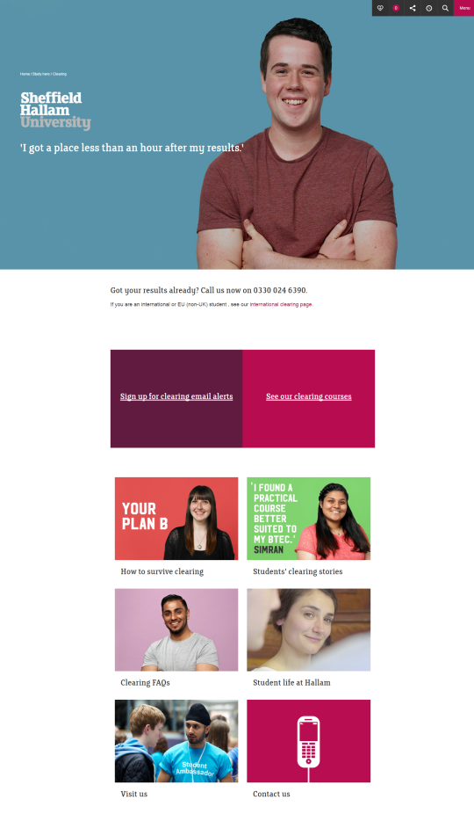
Clearing content
Website
Clearing area of the website live 1st July
- Contact phone number for students with results
- Specific international student area
- Pre-reg data capture form
- List of available courses
- Student stories
- FAQs
- Clearing open days
- Contact details
Notes:
SHU website & CRM emails
Clearing & Confirmation website now live
Pre-reg form to capture subject interest for follow up emails in priority areas
Engineering / maths
Journalism, PR and Media
Education studies / Childhood studies
English
Law
Sport
Biosciences and chemistry
Accounting, banking and finance
Languages
Food & Nutrition

Slide 18
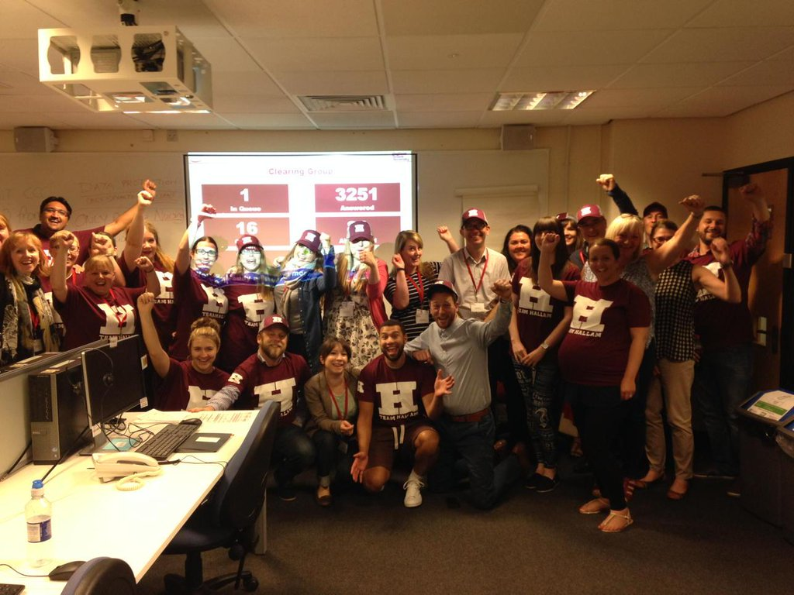
Social media
You and your teams can get involved!

Slide 19
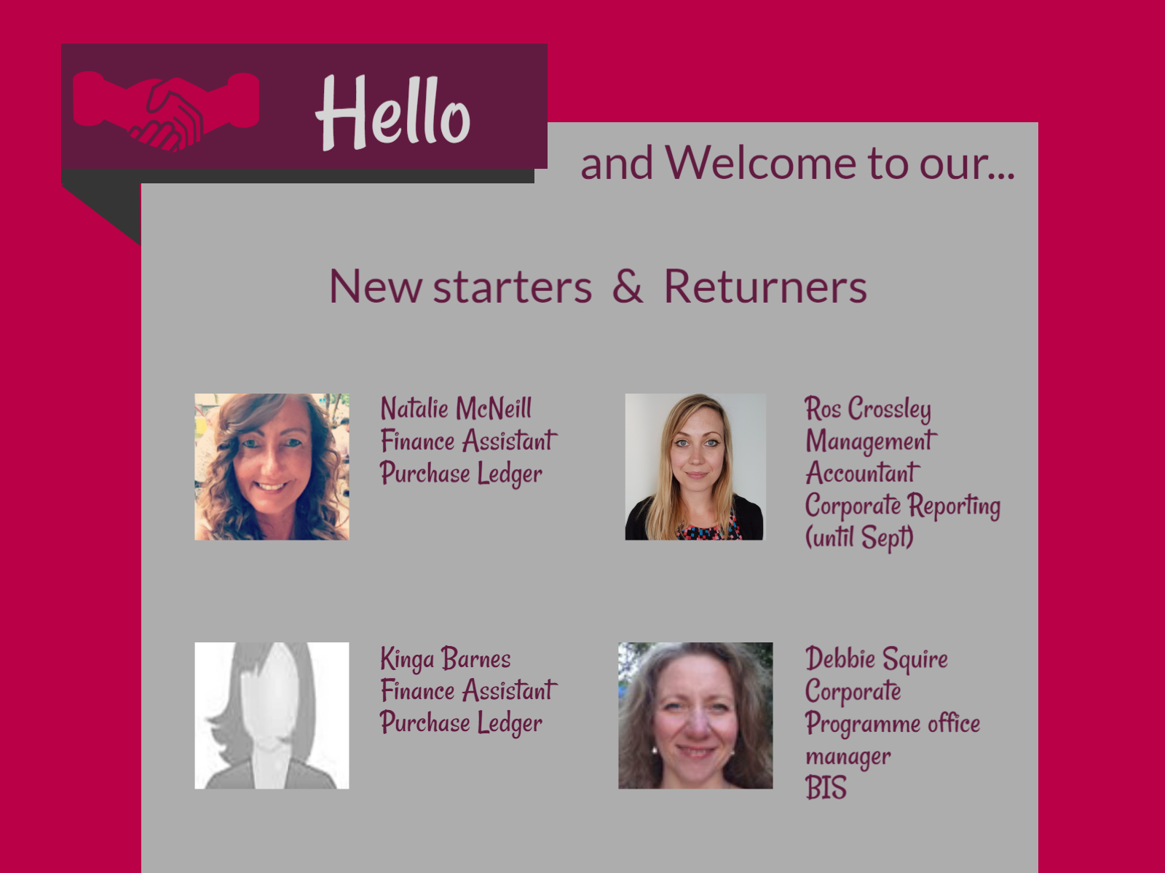

Slide 20
Change approval and benefits realisation
Sheffield Hallam University

Slide 21
Agenda
Purpose of the work
Principles
Progress to date
Next steps

Slide 22
To establish an approval process and benefits management approach for strategic change to support the delivery of the University Strategy
Purpose

Slide 23
Principles
A business case assesses the desirability and viability of an initiative by setting out:
Where we are now (problem / opportunity)
Where we want to be (goal)
The approach and investment to get there (options and costs)
The impact, the improvements what will be made, as a result of the investment (benefits)
It supports the delivery of strategic change by:
Demonstrating good governance and accountability
Providing a shared understanding, encourages effective decision making and provides reassurance that the initiative is the right thing to do - and continues to be so
Prioritises business change
Provides an early indication to feed into resource planning
Support benefits realisation
Notes:
What are your concerns?

Slide 24
Progress to date
Working group formed, input from key stakeholders (BIS, Finance, DTS, Estates and HR)
Development of a two stage approval process
Development of supporting documentation incl. mandate, business case, options appraisal tool kit and evaluation criteria
Development of a benefits management approach
Endorsement of the approach by the Strategic Control Group

Slide 25
Benefits Management
To Be
As Is

Slide 26
Next steps
Further feedback from senior stakeholders
Develop support and training to ensure effective completion of the business cases and benefits detail
Roll out of the approach

Slide 27


Slide 28
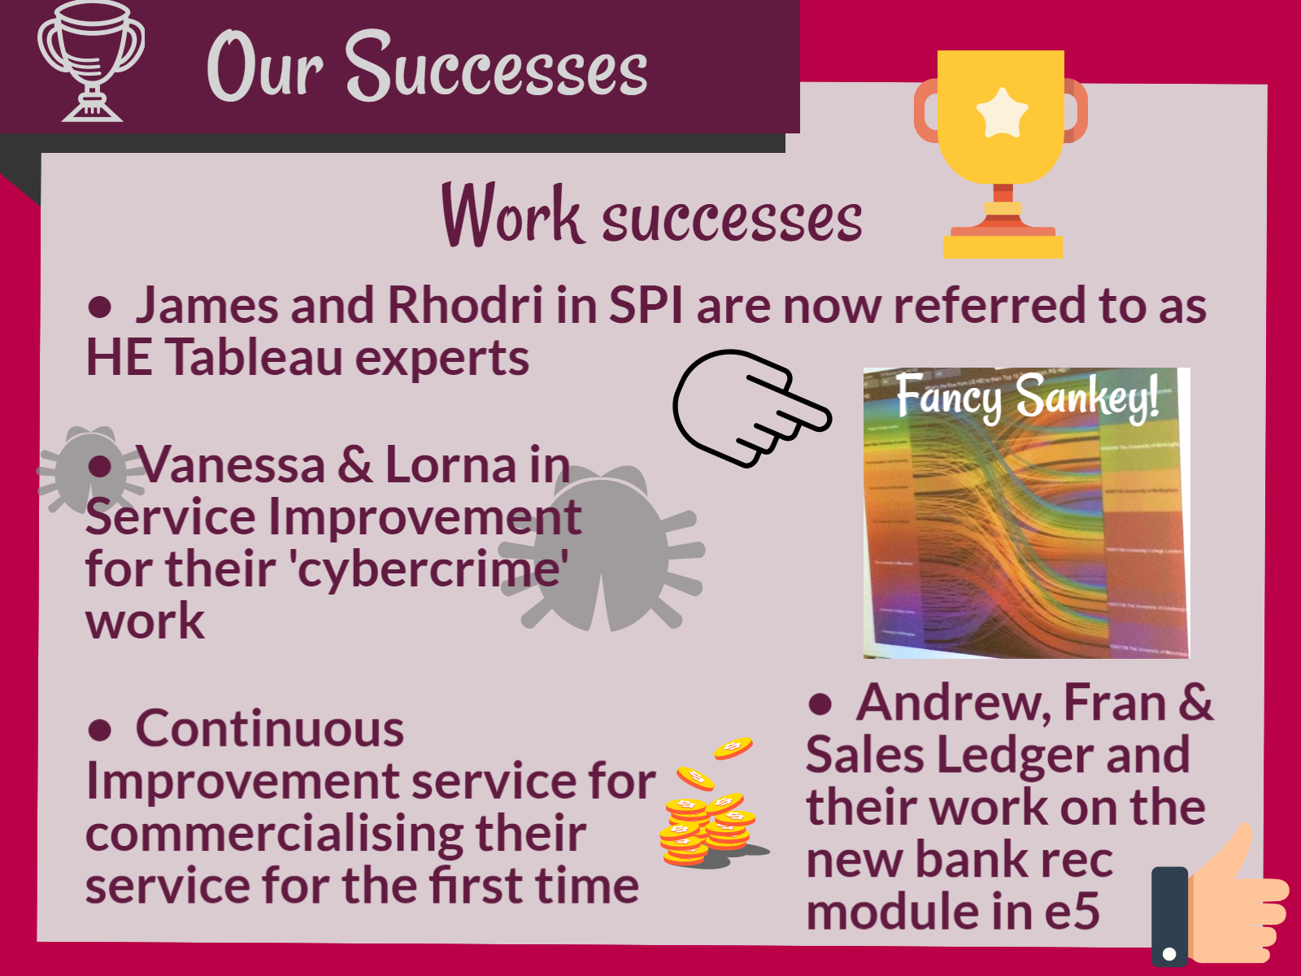
Notes:
James and Rhodri in SPI are now referred to as HE Tableau experts after some great success in projects they were working on with JISC (who provide digital solutions for HE).
Rhodri produced his 'Sankey' diagram which JISC are continuing to use and James has been invited to co-present at their "Connect More" event.
Well done both of you!
Vanessa and Lorna in Service Improvement for their work on developing and delivering the Cybercrime sessions for the Directorate. It is now being delivered to some teams outside of the Directorate and the feedback has been excellent
The Continuous Improvement service in BIS have recently commissioned their first piece of commercial work - selling their service to the Students Union. Watch this space as they will be letting us know how they get on via our blog.
Andrew Kendall, Fran Davies and Sales Ledger for all their hard work in implementing the new Bank rec module in e5 - Great cross team working

Slide 29

Notes:
Exams - 10 members of BIS recently completed their BCS Modellling Business Processes course, and two of our Management Accountants Erica and Grazina have recently passed another exam, taking them one step closer to their goal - and Sohil has now passed all his exams - well done
Sporting achievements - We have a very sporty bunch...
Paul and Grazina Manchester for successfully completing the Tour de Yorkshire sportives
Vicki Morgan’s has spent the past year competing in several running events including the Sheffield Half marathon raising money for Diabetes UK
Tom Russell and Jon Childs also took part in the Sheffield Half raising money for the Hallam Fund
New Home - Deborah has finally exchanged on her new home in Todwick - and completes on Friday, so no more commuting! Planning also now have a new home on floor 1!
Silver work anniversaries - Karen Nettleship and Sue Parkin both celebrated their 25 years of service at SHU at a dinner last week
Proud Parents & Grandparents - Craig Jeffries recently welcomed his first child Harry Ethan, Karen Hague welcomed her new grandson Bobby Lee (enter for photo), Karen Marsden now has a granddaughter Pippa Rose (enter for photo), not long after becoming a grandparent for the first time with Grandson Oscar

Slide 30
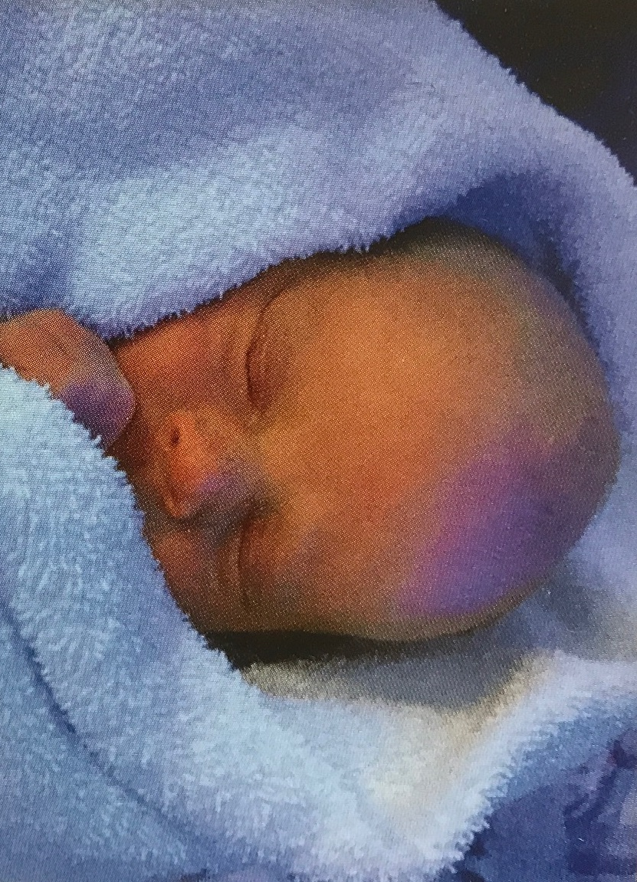
Notes:
Harry Ethan

Slide 31
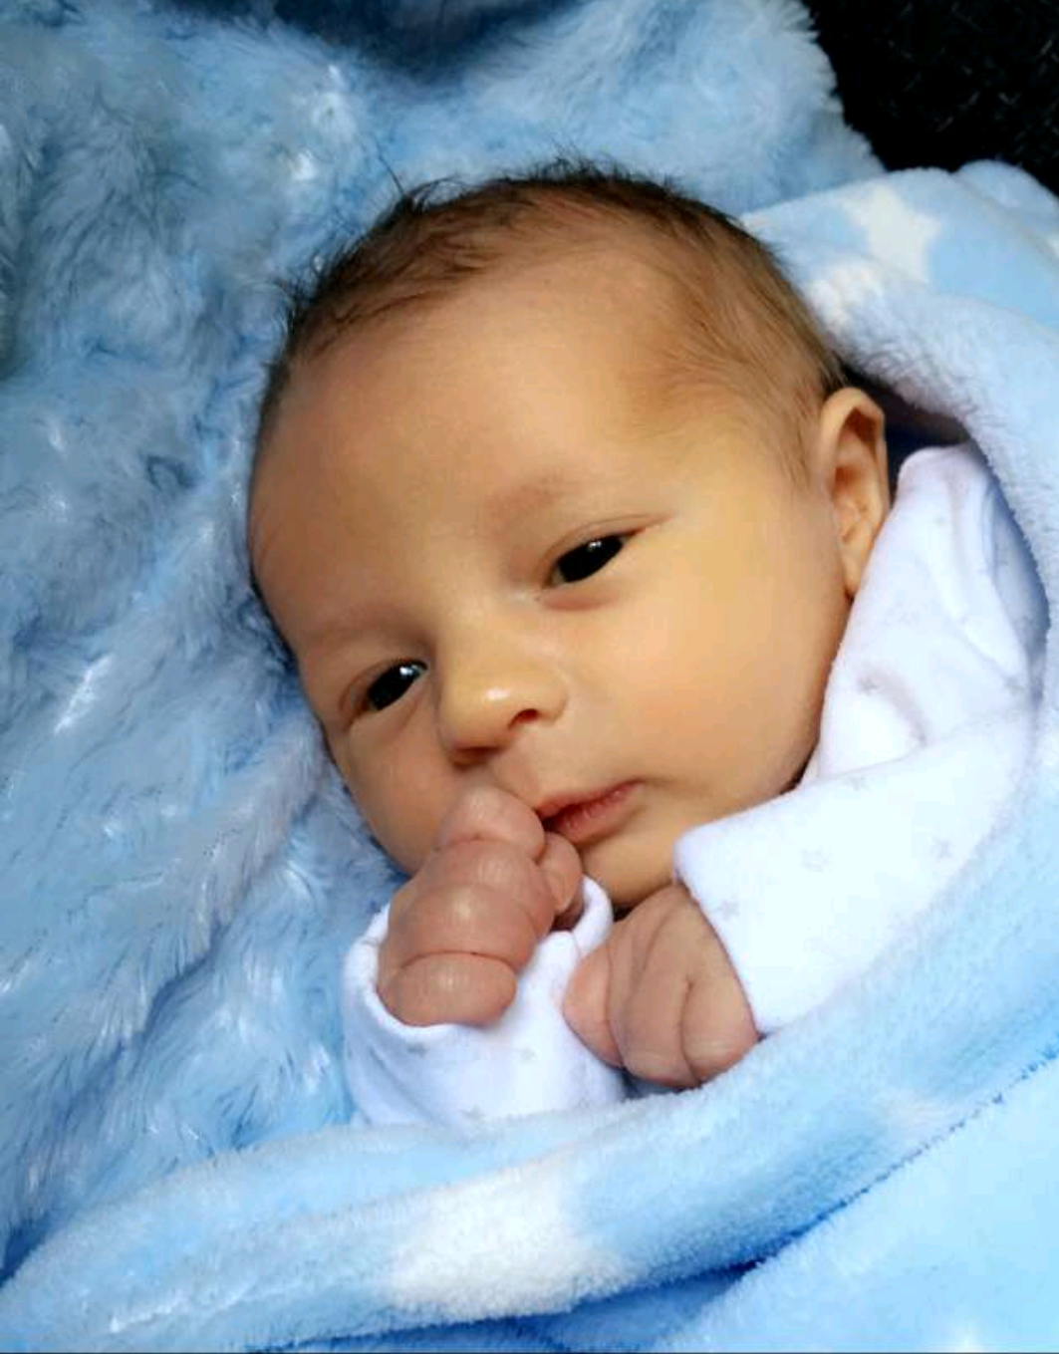
Notes:
Bobby Lee

Slide 32
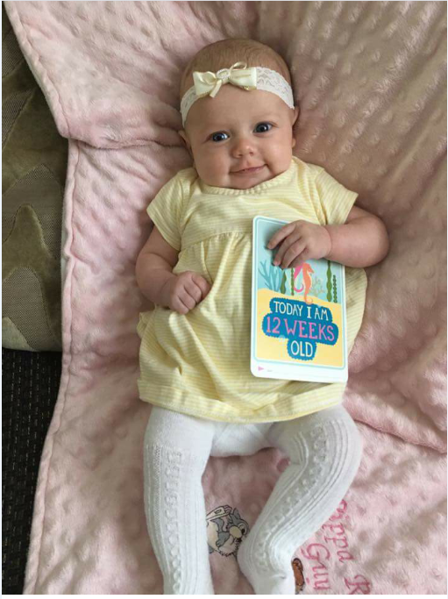
Notes:
Pippa Rose

Slide 33


Slide 34
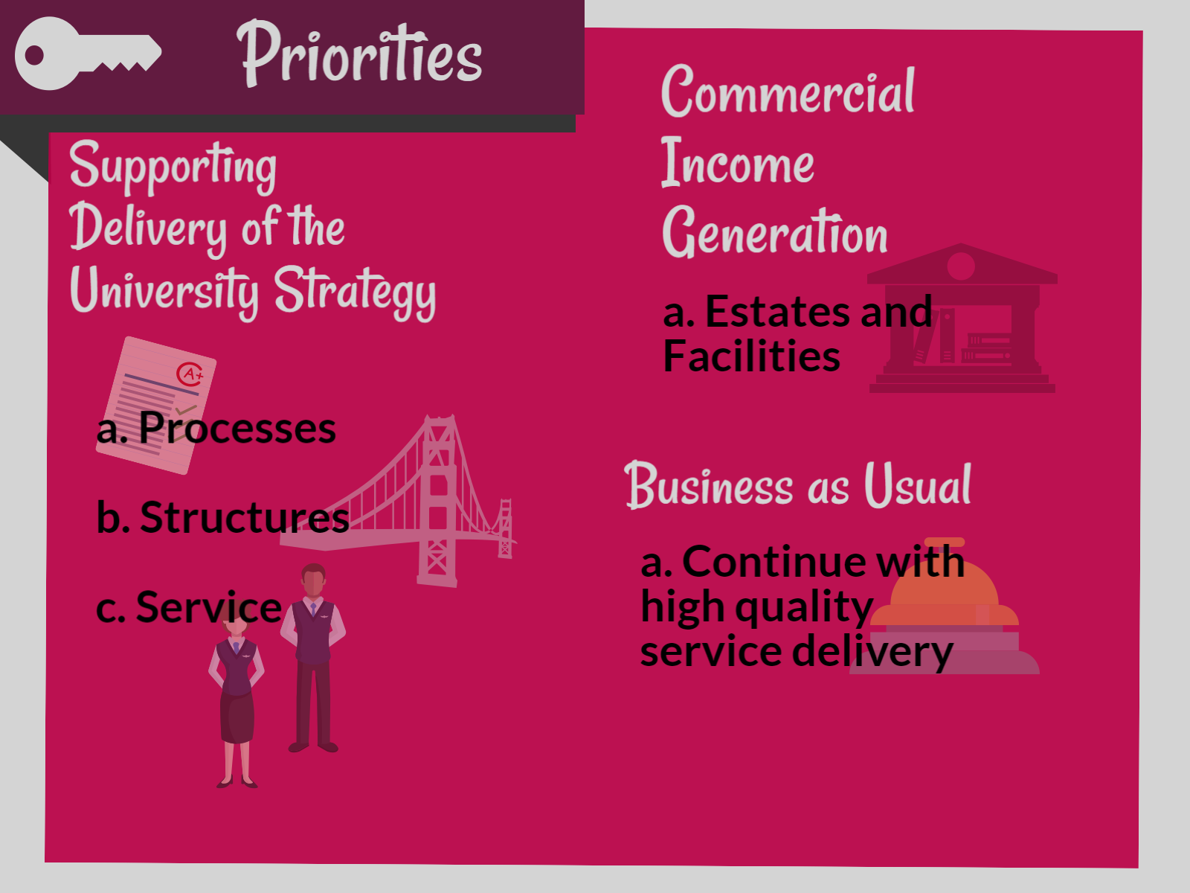
Notes:
Strategy
Establish a strong strategic portfolio management approach
Support review of portfolio size and shape
Provide appropriate financial support and challenge to the Pillar Boards
Embed new business plan and benefits realisation processes
Further improvements to the planning cycle
Income Generation
Work closely with the appropriate areas to identify and develop commercial income opportunities ensuring that these are financially viable and sustainable
BAU

Slide 35
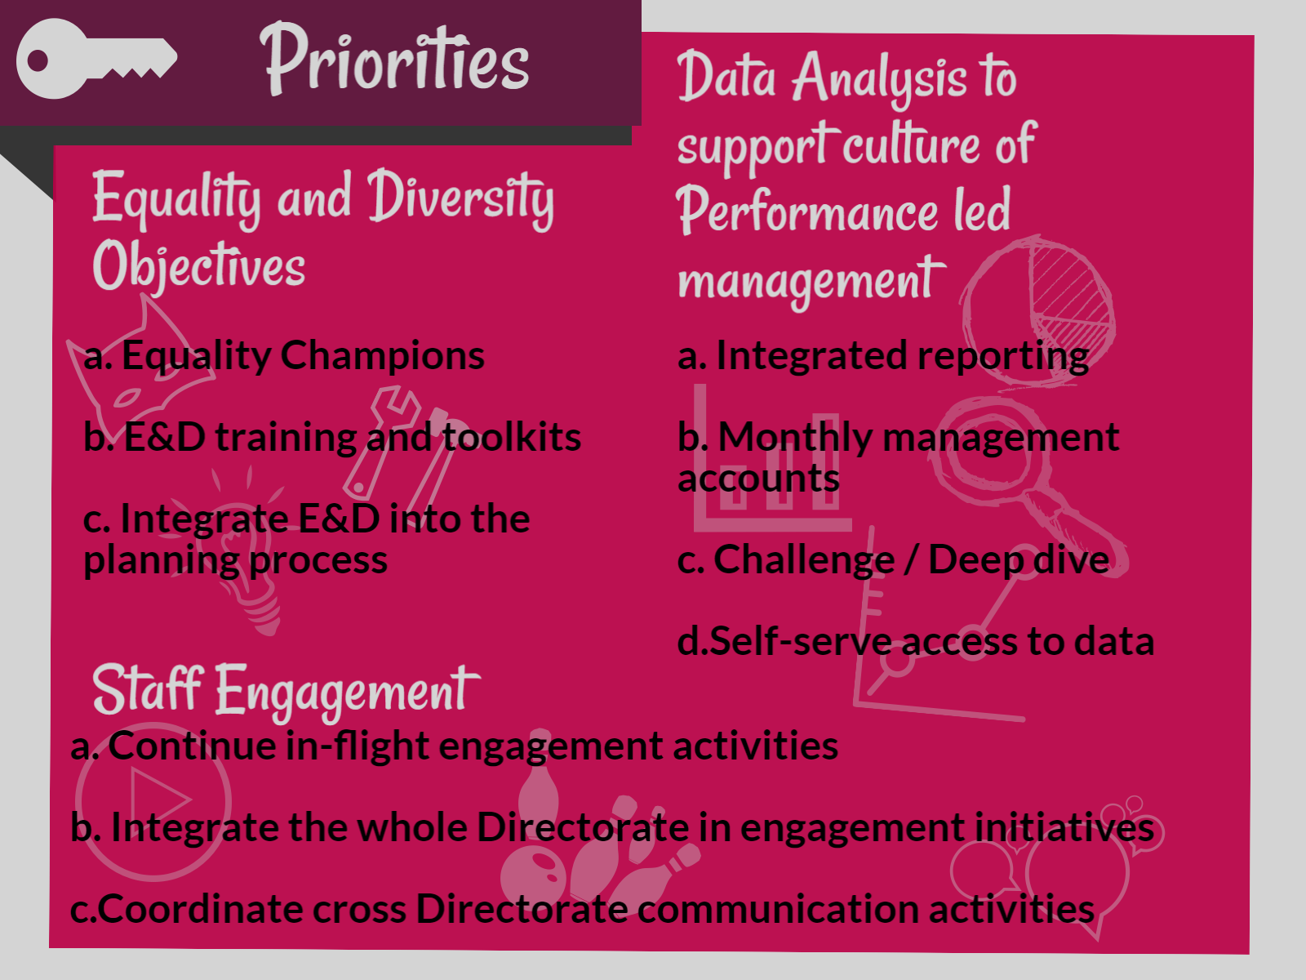
Notes:
E&D
Increase leadership capability and confidence through training and support
Reflect on internal Finance and Planning processes
Staff Engagement - change slide
Note Deborah will be expanding on the staff engagement next steps at the close

Slide 36
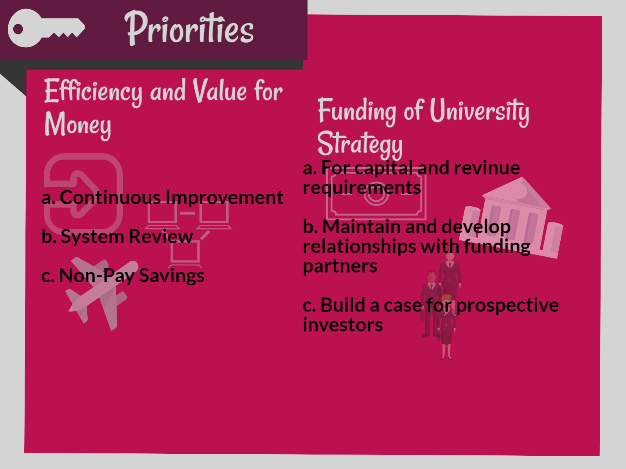
Notes:
Efficiency and VFM
Adapt our structures and processes as necessary to support the outcomes of the PSOM review
Investigate the benefits of using a student number forecasting tool
Improve the travel booking process
Involve students when improving or changing student facing processes
Analyse and suggest changes to non pay - e.g. overseas travel policy and costs - staff development

Slide 37

Notes:
Bernie

Slide 38

Notes:
Bernie

Slide 39


Slide 40


