Slide 1
SHU PGR Peer Mentoring
The essentials: 27 October 2022

Slide 2
Why was the PGR Peer Mentoring Scheme introduced?
The need for this type of support was identified via the work of the Hallam Guild PGR wellbeing group and student surveys.
Buddying and mentoring arrangements existed across the university but there was no overarching scheme that all PGR students could apply to.
Peer mentoring can provide mentees with support adjusting academically and personally to studying at SHU, a safe space to ask questions and an opportunity to draw on the experience of others in a similar position.
Mentors benefit in terms of their own development and the researcher community as a whole is strengthened through this network of support and sharing of experiences.

Slide 3
How does it work?
Mentors and Mentees create a profile containing some basic information and areas in which they are able to offer/are seeking peer mentoring support.
Doctoral School team match Mentors and Mentees based on what they are hoping to achieve from the mentoring relationship and notify participants of their match.
Mentors and Mentees agree the practicalities of their mentoring relationship and keep a log of the meetings and their own development.
At the end of the mentoring relationship, Mentors and Mentees inform the Doctoral School and provide feedback to help us evaluate the scheme.

Slide 4
What do mentors agree to?
Undertake initial training and attend support sessions
Have regular meetings with their mentee and keep records
Complete a personal development log
Complete a feedback and evaluation sheet at the end of each mentoring relationship
Abide by the SHU Peer Mentoring agreement

Slide 5
What do mentees agree to?
Let their mentor know what they expect from the mentoring relationship
Agree with their mentor how and when they will contact each other
Have regular meetings with their mentor and keep records
Complete a personal development log
Complete a feedback and evaluation sheet at the end of each mentoring relationship
Abide by the SHU Peer Mentoring agreement

Slide 6
What topics can I offer/receive support with?
The range of support on offer varies dependent on the skills and experience of Mentors. Past topics have included: Academic Writing Doctoral Assessment Points (RF1, RF2, Viva) Finding your way around campus services and university support Living/finding your way around Sheffield Looking after your mental health and wellbeing Making friends/interacting with PGR students Managing your time Questions about your doctorate degree Questions/problems with accommodation, study environment Settling into university Understanding cultural differences

Slide 7
Some common questions
How long does the mentoring relationship last? | Typically 3-6 months
Can I be mentored more than once? | Yes, you can re-apply
How often do we need to meet? | Typically every 2-3 weeks
Can I change Mentor? | After a period of reflection
How many Mentees can a Mentor have? | Up to 3 at a time
Can I be both a Mentor and a Mentee? | Yes

Slide 8
Key dates for 2022
11 November 2022 - deadline for expressions of interest for mentors and mentees
24 November 2022 - mentor training session
28 November 2022 - deadline for mentor/mentee profiles
5 December 2022 – participants notified of their mentor/mentee match(es)

Slide 9
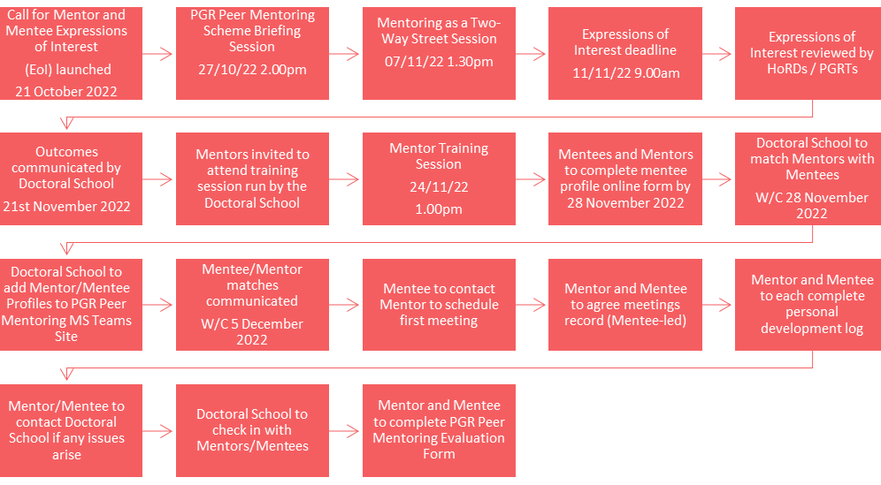

Slide 10
Upcoming Session
Mentoring As A Two-Way Street
7 November 13.30-15.00
Many potential mentors and mentees believe that mentoring is solely about the mentor providing advice about the mentee’s professional development. High quality relational mentoring has the potential to be bidirectional (enhancing the development of both the mentor and mentee) and transformational (impacting how the mentor and mentee think about not just their current job, but their careers, their vocations, and their lives). "Mentoring as a Two-Way Street" is a seminar and facilitated discussion which includes a description of high-quality mentoring and all the ways it has the potential to be a two-way street.
Book your place via Eventbrite

Slide 11
Where can I go for further information?
Website: PGR Peer Mentoring Scheme
Email: doctoralschool@shu.ac.uk

