Slide 1

Becoming a SHU Doctoral Researcher
28 June 2018

Slide 2





Housekeeping
Notes:
Katie

Slide 3
The Doctoral School Team doctoralschool@shu.ac.uk
Doctoral School Director
Prof Doug Cleaver
Head of Doctoral Training
Dr Nicola Palmer
Doctoral School Manager
Dr Sarah Smith
Researcher Development Adviser
Researcher Development Coordinator
Dr Elizabeth Scanlon
Liz Brearley
Oversight, Training and
Marketing
Quality and
Regulations

Slide 4
Becoming a SHU Doctoral Researcher
Outline for today
13:00 | Welcome / What is Doctoral Research? | Dr Nicola Palmer
13:15 | The RFs – Progression Processes | Dr Nicola Palmer
13:45 | Getting the most out of supervision | Dr Nicola Palmer
14:15 | Research Ethics and Integrity | Prof Ann Macaskill
14:45 | Break
15:00 | Library Support for Researchers | Pete Smith
15:30 | Support and Skills Development from the Doctoral School and wider university. | Dr Nicola Palmer, Liz Brearley & guests.
15:50 | Wrap Up / Close | Dr Nicola Palmer

Slide 5
Welcome
What is Doctoral Research?
Website:
https://www.shu.ac.uk/research/research-degrees
Twitter: @SHDocSchool
Blog Site: https://blogs.shu.ac.uk/doctoralschool/
Notes:
Corporate plan - our research strength will be concentrated in specific subject areas, but will be world class and designed to promote solutions that have a positive impact on the quality of life, solutions to questions of public policy, and contribute to the knowledge economy.
Income - £8 - 12M research income from grants and contracts (top 5 post 92 HEIs), £4M HEFCE funding, £1.7 Research capital funding
League tables e.g. Good University guide ranked 71 or 72
Impact - key government driver and HEIs will be assessed in future on the impact of their research and rewarded accordingly
Interesting informal research conducted that suggests this.

Slide 6
Doctorates at SHU
Total SHU research students in 2016/17 = 695
  328 = full-time, 367 = part-time
Route | No. Students
PhD (FT and PT) | 500
Ed. D. | 37
DBA | 91
D. Prof. | 35

Slide 7
Award Objectives
R1.4 MPhil award objectives
The MPhil will be awarded to a candidate who, having critically investigated and evaluated an approved topic and demonstrated an understanding of research methods appropriate to the chosen field, has presented and defended a thesis by oral examination to the satisfaction of the examiners.
R1.5 PhD award objectives
The PhD will be awarded to a candidate who, having critically investigated and evaluated an approved topic, resulting in an independent and original contribution to knowledge, and demonstrated an understanding of research methods appropriate to the chosen field, has presented and defended a thesis by oral examination to the satisfaction of the examiners.

Slide 8
QAA level 8 descriptor (extract)
Doctoral degrees are awarded to students who
have demonstrated:
the creation and interpretation of new knowledge, through original research or other advanced scholarship, of a quality to satisfy peer review, extend the forefront of the discipline, and merit publication
a systematic acquisition and understanding of a substantial body of knowledge which is at the forefront of an academic discipline or area of professional practice
the general ability to conceptualise, design and implement a project for the generation of new knowledge, applications or understanding at the forefront of the discipline, and to adjust the project design in the light of unforeseen problems
a detailed understanding of applicable techniques for research and advanced academic enquiry.

Slide 9
What Else?
Practitioner
Project Manager
Subject Expert
Presenter / Communicator
Analyst
Writer
Critical Reader
Teacher / Tutor / Mentor
Collaborator
Creator
Academic
Or
Professional
Or
…..?
Innovator
Independent Research Professional
Notes:
Corporate plan - our research strength will be concentrated in specific subject areas, but will be world class and designed to promote solutions that have a positive impact on the quality of life, solutions to questions of public policy, and contribute to the knowledge economy.
Income - £8 - 12M research income from grants and contracts (top 5 post 92 HEIs), £4M HEFCE funding, £1.7 Research capital funding
League tables e.g. Good University guide ranked 71 or 72
Impact - key government driver and HEIs will be assessed in future on the impact of their research and rewarded accordingly
Interesting informal research conducted that suggests this.

Slide 10
So – what is being “Doctoral”?
Research degrees are very different from taught programmes – there is no “book” with all of the answers. But if there were, then there wouldn’t be the space you require to develop your own ideas relating to the BIG questions of topic and method and voice.
The Key interactions and relationships are those with your Supervisors, your Cohort and External Researchers
The Student-Supervisor relationship is really important. It is well worth thinking about how it can best work for you – some aspects are fixed by regulation, but much is open to negotiation. You will also find that the relationship changes as your research progresses and your needs change.

Slide 11
Doctoral Provision at SHU - Devolved Structure, Delivered via 4 Faculties
DOCTORAL SCHOOL
Skills & development
Doctoral School Team, Research and Innovation Office
Students,
Faculty Teams
and Supervisors
Student Systems and Records Team, Registry Services
Funders, International, Marketing
Research Governance
Oversight, Training and
Marketing
Quality and
Regulations

Slide 12
Doctoral School
Essentially a wrap-around, developed to enrich student experience by providing add-ons to the main Research Degree Programmes
Generic Research Training
Broadening Events
    Student-led activities (Journal Clubs, Seminars, …)
    Research cafes and social events
    “Question Time” and “Shut Up And Write!” sessions
    3 Minute Thesis competition
Provide easy access to SHU’s Research Environment
Celebrate and Advertise Research Student Activities and Successes

Slide 13
The RFs - Progression Processes

Slide 14
Research Degrees Site on Blackboard
Button called 'Induction Packs' - MPhil/PhD
Who’s who in Student Systems and Records (Research Degrees)
Faculty Contacts
Getting Started and Keeping Going
Student Lifecycle and Key Stages
RDC Members
Research Student and Supervisor Responsibilities
Rapporteur/Assessor Guidance Notes
Guide to Doctoral Skills Training
The Thesis – guide to presentation and binding

Slide 15
Sheffield Hallam Code of Practice for Research Students and Supervisors
The University Quality Framework
Policies and Codes (Ethics, IP, misconduct)
Student Support
Resourcing the Research
Training and Development (methods, skills, teaching)
Responsibilities of Student and Supervisors
Monitoring/feedback
Appeals and Complaints

Slide 16
External Context
QAA Quality Code for Higher Education, chapter B11 Research Degrees
http://www.qaa.ac.uk/en/Publications/Pages/Quality-Code-Chapter-B11.aspx#.WBcdf02dG70
Provides quality framework for Sheffield Hallam's regulations, procedures and processes for managing research students
The 'RF' research forms for MPhil/PhD students are the mechanism for managing student progression and other changes to student registration throughout the student lifecycle

Slide 17
Research Degree Timescales
Degree |  | Normal minimum permissible time for completion from date of enrolment | Normal maximum permissible time for completion from date of enrolment
MPhil
Full-time | 18 months |  | 24 months
Part-time | 30 months |  | 36 months
PhD
Full-time | 24 months |  | 48 months
Part-time | 36 months |  | 84 months

Slide 18
Key Student Lifecycle Stages
Induction – Development Needs Analysis - this comprises the outputs 'my actions' and 'my action plan'
RF1 - Approval of Research Programme
RF2 - Confirmation of PhD
RF3 - Approval of Examiners and Thesis Title (note the word length of the thesis at an early stage)
RF9 - Other Changes to Registration (change of supervisors, additional time, suspension, change in mode, withdrawal)

Slide 19
Approval of Research Programme (RF1)
Submitted around 3 months after enrolment for FT students and 6 months for PT
Light touch validation of a student research project by an independent
Candidate details: include formal qualifications, relevant experience etc.
Title, Aims and Objectives: should be clear, realistic and succinct (100 words)
Programme of research: should include a statement of plan of work and intended methodology; must include a literature review (word limit of 1000 words)

Slide 20
RF1 contd……..
Information on PhD element optional at this stage; becomes a key issue at the Confirmation of PhD stage
Support: students usually have 2 supervisors, sometimes 3 if inter/multi-disciplinary, with appropriate expertise and experience
Split PhD students (who are international for fee purposes) who do the majority of study in their home country will need a local academic supervisor and details must be confirmed on the RF1

Slide 21
Statement and Declaration
Students must sign the statement and declaration box at the end of the form
confirm that they will engage with the ethics approval process and mandatory training
to confirm that, amongst other things, the Development Needs Analysis will be completed through the RDF planner
the 'my actions' and 'my action plan' parts of the planner MUST BE APPENDED TO THE RF1 FOR ASSESSMENT BY THE RAPPORTEUR
The HORD will also receive a copy to action

Slide 22
Confirmation of PhD (RF2a)
2 elements: to test written and oral skills
Comprises a Confirmation of PhD Report (maximum 6000 words) plus an oral assessment
Report should confirm methodology, a summary of work undertaken so far and a statement of intended further work. Must state PhD element of the project at this stage
Either ‘mock viva’ or faculty seminar presentation
see BB site for faculty/RI practices under the 'Regulations and Procedures' button

Slide 23
Confirmation of PhD Process
Students must submit the RF2a application form and a copy of their 6000 word report within set timescales of between 12 and 15 months for FT students and 24 to 27 months for PT students
Failure to do so will result in an automatic referral and loss of an assessment opportunity
The RF2a application form includes confirmation of the project title, a 500 word report summary, a progress report by the student and a DoS progress report
Confirmation of type of thesis to be submitted: monograph or article-based (see Appendix 1 of RD Regulations for information)
Confirmation that ethics approval has been granted
Supervisors do not take part in the assessment process

Slide 24
Assessment Decision
The decision is made by a Panel comprising the assessor(s) and the HORD or PG Research Tutor as Panel Chair
The Panel may invite supervisors to provide information/opinions in the event of borderline cases
If students are referred, they have 3 months to be reassessed if studying FT or 6 months if studying PT
If fail on reassessment, candidates may be counselled by their supervisory team to write up for MPhil (if the project is suitable) or may be asked to withdraw
The Academic Appeals Policy and Procedure allows students the opportunity to appeal the decision but only on the grounds that:
  There has been an irregularity in the application of the published regulation, policy or procedure which has had an impact on the decision.
  There is relevant new evidence or information that you did not provide and you have a valid reason why you did not submit it at the time.
  Disagreement with academic judgement is not grounds for appeal

Slide 25
Final examination stage (RF3)
Observe word length of thesis in 'The Thesis Guidelines' document
The thesis can be monograph, article-based or practice-based (with a creative element)
Thesis title – maximum 12 words
Examiners and thesis title approved on RF3 by RDC AT LEAST 4 MONTHS AHEAD OF THESIS SUBMISSION
Applications for Confidentiality of Thesis must be presented with the RF3 AT THE LATEST - applications received after this will not be considered

Slide 26
Examination continued........
Normally, 1 internal and 1 external (unless candidate is a member of staff – need 2 externals and an internal examiner)
Oral Examination is managed/overseen by an independent chair
Supervisor can be observer
Outcome verbally given after viva
98 students were examined last year in 2016-17
The majority of students, 73 (75%) achieved a pass with minor modifications to complete within 4 months FTE, with a minority of 9 students gaining a straight pass (9%) and the rest, 16 students (16%) having a re-examination opportunity to resubmit within 12 months

Slide 27
Progress Monitoring
Students should have a monthly supervision meeting if FT or a 3 monthly if PT (can be virtual)
Students and supervisors should maintain regular contact, agree schedule of meetings and agree records of meetings
Alongside the key stages, annual review is a formal progress monitoring mechanism undertaken by students and Directors of Studies - students are also expected to engage with the PRES survey
if problems arise, please talk to someone at the time they are happening
Confidential/sensitive issues can be raised with Professor Doug Cleaver as Director of the Doctoral School

Slide 28
Student Responsibilities
INCLUDE THE FOLLOWING:
Maintain regular contact with supervisors to review progress and keep on schedule in hitting key progress milestones
Take records of meetings and agree subsequent milestones for submission of work
Discuss/present work to others via networking opportunities
Publish work
Take initiative when problems arise
Decide with supervisors when to submit your thesis whilst considering the regulatory timescales for completion

Slide 29
Summary
Use the 'Research Degrees' BB site for some of your student information needs
Follow the key stages of the student lifecycle as closely as possible
If any problems arise along the way, be timely in seeking help and advice (for example, requesting suspensions, change of supervisors etc.)
Make sure you fulfil your student responsibilities and are able to utilise the university's facilities and resources
Make the most of the skills/PDP training on offer to enhance employability after you achieve your award
Enjoy your student experience!

Slide 30
Getting the most out of supervision

Slide 31

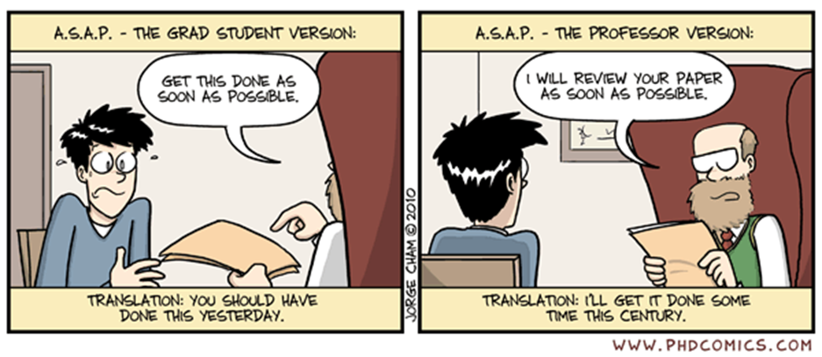
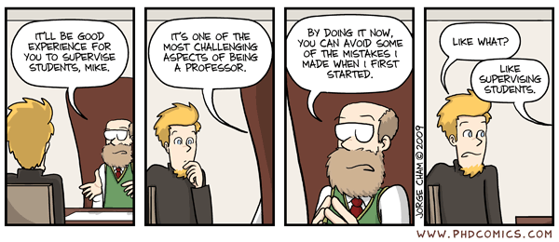
Management of Expectations

Slide 32
Tools to help you manage supervisory relationships
See 'Research Degrees Site' Blackboard Site to access:
Meeting records proforma
–agenda setting
–checking shared understanding
–official meetings record
Online Epigeum modules
–'Managing your research supervisor or principal investigator'

Slide 33
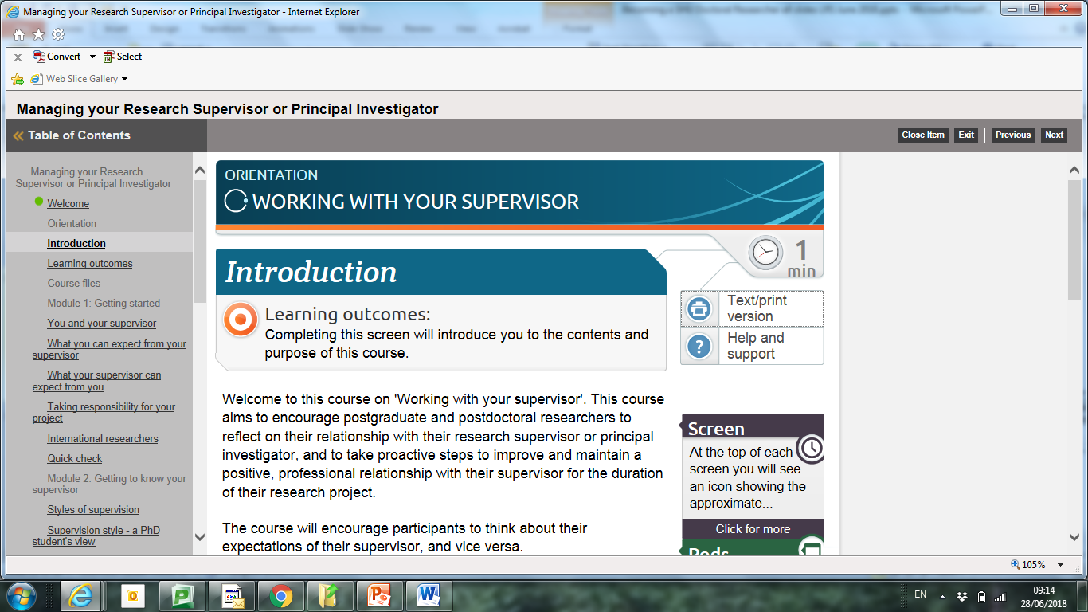
Example: Managing your research supervisor (Online Training & CPD - 'Research Skills', access via link on Research Degrees Blackboard site)

Slide 34
Support available in SHU
•Your Faculty doctoral teams - 'PGRT' (Postgraduate Research Tutor) or 'HoRD' (Head of Research Degrees)
•SHU Code of Practice for Research Students and Supervisors (2016/17) - See 'Research Degrees Site ' on Blackboard to access the electronic version.

Slide 35
Research Ethics & Integrity
Professor Ann Macaskill
Head of Research Ethics

Slide 36
Why do we need a code of research ethics?
If we all shared common moral values then a code might well be redundant.
Helps combat pressures that may be put on researchers
Helps combat pressures that researchers may put on themselves
Ensures that we have appropriate standards of behaviour and practices in relation to our research
Notes:
History : Tusadee Syphilis study

Slide 37
Where did the motivation to develop research ethics codes arise from?
Medical experiments on thousands of concentration camp prisoners during World War II. Most prisoners died or were maimed for life.
74 doctors and administrators were tried as war criminals.
As a result a code to guide research was produced in 1948, the Nuremberg Code - voluntary
WHO Declaration of Helsinki (1964) most recent revision in 2013 - underpins ethical research
.

Slide 38
Underlying principles
Research must comply with all legal requirements
Research needs to conform to commonly agreed standards of good practice. Declaration of Helsinki, ESRC Research Ethics Framework, the MRC & Research Councils UK.
These principles can be categorised as:
Beneficence (Do positive good)
Non-malfeasance (Do no harm)
Integrity
Informed Consent
Confidentiality/Anonymity
Impartiality
All research must be undertaken with highest levels of integrity
Notes:
.

Slide 39
Is it working?
Stem Cell Researcher at Kyoto University found Guilty of Data Fabrication (member of team led by a Nobel laureate Shinya) January 2018
2017 UK senior geneticist at UCL investigated over claims of research misconduct - He has already retracted 2 papers and corrected others but more papers are being examined
Pyou Han, a former biomedical scientist at Iowa State University, guilty of fabricating and falsifying data in HIV vaccine trials. -57 months in prison and fined US$7.2 million.
2018 Erin Potts-Kant, her former supervisor, and the university accused of including fraudulent data in applications and reports involving more than 60 grants worth some $200 million. If successful, could force Duke University to return to the government up to three times the amount of any ill-gotten funds, and produce a multimillion-dollar pay out to the whistle blower.

Slide 40
Numbers of articles being retracted from journals is growing (misconduct or errors)
Web of Science: 2,294 retractions (2001-2010)
Fraud:34%; Error 21%; Plagiarism, 10%; Duplication 14%; Suspected fraud9%; Other 14%.
Growing - 611 retracted in 2011.
PubMed 1113 retractions (2003-2010) Fraud:48%; Error 31%; Plagiarism, 16%; Duplication 17%; Not reproducible 13%; Ethical approval issues 7%; Other 11%.

Slide 41
New Emphasis on Research Integrity: Singapore Statement (2010)
Honesty: being truthful in all aspects of research
Accountability: taking responsibility for your actions as a researcher
Professional courtesy: treating colleagues, staff and students fairly and with respect
Good stewardship: using and managing resources provided by others responsibly.
___________________
The European Code of Conduct for Research Integrity (European Science Foundation) and a UK version

Slide 42
What does it meant for you as a SHU Doctoral Researcher?
Responsibilities:
1. Must become familiar with and comply with University policy and procedures.
SHU Policies and Procedures can be found at:
http://www.shu.ac.uk/research/ethics/
2. Must ensure that all research undergoes appropriate ethical scrutiny before data collection begins

Slide 43
What if someone questions the integrity of your research?
How do you respond?

Slide 44
Ways of demonstrating the trustworthiness of your research?
Research records:
Clearly document procedures (Ethics proforma is a core document)
Maintain accurate Lab Books- signed off by supervisor
Record any changes to procedures
Ensure equipment is regularly checked to ensure it is working correctly (Calibration etc.) & document this.
Keep records of relevant documents (consent forms, data files etc.).

Slide 45
Overarching aims are to:
Demonstrate that you have complied with university policies & procedures when undertaking your research as stated in your proforma
Ensure records are sufficiently detailed to allow verification and replication of your studies by others
Once papers are accepted for publication data files and other evidence to be stored in university Research Data Archive - 7years (paper or electronic )

Slide 46
Summary of Supervisor and Student Responsibilities
Supervisors: ensure that appropriate ethical scrutiny of their students' research occurs and to provide advice.
Take reasonable steps to ensure the research integrity of their students' research e.g. listen to interview tapes, check lab books, or examine data sets.
Students: complete ethics application.
undertake research ethically in accordance with approvals received
Maintain research records to demonstrate research integrity

Slide 47
Other Responsibilities
Publications: authorship & acknowledgements
Societal Considerations: How will research impact on wider society? Benefits vs risks.
Public communication: Principles?

Slide 48
Locating University Policies
University has policies and procedures on Research Ethics; Research Involving Human Participants; Procedures for Dealing with Scientific Misconduct and Research Funding from External Sources
Policy and procedures governing Research Misconduct by PG Research Students (doctoral)
https://www.shu.ac.uk/research/ethics-integrity-and-practice
Website is full of useful resources

Slide 49
How to make an Ethics application
Ethics Applications are made in the University's Research Management System - Converis.
Web-based system so can be accessed on and off campus
https://shu.converis.thomsonreuters.com/converis/secure/login
Login details to be emailed after this session.
For technical support contact converis@shu.ac.uk
Discuss the content of the application with your Director of Study.

Slide 50
Process
Templates based on level of risk:
  No human participants, human tissue or personal data
  Very low risk human participants studies
  All other research with human participants
  IRAS - projects requiring NHS or HMPPS ethics
  Approval given elsewhere - another UK HEI
Once ready to submit; this will be sent to your Director of Study to approve.
For pathways 3 & 4 Reviewers will be assigned to Review the application. You will be notified by email of the outcome.
For pathways 1 & 2 & 5 once checked by Faculty Admin, they are recorded and you will be notified by email that the application is approved.

Slide 51
Accessing help and support:
converis@shu.ac.uk
Training and detailed guides available for all roles in the system.

Slide 52

Becoming a SHU Doctoral Researcher
Break

Slide 53

Library Support for Researchers

Slide 54
SHUSPACE
shuspace.shu.ac.uk

Slide 55

Resources...
Image https://flic.kr/p/rrWYRE by Leo Hidalgo https://www.flickr.com/photos/ileohidalgo/

Slide 56
What if we don't have something?...
Notes:
Document delivery service

Slide 57
Managing your search
Create individual accounts in databases
  save searches, set alerts
Reference management systems
  e.g.Refworks, EndNote (SHU supported)

Slide 58
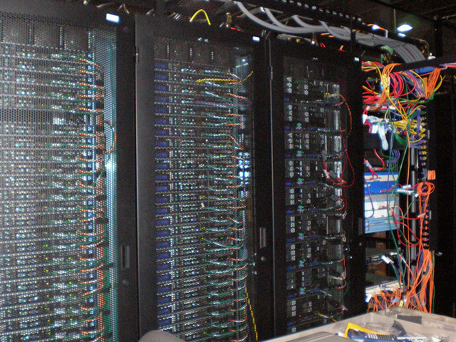
Research Data Management
Image https://flic.kr/p/55VAZm by Sean Ellis https://www.flickr.com/photos/s_w_ellis/

Slide 59
Timelines
For doctoral researchers, training needs and awareness of RDM issues shown at RF1 stage; data management plan submitted with online ethics application ahead of RF2

Slide 60

Sharing your work...
Image https://flic.kr/p/nvQocB by Furcifer Pardalis https://www.flickr.com/photos/13916314@N08/

Slide 61
Open data
'Open by default'- data shared via SHURDA
Some variations possible
  too risky to share / sharing not permitted by data sharing agreement
  some data shared
  embargo, data shared after set period

Slide 62
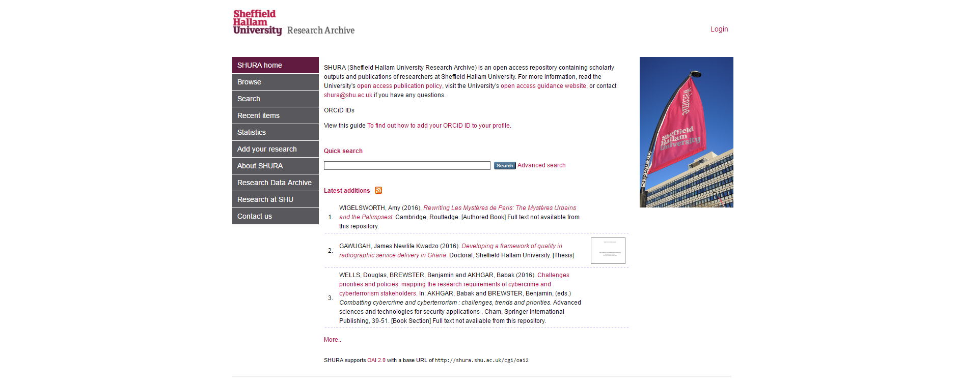
Copyright and your e-thesis

Slide 63
Copyright advice
See https://library.shu.ac.uk/lms/freebooks/shucopyrightelectronicthesis.pdf for detailed advice on copyright issues relating to e-theses

Slide 64
Keeping up to date...
Image https://flic.kr/p/rrWYRE by Leo Hidalgo https://www.flickr.com/photos/ileohidalgo/

Slide 65

Networking
Image https://flic.kr/p/5XhZ1u by Simon Cockell https://www.flickr.com/photos/sjcockell/

Slide 66
In summary...
Research data management
  writing data management plans
Literature review and finding sources
  writing and implementing search strategies
Sharing your work
  choosing where to publish, open access
  online thesis (SHURA) and data (SHURDA)

Slide 67
Where can I get more help?
  https://blogs.shu.ac.uk/libraryresearchsupport
  library@shu.ac.uk
  0114 225 3852

Slide 68



Slide 69
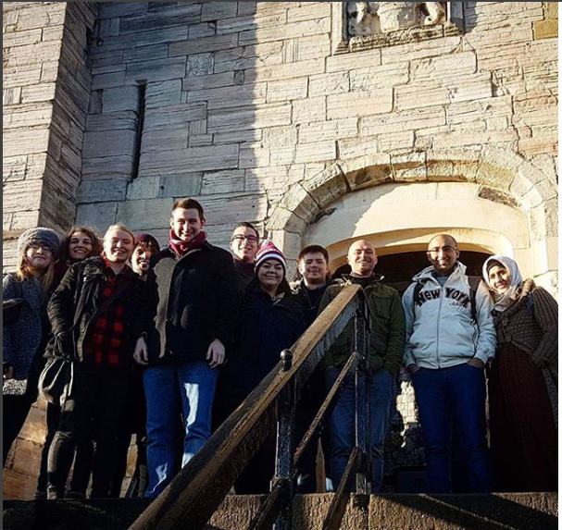
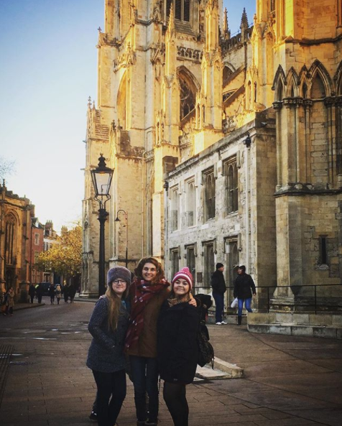
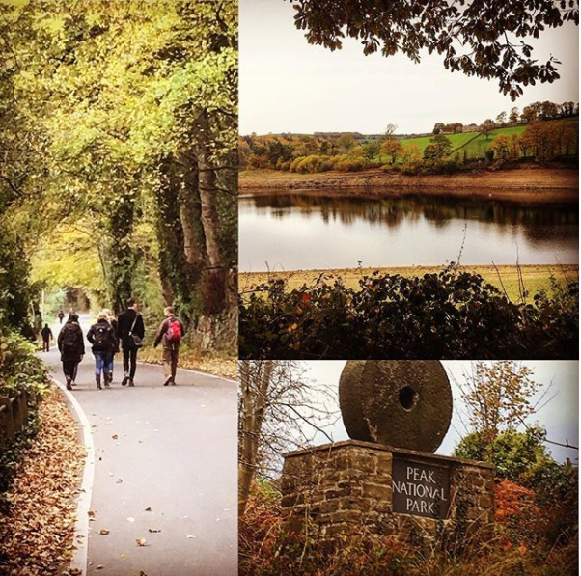

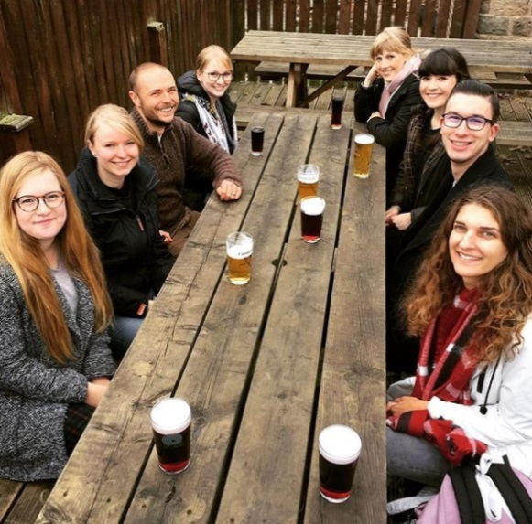
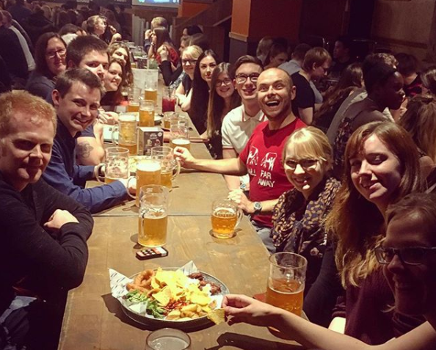

Slide 70
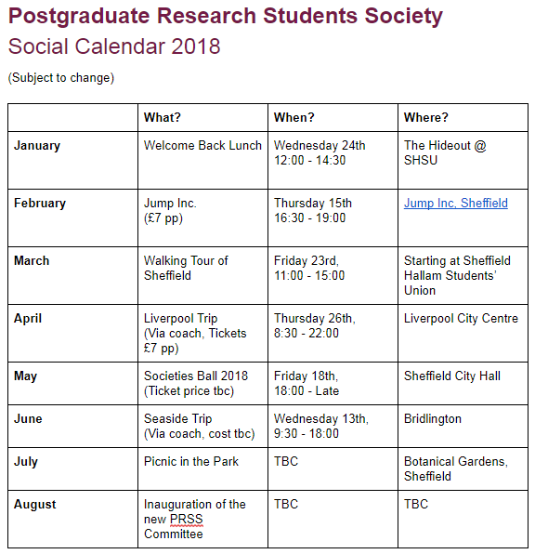



Become a member for free via the Hallam Students' Union website.
Postgraduate research students' society (shsu)
@shsuprss
pgresearchsociety@
gmail.com

Slide 71
Postgraduate Women in Academia is a network for women in postgraduate study at SHU, which aims to:
- Serve as a network of support for women in PG study and as a safe space to discuss issues affecting women in academia today
- Provide women in PG study with opportunities to develop their skills
- Encourage women in PG study in their career development

Slide 72
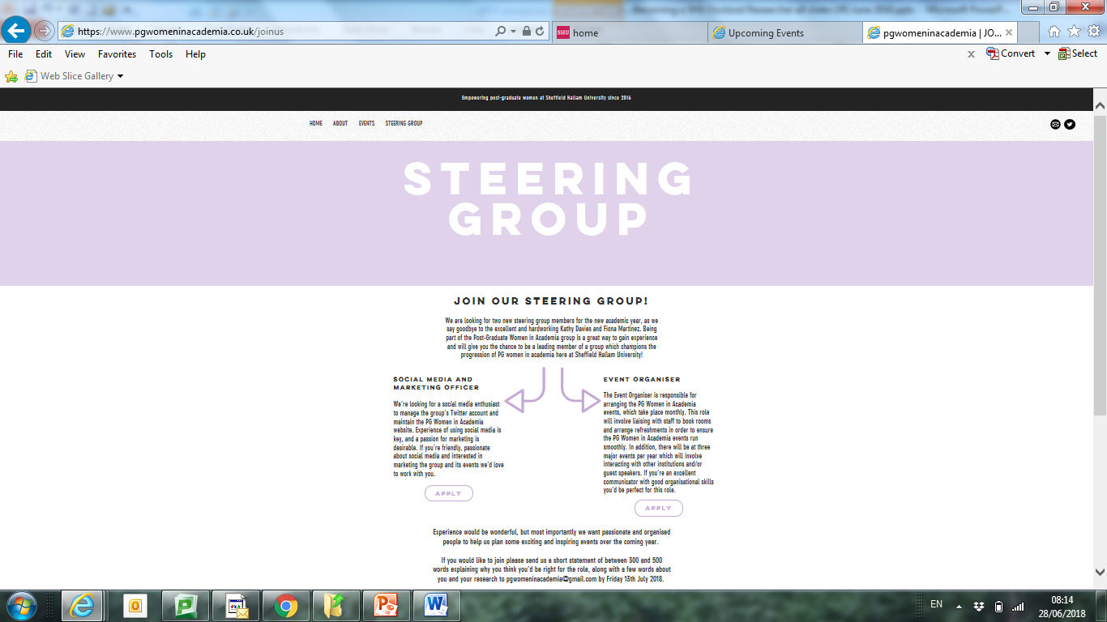

Slide 73
Visit our website:
pgwomeninacademia.co.uk
@pgwomenatshu

Slide 74


Slide 75
'An individual but not alone':
Building the Doctoral School community & doctoral skills development
Dr Nicola Palmer, Head of Doctoral Research Training
& Liz Brearley, Researcher Development Coordinator
SHU Doctoral School
Notes:
Introduction - a bit more about role within purpose of Doctoral School
Doing a doctorate - your expectations??

Slide 76
Our aspirations
Creation of a SHU PGR student identity
Excellent student experience for all SHU PGR students
PGR Students as an integral part of Research Environment
Supporting timely completion of the doctorate - academic, social, motivational support ('critical friends' etc.)
Building networks and equipping you for life beyond the doctorate....
Community, support and 'employability' as central issues

Slide 77
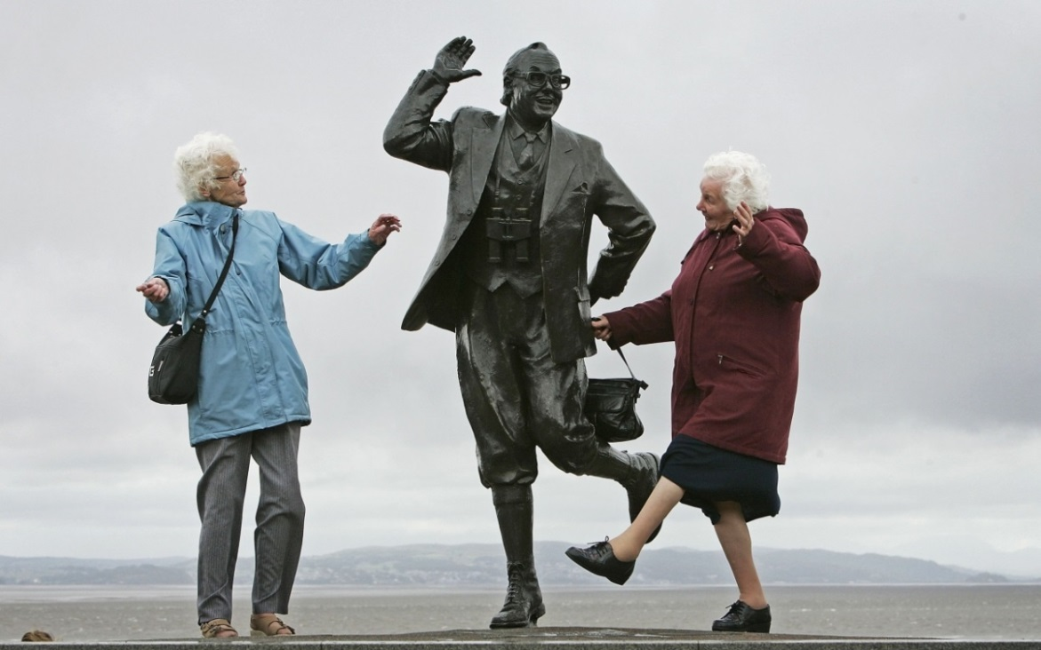
Did you know?....
The 2 biggest contributory factors to happiness around world are:
Sense of community
Frequent community celebrations
(Source: Thompson, T. (2015) What are the scientifically proven ways to be happier?, The New Statesman, 8th July 2015)

Slide 78

Actively embracing the doctoral communities
  What communities are you aware of so far at SHU?
  Where do you fit in?
Notes:
PGR Reps as instrumental in development of PGR communities

Slide 79
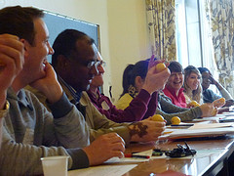
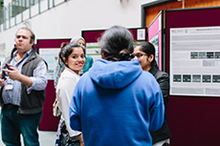
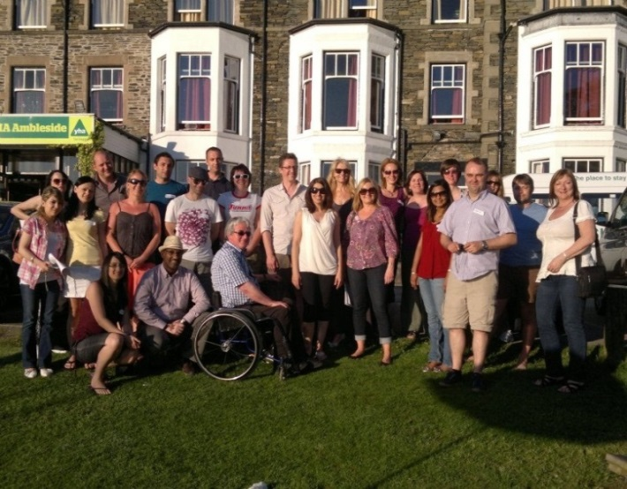
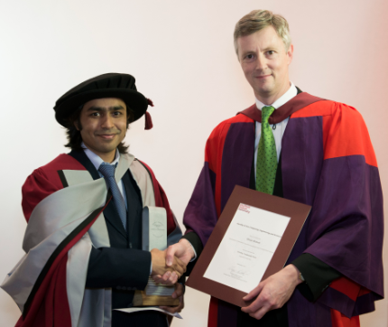
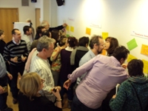

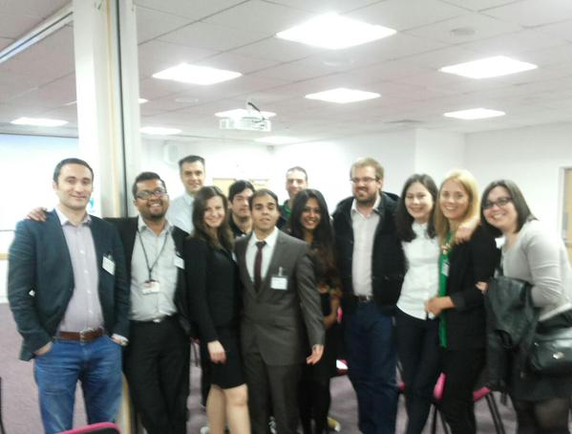
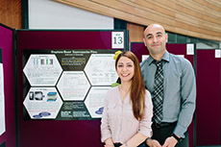

Example SHU Doctoral Community Events
Notes:
Talk through range of events....

Slide 80

Sheffield Hallam Doctoral School
https://blogs.shu.ac.uk/doctoralschool/
Notes:
Our blog site

Slide 81
Connect with the SHU doctoral community
https://blogs.shu.ac.uk/doctoralschool/
Send us your news, events, stories, reflections, tips or anything else you want to share with the doctoral community.
doctoralschool@shu.ac.uk
@SHDocSchool
Contact your local PGR student rep
Notes:
Ways to connect

Slide 82
Doctoral Skills Development
Why?
Expectations - QAA and research funders
Mantra now that: PhD = thesis + PPD
Employability - need transferable skills whether preparing to go into academia or industry
Competition with PGRs at other institutions - Doctoral Training Centre 'balanced skills portfolio' model
Notes:
QAA Indicator 14: "Research students have appropriate opportunities for developing research, personal and professional skills. Each research student's development needs are identified and agreed jointly by the student and appropriate staff at the start of the degree; these are regularly reviewed and updated as appropriate"
Roberts' Review: "Minimum standards should include the provision of at least two weeks of dedicated training a year, principally in transferable skills“
Widely recognised as a key element of the postgraduate research experience
Opens up a range of career choices
Gives you a competitive edge

Slide 83
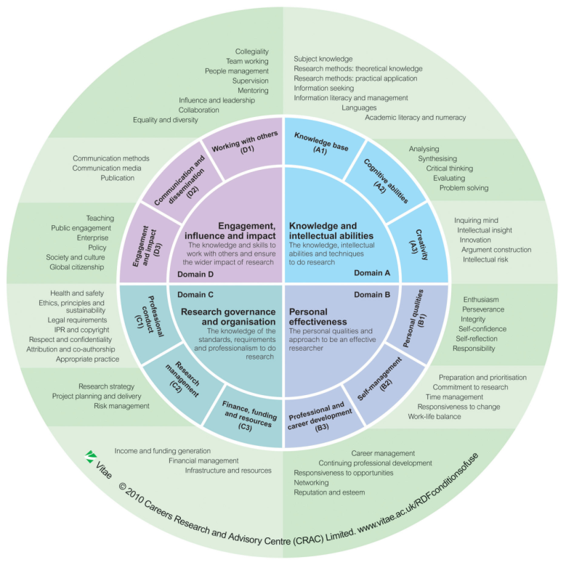

Doctoral Skills Development
What?
Use the Researcher Development Framework (RDF) to identify your development needs

Slide 84
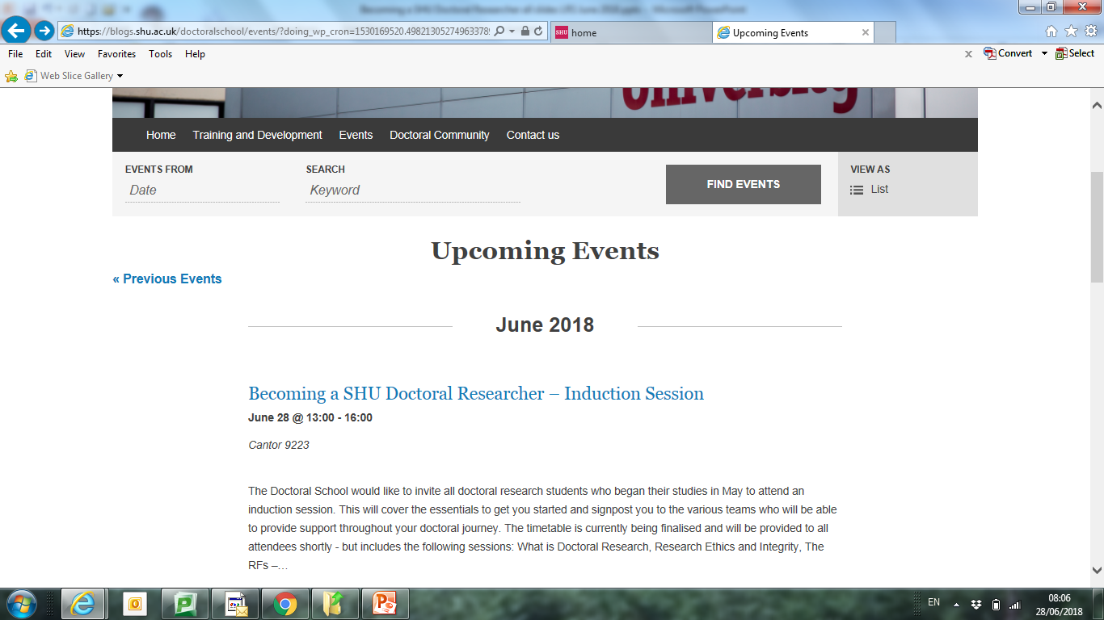
Doctoral Skills Development
When? (How?)
Use the events calendar to see what’s coming up and book your place

Slide 85

Doctoral Research Training Series a needs-based development programme, aligned to the PGR lifecycle and the Researcher Development Framework (RDF)

Slide 86
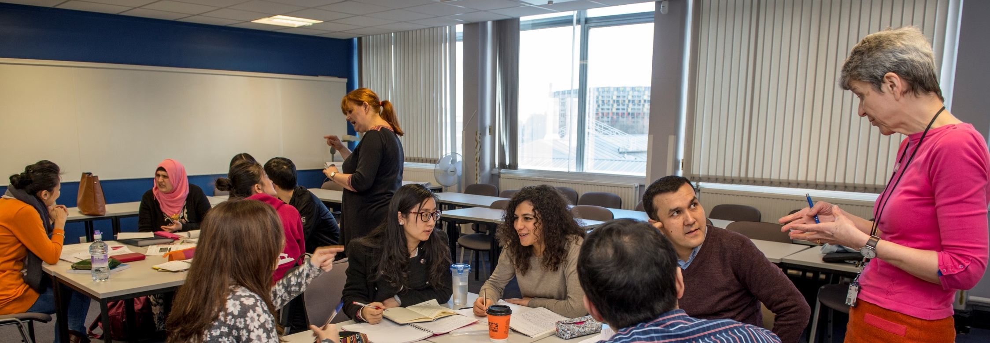
Teaching Skills for Doctoral Students
Programme run over 4 consecutive weeks
Online Epigeum courses
The Brilliant Club

Slide 87

Academic writing
Regular Shut Up and Write! sessions
Academic English for your PhD

Slide 88
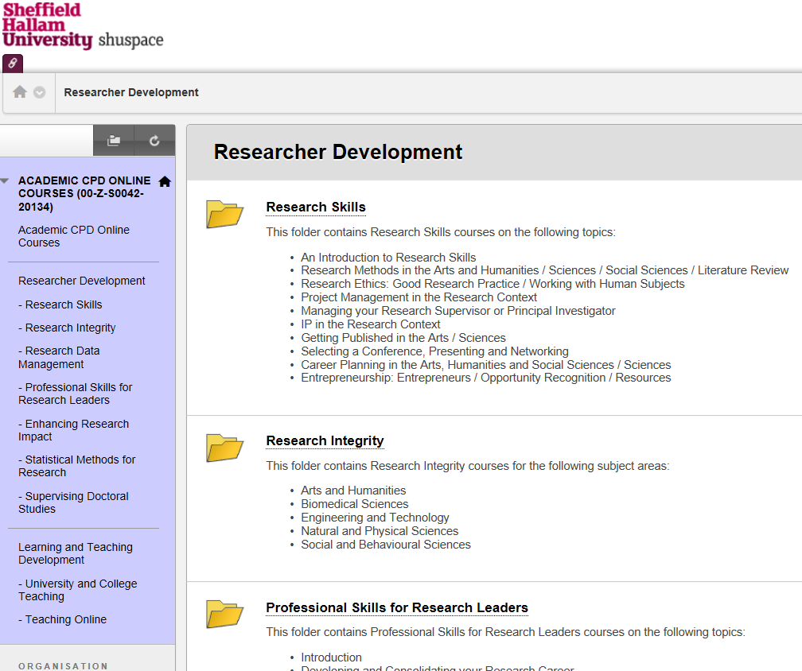

Online Courses and Resources

Slide 89
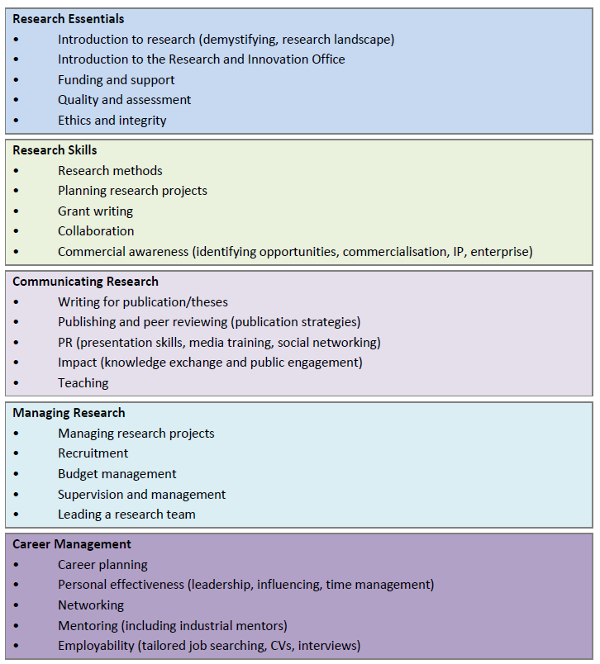
The SHaRD Programme https://blogs.shu.ac.uk/shard/ a blend of: delivered courses online courses resources

Slide 90
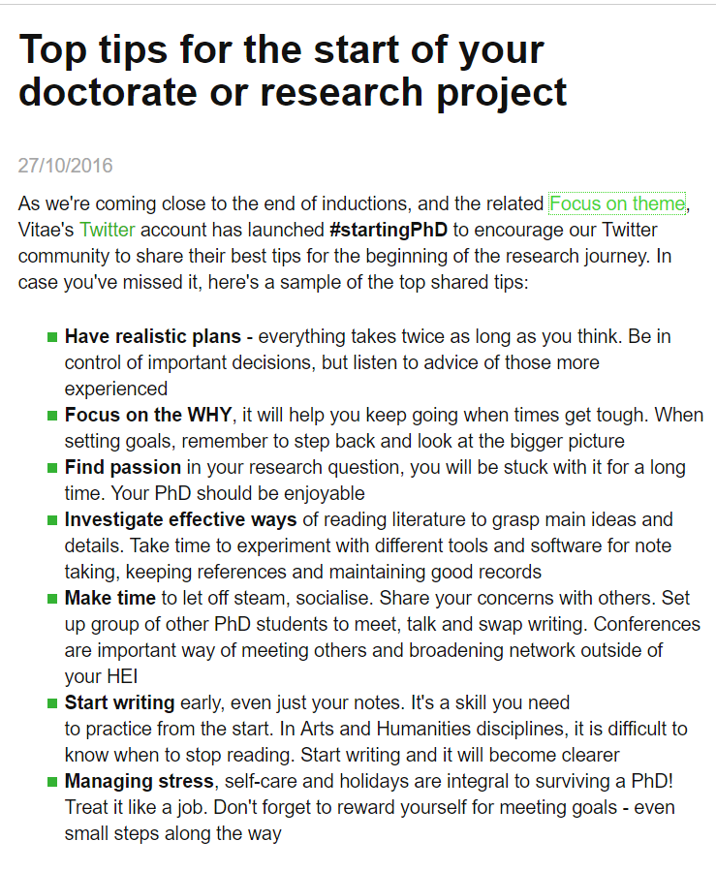
Vitae www.vitae.ac.uk register with your shu email to access full member content including tips and resources on managing your professional and career development
#startingPhD

Slide 91


Becoming a SHU Doctoral Researcher
28 June 2018

