Slide 1

Doctoral School:
Career Planning Tactics
Kent Roach
Careers and Employability Consultant

Slide 2
Today's Aims...
This session will help you:
find your approach to career planning
Increase your awareness of career opportunities and vacancy sources after your PhD/Masters by research
know where to go for further Careers support, guidance and self-help resources

Slide 3


Which picture resonates?....

Slide 4
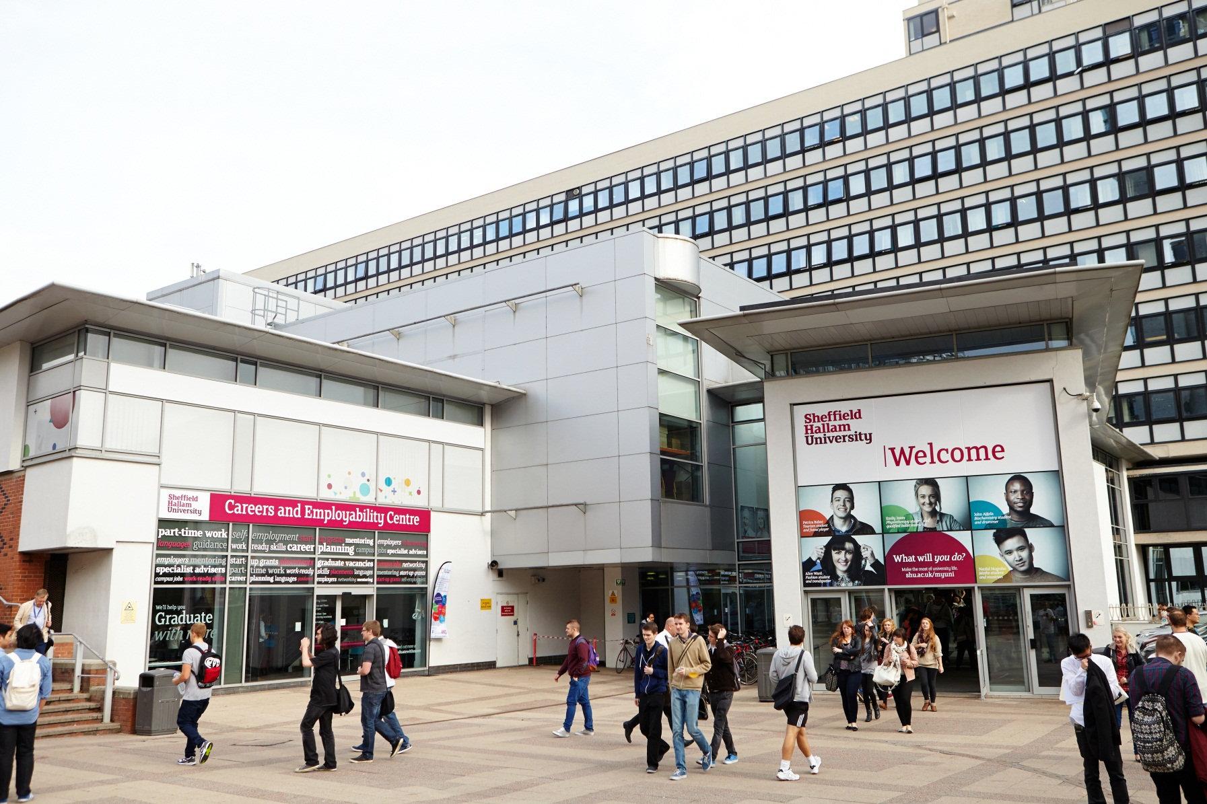
Careers & Employability Centre
Notes:
Whatever stage you are at we can help you

Slide 5
How can the Careers Service help?
One to One Advice & Guidance
Jobs Grad/Prof roles
Work while you study
Experiential Support
Employer Events & Fairs
Workshops such as LinkedIn, Mock Interviews
Notes:
These are some of the activities that we can offer

Slide 6

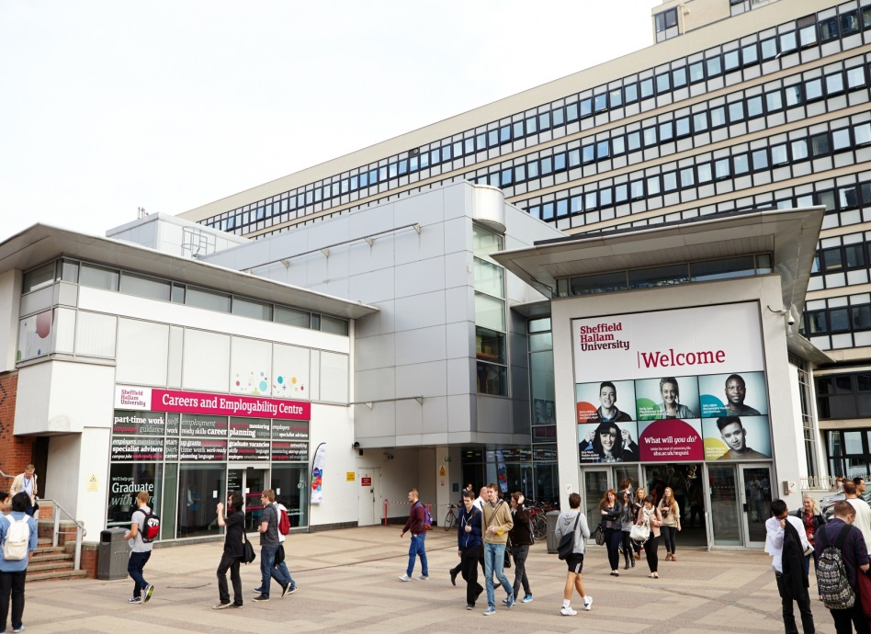
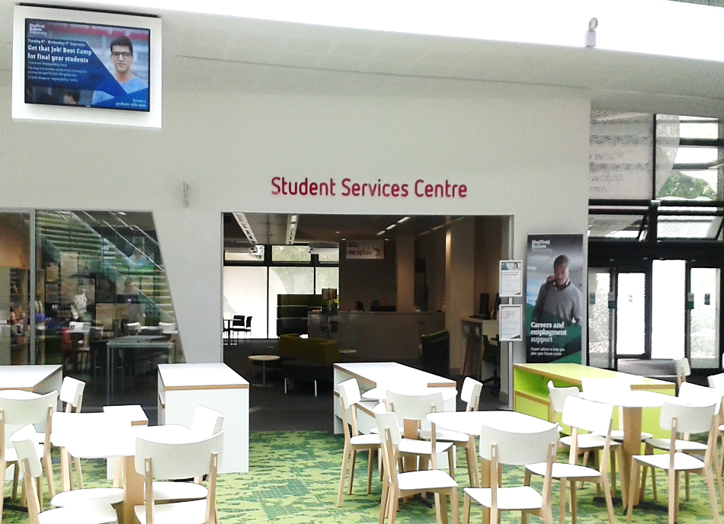
Book an appointment...
Tel: 0114 225 3752
Web: http://careerscentral.shu.ac.uk
Email: careers@shu.ac.uk @SHUCareers
Careers and Employability Centre
City Campus
Careers @ Student Services, Heart of the Campus, Collegiate

Slide 7

‘When the wind blows our working lives are shaped by many forces. What matters
is how we react to them’
Dr Peter Hawkins
The Art of Building Windmills
Some build walls to resist the opportunities which come their way.
Others build windmills taking control and turning those opportunities to their own advantage
The world of work is changing all the time and
this quote lies at the heart of career
management
We have to be aware of and respond to these
changes and work them to our advantage in
order to remain employable.

Slide 8

What is Employability?

Slide 9
EMPLOYABILITY: a definition
‘Employability is having a set of skills, knowledge, understanding and personal attributes that make a person more likely to choose and secure occupations in which they can be satisfied and successful.’
(Dacre Pool & Sewell, 2007)

Slide 10

What is 'career management'?

Slide 11
What is career management?
Implies taking charge of your future
In reality a highly interactive process between an individual and their environment/employer – can be difficult to feel in control of your own destiny
Good career managers therefore need:
  To understand what they want from life
  Be knowledgeable about careers, routes into them and career prospects
  An understanding of the wider economic, political, social and technological climate

Slide 12

DOTS
Well informed career decisions are made when a person has:
a sense of Self: understands strengths, weaknesses, likes, dislikes
knowledge of career Opportunities and routes into career opportunities
understood influences on Decision making and consequences of decisions
the skills to Transfer into opportunities e.g. CV, interviews, tests
Bill Law & Tony Watts NICEC

Slide 13
Career management...
A continuous process throughout your lifetime which will change according to your personal circumstances
Sometimes geared to developing you in your current role
Sometimes focussed on preparing you for promotion
Sometimes aimed towards getting you a new role or career
Notes:
Although life is unpredictable it is still possible to manage your career as an ongoing process where you keep adding to your experiences and reflecting on what you have learned. Sometimes you can put these experiences to something new, sometimes to enhance what you are already do – either way these experiences are never wasted.

Slide 14
A Planning Cycle...
Building Self Awareness
Take action
Research and online tools
The wider picture
Reflect on experience & talk to people
Yourself
Careers
The wider picture
Taking action
Review progress
Notes:
Today we are going to focus on three aspects – Yourself, Careers and The Wider Picture – the next seminars will look at Taking Action and Review Progress

Slide 15
Issues...?
In small groups discuss:
What do you feel are the main issues facing you as you plan the next stage of your career?
What barriers do you face?
What could you do to overcome these?

Slide 16
Some of the issues you may face...
How to progress a career in academia
Need to assess strengths and weaknesses
Where to look for opportunities
How to tailor my CV/Portfolio
Personal expectations too harsh?
How do generic employers view PhD holders?
Awareness of options other than academia

Slide 17
Career Planning: Your Steps
Notes:
**ASK Group** what are YOU going to do?

Slide 18
Career Planning: Your Steps
You: very important to know your ideas, values, skills, experience...
Research: know what's out there and what can help
Reality check: do I have what I need for this path...?
Test it out: get experience, test options, reflect on experience
Action Plan: what are you going to do next?

Slide 19

Career planning where do you start?
You: very important to know your ideas, values, skills, experience...
Where am I now?
Where do I want to be?
How do I get there?
What support do I need?
How can I keep improving?
Courtesy of The Art of Building Windmills
by Dr Peter Hawkins

Slide 20
Career planning tactics
Start by assessing your current situation
  motivation
  skills
  experience
The key is to step back and take an objective look at yourself.

Slide 21
Think about yourself...
Your Career ideas? what would you like to do? Your 'dream job'?
Your likes, dislikes and values? What are you already good at?
Are you self aware?
'Occupational Awareness'
what could you do?
what steps do you need to take to get there?
What choices have you already made?
Skills
What are my skills and abilities (actual and potential)?
Motivation
What am I interested in doing?
What do I enjoy and find important?
Personality
How do I interact with my
environment and circumstances?
Notes:
Ask for hand-out on Skills Auditing

Slide 22
Self Awareness: Tools to help you know yourself better
A good tool for self awareness is Profiling for Success online tests
These will test your abilities, potential, style, personality, motivations, interests, values and approach to relationships.
Types of personality test you can practice:
Learning Styles Indicator
Type Dynamics
Values-based Indicator of Motivation
This is just for Hallam students and you can log in for free through our Login code:
Client Code: tflhe
Access code: shu Password: shu041012
More of this in week 2!

Slide 23
Self Awareness: Tools to help you know yourself better
Some tools just for researchers....
'Skills of Research Students'
  http://www.sheffield.ac.uk/careers/postgraduates/research/analyse.html
  From the Vitae website
  Where are you now - www.vitae.ac.uk/researchers

Slide 24
What Jobs may suit me...?

Slide 25
Researching careers
Once you know what motivates you and what knowledge, and attributes you have you can begin to think about possible job roles
How much thought have you really given to job roles and career opportunities?
How far have you considered widening your career horizons?
Stepping away from what you know can be scary but it can help to open up more opportunities

Slide 26
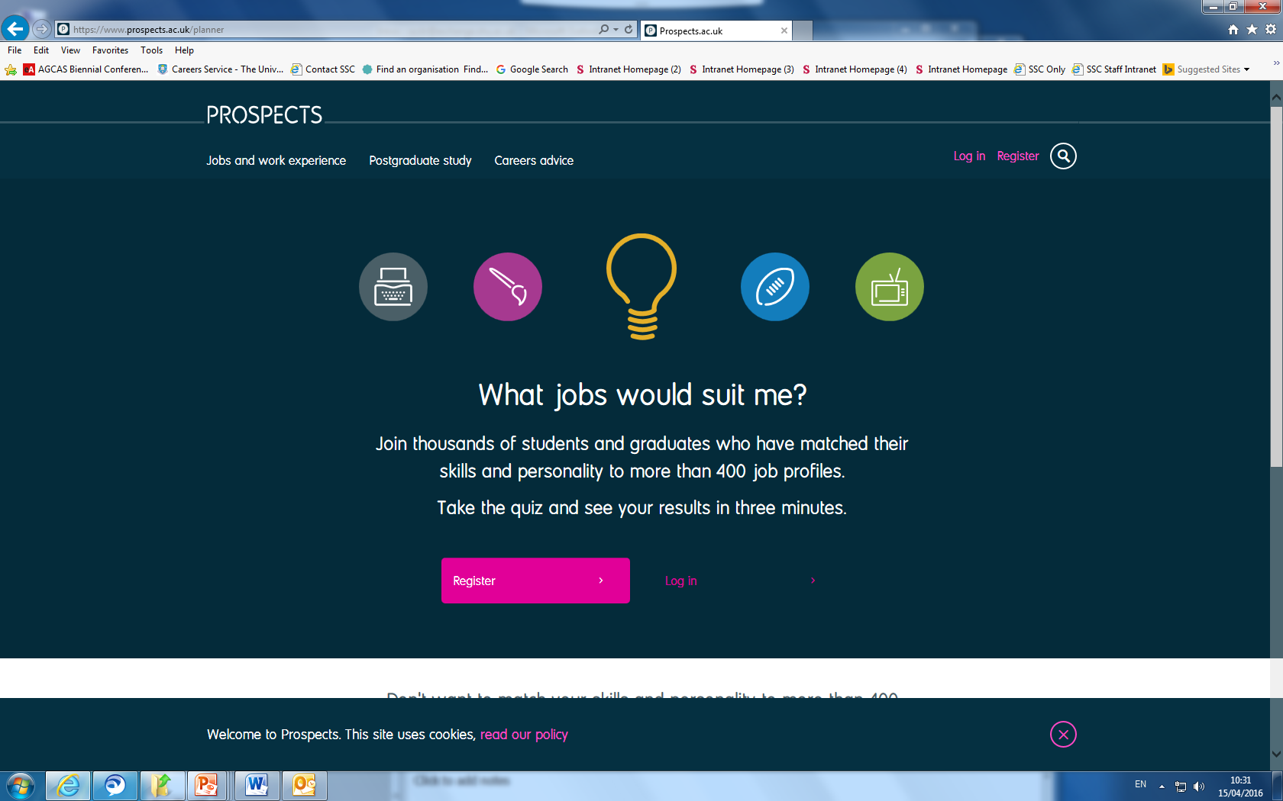
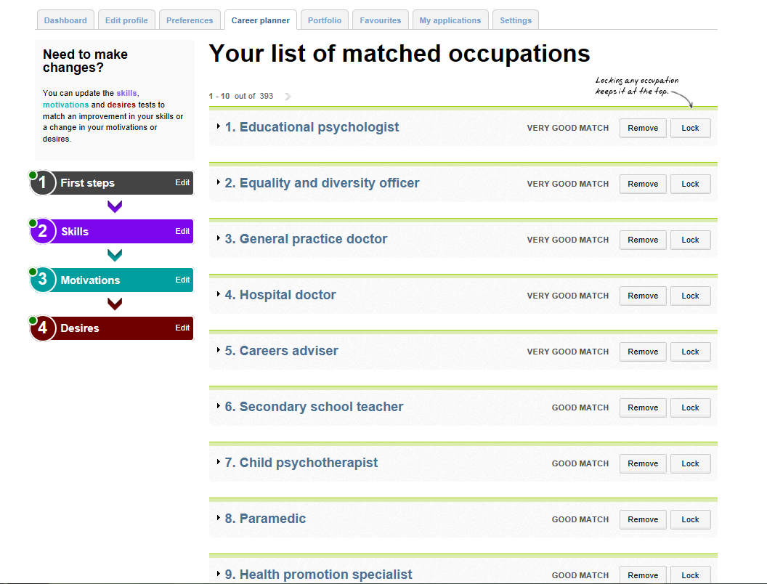
Prospects Planner
http://www.prospects.ac.uk/myprospects_planner_login.htm
Great For:
A quick careers assessment tool ('which job would suit me?')

Slide 27
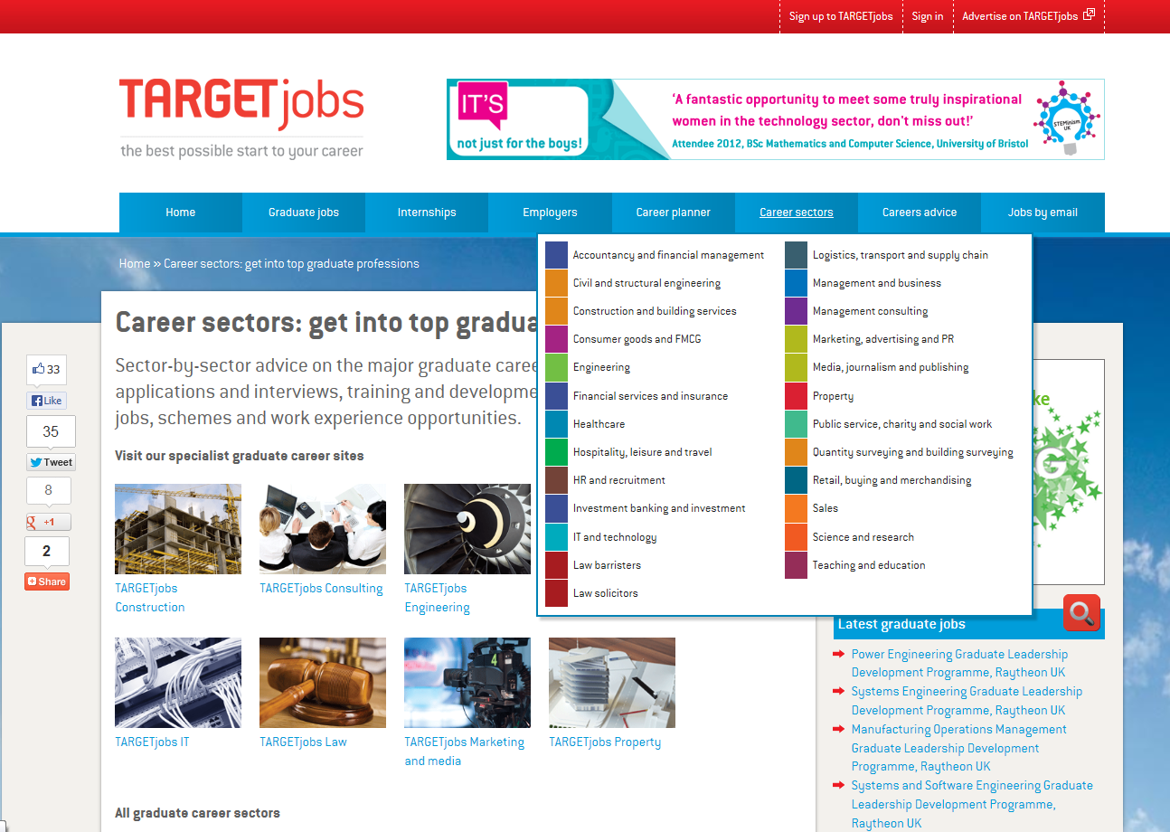
TARGETjobs
http://targetjobs.co.uk/
Great For:
Careers Information
Specific industry & sector insights
Employer tips
Graduate Jobs
Work Experience & Placements
Skills Assessment (Target Careers Report)

Slide 28
Where do you see yourself?
Are you looking for?
  Work in an academic environment?
  A research role in a different setting?
  Self-employment?
  To apply your skills and knowledge to a non-research environment?
Broadening your horizons
  are there other options you haven't considered?

Slide 29
Academic career- route in via post doctoral research post – usually fixed term – i.e. 1-3 years
Lecturing post – possibly teaching only
Research roles outside academia in industry, commerce, public sector, charities, pressure groups, ‘think tanks’, cultural organisations
Opportunities which use your transferable skills
See the University of Sheffield’s Skills of researchers for a list of these Research Students
Some Researcher Career Options

Slide 30

Careers Information for Researchers...
Prospects job profiles
  www.prospects.ac.uk
Vitae career stories
  www.vitae.ac.uk/careerstories
Epigeum - training and resources for researchers
  https://www.epigeum.com/ (have a look at the library catalogue)
The Shard - SHU's website for Researchers
  https://shardprogramme.wordpress.com/shard/career/
The RCUK’s Case study series: Careers in Research
  http://www.rcuk.ac.uk/skills/percase/
Vitae.ac.uk: Find out what happens to PhD graduates
  What do researchers do? Labour market information -
  UKCGE - UK Council for Graduate Education
  http://www.ukcge.ac.uk/
  AGCAS
    University Researchers & the Jobs Market(2001-09)

Slide 31
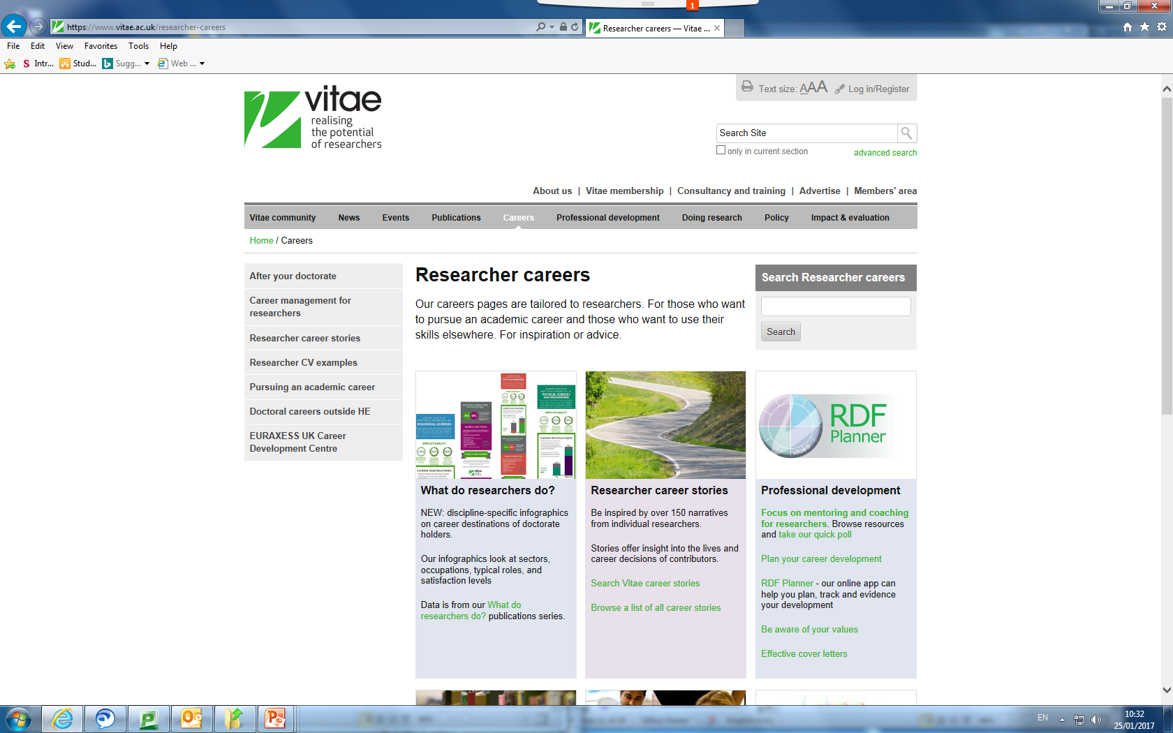
Vitae Online
https://www.vitae.ac.uk/researcher-careers

Slide 32
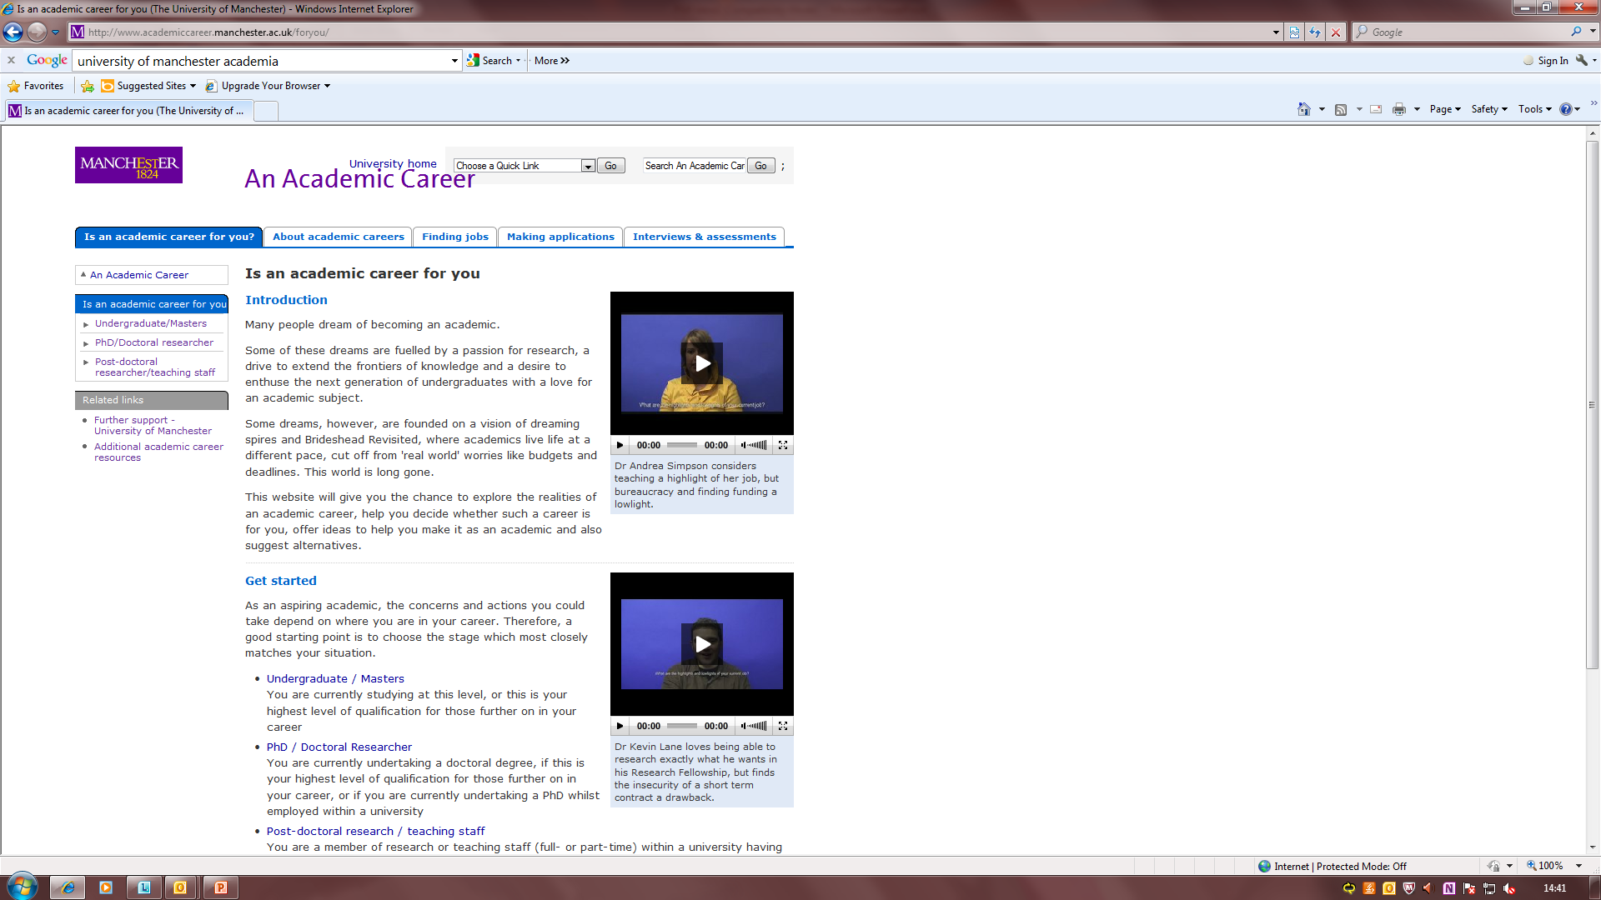
The University of Manchester Careers Service’s
Award winning website for postgraduate researchers and research staff

Slide 33
Explore what’s out there
Review job adverts
Try to not limit yourself by just choosing ones you know or think you could do
Choose ones you find interesting, rewarding, worthwhile, feel ‘right’ for you

Slide 34
Generate ideas
Using the Widening Horizons Funnel template:
  write down one career idea you have been considering for a while
  then list ideas very similar to this
  gradually broadening out your ideas so you have more options to consider
Aim
  to get you to consider how far you might be willing to step beyond the environments you are currently considering/know

Slide 35
The widening horizons funnel - example
Nearby | Still close | A little further | Away from research | Anything goes
 |  |  | Legal or patents | ‘Any discipline' – Law, HR, Accounting, Admin.
 |  |  | Teaching schools/colleges | HR
 |  | Govt. Lab | Scientific/public policy adviser | Private sector
 | Research fellow | Museum/gallery | Government ‘desk researcher’ | Not-for-profit
 | Technical support | Research Institute | Publishing | Self-employment
Research post | Lecturer | Research Council, Charity, Private company | Research Council roles | SME
 | Administrator | SME, R+D | Pharmaceuticals | Large company
 |  | Consultancy firm or indep. consultant | Production manager | Service sector
 |  | Your own business | Technical sales/marketing | Manufacturing
 |  |  | Consultancy | Government
Narrow horizon = Known, safe and secure | A little wider but still university based | Still research based but different setting | Using knowledge but not in research context | Using transferable skills rather than specific knowledge or experience
Increasing ‘risk’ and research effort to investigate, breadth of opportunity, likelihood of some form of re-training (though not always), wide horizons

Slide 36
Seeing the wider picture
Being proactive and using networks
Keep yourself informed
Keep up to date with developments in the sector, possible new openings via: www.vitae.ac.uk/lmi
Join online discussion forums - academia.edu. , researchgate.net for scientists, and Mendely and and #phdchat on Twitter
Put yourself out there! Create a professional LinkedIn profile and use Twitter to ‘follow’ professional associations, individuals etc.
Use professional journals and national newspapers such as the FT
Do you know where vacancies for your sector are advertised?
Notes:
Many jobs are never advertised which means you need to use more proactive methods to uncover the ‘hidden’ ones. Here’s a few ideas to get you started.

Slide 37
Reflecting on your path so far...
Why did you decide to do a PhD/Masters by Research?
Reflect on the following:
  Was this a long held ambition or chance occurrence?
  Did you have a clear idea where your PhD would take you?
  Has the reality matched your expectations?
  What impact has undertaking a PhD had on you as a person?

Slide 38
Types of jobs for PhD graduates
Academic Research - universities, research institutes, government
Research in Industry or Business - technology, bio-industry, policy think tanks, media
Scientific services - clinical sciences, advisory services, specialist industries
Associated commercial careers - technology transfer, patent agent, data management, regulatory affairs, marketing
Communication – publishing, editorial, commissioning, production, press officer, outreach, medical writer
Teaching - university, schools
Administrative work
Self Employment/Consultancy work
Something completely different ..... Finance, IT, hobby ….

Slide 39
Achieving an academic career
Publications – in ‘high impact’ journals
Grant funding – Research Councils, charities, EU
Teaching – at university level
Supervising – research students (PhD & MSc)
Administration – supporting the Dept/University
Notes:
Start doing these things at PhD level

Slide 40
Research outside academia – some points to consider
Focus is likely to be practical, policy-orientated rather than theoretical
Need to distinguish ‘research’ from policy advice or knowledge management
Research will be driven by employer’s or client’s needs rather than own
intellectual interests
Employer may have an ‘agenda’
Findings may have higher public profile but there may be less personal recognition than in academia
Employer may have a fairly ‘flat’ hierarchy, leading to limited opportunities for promotion
Some scope for freelance

Slide 41

Skills for a research career outside academia
Quantitative skills – identified by employers as being in short supply
Report writing
Ability to adapt communication styles to a wide range of audiences
Customer service skills
Ability to handle the media
Creativity/Innovation (BLOOM'S TAXONOMY)

Slide 42

Reality check: do I have what I need for this path...?
Speak to an adviser
  not sure how to book an appointment? check out our website
  Check out our Career planning guide
talk to friends and family
  ask for advice and opinions
Think about factors that may affect your ideas
Talk to someone in the industry
  use your networks, try industry websites, professional bodies, local companies, LinkedIn...

Slide 43

Test it out: get experience, test options, reflect on experience
PRACTICAL ENGAGEMENT

Slide 44
Find work experience
Volunteering
In many different organisations and roles
Valuable networking and experience
Can be a couple of hours a week to a few months
Shadowing
Being someone's 'shadow' for a few days
Less formal, so employers usually open to this
Temping
Short term work through a recruitment agency
Variety of opportunities, usually fairly flexible
Insight Days
1-7 days, often within bigger companies, chance to talk to employers and staff members
Internships
From 1 week to several months
Can be formal or something you arrange yourself
Self employment / Freelancing
Test out a path yourself
support from uni (e.g. Enterprise Team and Hallam Freelancers)

Slide 45

Where am I now?
Where do I want to be? Short Term, Medium Term, Long Term
How do I get there? Immediate actions: Today, tomorrow, this week, next month
Action Plan: what are you going to do next?

Slide 46
Common Vacancy Sources
www.prospects.ac.uk
www.targetjobs.co.uk
www.yorkshiregraduates.co.uk
www.jobs.ac.uk
www.labstaff.co.uk
http://jobs.timeshighereducation.co.uk/
www.phdjobs.com
www.thes.co.uk
www.rec.uk.com
www.FindAPostDoc.com
www.FindAUniversityJob.com
http://jobs.theguardian.com/

Slide 47
Homework for next session
ME Plc Exercise
  Helps you to assess how good you are at managing your career
  Where you are strong and areas where you need to develop
  The performance audit is based on the principle that in our careers we are all a business of one - ME Plc
  Complete the questionnaire and bring your copy to the next session on Thursday 9th February
  Topic: Personal Skills Analysis

Slide 48
Career Planning: More Resources
The Academic Scientists’ Toolkit’ http://sciencecareers.sciencemag.org/career_development
‘Building a successful career in scientific research’ : a guide for PhDs and Postdocs, Phil Dee, (Cambridge University Press 2006)
www.beyondthephd.co.uk Beyond the PhD – specialist career planning resource for Arts and Humanities PGRs
http://www.ironstring.com/sellout/ Specialist USA resource for Arts/Humanities PGRs. Gives useful ideas on how to relate skills and knowledge gained from your PhD to non-academic roles
Notes:
**ASK Group** what are YOU going to do?

Slide 49
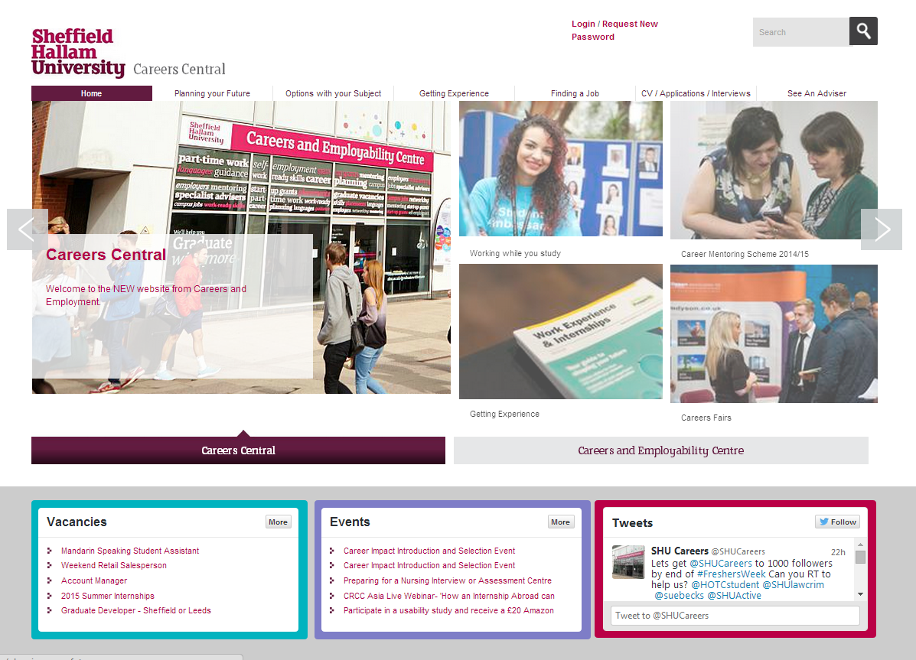

More Info? Careers Central Website http://careerscentral.shu.ac.uk/
INFO
Jobs
EVENTS
Notes:
New website where you can find our jobs and events

Slide 50
Need more help?
Tel: 0114 225 3752
Web: http://careerscentral.shu.ac.uk
Email: careers@shu.ac.uk @SHUCareers
Careers and Employability Centre
City Campus
Careers @ Student Services, Heart of the Campus, Collegiate

