Slide 1
Assistive Technology: Supporting your Studies

Slide 2
What is Assistive Technology?
Assistive technology (AT) is any item, piece of equipment, software program, or product system that is used to increase, maintain, or improve the functional abilities of a person.
Source: Assistive Technology Industry Association

Slide 3
The AT Service
Group Training sessions
AT Appointments
For all Students
For students who have
registered a disability

Slide 4
Campus Offer for Group Training
Mindview (apps anywhere)
Planning
Organisation
Research
Revision
Office 365 (free for all Hallam students to download)
Improve reading comprehension
Enhance research techniques
Audio Notetaker (apps anywhere)
Record your lectures
Enhance note taking
Revise more efficiently
Practice presentations

Slide 5
Online Offer for Group Training
Mindview (extended trial licence)
Planning
Organisation
Research
Revision
Office 365 (free for all Hallam students to download)
Improve reading comprehension
Enhance research techniques
Glean – cloud based (no training offered due to basic nature of software)
Record your teaching sessions
Use for face to face teaching or online
Easy to use
Unlimited storage

Slide 6
Office 365 Immersive Reader
Accessibility tool used to make word documents
and web pages easier to understand and navigate

Slide 7
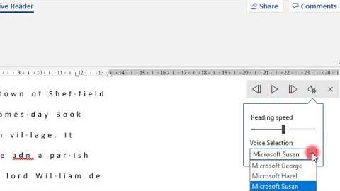
Office 365 Immersive Reader for Word

Slide 8
Office 365 Immersive Reader for Edge
*SHU laptops are not up to date with the latest version of Edge so there is a tool omitted........
But if you have your own PC or laptop you can update the latest version and use all the tools
https://www.britannica.com/place/Sheffield-England

Slide 9
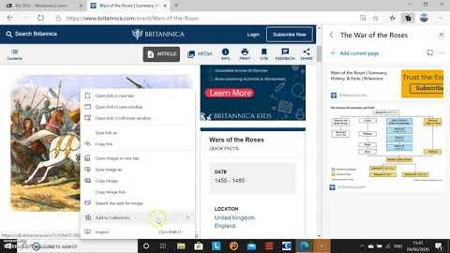
Collections in Microsoft Edge

Slide 10
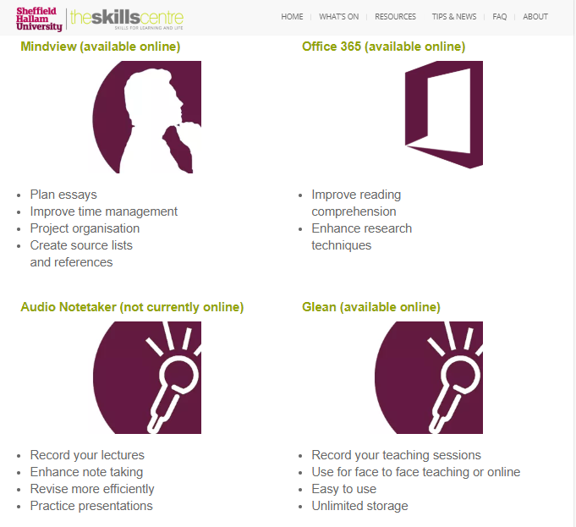
Online Resource

Slide 11
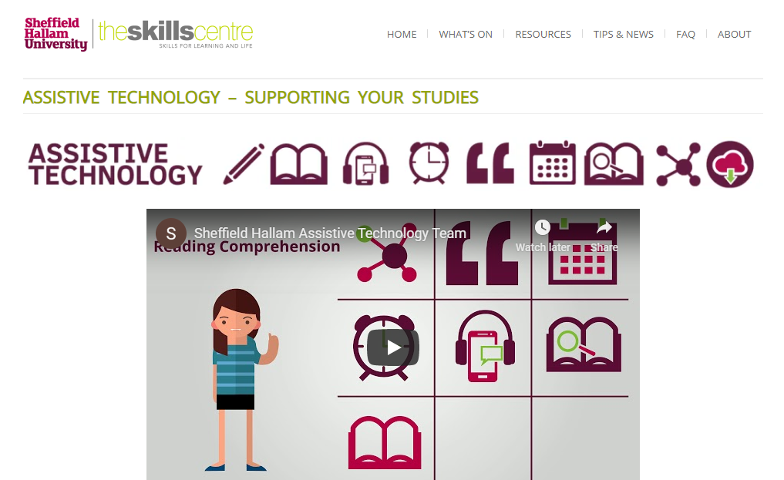
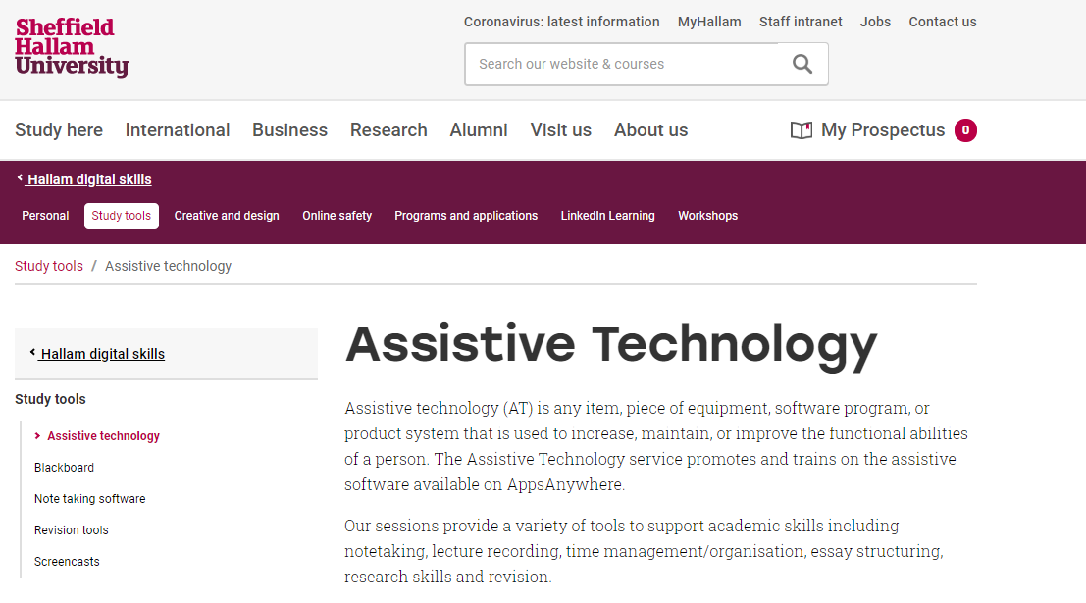
More information and booking
Assistive Technology Blog
MyHallam – Digital Skills

Slide 12
What Can you Do Now?
For anything disability related refer to a SSA or Disability Advisor
Recommend students book onto a group session or send them to our blog
Come to a group session to learn more about Assistive Technology

Slide 13
Get in Touch
Telephone: 0114 225 5311
Or create a case on Dynamics
Students can contact us via Hallam Help (to set up a case)

