Slide 1
Welcome!
Please could you download the VEVOX app on to your phone? It’s free and available in your usual App store.
The session ID is: 189-815-559
You could also open it in your browser on a new tab: https://sheffhallamuni.vevox.com/
Please could you also open the Zoom chat.

Slide 2
Working Alongside Online
Join: vevox.app ID: 189-815-559
A student engagement and co-design workshop for course leaders

Slide 3
Student Engagement, Evaluation & Research
Dr Jill LeBihan
Head of Student Engagement
Email: j.lebihan@shu.ac.uk
Twitter: @drlb66
Nathaniel Pickering
Senior lecturer in evaluation and research
Email: n.pickering @shu.ac.uk
Helen J. Parkin
Senior lecturer in evaluation and research
Email: h.j.parkin @shu.ac.uk

Slide 4
What do you hope to get out of this session?
You can tell me by adding ideas in chat
You can also annotate this screen using Zoom whiteboard tool

Slide 5
What do I hope you’ll get out of this session?
Knowledge of student engagement sector research
Understanding how to include students in co-designing their own teaching and learning activities
Tips and tricks for use in online activities to capture attention
Help with student representation and student voice
Useful evaluations of sessions so they can be improved

Slide 6
Representative Partnership
Partnership
Co-operative Partnerships
Pros | Cons
Students and academics feeling part of academic community | Resource-intensive for the institution
Joint ownership of the student academic experience | Challenges for less traditional modes of study or students
Engaged students feel greater ownership of learning | Not all students want ownership: instrumental-mindset
Pros | Cons
Project-based staff-student partnership activities | Resource-intensive (time and money)
HEI scheme supporting partnerships | Non-democratic, super-engaged only
Community of practice rather than customer and service provider model | Not open to all; projects might not represent all interests
Student
representation
Individual
Engagement
Pros | Cons
Students are empowered to demand change | Students less involved in developing solutions
Ability to hold institution to account | Potential adversarial relationship between students and institution
Getting recourse – including financial – when things go wrong | Loss of learning opportunity to fix problems
Pros | Cons
Surveys etc. open to all students to engage | Potential lack of environmental controls, crude data
Complaint systems offer a formal route for students to feedback on personal experiences | Complaint systems require a degree of student confidence; the policies can be unfamiliar and hard to navigate
Power given by social media to students | 'Student as customer' mindset and 'misuse' of student voice can be reputationally risky for staff, students and HEIs.
Consumer Rights Champions
Consumer-driven
Individual Agents
Tom Lowe and Alex Bols, 'Higher Education institutions and policy makers: the future of student engagement', Ch. 22 of A Handbook For Student Engagement (Routledge, 2020), p.267-284.

Slide 7
Jesse Stommel’s Digital Studies 101
COURSE OBJECTIVES Nothing in this syllabus will be set in stone or taken for granted. The instructions and outcomes laid out here are a beginning, something we’ll treat roughly as the course proceeds. This is not a map, but rather a direction in which we’ll point ourselves at the outset with the goal of vigorously rewriting the syllabus as we go, discovering what we’ll learn together as we learn it, questioning what we’ll do even as we begin to do it.
In this course we will:
Work to understand the history, present, and future of the web.
Think with the web, write for the web, and build upon the web.
Consider our own digital identities and how our digital selves intersect with, conflict with, or are synonymous with our embodied selves.
Discover the ways different individuals (with varied bodies, contexts, cultures) experience the digital in decidedly different ways.
Engage a broad network that stretches well beyond the bounds of University of Mary Washington.
Have epiphanies.

Slide 8
Stommel’s Assessment Brief
ASSESSMENT This course will focus on qualitative not quantitative assessment, something we’ll discuss during the class, both with reference to your own work and the works we’re studying. While you will get a final grade at the end of the term, I will not be grading individual assignments, but rather asking questions and making comments that engage your work rather than simply evaluate it. You will also be reflecting carefully on your own work and the work of your peers. The intention here is to help you focus on working in a more organic way, as opposed to working as you think you’re expected to. If this process causes more anxiety than it alleviates, see me at any point to confer about your progress in the course to date. If you are worried about your grade, your best strategy should be to join the discussions, do the reading, and complete the assignments. You should consider this course a “busy-work-free zone.” If an assignment does not feel productive, we can find ways to modify, remix, or repurpose the instructions.

Slide 9
How would you rate the Digital Studies 101 module descriptor?
Join: vevox.app ID: 189-815-559
POLL OPEN
Average:
3.38
53.8%
30.8%
7.7%
7.7%
0.0%
Vote Trigger

Slide 10
Choose the statement that most closely matches your view
Join: vevox.app ID: 189-815-559
POLL OPEN
1.
I liked the approach and would like to try it (or some aspects of it)
15.38%
2.
I liked the approach but don't think it can be done easily here
84.62%
3.
I didn't think the approach had anything to offer me
0%
Vote Trigger

Slide 11
Cathy Bovill & relational pedagogy
The challenge of the ‘first five minutes’ in the online space
What opportunities are there in your planned sessions for dialogue?
How can you make room for students to bring their own interests and perspectives into what you are designing with them?

Slide 12
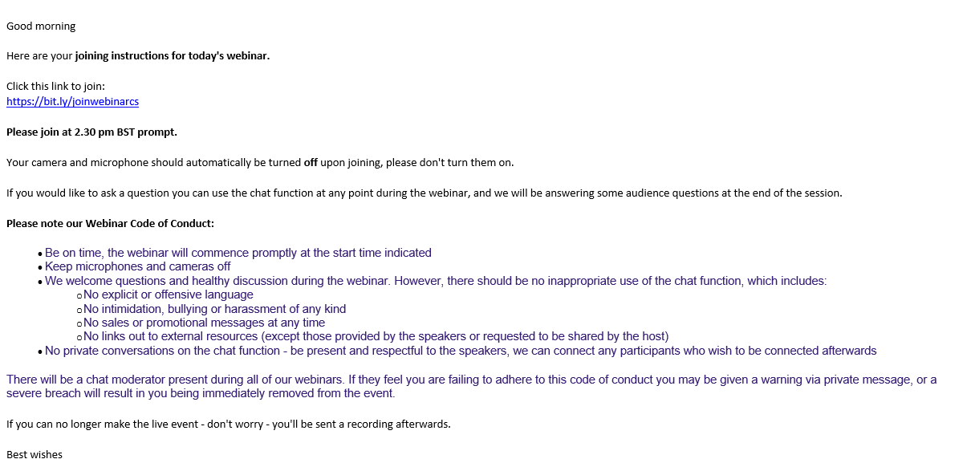
Learning from mistakes (or here is an example of how not to welcome students to synchronous learning activity)

Slide 13
Workshop activity
Breakout Room 1: Assessment co-design
Breakout Room 2: Student Rep activities
Main Room: Online learning activity
As part of your preparation, I asked you to think about an activity that you want to co-design with students.
Decide which of these rooms most closely aligns with the activity you want to design, and we’ll put you in a relevant room.

Slide 14
Things to think about whilst in the room
In your break-out rooms, get as far as you can in planning how students could work with you to design your learning activity/assessment/course rep activity. Share your ideas in the group.
Your facilitator has some prompts for you and will remind you of them in the breakout room:
How will you welcome your students to your activity/class?
What can they contribute in terms of co-design?
How will you interest them to get involved in the co-design?
How will you make sure there are different levels of engagement required to be involved in the co-design?
Will you do anything about students who don’t want to be involved at all?
How will the students be able to feel the impact they have had on the co-design?

Slide 15
Feedback from the break-out rooms
How far did you get with your planning?
What do you need now to make sure it happens?

Slide 16
I have learned something about this today (choose any that apply)
Join: vevox.app ID: 189-815-559
POLL OPEN
Vote for up to 6 choices
1.
Knowledge of student engagement sector research
66.67%
2.
Understanding how to include students in co-designing their own teaching and learning activities
58.33%
3.
Tips and tricks for use in online activities to capture attention
75%
4.
Help with student representation and student voice
25%
5.
Useful evaluations of sessions so they can be improved
8.33%
6.
Other
8.33%
(% = Percentage of Voters)
Vote Trigger

Slide 17
Did the preparation materials for this session help with getting ready for today?
Join: vevox.app ID: 189-815-559
POLL OPEN
1.
Yes, they helped and I felt well prepared.
33.33%
2.
They helped a bit, but I would have liked more.
13.33%
3.
They didn't help at all and it was a waste of my time doing them.
6.67%
4.
I didn't make use of the session preparation materials
46.67%
Vote Trigger

Slide 18
Please use this opportunity to feed back on anything you would like to know more about or any further sessions you would like us to deliver on student engagement and evaluation to help you.
Join: vevox.app ID: 189-815-559
Data Captured
Enter Text and Press Send
Vote Trigger

