Slide 1
Transition Model Toolkit
Course Leader Fest
17th June 2020
12:10pm – 13:10pm

Slide 2
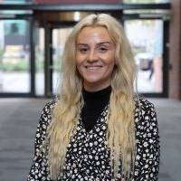
Today’s Team
Charmaine Myers
Nichola
Bell
James
Coope

Slide 3
Agenda
Time | Activity
12:12 | The concept - Charmaine Myers
12:20 | In practice - James Coope
12:30 | Impact on academic practice and students - Lindy Nahmad Williams
12:35 | The Toolkit - Charmaine Myers
12:40 | Adopting the Model in your course area: Think about: What is your current approach? How could you adopt the model in your course area – what would be the benefits, challenges and barriers? Questions/comments in the Chat
12:45 | Feedback to the room and responses to questions - Charmaine Myers
13:10 | Close and next steps - Charmaine Myers

Slide 4
The Concept
Charmaine Myers

Slide 5
The Concept
“Challenges educators to develop curricula that begins prior to arrival, with activities that promote a sense of inclusion, inspire belief in the ability to achieve, give a clear idea of what it will take to achieve, and develop a sense of aspiration”
Lizzio (2011)
Ref- Lizzio, A. (2011). The student lifecycle: an integrative framework for guiding practice. Available from: www.griffith.edu.au/learning-teaching/student-success/first-year-experience/student-lifecycle-transition-orientation [Accessed 9 May 2020]

Slide 6
The Concept Aligned to Our Strategy
Ambition Sheffield Hallam University: The world’s leading applied university
Hallam Model Principles: Engage, Collaborate, Challenge & Thrive
Highly Skilled Employment (HSE)
Discipline at the heart Develop Graduate Outcomes
Career Readiness
Discipline
Authentic Learning
Digital Skills

Slide 7
The Framework
Orientate-Apply-Connect (O.A.C) – pre arrival on-line Transition Model
3 Sections | 1. A Taste of the Subject - Orientate | 2. Apply | 3. Connect
What? | Academic Context e.g. Approach, Theory or Model from the subject area | Application of the Academic Context | Professional Practice – The Academic Context in a real-world situation
How? | 5 minute TED-esq Talk video – Course Lead | 1- 3 Tasks – Learners apply in their own home environment (max 45 minutes) | 5 minute Video – Employer &/or Student/Graduate – how
In Practice? (Sociology) | Social Inequality (Note taking & Reflection) | 1) Quantitative - Examining the demographics in your Town/City 2) Qualitative - A bus ride across your Town/City 3) Mixed Methods - a local newspaper article | Professional practitioners talk about how social inequality in the context of their organisations and how research data is used to inform service delivery

Slide 8
In Practice
James Coope

Slide 9
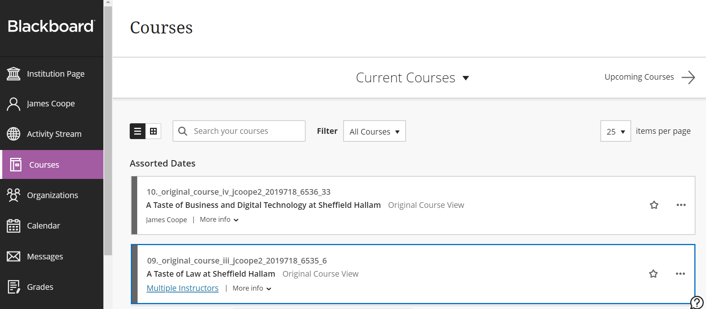
In Practice

Slide 10
Impact on Academic Practice and
Students

Slide 11
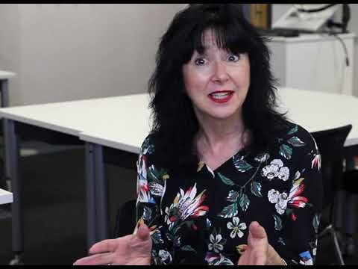
Impact
Dr Lindy Nahmad-Williams, Senior Lecturer, Education Studies, Education, Childhood & Inclusion.

Slide 12
The Toolkit
Charmaine Myers

Slide 13
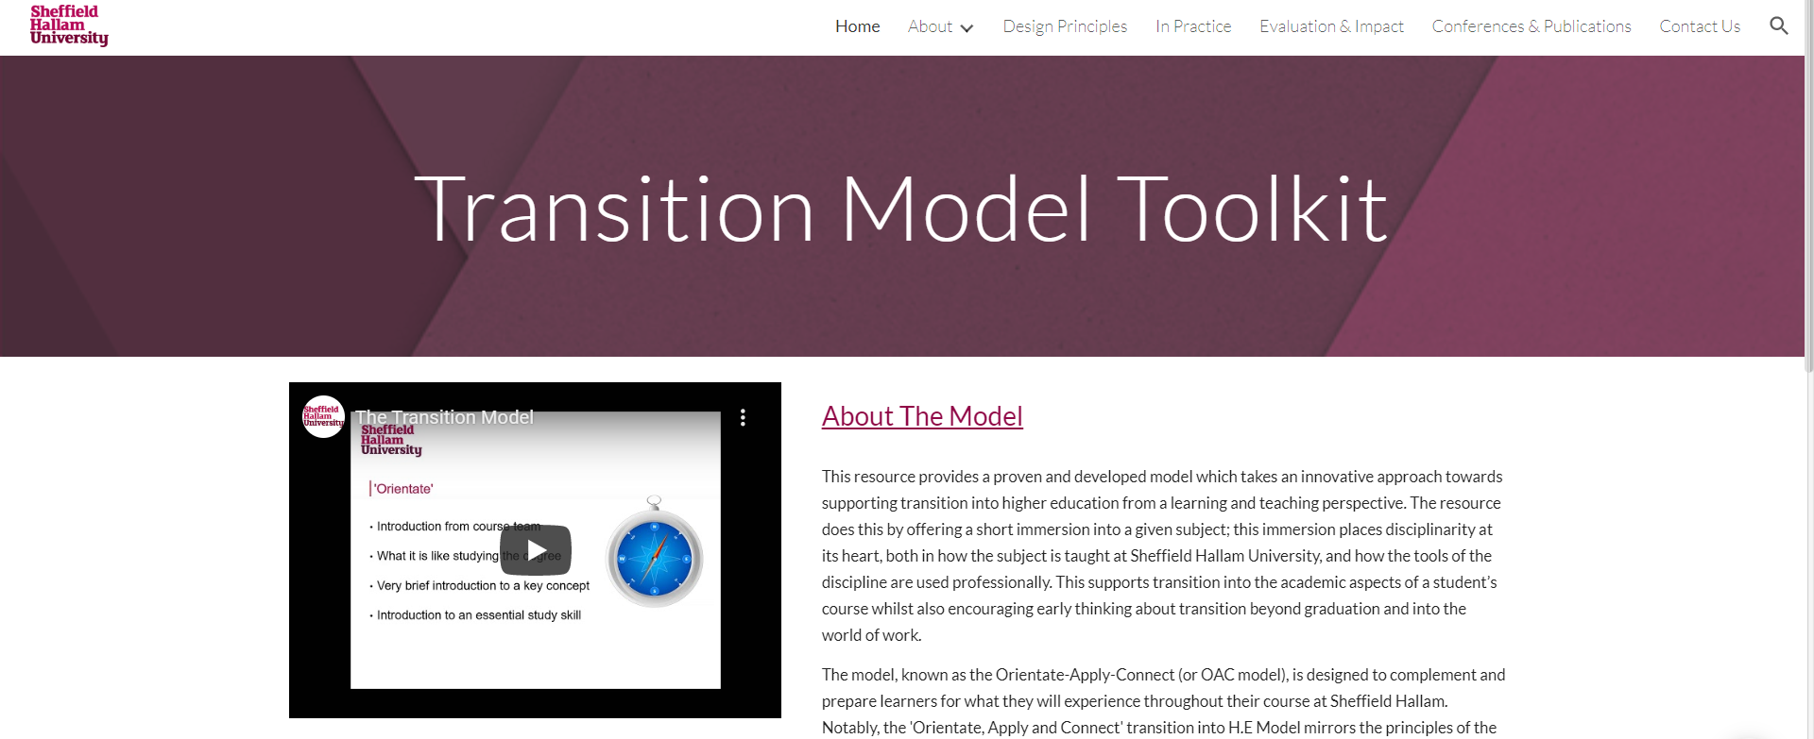
The Toolkit

Slide 14
Adopting the Model in your Course Area
Thinking about your current practice (pre-enrolment & welcome week);
Could you adopt the model in you course area?
What would be the benefits, barriers and challenges?
Comments/Questions in the Chat, please

Slide 15
Close and Next Steps
“Recommendation that students be reorientated at the star of each level of study” (Morgan, 2012)
Orientate | Apply | Connect
Prior learning from previous year’s work-experience module e.g. Level 4 – Live Project | to next year’s work experience module e.g. Level 5 – 120 hours (digital as part of solution) | Application to future career
Ref: Morgan, M. (2012). Improving the student experience: a practical guide for universities and colleges. London, Routledge

Slide 16
Close and Next steps
URL: go.shu.ac.uk/transitionmodel
Email: transitionmodel@shu.ac.uk

