Slide 1
Research in Partnership
Working with Children and Young People
Catherine Wright
CAHPR CPD Event
April 2017

Slide 2
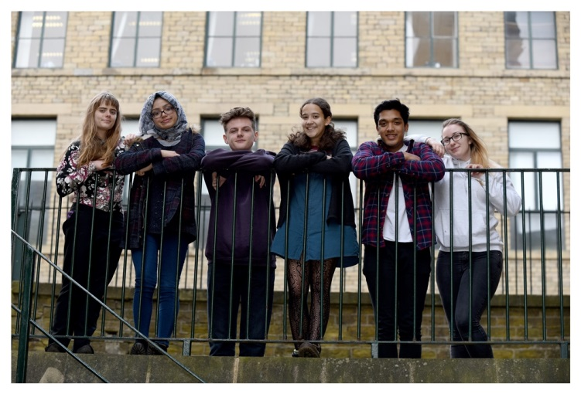
Who are YD?
Young peoples research advisory group
Set up to provide young people with opportunity to learn about, participate in research and gain skills and experience for CV
Part of a growing network of research groups for young people – pioneers for mental health!

Slide 3
Why involve young people?
Increased relevance of research to young people and surety that outcomes capture most effectively young peoples views and perspectives – shared agenda
Young people voicing their experience through being on the receiving end of services enables a fuller understanding of young peoples perspectives
Development of personal skills and confidence, giving opportunity to make a difference – experiencing ownership – a stepping stone to future pathways
motivates a sense of altruism - young people want to be able to contribute in order to improve services for others.
provides opportunity to have fun, make new friends and bring people together to develop ideas through discussion.

Slide 4
Work so far…
York University, LEGO research for young people with autism
Developed, conducted research and written a report for the Bradford CCG board evaluating WRAP ( Wellness Recovery Action Planning ) project undertaken by Barnardo’s.
Participated at PREP - research conference.
Contributed to reviewing a new parenting programme – ENGAGE - being developed by Bradford Council children’s services.
Meeting with BTHFT - to plan how YD’s can help them structure research questionnaires for children and young people who are admitted to the wards..
Working with CAMHS around plans for transformation of services – so far working with the Eating Disorders team ( CAMHS) consultation with regard to research and developing branding for young people.
York University -TRECA study – which is being developed with the aim of increasing the numbers of children and young people who participate in health research
There is also interest from lecturers/researchers at Leeds Beckett on working with them on developing research around children and young peoples mental health

Slide 5
Feedback…
“I recently visited the Young Dynamos to discuss a research study which is aiming to try and improve children and adolescents engagement with research. I was really impressed by the Group who were very welcoming, intelligent and honest in their feedback! They provided a much needed young person’s perspective on the study and I look forward to working with them again in the future” –
Dr Rebecca Sheridan –TRECA
“Many thanks for having us. I would like to say what a polite, funny, insightful and respectful group of young people they are. They were immediately ready to help us, enquiring about the aim of our service and needs of the young people we’re working with. They were creative, imaginative and quickly came up with some great names for our new team as well as a logo. Most of all, I found their youthful, positive perspective really useful and refreshing and came away very happy with the result. I look forward to working with them again”.
Louise Austen-Rose
EDT Manager

Slide 6
“I first met the Young Dynamos at the Putting Research into Evidence & Practice (PREP) conference last year where the group gave an engaging and uplifting presentation on their involvement in research. Together with a colleague, I visited the group to give an overview of the research we do as part of the Born in Bradford Project. In the discussions that followed, the group demonstrated an impressive and critical awareness of many key issues in research such as ensuring confidentiality of participants and the need for non-burdensome data collection. Not only did the group give us many helpful suggestions for engaging particular groups in research e.g. fathers, but also some very interesting ideas for further research projects - some that we had never thought of before! We admired the group's enthusiasm, astuteness and passion for research and are excited to see such a talented, dynamic and budding young group of researchers in our community.”
Nimarta Dharni
Researchers from University of York re LEGO Research
“I wanted to formally say thank you for inviting Dani and I to attend the YDRG meeting last week.
Dani and I were really impressed with how engaged and interested the group members were in discussing the LEGO therapy study and they asked some really great questions so please pass on another huge thanks from us to the group when you meet with them again this week.

Slide 7

follow us on:
@youngdynamos

