Slide 1
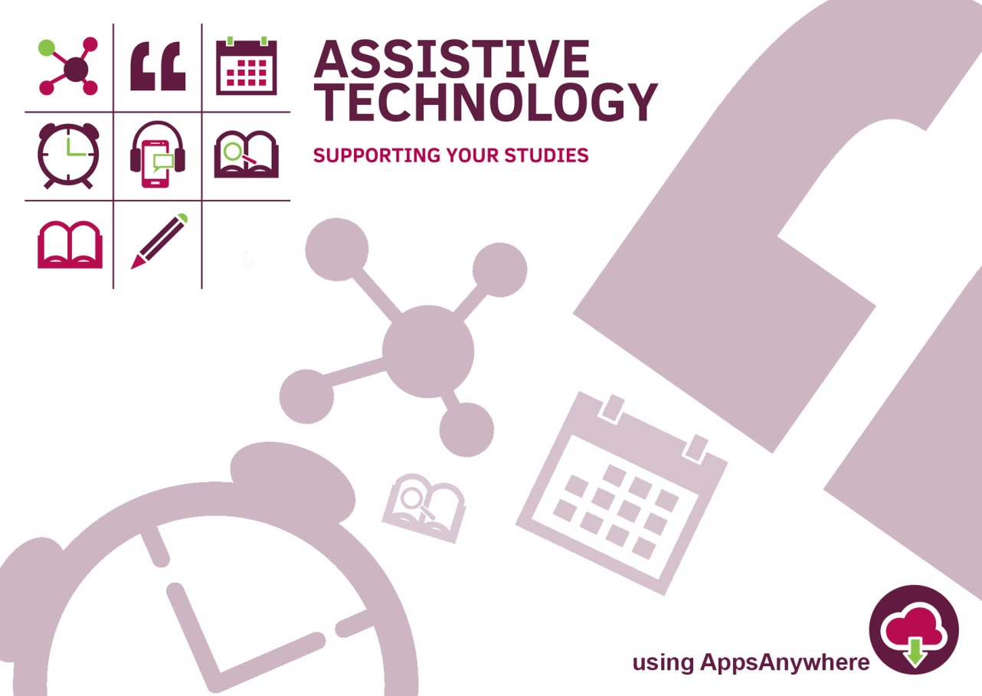
Notes:
Welcome
This session is going to be looking at using technology to enable students to record lecture content, where applicable, with the aim of supporting their studies. We will be looking at a brief history of support that has been available to disabled students to support note-taking, along with what SHU offer to make this support more inclusive.
We are part of the AT Service, does everyone know what Assistive Technology refers to? - (a definition on the next slide)

Slide 2
Assistive Technology
Assistive Technology (AT) is any item, piece of equipment, software program, or product system that is used to increase, maintain, or improve the functional abilities of a person.
Notes:
The remit of assistive technology in SHU has, historically, been to support students and staff who have a disability. However what is classed as assistive technology can now be seen to benefit a wider range of users, not solely a person who has a disability. Our service has, over the last year or so, has opened up training sessions on the use of assistive technology to all students

Slide 3
The AT Service
We are a small team of advisors who offer AT software training and provide support and guidance for the Sheffield Regional Assessment Centre and the Disability service.
This offer includes group training sessions which are available to students and staff, using software accessed through AppsAnywhere.
Notes:
So who are we.. (from slide)
The group offer - sessions booked through unihub, includes a session in which we train students to make a personal recording of taught sessions, where these are permitted in lectures
The software we cover is accessed through AppsAnywhere. Is anyone unfamiliar with AppsAnywhere?

Slide 4
AppsAnywhere
AppsAnywhere icon on the desktop
which provides access to a catalogue
of software
Assistive software tools available include -
- Audio Notetaker
- Read&Write
- MindView
- Inspiration
Notes:
Access to course software such as Adobe packages etc
General overview of what each AT package offers. This session is looking at the introduction of Audio Notetaker to support recording in classes

Slide 5
Support Available
Learning contract recommendation
Students who disclose a disability
DSA support e.g. digital recorder
Majority of DSA eligible students are recommended a device or app to support recording in classes
Notes:
So what support has previously been available to support notetaking ...
Students who have declared a disability with the university have been recommended options to support difficulties with notetaking for a number of years.
Learning contract - recommended that she student can record teaching sessions where applicable - usually with support through loan equipment or DSA. Students may receive manual support such as notetakers and electronic notetakers for sensory impairments (VI and HI)
DSA support - recorder has been common for a number of years. More recently a move towards using a student's phone in conjunction with an app, or recording directly to a laptop so can type some notes simultaneously.
Recording has been a tried and tested mechanism of support for students who struggle with notetaking.

Slide 6
How Does This Help
Having a recording of lectures can support students who have difficulties with -
Working memory
Processing speed
Concentration
Fatigue
Handwriting
Auditory processing
Notes:
Supports students with disabilities that would impact their ability to note take effectively, such as SpLD's, Mental Health, AS, VI, etc
However, while this supports students with known difficulties due to a disability, this technology is beneficial to all as it allows for students to -
- revisit and reflect on ideas and concepts discussed
- supplement and develop their notes
- revise for assessments

Slide 7
Recording at SHU
A SHU created task group looked into the implementation of lecture capture support
As a result of this, regulation guidelines were released to inform students and staff of responsibilities when recording teaching sessions
https://students.shu.ac.uk/regulations/it/Guidelines%20for%20students%20on%20 recording%20teaching.pdf
Notes:
A number of universities now have lecture capture available across campus or in selected buildings, that operate on either an opt in or opt out basis, as decided by the tutor
Open up the ink and cover the main points under -
- you may
- you must not
- guidelines for use of recordings
Make a point of it being on an opt out basis, so if nothing is said by the tutor the expectation would be that it is ok to record the lecture / class, providing the guidelines are met

Slide 8
Using a Mobile Device
SHU offers students and staff access to an app for Apple or Android devices called Sonocent Link
Recordings made in this app can then be transferred across to a computer for use within Audio Notetaker, which is available through AppsAnywhere
Notes:
App is downloaded through the relevant app store, there is a code to enter that is tied to SHU email address
We currently transfer recordings using Microsoft OneDrive that is built-in to the Windows 10 computers

Slide 9
Demonstration

Slide 10
What Now?
We offer sessions through UniHub for staff and students where we can set up the app and train on the use of this software
Please contact us on at-service@shu.ac.uk for more information
Thank you for listening!
Notes:
Questions?

