Slide 1
Academic Adviser Community of Practice
September 2019
Melissa Jacobi

Slide 2
10.30am – 11am AA Updates
11am – 11.30am Skills Centre
11.30am – 12noon Student Union
12noon – 12.30pm AA, SSA, EA

Slide 3
Updates and Key Messages
See Sheet.
Signposting handbook is being checked and updated, will be circulated before induction week.

Slide 4
UKAT Institutional Membership

Slide 5
Feedback on Checklist Notes.

Slide 6
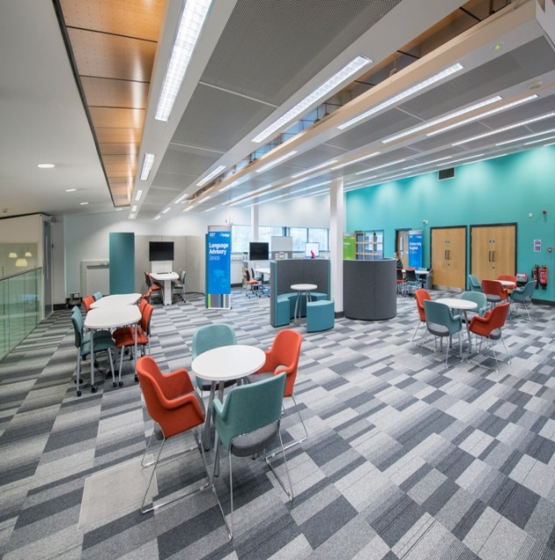
The Skills Centre
Develop your academic writing and study skills

Slide 7
Who we are...
Learning Advisors and Specialist Advisors who support students develop their academic and study skills
Part of Library and Student Support Services
Based in both Adsetts Library (City) & Collegiate Library
Available Mon-Friday (Tues-Thurs until 7pm).

Slide 8
Who can use the Skills Centre?
All students!
We provide information, advice and guidance on academic writing and study skills for students at all levels:
Undergraduates
Postgraduates (MA, MSc)
PhD
...on all courses.

Slide 9
What we offer:
Workshops
Writing forums
1-1 appointments (in person or over
the phone)
Webinars
Online resources
Notes:
Workshops on a variety of topics (I will say more about this in a moment). Workshops are held at the Skills Centre and are one hour sessions taught by a Learning Advisor with up to 12 other students. Many workshops involve discussions, small activities and opportunities to ask questions to help you develop your understanding.
Writing Forums: These are small group sessions of up to 4 people where students can bring an example of their writing and receive feedback from a Learning Advisor, and discuss with other students. You can book on with your friends, or as an individual.
1-1 appointments: All students are able to book 1-1 appointments with an advisor (one per month). In these, you can discuss anything related to academic writing, skills or studying. You can even bring a piece of work and an advisor can provide feedback on this. We also offer specialist appointments for students who have declared a disability, SpLD or mental health difficulty; specialist appointments can be booked more frequently (once per week). You can have these appointments

Slide 10
Workshop topics
Writing Skills
Academic Writing
Critical Writing
Reflective Writing
Planning and Structuring
Literature reviews
Editing and Proofreading
Effective study skills
Academic reading strategies
Effective notetaking
Presentation skills
Time management
Exam and revision strategy
Research skills
Planning your research
Writing up your research

Slide 11
Writing forums
Small groups - maximum of 4 participants.
Students share and discuss their work and give and receive feedback to peers, facilitated by an Academic Skills Advisor.
Aim to develop and apply new writing strategies.
Book as a group to discuss an assignment from your course.

Slide 12
1-1 appointments
30 minute 1-1 tutorials with an Academic Skills Advisor.
Available to book 2 weeks in advance.
Offered at both campuses: in-person & over the phone.
Work with an advisor on a range of academic skills topics: for example, to focus on a section of your draft assignment or to plan and manage your workload.

Slide 13
For quick questions?
Drop-in appointments:
up to 15 minute quick queries in two-hour blocks
In faculty buildings across campus
Scheduled both at City and Collegiate
For more information see:
blogs.shu.ac.uk/skillscentre
Notes:
Exact delivery pattern to be finalised.
See website for updated schedule once term starts.
4-5 days a week?
Click online resources image: https://blogs.shu.ac.uk/skillscentre/resources/?doing_wp_cron=1560513823.8415338993072509765625
Click Studiosity image: https://blogs.shu.ac.uk/skillscentre/studiosity/?doing_wp_cron=1560513765.3841750621795654296875

Slide 14
Off campus?
Weekly webinars
1-1 appointments via phone
Online e-resources
Studiosity
Notes:
Click online resources image: https://blogs.shu.ac.uk/skillscentre/resources/?doing_wp_cron=1560513823.8415338993072509765625
Click Studiosity image: https://blogs.shu.ac.uk/skillscentre/studiosity/?doing_wp_cron=1560513765.3841750621795654296875

Slide 15
Student feedback
95% of workshop attendees say their confidence in the topic increased after attending a session.
97% of students said the sessions were relevant to their studies.
I will now efficiently organise my time for reading research materials using the tips and tools provided in the workshop.
I am now able to identify when I have written critically and used this to improve my literature review immediately after the session.

Slide 16
Assistive Technology
The Assistive Technology team offer support and workshops on using Assistive Technology and software, including:
Mindview: Mindmapping software
Read and Write Gold: Text-to-speech software
Audio Notetaker: Allows you to capture audio, text and slides in one place
Book a place via the website.
Notes:
update

Slide 17
Maths and Statistics Support
Provides drop-in Maths and Stats Support at both libraries for:
Mathematical content of courses
Using statistical software (e.g. SPSS)
Quantitative research planning, analysis and interpretation
Numeracy aptitude tests for job applications
For more information and online resources, visit:
https://maths.shu.ac.uk/mathshelp/
Notes:
accessibility update
19 08 2019
V1

Slide 18
Get in touch
You can view our schedule and book sessions via our website:
blogs.shu.ac.uk/skillscentre
Other ways to keep in touch or ask questions:
Email: skillscentre@shu.ac.uk
Twitter: @HallamSkills

Slide 19
Additional services
Studiosity An online writing feedback service available via MyHallam
University English Scheme Resources and workshops to improve your academic English
Disabled Student Support For help with any disability related enquiry
Student Wellbeing For confidential help with psychological wellbeing

Slide 20
Any questions?
Notes:
Last accessibility checked
19/08/2019
V1

Slide 22
Notes:
The Students' Union has got your back and represents students who need support. With a course and department rep for every single student, you can ensure you have access to the best support available for your academic interests. There is also a free, independent student advice centre which is completely separate from the University. Students can access advice and support on everything from housing to money to issues with your course and assessments.

Slide 23
Notes:
The HUBS is the heart of the student experience and you'll find your mates for life in one of over 100 student-run Societies and groups. There are also groups for LGBT+ students, disabled students, BME students, mature students, postgraduates and many more - find where you belong and make the most of free social spaces, and student-friendly trips and events together.

Slide 24
Notes:
The Students' Union is here to give you the edge and help you get even more out of your time at Sheffield Hallam. With training and development opportunities and support to recognise your achievements through the Hallam Award, you can be sure that you're equipped with the life skills you need to support your degree and future career.

Slide 25
Notes:
What better way to feel good about yourself than supporting the local community? Volunteering has been proven to improve mental wellbeing and the Students' Union is partnered with the local Volunteering centre to give Hallam students access to hundreds of exciting community projects. You could change lives while giving yourself a well needed break from your studies.

